Slide 1
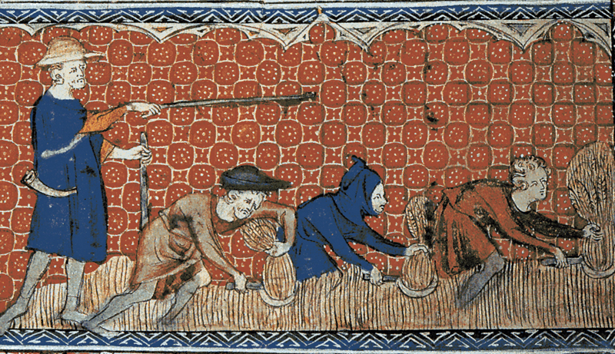
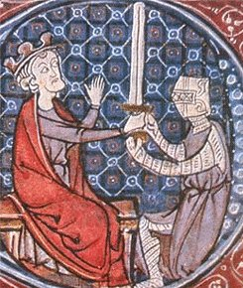
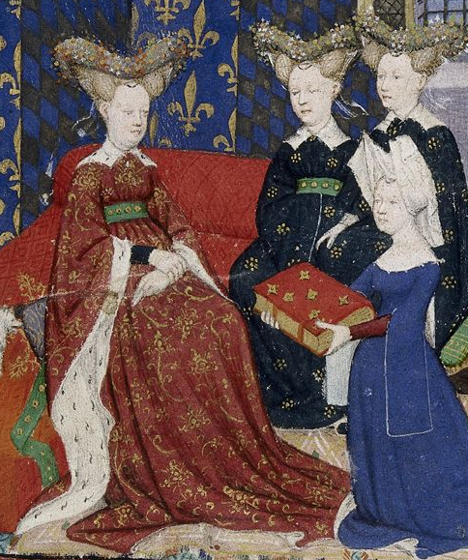
HIS ###: Course Name
CLASS MEETING TIMES
FALL SEMESTER 2014:
T – TH | 9:25-10:50 a.m.
CONTACT:
Professor ### ###### at #####@uwlax.edu
Credit in ######## ##########Focus
SUBHEADING
Bullet
Points

