Slide 1


How Many Kinds of Atoms are Possible in Nature?
Bradley Sherrill
Director NSCL

Slide 2
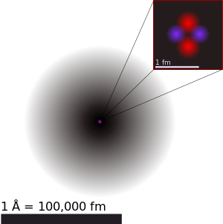
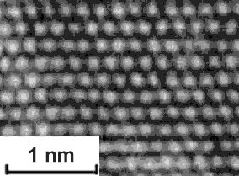
Atoms
Transmission electron microscope image of a Fe crystal
Helium Atom
Helium Isotopes:
Different Physical Forms
Helium-3
Helium-4
Helium-6
Helium-8
Helium-5
2 protons makes it helium
Atomic Number 2
Helium-7
www.tf.uni-kiel.de

Slide 3

Unobtanium
What are Nature’s Limits of Atomic Number ?
James Cameron’s Avatar

Slide 4
Talk Outline – The Limits of Atoms
Elements and the Periodic Table
Experimental Searches for the Limits – What is the heaviest element possible? Is unobtanium obtainable?
The limits of isotopes
Overview of accelerator facilities NSCL and FRIB
Theoretical Approaches – With an understanding of the nuclear force, we can calculate the limits. How do we arrive at a workable description of the nuclear force?
Future Prospectives

Slide 5
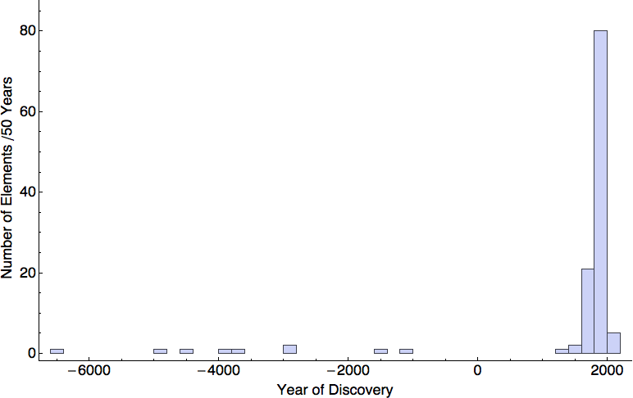
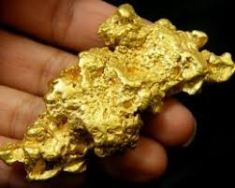
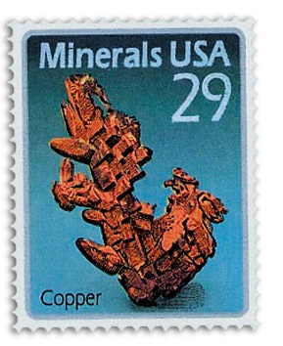
History of Element Discovery
1700+ Rise of modern chemistry – Dalton’s Atomic Theory
India
Babylonia
Egypt
China
Democritus – idea of atoms
Copper Age
Source: Mathematica + Wikipedia

Slide 6
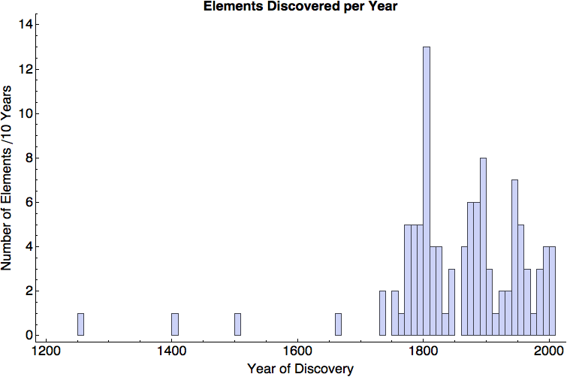
The History Of Element Discovery 1200-2010
Chemistry
Dalton’s Atomic Theory
Cavendish, Priestly, Scheele, …
Mendeleev’s
Periodic Table
Particle Accelerators
Reactors
Time of the Alchemists
Future?
Notes:
The Alchemist Discovering Phosphorus is a painting by Joseph Wright of Derby originally completed in 1771 then reworked in 1795.[1] The full title of the painting is “The Alchymist, in Search of the Philosopher’s Stone, Discovers Phosphorus, and prays for the successful Conclusion of his operation, as was the custom of the Ancient Chymical Astrologers”. It has been suggested that “The Alchymist” refers to the discovery of phosphorus by the Hamburg alchemist Hennig Brandt in 1669.[2] This story was often printed in popular chemical books in Wright’s lifetime, and was widely known.

Slide 7
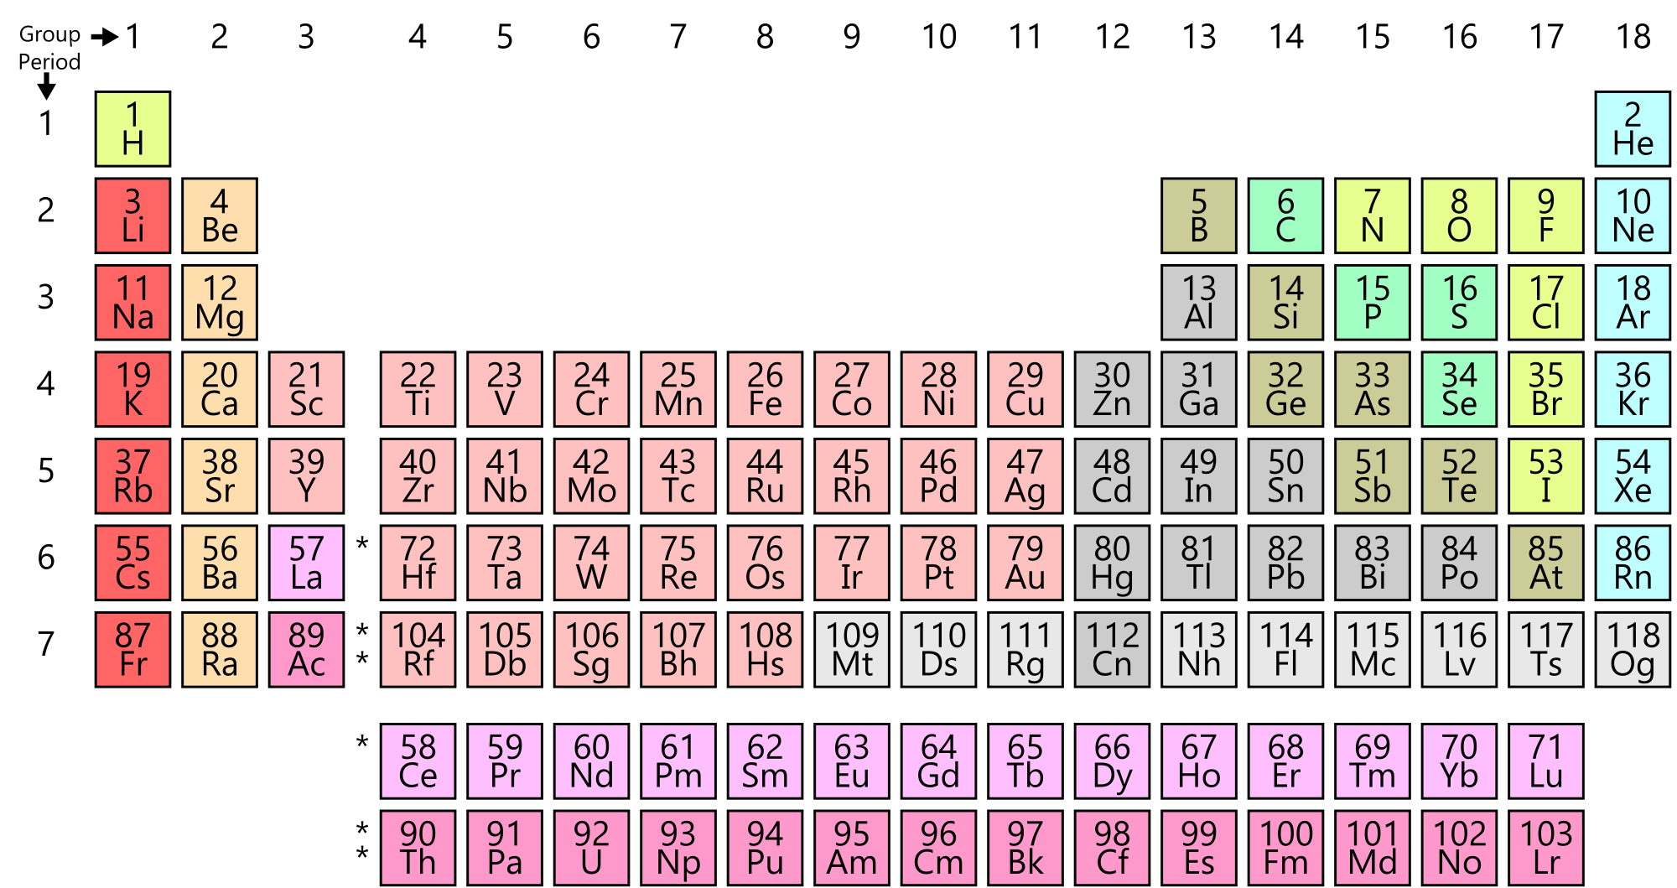
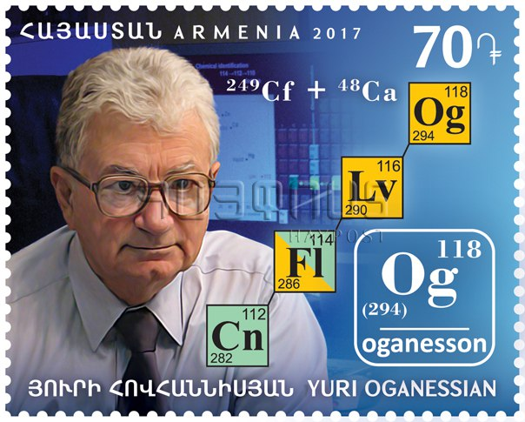
Result: Periodic Table of the Elements
https://en.wikipedia.org/wiki/Periodic_table
P. Pyykkö: Phys. Chem. Chem. Phys. 13, 161-168 (2011) “Half of chemistry is undiscovered.
Due to relativistic effects above Z=118 electrons behave like a Fermi gas - Jarabek, Schuetrumph, Schwerdtfeger, Nazarewicz Phy. Rev. Lett. 120 053001
End of chemistry?
Superheavy: Only stable due to many-body effects

Slide 8
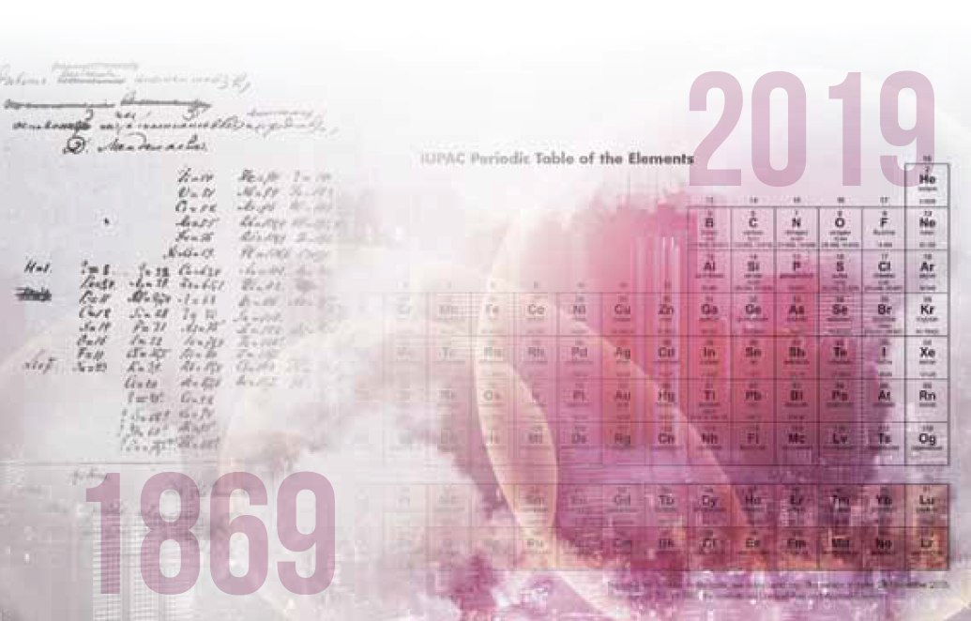
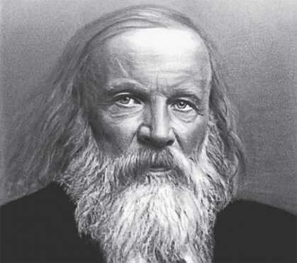
2019 - International Year of the Periodic Table
The United Nations named 2019 as the International Year of the Periodic Table of Chemical Elements
Dmitri Ivanovich Mendeleev

Slide 9
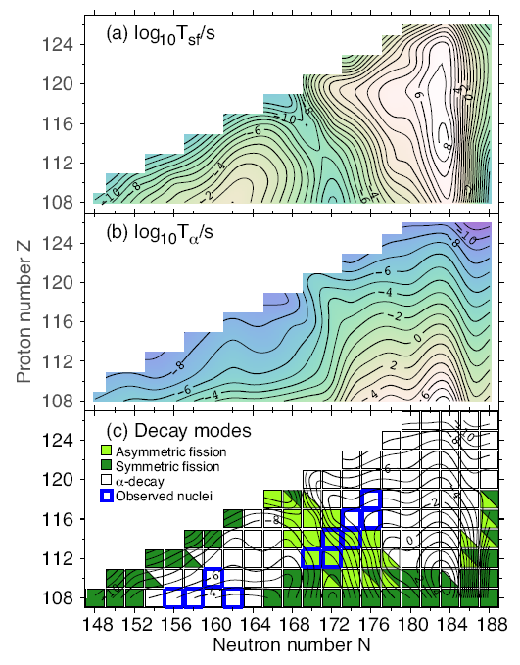
Half-lives of Superheavy Elements
Lifetimes of heavy elements can be calculated (more later)
The two main decay modes are alpha emission and fission
Staszczak, Baran, Nazarewicz Phys. Rev. C 87 (2013) 024320 and E M Ramirez et al. Science 2012;337:1207 …
1 year
Symbols: exp. values
Lines calc. Sobiczewski & Smolanczuk

Slide 10
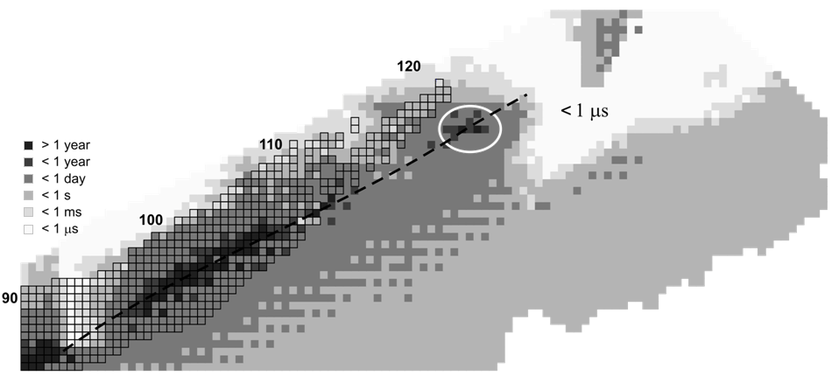
You Might Hear - Island of stability
The possibility of an "island of stability" was first proposed by Glenn T. Seaborg in the late 1960s.
258
Protons
184
Zagrebaev, Karpov, Greiner [arXiv:1207.5700v1] masses from P Möller
126
Neutrons

Slide 11
Even Higher Atomic Numbers
How much higher in atomic number?
Beyond Z=120-130 the character of nuclei change
Bubbles or doughnut shapes
Figure right predicts some form of stability for Z=254: See Giulani, Matheson, Nazarewicz, Olsen, Rev Mod. Phys 2018

Slide 12
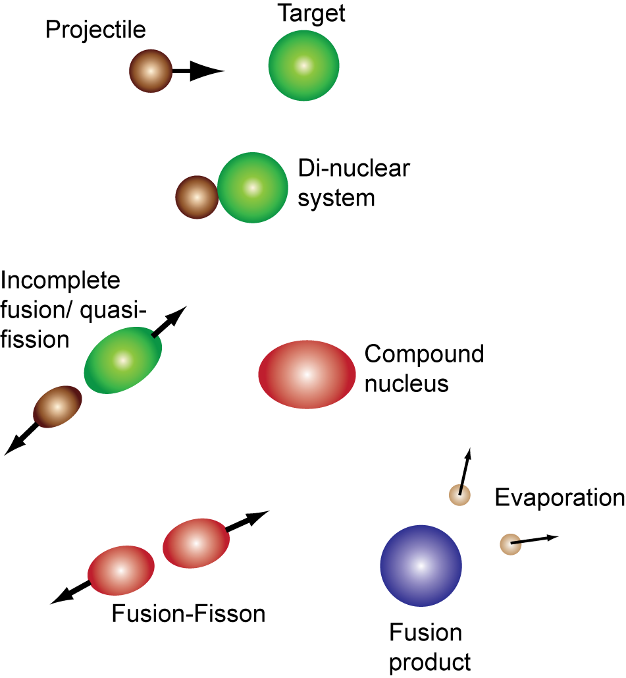
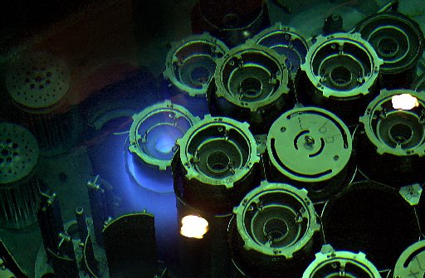
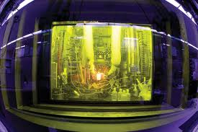
Synthesis of the Heaviest Elements
Hamilton, Hofmann, Oganessian Ann Rev Part Nucl Phys 63 (2013) 383
Probability = P_{Interact}P_{CompNucl}P_{FusProd}
⁴⁸Ca + ²⁴⁹Bk → ²⁹³Ts
Bk from HFIR
In new element searches the product happens only 1 in 10¹⁸

Slide 13
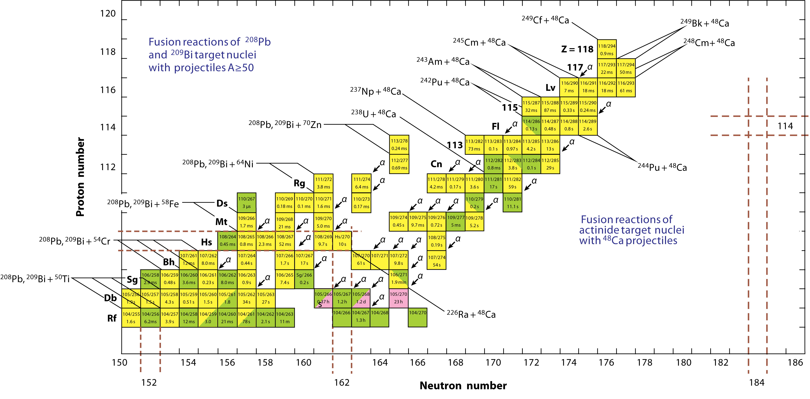
Summary of Super Heavy Element Landscape
Hamilton, Hofmann, Oganessian Ann Rev Part Nucl Phys 63 (2013) 383

Slide 14
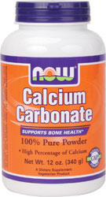
Isotopes of the Elements
Gold occurs naturally as Au-197 – Oct 15th value of $1,228 per ounce
Six isotopes of Calcium are found naturally on Earth.
(Calcium-40 $.32 per ounce)
Expensive Calcium (.2% of natural Calcium-48 $7M per ounce)
Among most expensive isotopes: Berkelium-249 $644M/ounce
20 protons
20 neutrons
20 protons
28 neutrons
Notes:
Californium-252 is now being offered for sale by the Oak Ridge National Laboratory (O.R.N.L.) at a cost of $50/ug and Californium-249 at a cost of $160/ug plus packing charges. This comes out to $50,000,000/g and $160,000,000/g respectively. Californium-249 is $160M*28.35 = $4,560M/ounce
249Bk .5M$ for 22 mg->

Slide 15
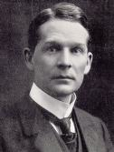
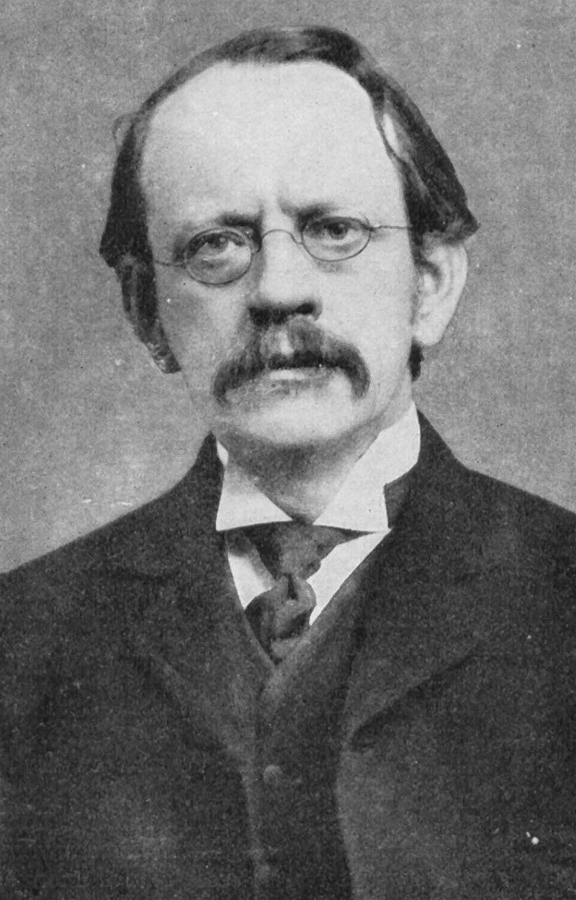
Discovery of Isotopes - 1910
Fredrick Soddy – Credited with discovery of isotopes
  Talented chemist who began at McGill University (Montreal) as a lecturer in 1900
  E. Rutherford came to McGill at about the same time. Rutherford needed the help of a Chemist to try to understand radioactivity.
Isotopes
  In 1910 Soddy found that the mass of lead from thorium decay differed from the mass of lead from uranium decay
  He realized that atoms of a given elements must come in different forms that he called isotopes (Greek for “at the same place”) JJ Thompson in 1913 showed the first direct evidence – Ne isotopes in cathode ray tube.
  "Put colloquially, their atoms have identical outsides but different insides.” – Soddy Nobel Prize Lecture
  Won Nobel Prize in 1921 for discovery of isotopes

Slide 16
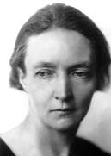
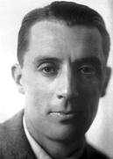
First Synthesis of Radioactive Isotopes
  The first “artificial” isotopes were produced by F. Joliot and I. Curie (Nature, 10 Feb 1934 ) by bombarding B, Mg, Al with alpha particles from Po
  “We propose for the new radio-isotopes formed by the transmutation of boron, magnesium and aluminum, the names radionitrogen, radiosilicon, radiophosphorus”
  For this discovery, Curie and Joliot won the Nobel Prize in chemistry in 1935
  Workforce Diversity was excellent at the beginning of the rare isotope field

Slide 17
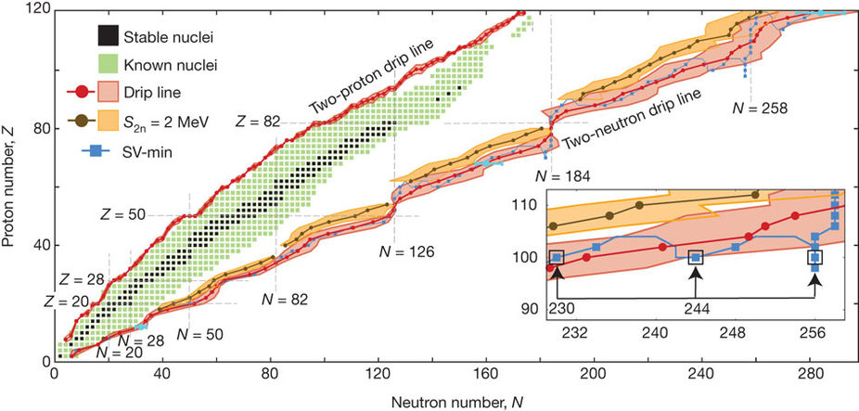
Predicted of the Limits of the Nuclear Landscape
265 stable isotopes, 3100 observed, more like 2000 “known”
J. Erler et al., Nature 486, 509 (2012) – About 7000 isotopes possible for Z < 93

Slide 18
A Goal is to Study ⁶⁰Ca
One of the reasons to build FRIB: Calcium-60 ($10,000 for 1000 atoms; $1.3x10²⁵ per oz )
In 10 years from now, after envisioned FRIB upgrades, we may be able to produce Calcium-70 (if 20 protons and 50 neutrons can make a nucleus)
With a beam of ions that have extra neutrons we can reach the longer-lived superheavy elements
20 protons
40 neutrons
Notes:
6E23*60/28.35 = atoms/oz * (1E4$/1000) = 1.3E25 $/oz
18.6E12 $ is 2016 US GDP

Slide 19
Summary of Super Heavy Element Lanscape
Hamilton, Hofmann, Oganessian Ann Rev Part Nucl Phys 63 (2013) 383
⁵⁸Ca

Slide 20
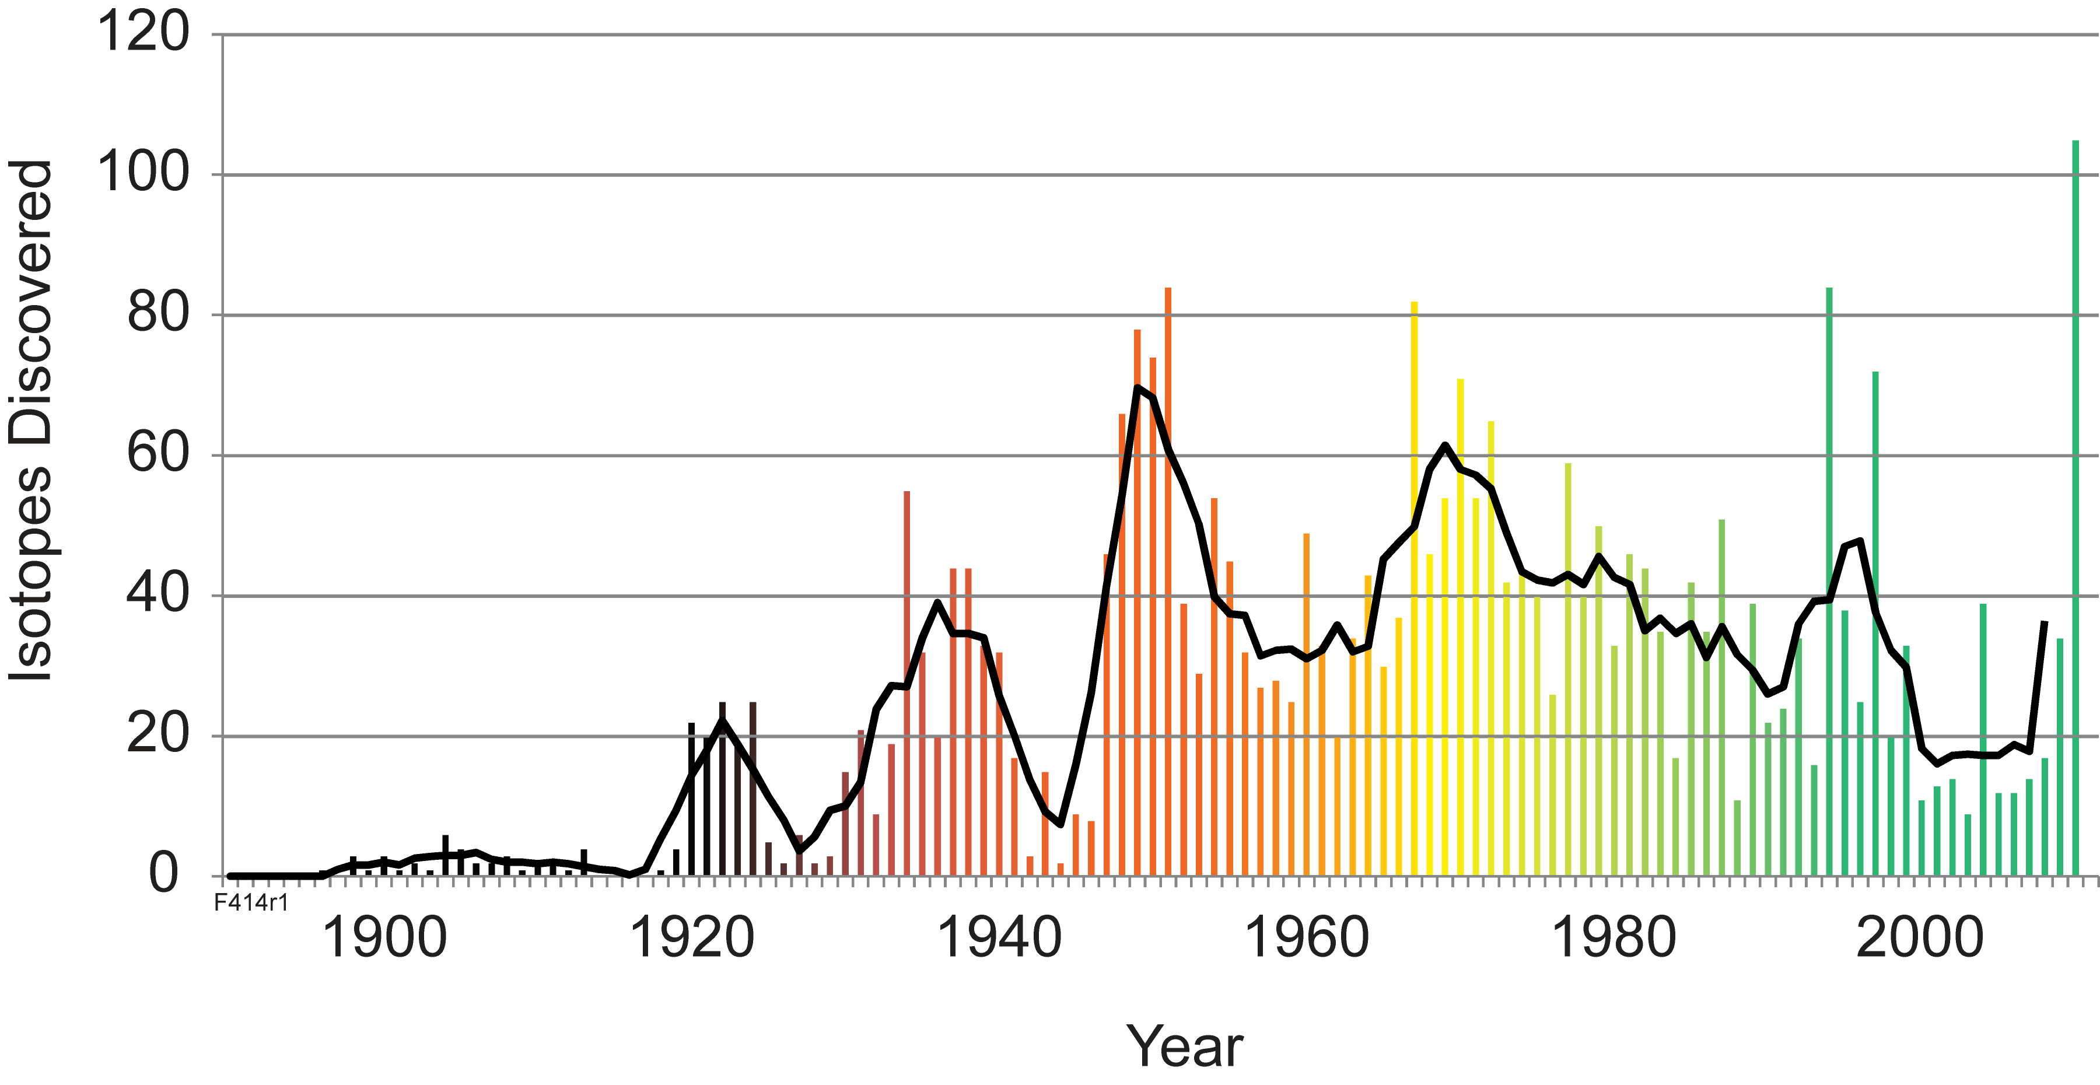
New isotope discoveries per year
Thoennessen and Sherrill, Nature 473 (2011) 25
Fusion evaporation
Spallation
Projectile
fragmentation
WWII
Reactors
First accelerators
Mass
spectroscopy
Radio-
activity
See Isotope Discovery Project: https://people.nscl.msu.edu/~thoennes/isotopes/

Slide 21
Chasing Rare Isotopes
Cartoon of the isotope production process – projectile fragmentation or fission (Coulomb breakup, transfer, …)
¹²²Zr production cross section (from ¹³⁶Xe) is estimated to be 2x10⁻¹⁸ b (2 attobarns, 2x10⁻⁴⁶ m² )
With a ¹³⁶Xe beam of 8x10¹³ ion/s (400 kW at 200 MeV/u) a few atoms per week can be made and studied
For comparison: Tenesine (117) production cross section was 1.3 (+1.5 -0.6) pb (1.3x10⁻¹² b) (Oganessian, Yu. Ts. et al PRL 104 (2010) 142502)
Few x10⁻⁴⁶ m² is on the order of 100 MeV neutrino-electron elastic scattering cross sections
projectile
target

Slide 22
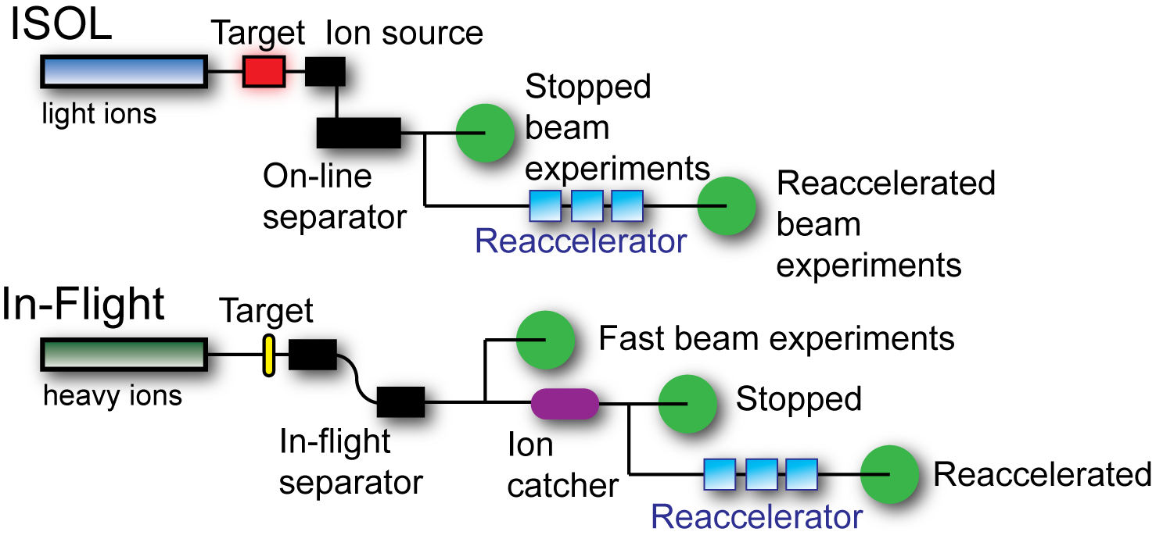
Rare Isotope Production Methods
For rare isotopes there are two main methods
Isotope Separation On-Line
In-Flight Separation

Slide 23
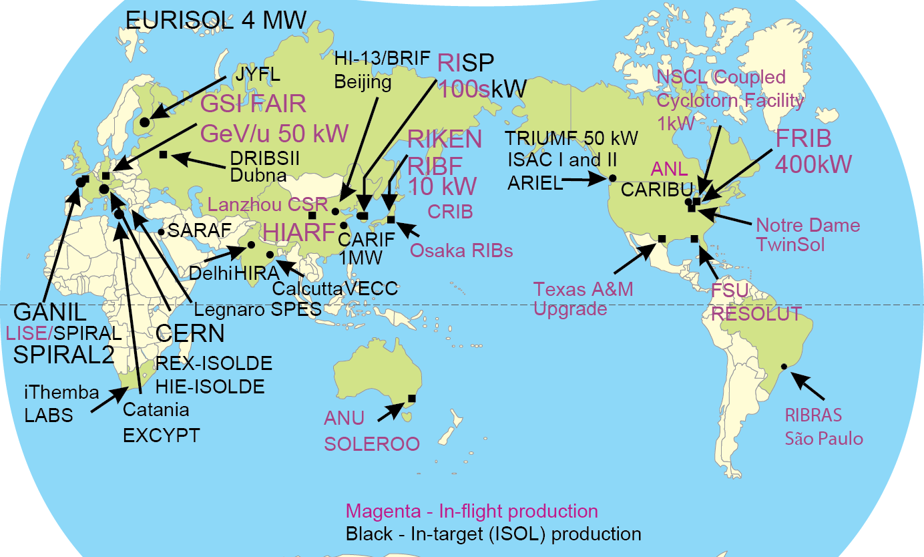
Facilities to Produce Rare Isotopes

Slide 24
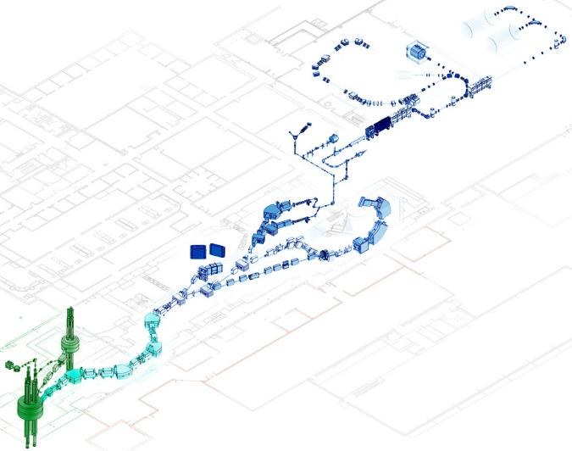

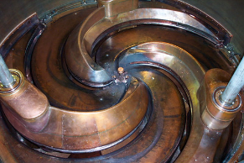
National Superconducting Cyclotron Laboratory (NSCL)
National User Facility funded by US National Science Foundation – 100 graduate and 140 undergraduate students
Structure of atomic nuclei, history of element formation, search for new physics, applications of isotopes for societal needs
Opportunity to prepare for FRIB
First system for in-flight separation and reacceleration of rare isotopes ReA3
Operation of NSCL user facility is supported by NSF Physics Division
NSCL Facility

Slide 25
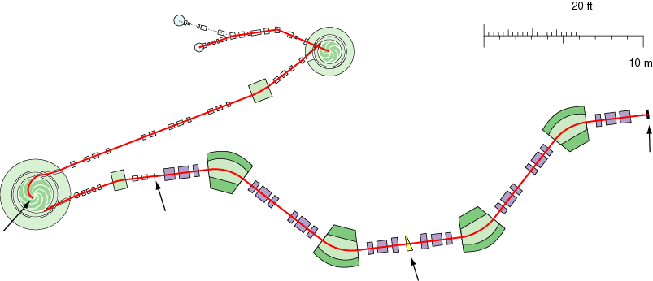
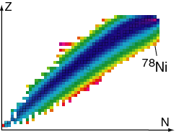
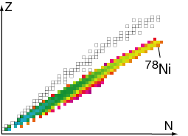
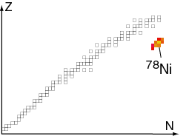
In-Flight Production of Rare Isotopes at NSCL
D.J. Morrissey, B.M. Sherrill, Philos. Trans. R. Soc. Lond. Ser. A. Math. Phys. Eng. Sci. 356 (1998) 1985.
K500
Example: ⁸⁶Kr → ⁷⁸Ni
ion sources
coupling
line
⁸⁶Kr¹⁴⁺,
12 MeV/u
K1200
A1900
focal plane
Δp/p = 5%
transmission
of 65% of the
produced ⁷⁸Ni
production
target
stripping
foil
⁸⁶Kr³⁴⁺,
140 MeV/u
wedge
fragment yield after target
fragment yield after wedge
fragment yield at focal plane

Slide 26
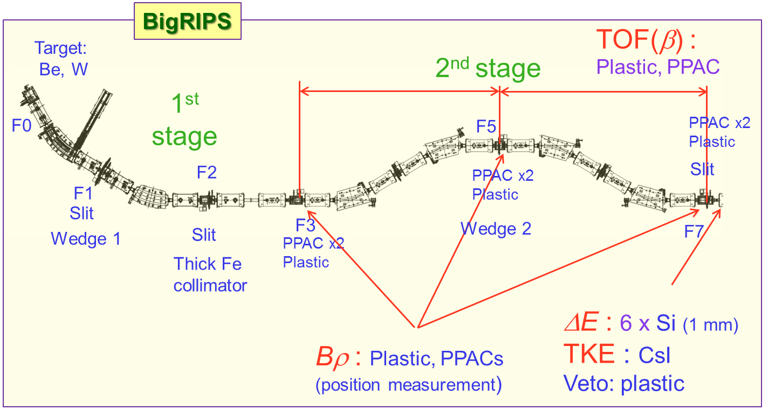
Recent Discovery of ⁶⁰Ca in Japan
⁷⁰Zn beam @ 345 MeV/u at 1.25e¹² /s
Fragment ⁷⁰Zn to make ⁶⁰Ca at RIKEN using RIBF
The products are separated by BigRIPS
Ions are identified by their flight time, energy loss, and how they bend in a magnetic field

Slide 27
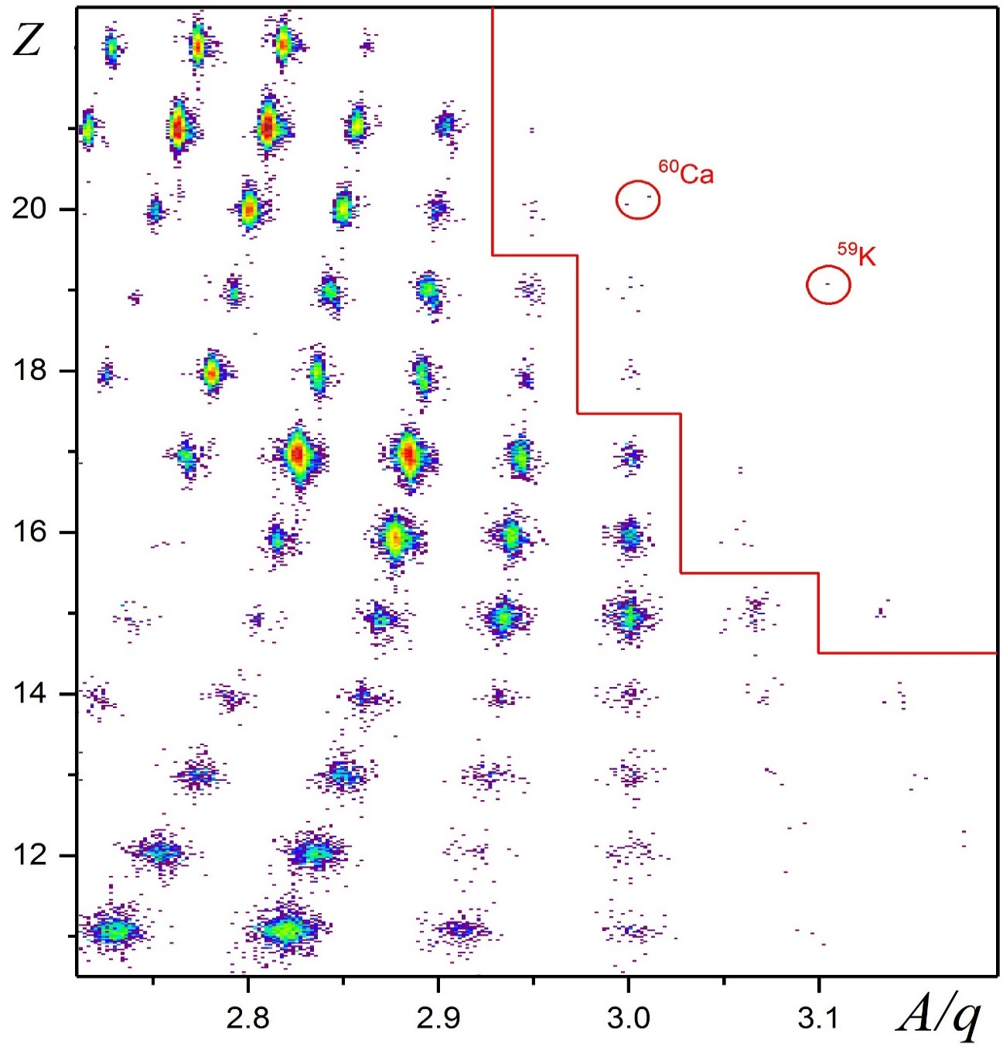
Success! ⁶⁰Ca Observed for the First Time
O. B. Tarasov et al. Phys. Rev. Lett. 121, 022501
_____
_____
____
___
___

Slide 28
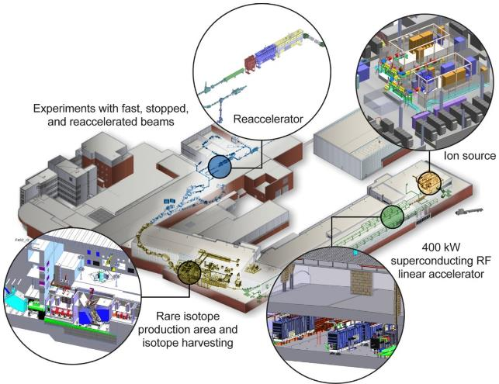
Facility for Rare Isotope Beams
Thomas Glasmacher, FRIB Laboratory Director
Funded by the US DOE– Office of Science Nuclear Physics Program with contributions from Michigan State University
Key feature is 400 kW
beam power for all ions
(8p𝜇A or 5x10¹³ ²³⁸U/s)
Separation of isotopes
in-flight provides
  Fast development time for any isotope
  Beams of all elements and short half-lives
  Fast, stopped, and
  reaccelerated beams
Goal to operate in 2021

Slide 29
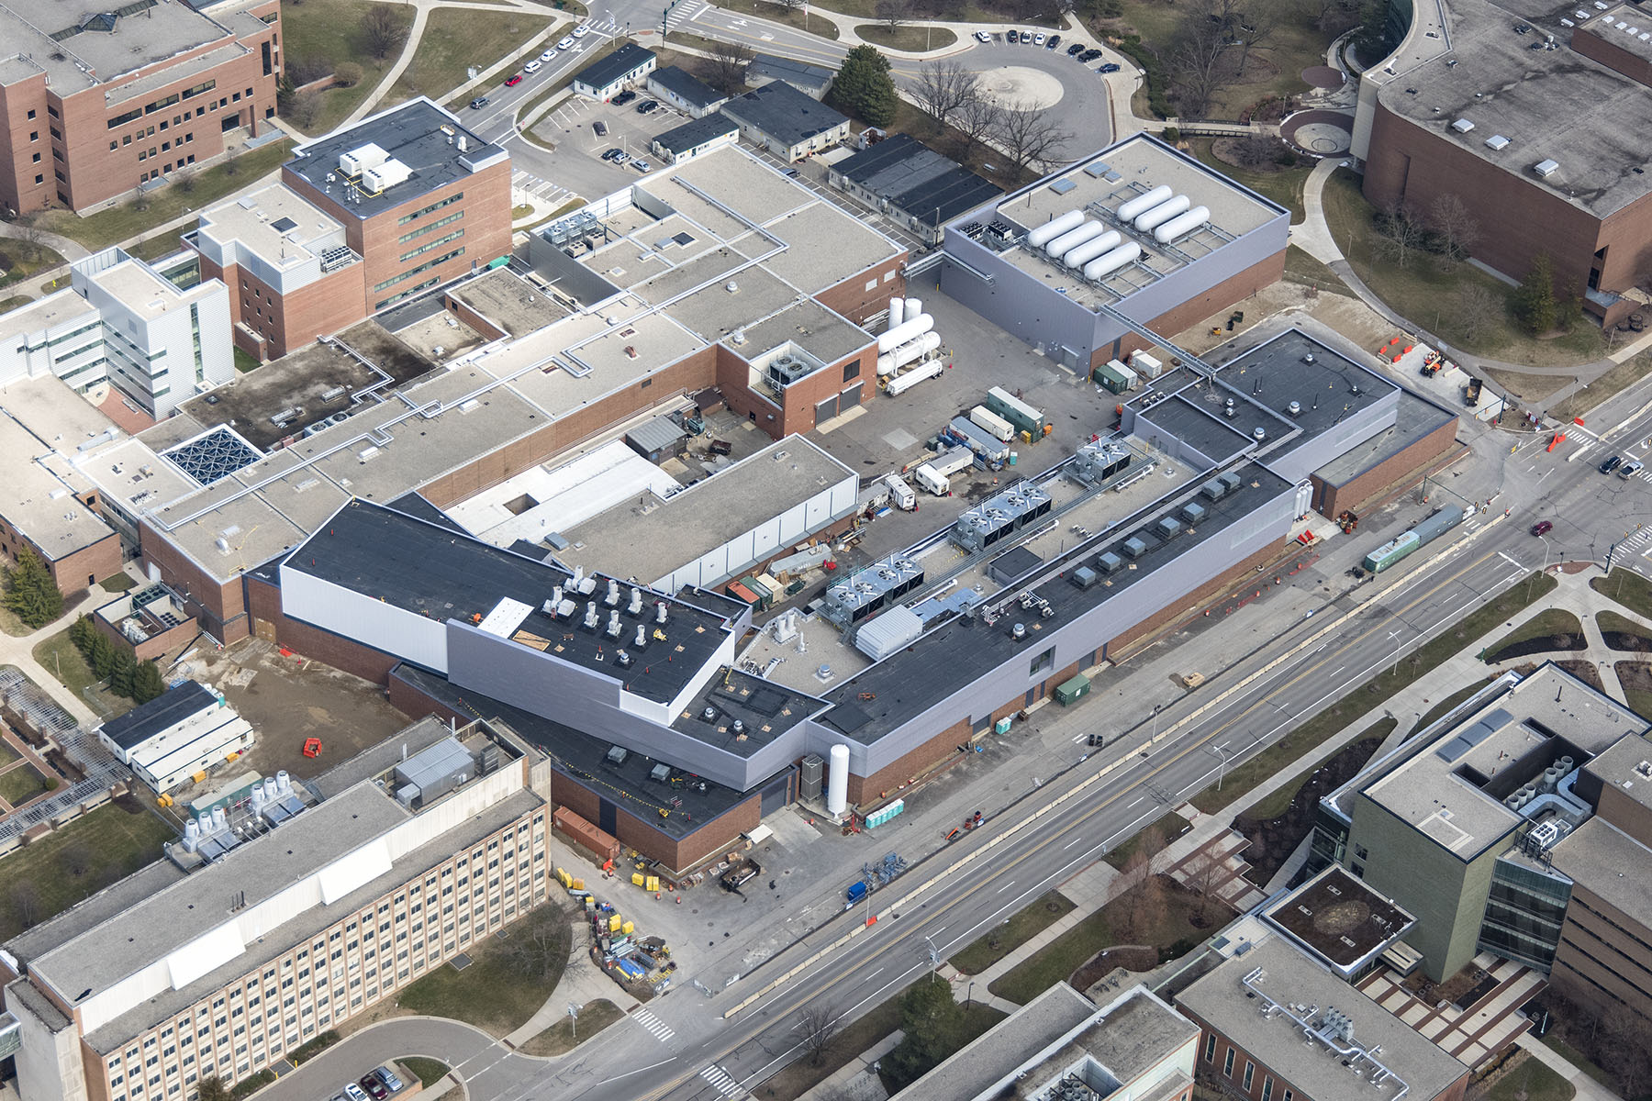
FRIB Construction Progressing Well – Now Installing Technical Components
Web cameras at www.frib.msu.edu

Slide 30
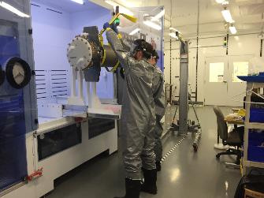
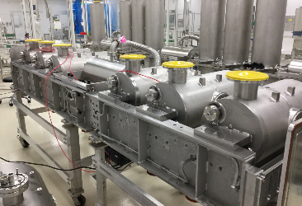
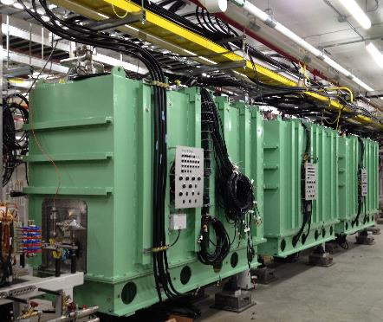
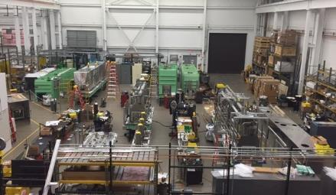
Cryomodule Production, Testing, and Installation Underway
Chemical processing
of cavities
Coldmass assembly
in clean room
assembly
Cryomodule assembly
(four of five bays)
The three β=0.041 cryomodules installed and being cabled up in the FRIB tunnel

Slide 31
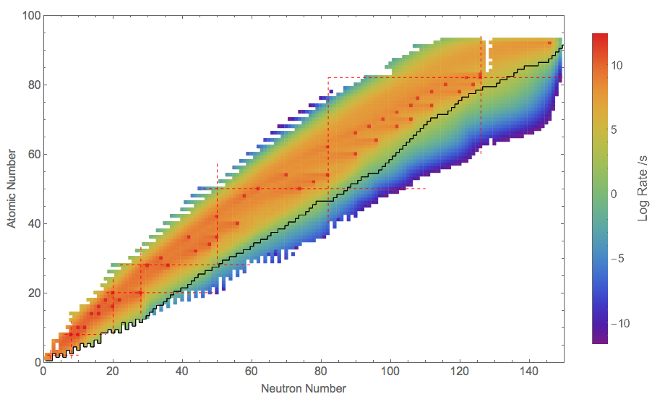
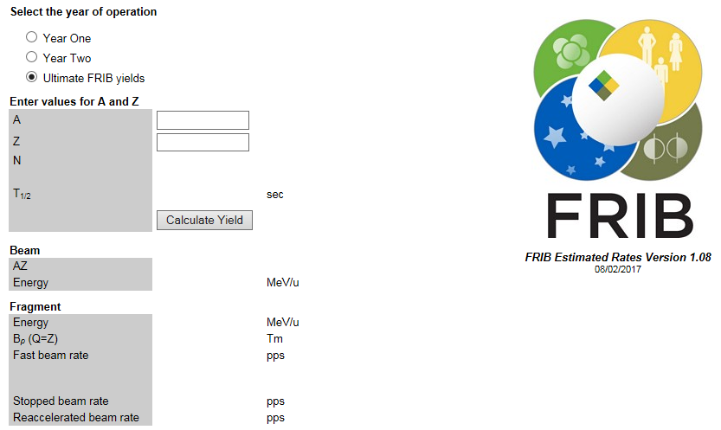
FRIB Estimated Beam Rates
https://groups.nscl.msu.edu/frib/rates/fribrates.html
O. Tarasov, et al. EPAX 2.15

Slide 32
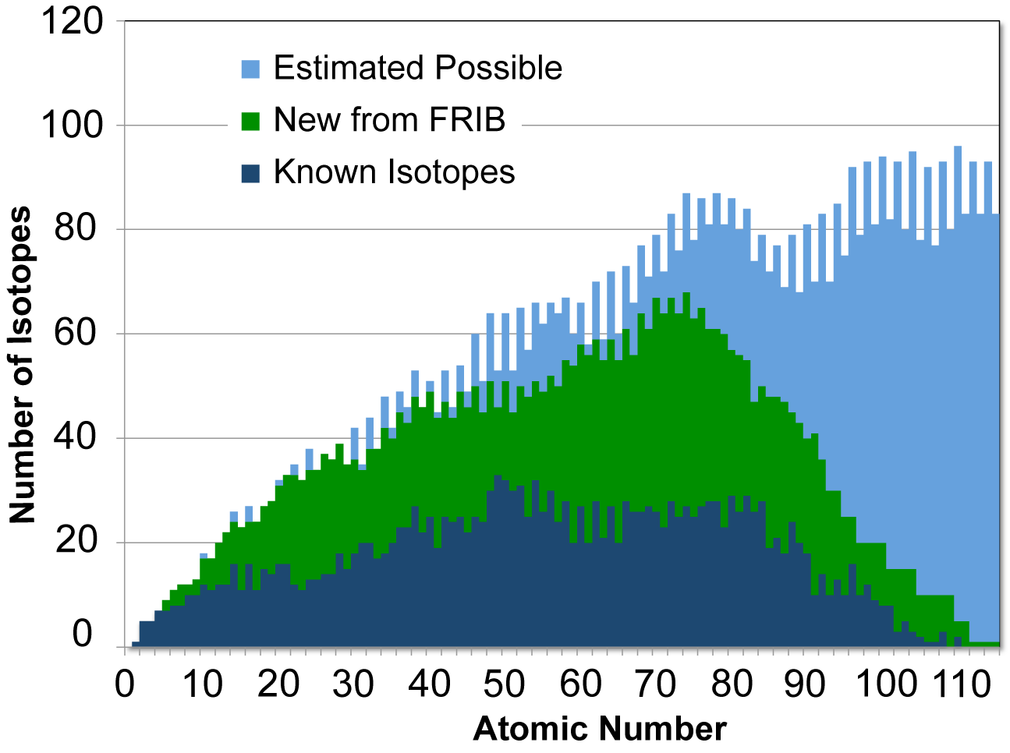
The Number of Isotopes Available for Study at FRIB
Estimated Possible: Erler, Birge, Kortelainen, Nazarewicz, Olsen, Stoitsov, Nature 486, 509–512 (28 June 2012) , based on a study of EDF models
“Known” defined as isotopes with at least one excited state known (1900 isotopes from NNDC database)
For Z<90 FRIB is predicted to make > 80% of all possible isotopes

Slide 33
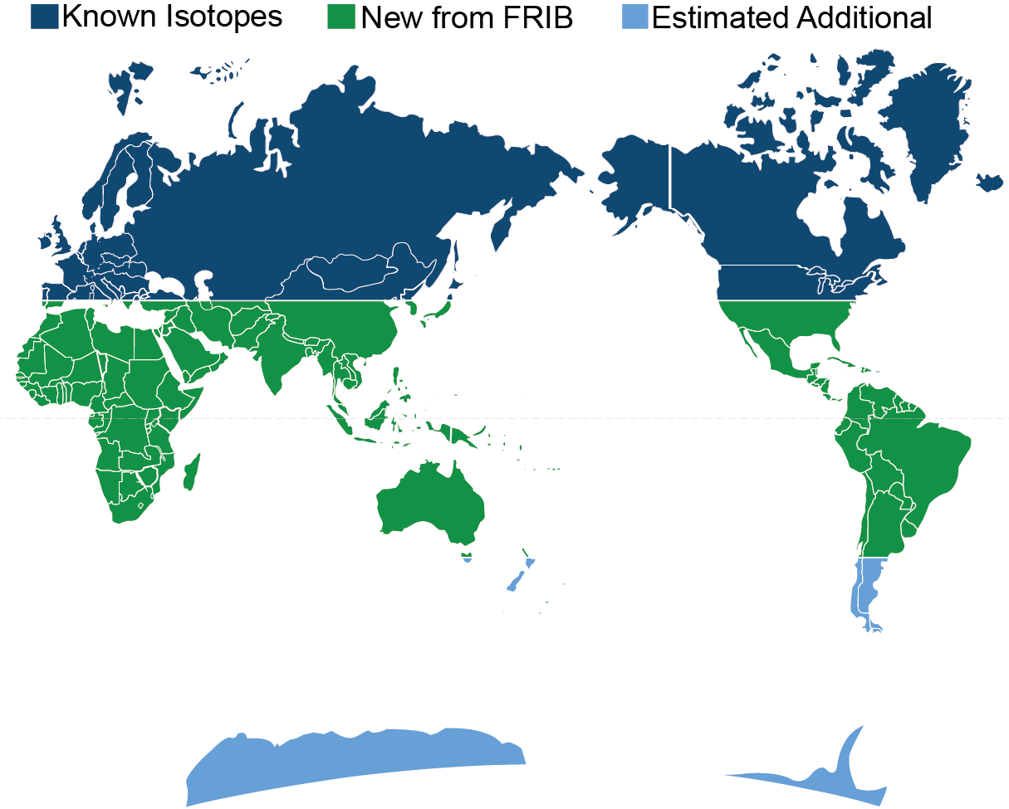
A Voyage of Discovery
FRIB will have a chance to make something like 4500 isotopes, or 80% of all the ones possible for Z<92.
This process will be a voyage of discovery!

Slide 34
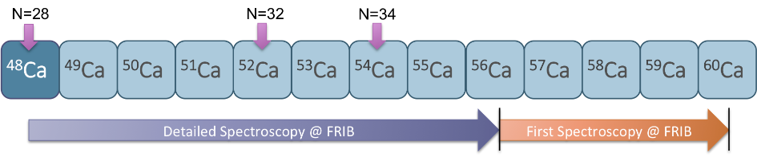
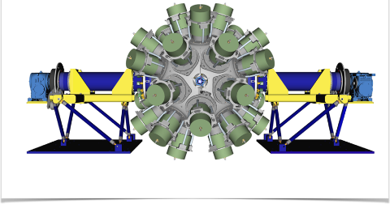
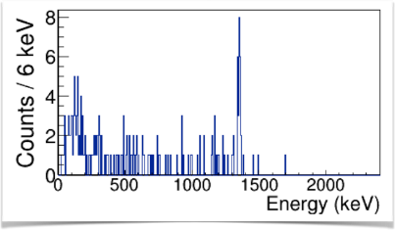
GRETA and HRS ⁶⁰Ca example
GRETA – CD1 in 2017,HRS – Conceptual Design
Crawford, Gade et al.
http://greta.lbl.gov/science/calcium
Simulation for ⁹Be(⁶¹Sc, ⁶⁰Ca + γ) with GRETA
GRETA

Slide 35
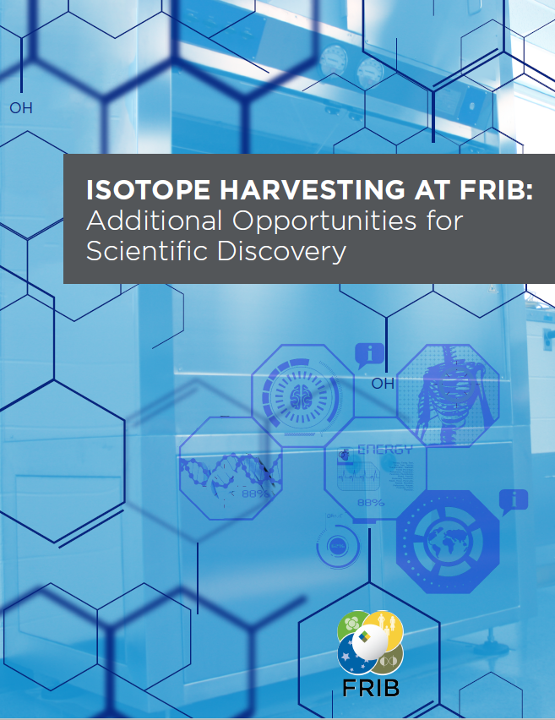
Useful Isotopes: FRIB Isotope Harvesting
Available at frib.msu.edu
Greg Severin, MSU – White Paper Editor
Describes opportunities for isotopes collected in parallel to normal operation
  Matched pairs to diagnose and treat disease ⁶⁴Cu/⁶⁷Cu and ⁴⁴Sc/⁴⁷Sc
  A readily available ⁵²Fe/⁵²mMn generator for oncology, neurophysiology, and diabetes
  Alpha and Auger emitters for therapy
  PET imaging of plants, e.g. ⁵²Fe
  Radioisotope Micro Power Source
  Homeland security
  Special isotopes for tests of nature’s laws
Contributors: MSU, LLNL, LANL, ANL, Missouri, Alabama, ND, ORNL, BNL, Iowa
Cover: Erin O'Donnell

Slide 36
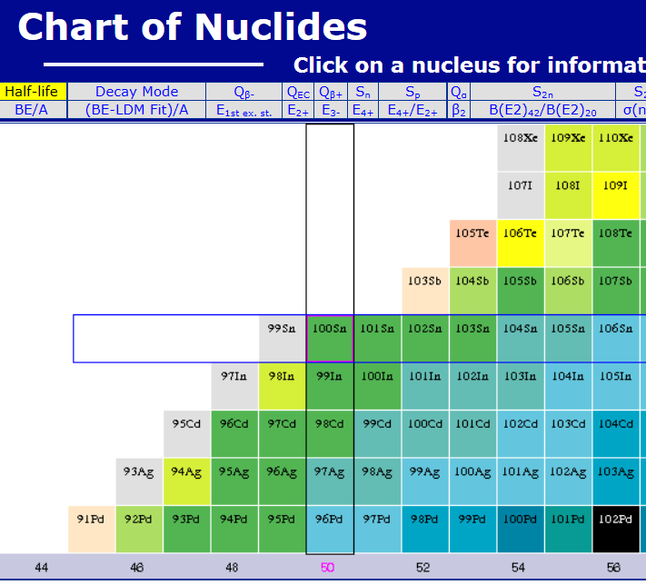
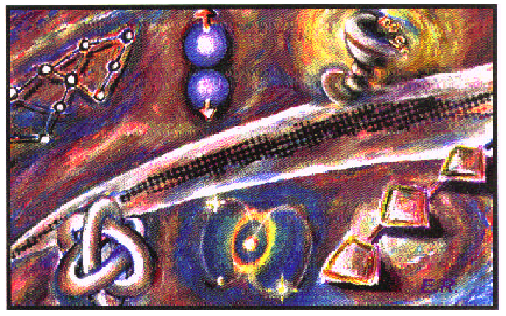
Remarkable Progress in Making Rare Isotopes
1985 - my postdoc supervisor said “¹⁰⁰Sn will never be observed”
1994 - Discovered by Schneider et al., Z. Phy. using the FRS at GSI and Lewitowicz et al., PLB at GANIL using LISE3
2008 14 decays observed, Bazin et al., PRL 101
2013 - 3000 ¹⁰⁰Sn produced at RIKEN for a detailed study
2024 - FRIB predicted ¹⁰⁰Sn separated beam rate of 1/s (see FRIB Rates online)
http://www.nndc.bnl.gov/chart/

Slide 37
Predicted of the Limits of the Nuclear Landscape
265 stable isotopes, 3100 observed, more like 2000 “known”
J. Erler et al., Nature 486, 509 (2012) – About 7000 isotopes possible for Z < 93

Slide 38
Modeling of the Limits of Atoms – 3 Approaches
Ab Initio Theory
Start with a nuclear force
Use a mathematical technique to calculate multi-particle system
Limited (mostly) to light nuclei like ¹²C
Requires more computational power than we have
Configuration Interaction
Start with a basis set of wave functions, Ψ, interactions (e.g. Shell Model)
HΨ = EΨ (Schrödinger's Equation)
Hamiltonian, H, comes from two- and three-body interactions
Requires H and basis
Density Functional Theory
Fermions moving in an external potential.
Hohenburg-Kohn theorem: density functional describes E_{gs}
Pick a functional, minimize the energy to get ρ(Ψ), get V_{ext}, iterate
Requires the correct density functional

Slide 39
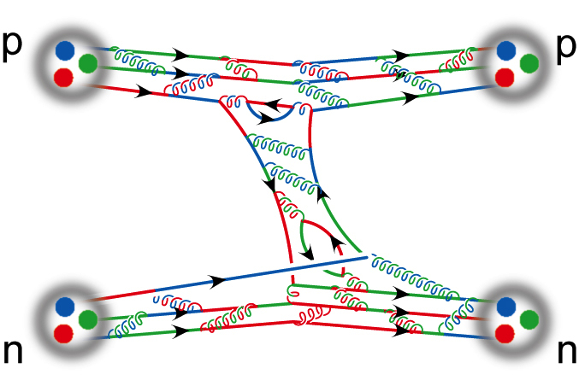

Challenge: Nuclei Force from NN Interactions
How do we determine the nuclear force to use in calculations
Modern approaches to NN potentials include
  QCD Inspired EFT - Epelbaum, Machleidt, …
  String Theory Inspired – Hashimoto …
  Lattice QCD – Detmold, Aoki …
Three (and maybe more) nucleon interactions are important
“Theory”
“Data”
N. Ishii, S. Aoki, T. Hatsuda, Phys. Rev. Lett. 99, 022001 (2007)

Slide 40

Construct NN Potentials: EFT based on QCD Symmetries – “Chiral”
Use the features of the pion (QCD) in constructing an effective theory
Effective Field Theory, EFT, based on QCD Symmetries (Weinberg, Epelbaum, Furnstahl, Machleidt, van Kolck, Navrátil, … )
Cut-off parameter Λ ≅ 500 MeV
Contact interactions have constants that are fit to experiment
Picture from E. Epelbaum

Slide 41

Energy Density Functional Theory
Best approach to calculate the heaviest atoms (atomic and nuclear)
Widely used in Chemistry (calculation of molecular properties are as good or better than what can be measured)
Technique: Minimize the variational equation δ(E(ρ) – ∫ V_{ext}(r)ρ(r) dr) = 0, E=<Ĥ>
Example: Skyrme functional

Slide 42
Prospective
There is a reasonable chance to observe a few more new elements in the next decade (Z = 120)
In a similar time frame, we will explore the chemistry of elements up to Z=118 – the periodic table may not hold
More neutrons are needed to reach even heavier elements. We might find a path with facilities like FRIB
In the next decade we expect to be able to make 80% of the isotopes of known elements (we don’t know the limits) – we may learn the limits
Theory: Ab initio, Configuration Space, Density Functional Theory may be able to answer the question of the limits of atoms at the end of a decade
You could be the person to determine if unobtanium is obtainable

Slide 43
Isotopes Matter
Accelerators are responsible for $500 billion worth of products each year
Around 20 million people in the US receive a nuclear medical procedure each year
Nuclear techniques are important for security and sustainable energy
Radioisotopes are used in many sciences, e.g., arsenic in environmental studies
Californium is a key tool in oil exploration
Industry uses radio-tracers to improve processes
Radio-activity powered batteries are used for many space missions
…

Slide 44
Backup

Slide 45

Heaviest Elements Have Unusual Atomic Structure
Electron and Nucleon Localization Functions of Oganesson: Approaching the Thomas-Fermi Limit
P. Jerabek, B. Schuetrumpf, P. Schwerdtfeger, and W. Nazarewicz
Phys. Rev. Lett. 120, 053001

Slide 46



When Did People First Change Mercury Into Gold?
1924 Editors of Scientific American “Gold can be extracted from mercury, but mercury cannot be transmuted into gold.”
A Philatelic Ramble Through Chemistry (Heilbronner and Miller; Verlag 1998) “It was not until 1941 that gold was actually prepared from a base metal. By bombarding mercury with fast neutrons, Sherr, Bainbridge, and Anderson obtained three radioactive isotopes of gold. Even that did not fulfill the dream of the alchemists; the gold was radioactive and the process did not produce wealth; it consumed it.”

Slide 47

Relative Abundance of Atoms Over Time
Plots: M. Weischer NDU

Slide 48
There are a Number of Nucleosynthesis Processes that Nature Uses
Big Bang Nucleosynthesis
pp-chain
CNO cycle
Triple alpha
Helium, C, O, Ne, Si burning
s-process
r-process
rp-process
νp – process
p – process
α - process
fission recycling
Cosmic ray spallation
pyconuclear fusion
Sample reaction paths
(α,γ)
fission
(p,γ)
β⁻
(α,p)
(n,2n)
^{A}Z
(n,γ)
β⁺ , (n,p)
(γ,p)

Slide 49

Rare Isotopes and Nuclear Process in the Universe
Data on rare isotopes are required to elucidate many astrophysical scenarios
rp-process in X-ray bursts/Novae/Supernovae
Direct reaction rates (SECAR)
Indirect reaction rate studies
Masses and p-drip line
s-process in AGB stars
Harvesting of targets for n-capture on branchpoints
Supernova cores
Electron capture rates with
charge exchange reactions
p-process in supernovae
Direct reaction rates
r-process
β decay properties
Masses
Indirect neutron capture rate studies
Fission barriers
Explosive Si burning in
supernovae (⁴⁴Ti, ..)
Reaction rates (SECAR)
Indirect reaction rate studies
Neutron star crusts
Fusion reactions of n-rich isotopes
Electron capture rates with charge exchange
Masses
Complete mapping of n-drip line
H. Schatz

Slide 50


Elemental abundance data: Surveys Large Aperture Telescopes
Hubble
Space
The measurement of elemental abundances is at the forefront of astronomy using large telescopes
Large mirrors enable high resolution spectroscopic studies in a short time (Subaru, Hubble, LBT, Keck, …)
Current and future surveys provide large data sets (SDSS-V, RAVE, LAMOST, SkyMapper, LSST…)
Future missions: JWST - one key question: “How are the chemical elements distributed through the galaxies?”
What does the chemical composition of a star tell us about its history? Can we infer the properties of the first stars?
SUBARU

Slide 51
FRIB Timeline
Early 1990s – Community effort to push construction of a new rare isotope facility (ISOL)
2002 NSAC Long Range Plan endorsement
2007 NSAC Top priority for new construction
September 2010 – CD-1 approved
April 2012 – Lehman review, baseline and start of civil construction
August 2013 – CD-2 approved (baseline), CD-3a approved (start civil construction pending FY2014 federal appropriation)
March 2014 – Start civil construction
August 2014 – CD-3b approved (technical construction)
October 2017 – First accelerated beam in LINAC hall
December 2017 – First liquid from FRIB cryoplant
2021 – End of NSCL operation
2021 – Early completion goal
June 2022 – CD-4 (scheduled project completion)

