Slide 1
Chunking:

Slide 2
125678983

Slide 4
125-678-983

Slide 6
Acronym:

Slide 7
Superior, Michigan, Huron, Ontario, and Erie

Slide 9
H.O.M.E.S

Slide 11
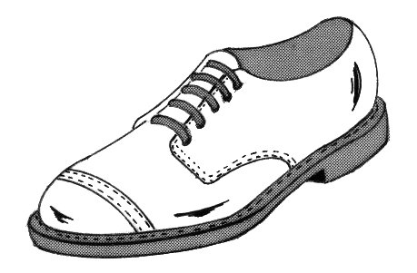
Rhyme Key:

Slide 12
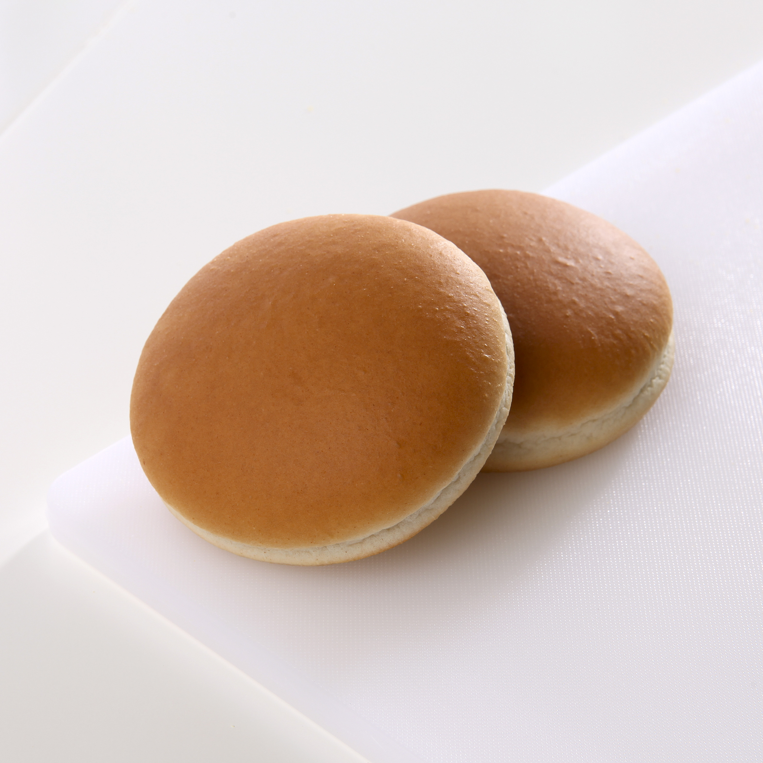
Ketchup
2) Butter
3) Toilet Paper

