Slide 1
“911… What is Your Emergency?”
Create your own emergency response team!
University of Wisconsin-La Crosse
University of New Hampshire
Western Carolina University
University of Florida

Slide 2
Sudden Cardiac Arrest
21:24:13 - call received by 911
21:25:11 - call dispatched to station
21:26:12 - University Police informed
21:26:20 - call to Mo
21:26:21 - paramedics in route
21:26:46 - face is blue
21:28:40 - AED in use
21:29:00 - University Police arrive
21:30:50 - paramedics on scene
21:31:09 - code in progress
21:49:30 - ambulance departs to hospital
21:57:42 - ambulance arrives at hospital
January 27, 2010
9:24 PM
20 year old female
Group X class

Slide 3
UW-L Collaboration
Recreational Sports
Training with Exercise and Sports Science Department
University Police
Student Life Office
Counseling & Testing Department

Slide 4
Improvements
Verbiage on 911 phone calls
Building Manager cell phones
CPR masks for entire facility and employees
Red Cross reference cards
Semester CPR reviews with staff
Bystander awareness

Slide 6
Evolution of Emergency Response Team (ERT)
Idea
Pilot
Bookshelf
Sudden Cardiac Arrest
ERT

Slide 7
Mission
As a preparatory unit of the Recreational Sports student staff, the Emergency Response Team (ERT) will ensure the readiness of the Recreational Sports Department for any potential emergency, review emergency action plans, and strive for efficiency in upholding accident, incident, and injury protocol.

Slide 8
Current Structure
Advisor:
Associate Director
Chair:
Student staff member
Representatives:
1 from each position area

Slide 10
What are your current procedures?
Your demographics
Emergency action plans
Common practices
Reports and documentation
Equipment and supplies
Certifications and training of staff
Institutional coordination

Slide 11
UW-L Demographics
Enrollment of 10,000 students
Recreational Eagle Center, Mitchell Hall, Sports Complex, and North Campus
96% entered the facility at least once
6 professional staff
3 graduate assistants
85 service staff
165 additional student staff

Slide 12
UW-L Current Practices
Injury and incident reports
AED
Portable first aid packs
Two-way radio and cell phones
Graduate certified athletic trainer
Undergraduate student athletic trainers
All service staff certified
Relationship with University Police

Slide 14
Emergency Action Plans
Definition: a written plan detailing procedures that facilitate and organize the actions taken during an emergency situation
Medical emergencies
Severe weather
Campus threat

Slide 15
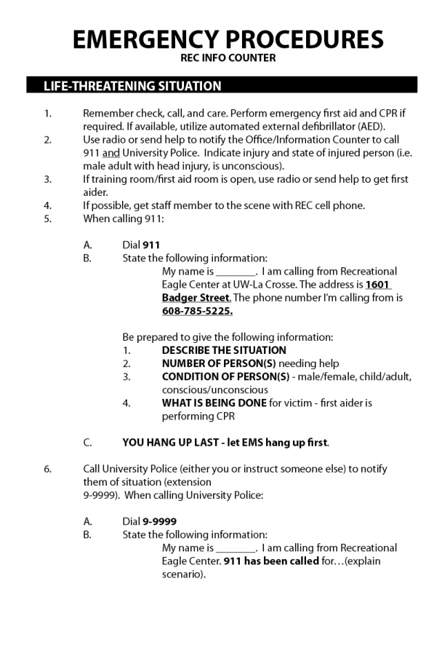
Emergency Action Plans
Bullets vs. Paragraph
Consistency
Locations
Indoor and Outdoor
Staff Handbook
Collaboration
Risk Management
University Police

Slide 16
UW-La Crosse Examples
Announcements
Handbook

Slide 18
Red Shirt Reviews
Purpose: to create a non-intimidating environment with real life situations for staff members to practice and become comfortable implementing EAP’s
Resources
Your institution
Other institutions
NIRSA Habitat

Slide 19
Red Shirt Reviews
Red Level
Green Level
Life-threatening
911 and University Police
Factors above training level
May include first aid treatment
May include shock
Non-life-threatening
Within training level
May include some first aid treatment
Does not include 911, University Police, or shock

Slide 20
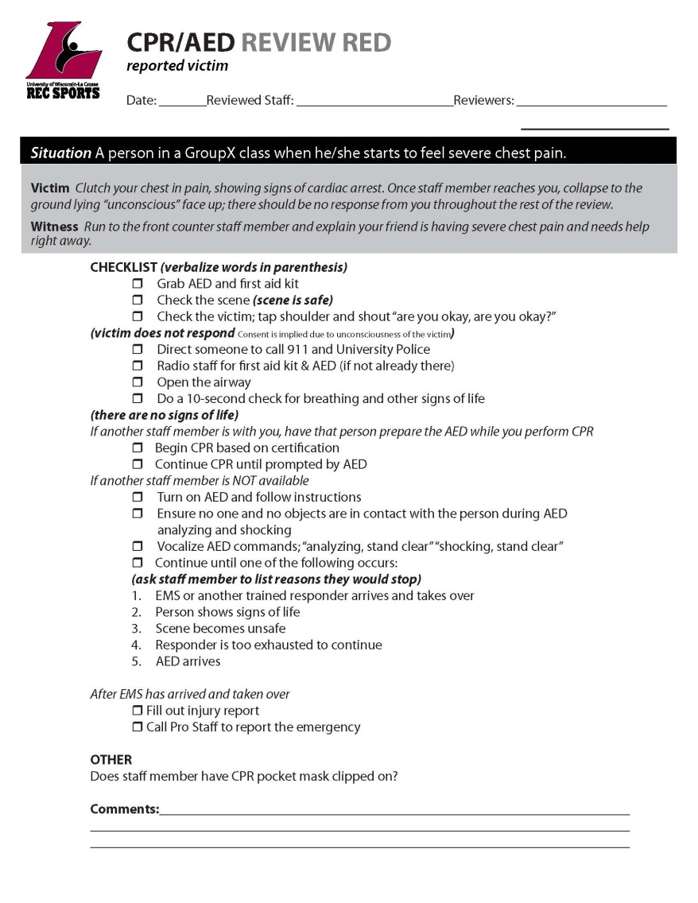
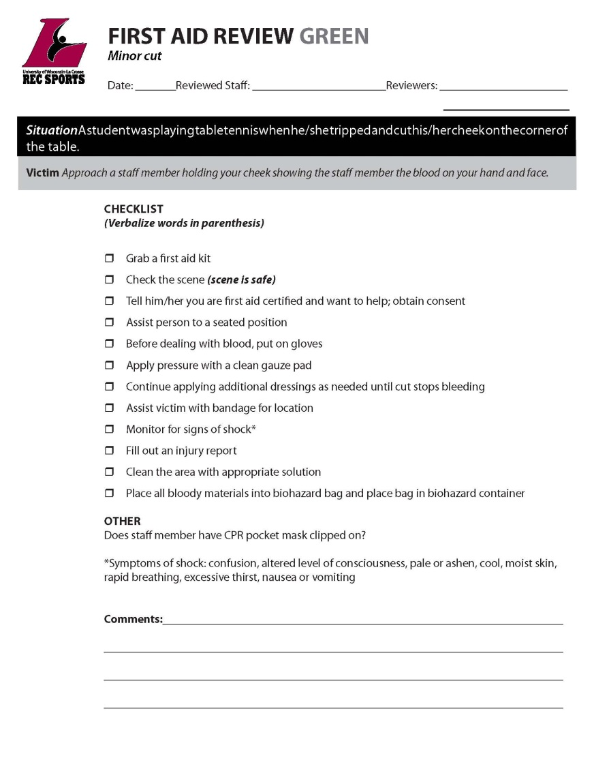

Slide 21
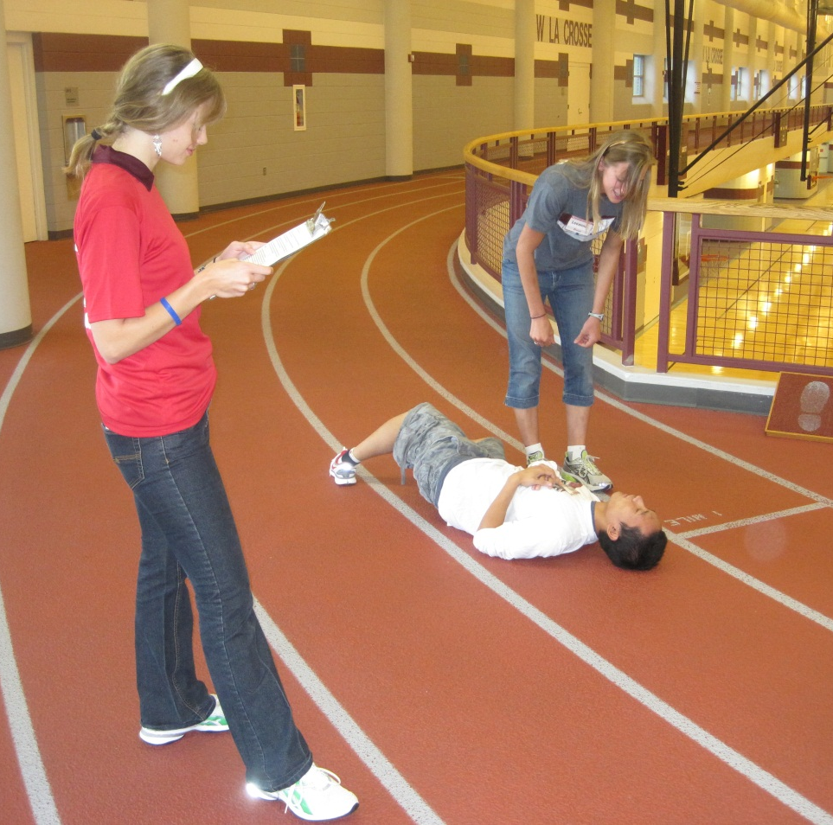
Red Shirt Reviews
Checklists
Scenarios
Front Desk
Logistics
Training ERT members
Scheduling
Planning coverage
Props

Slide 22
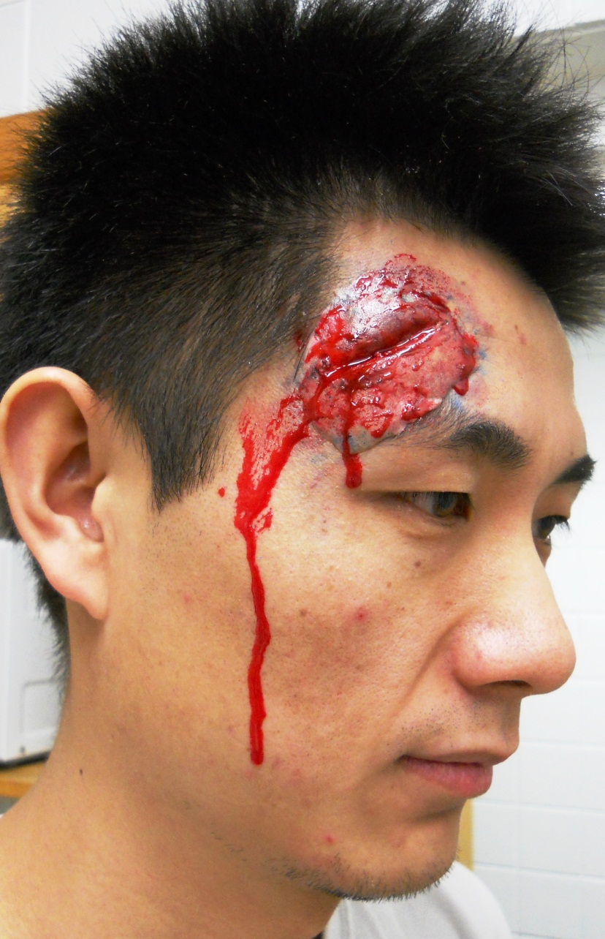
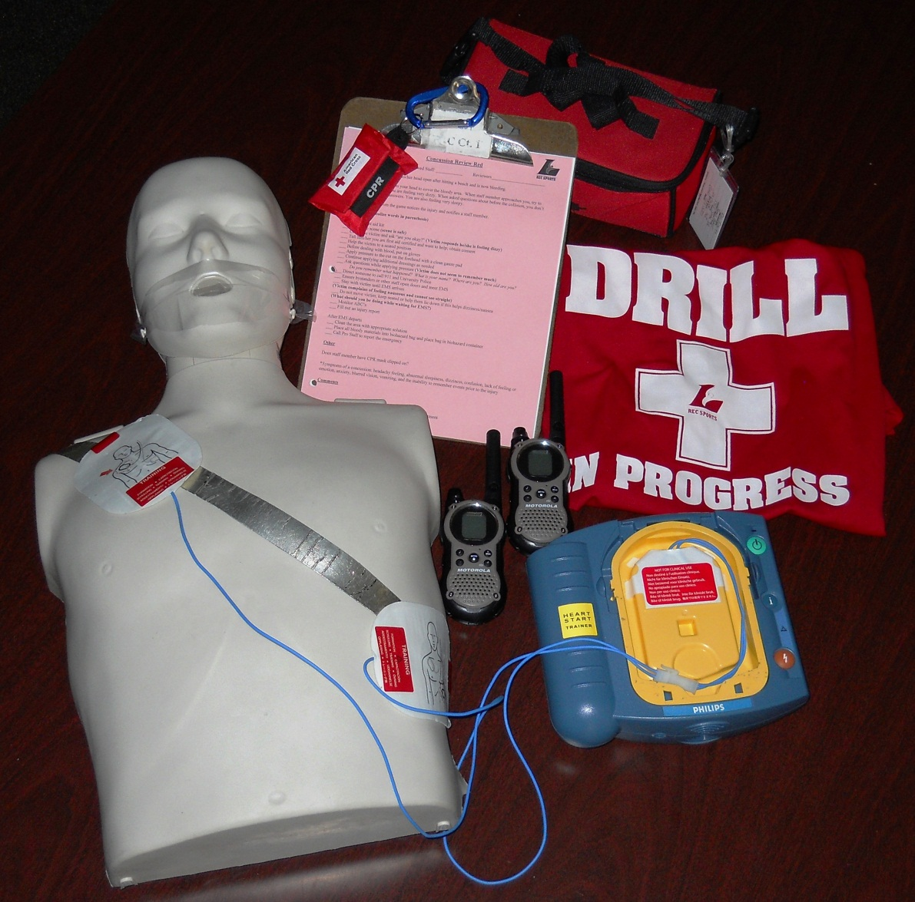

Slide 23
Mock Red Shirt Review

Slide 24
Red Shirt Reviews
Debriefing
Review entire scenario with staff on duty
Paperwork
Injury Report
Incident Report

Slide 26
Staff Comfort Level
Survey tool and results
Daily implementation
Positive comments from University Police
Increased level of care in real situations

Slide 27
Staff Training
Fall (prior to academic year)
Spring (first week of semester)
Emergency procedures and action plans
Mini-red shirt reviews
Large group debriefings
Facility tours
Introduction to emergency equipment and location
Updates on emergency procedures and action plans
Hands on CPR and AED review
First aid presentations by student athletic trainers

Slide 28
Staff Training
Certifications
CPR, AED, and first aid
Weekly Staff Meetings
ERT updates from committee members
Debriefings regarding recent incidents
Situational Debriefings
Review with staff involved

Slide 29
Make it Happen!
Thank You Video
www.uwlax.edu/recsports/ert.htm

