Slide 1
ESS-Exercise Science Program
Mass Advising Meeting
www.uwlax.edu/exercise-sport-science/
undergraduate-majorsminors/exercise-science/

Slide 2
Reasons For This Meeting
Learn about the people who can help you
Learn more about the program (including recent changes)
Get help with your class schedule
Get help with application for admission
Prepare for graduation & beyond
Get answers to questions (yours and others)

Slide 3
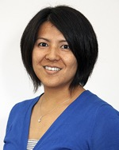
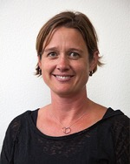
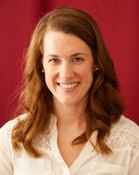
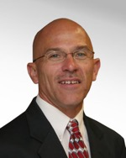
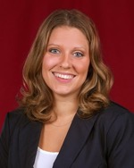
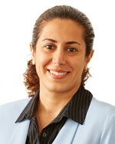
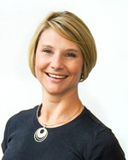
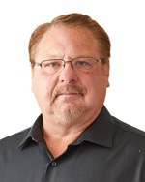
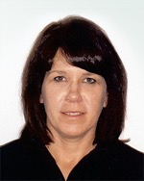
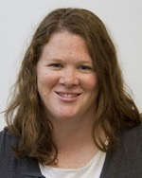
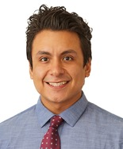
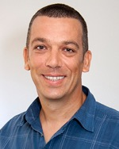
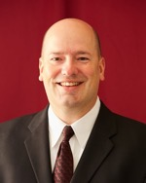
Your ESS Academic Advisors
Naoko
Aminaka
Susan
Bramwell
Kari Butterfield Emineth
Kasey
Crawford
Scott
Doberstein
Amber
Dunn
Naghmeh
Gheidi
Cordial
Gillette
Randy
Gretebeck
Melanie
Healy
Teri
Hepler
Salvador
(Cha) Jaime
Attila
Kovacs
David
Malecek
Andrew
McGlenn
Rick
Mikat
Kim
Radtke
Sheldon
Wagner

Slide 4
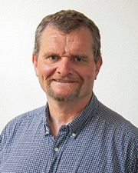
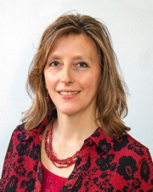
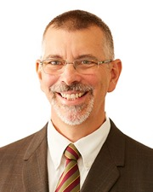
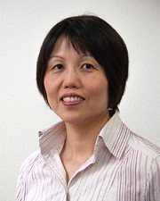
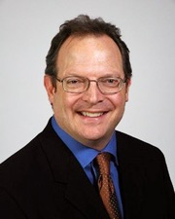
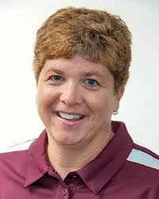
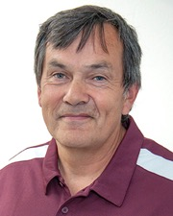
College and Department Office
Mark
Sandheinrich
CSH Dean
Carla
Burkhart
CSH Academic Services Director
Guy
Herling
CSH Academic Services Director
Chia-Chen Yu
ESS Department Chair
Mark Gibson
Assistant ESS Department Chair
Jeanne Voss
ESS ADA
Chris Dodge
ESS HP Lab Manager

Slide 5
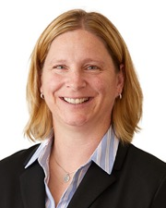
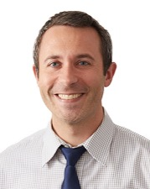
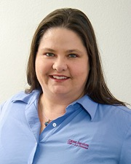
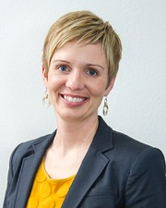
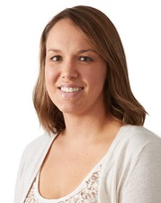
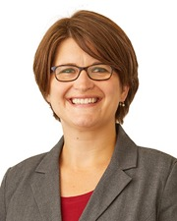
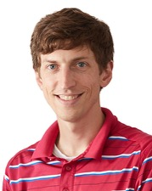
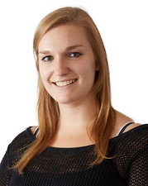
Career Services and Academic Advising
Stacy
Narcotta-Welp
Student Services Coordinator
Joshua Bench
Pre-health Student Resource Coordinator
Karolyn Bald
Assistant Director of Academic Advising
Becky Vianden
Director of Academic Advising & Career Services
Katy Morrison
Advisor – Academic Advising Center
Jamie Schweiger
Senior Advisor – Academic Advising Center
Chris Stindt
CSH Pre-health Academic Advisor
Shari Schoohs
Advisor – Academic Advising Center

Slide 6
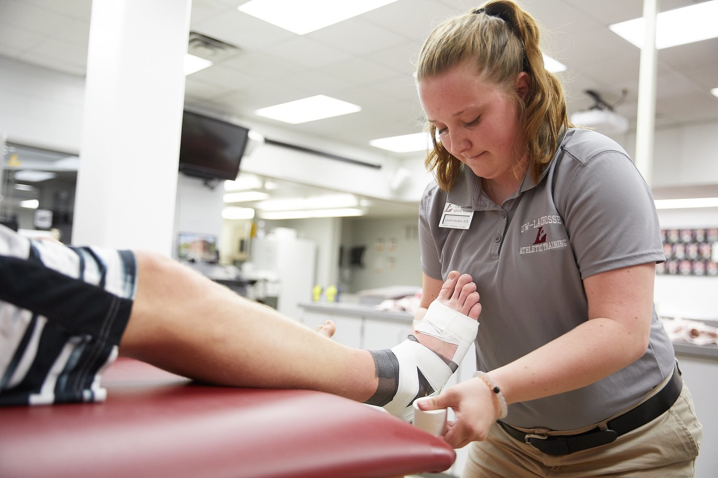
Athletic Training at UWL

Slide 7
Exercise Science Program
Major: Exercise and Sport Science
Emphasis: Exercise Science
Track: Fitness or Pre-professional
Requirements
General Education (48 cr.)
ESS Core (33 cr.)
Additional required courses focus on track-specific goals (47-53 cr.)

Slide 8
Two Tracks
Fitness: …for students interested in pursuing a career in the fitness industry - such as strength and conditioning coach, fitness or wellness center manager, etc.
Pre-professional: …for students interested in going on to graduate school for a career that uses the clinical application of exercise or activity - such as physical and occupational therapy, athletic training, cardiac rehab, etc.

Slide 9
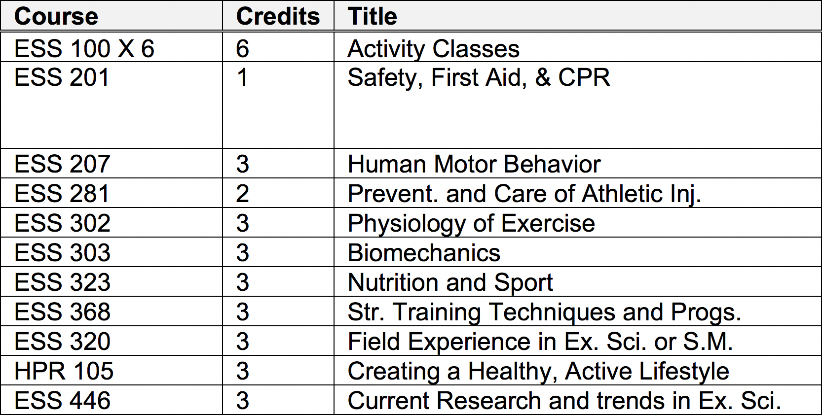
ESS Core Courses (33 Cr.)

Slide 10
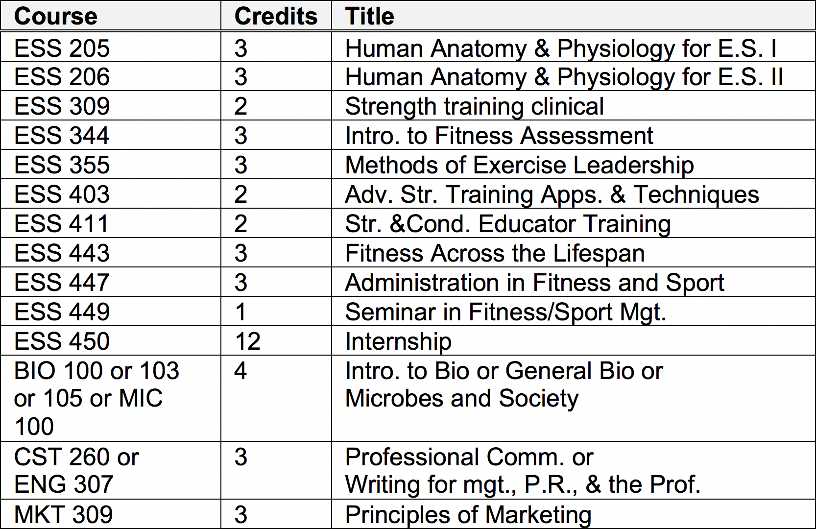
Fitness Track (47 Cr.)
* BIO 312 and 313 may be taken in place of the ESS 205 and 206 series

Slide 11
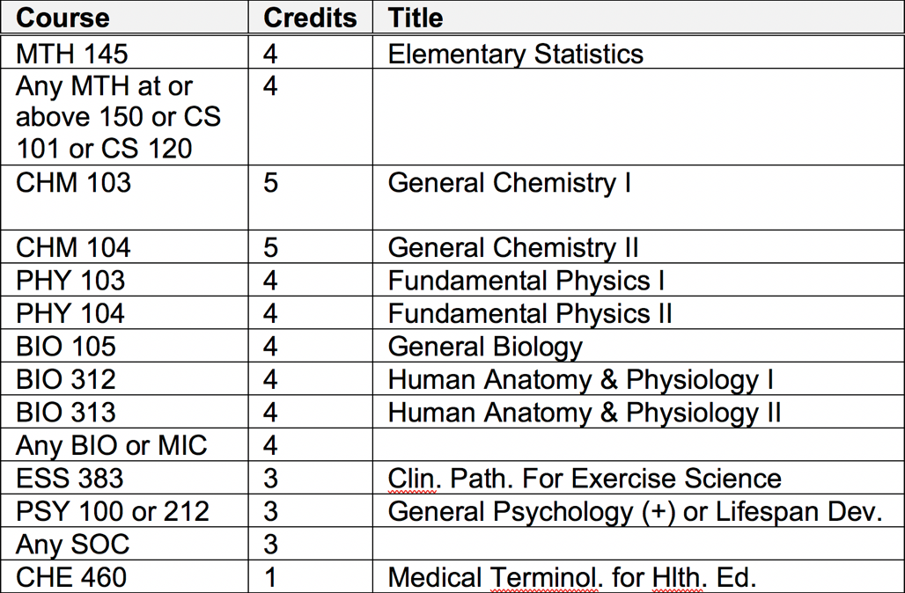
Pre-professional Track (53 Cr.)
Minor, Second Major, or Additional Credits
Students must complete a 2nd major or a minor outside the major or an 18 credit “individualized option”

Slide 12
Individualized Option (18 Cr.)
At least 12 cr. outside of ESS at the 300(+) level
Six remaining credits
100(+) level courses outside ESS (GE okay if not used to fulfill a GE requirement)
300(+) level courses in ESS that are not used to fulfill major requirements

Slide 16
General Scheduling Advice
Use the UWL Course Timetable along with your 4-year plan to create a schedule for your remaining semesters
Carefully review prerequisites
Generate a registration back-up plan for difficult classes
After being admitted, count on at least three semesters of coursework (plus an internship for Fitness Track students) to graduate
Look online to see admission prerequisites for graduate school

Slide 17
Admission Stats
Percentage of applicants admitted: ~75%
Average GPA of admitted students
Fitness Track: ~3.3
Pre-professional Track: ~3.55
Typical application contents (resume items)
Shadows & clinical observations: 2
Research: 1
Memberships: 1
Certifications: 3 (Red Cross)
Volunteer and professional experiences: ???

Slide 18
Application for Admission
First you must qualify
Officially declare Ex. Sci. with track
Complete at least 30 college credits
UW-L overall GPA (Cum GPA) of at least 2.75 for Fitness or 3.0 for Pre-professional
“C” or better in BIO 100 or 103 or 105
“C” or better in HPR 105
Pass fitness test
Application Workshop with Career Services

Slide 19
Career Services Workshops
Will replace resume check beginning in spring, 2019
Three dates before spring application deadline (February 1, 2019)
Tues., Nov. 13th 7-8pm Centennial Hall
Wed., Jan. 23rd 7-8pm Centennial Hall
Tues., Jan. 29th 7-8pm Centennial Hall

Slide 20
Application for Admission
Application Check Sheet
Online Application Form
Deadlines are Oct. 1 and Feb. 1
Forms and detailed instructions on the Exercise Science Program website

Slide 21
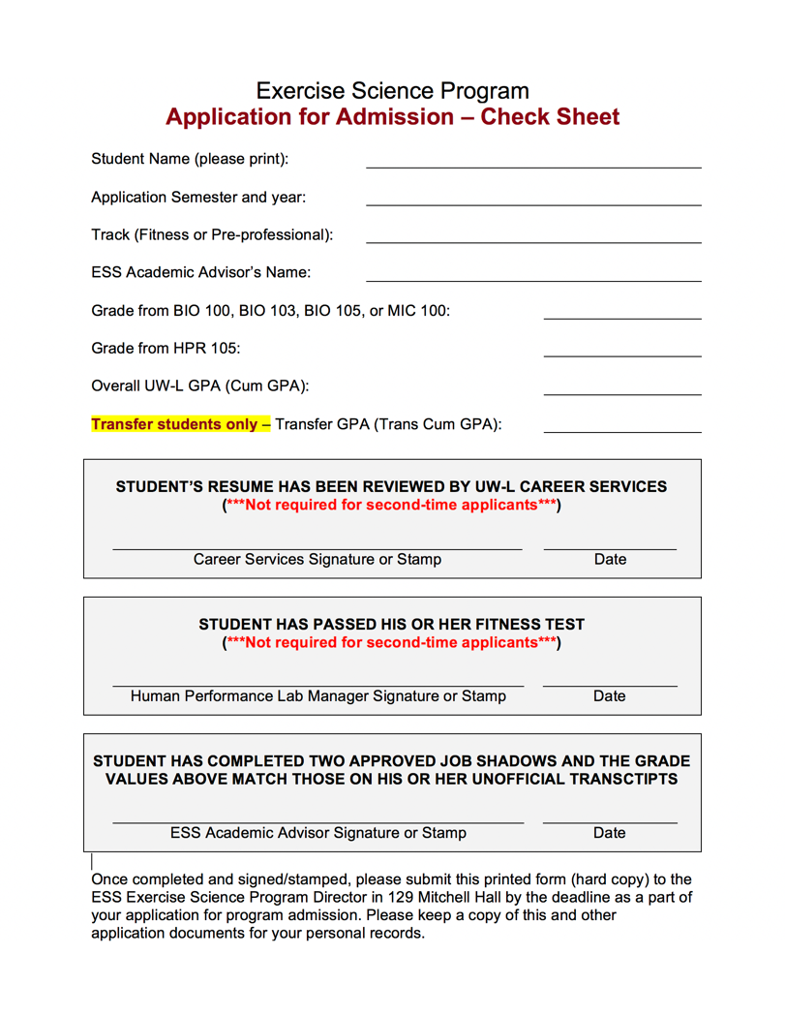

Slide 22
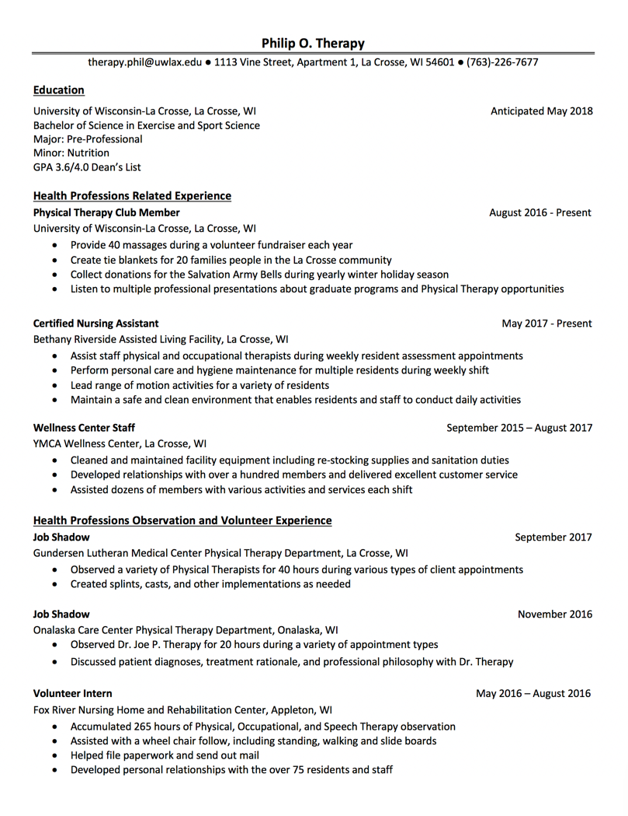
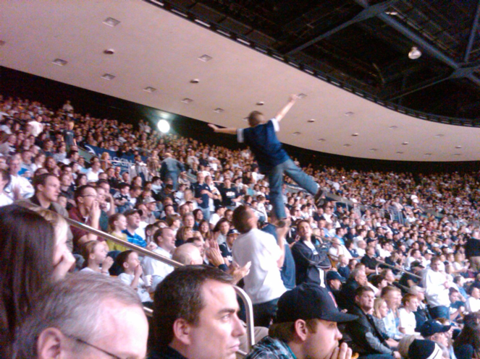

Slide 23
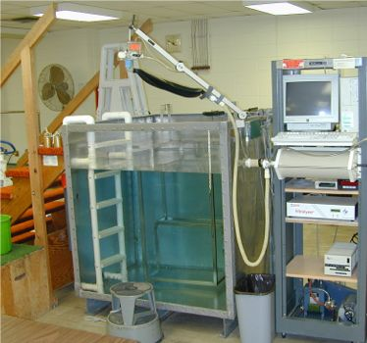
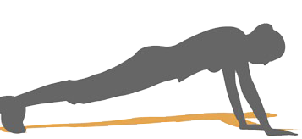
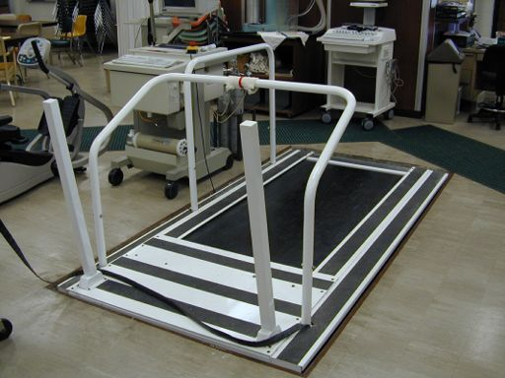

Slide 24
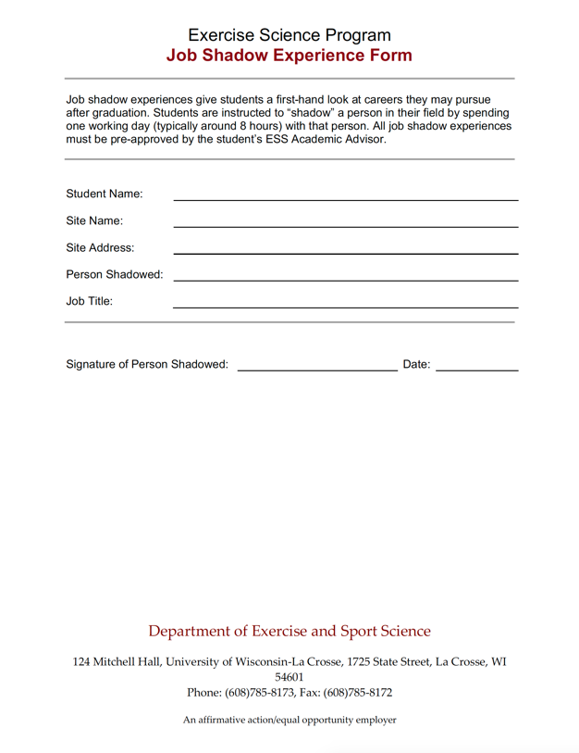
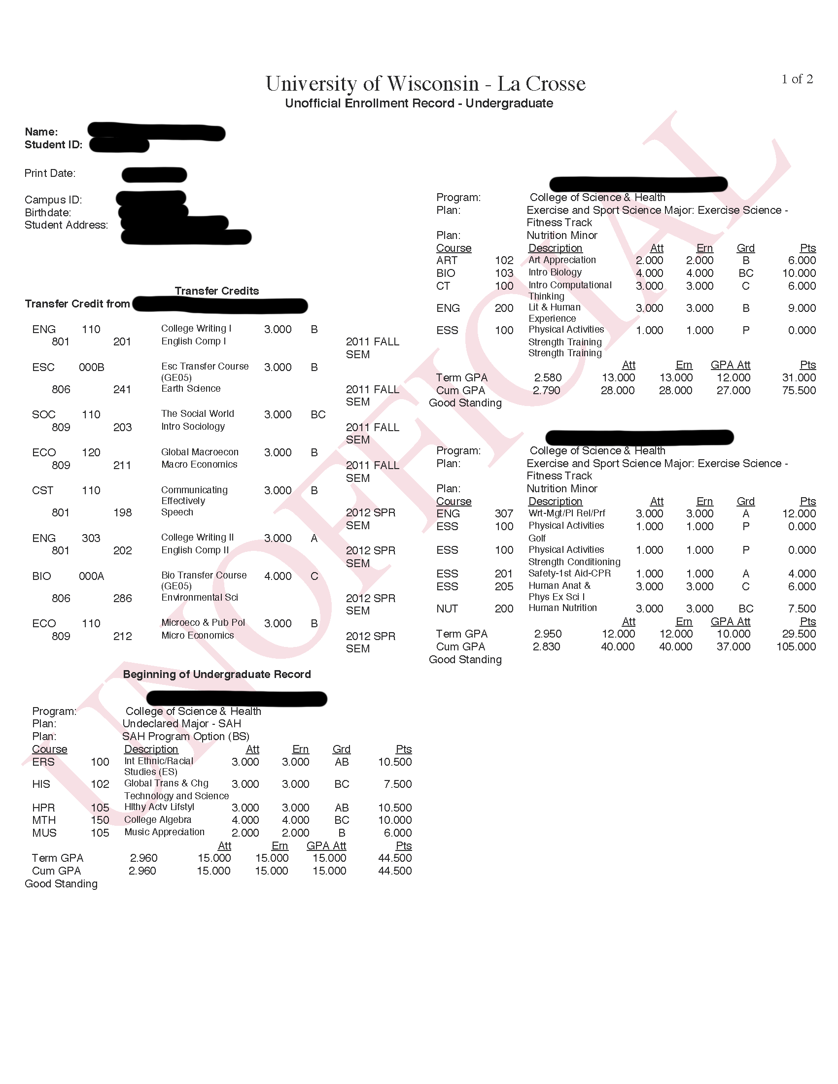
HPR 105 Hlthy Actv Lifstyl
BIO 105 General Biology
Cum GPA
Trans Cum GPA

Slide 25
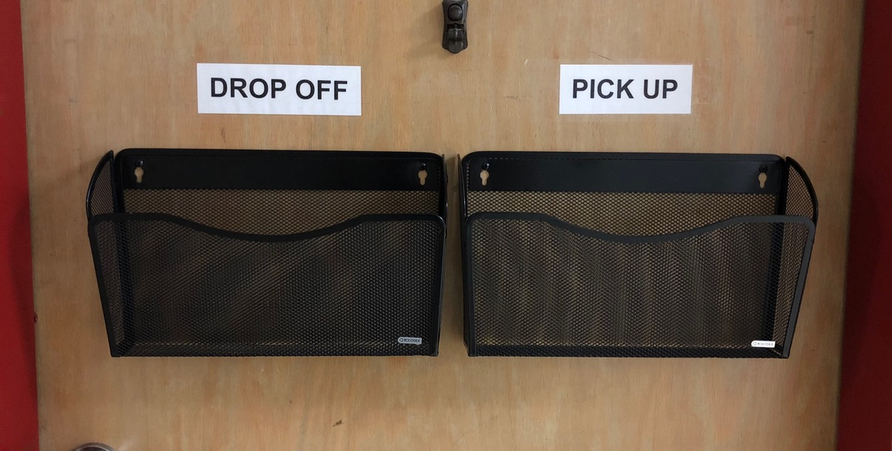
Check Sheet to 129 Mitchell Hall

Slide 26
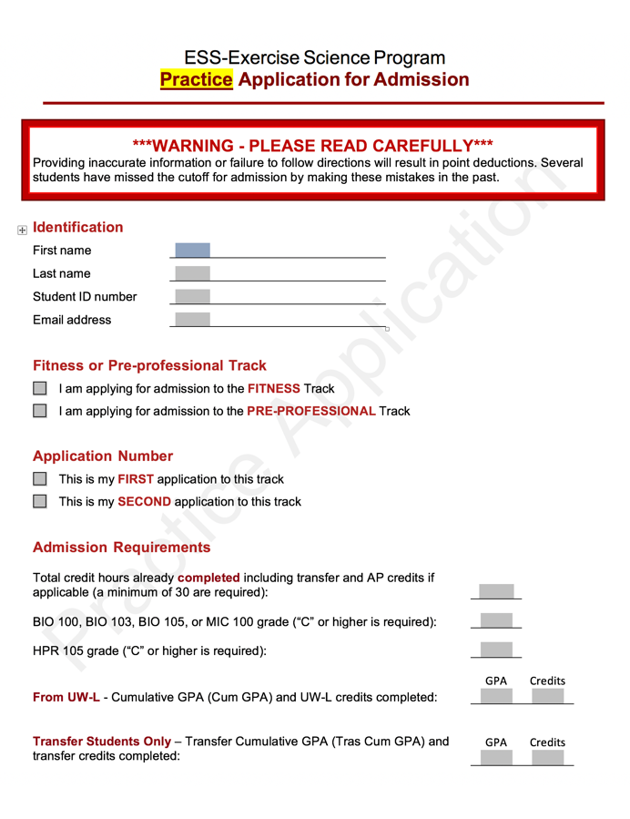
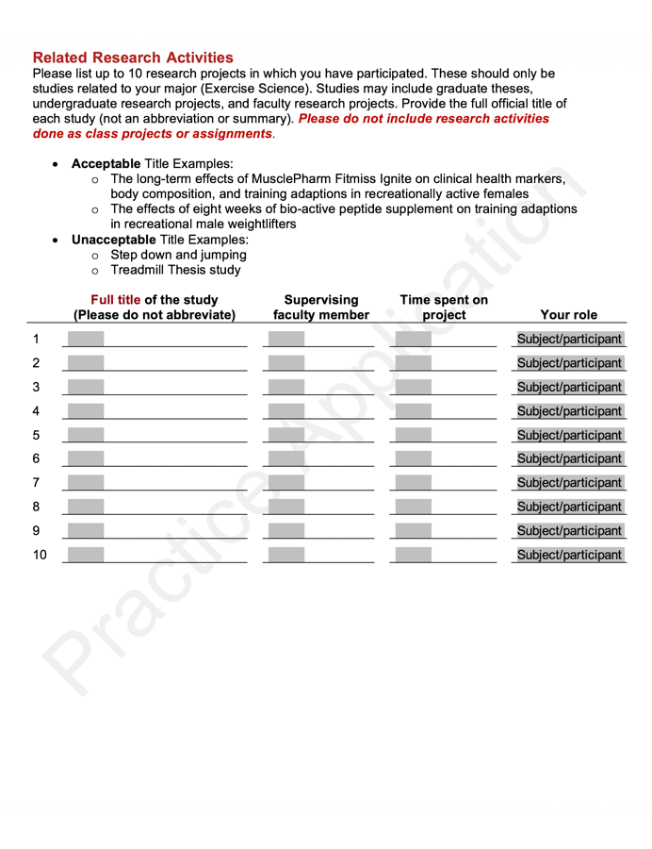

Slide 27
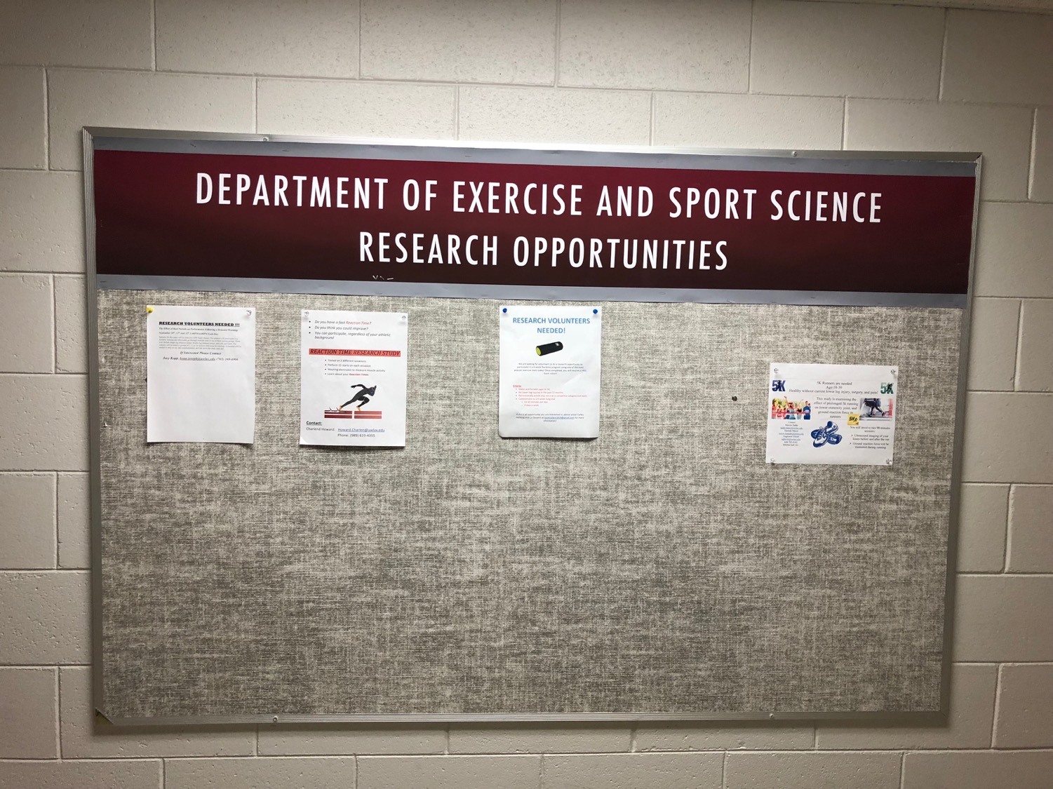

Slide 28
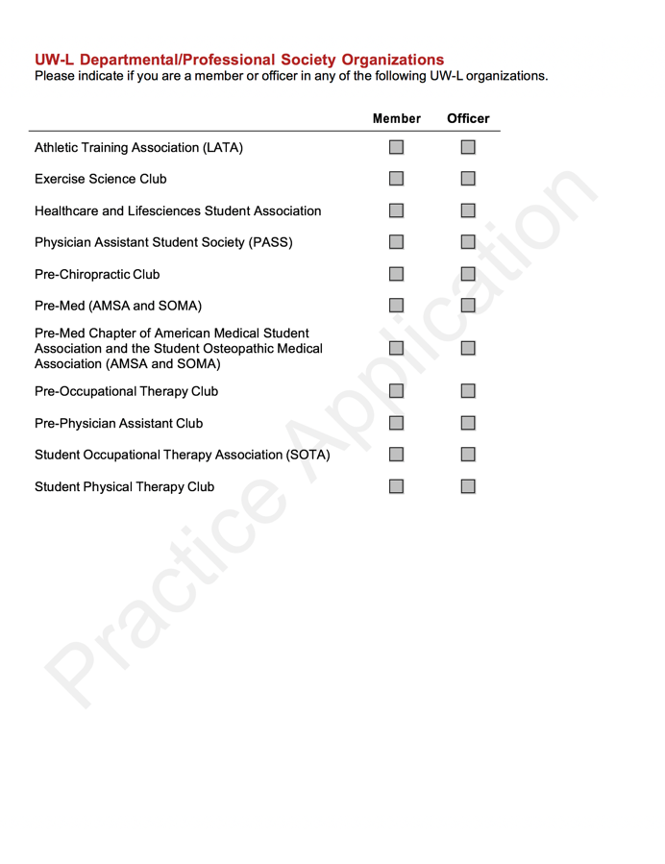
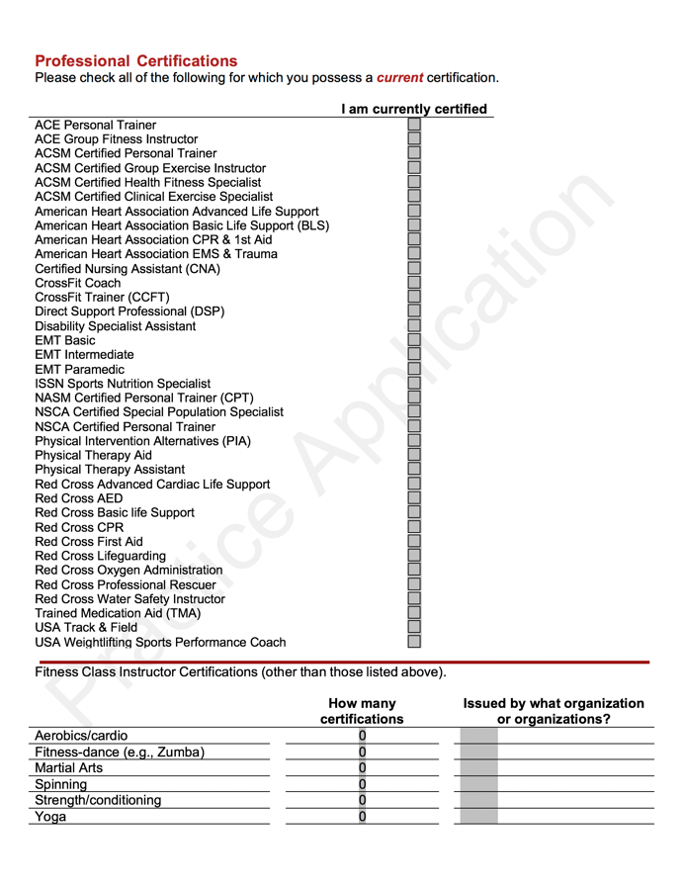

Slide 29
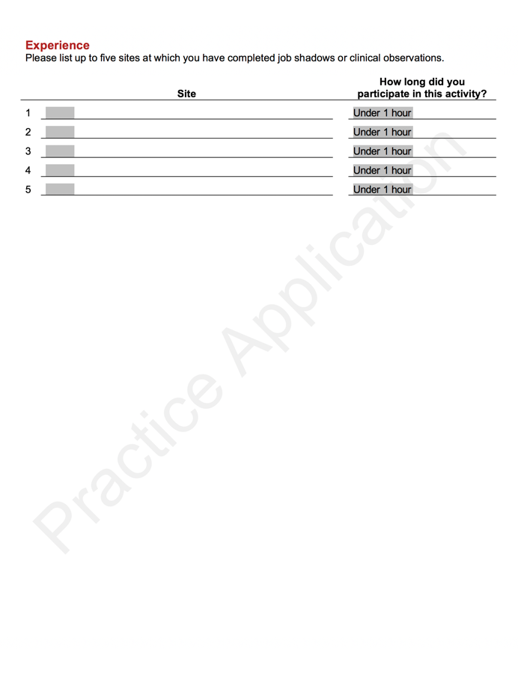
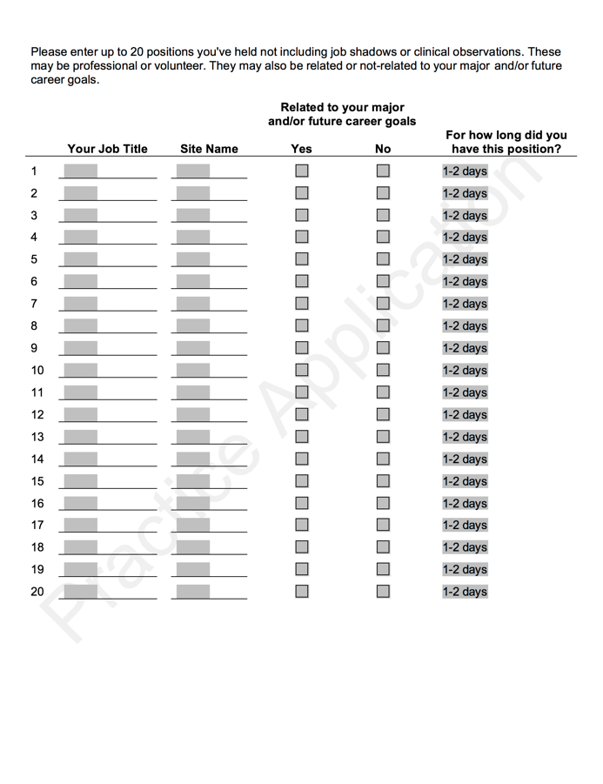

Slide 30
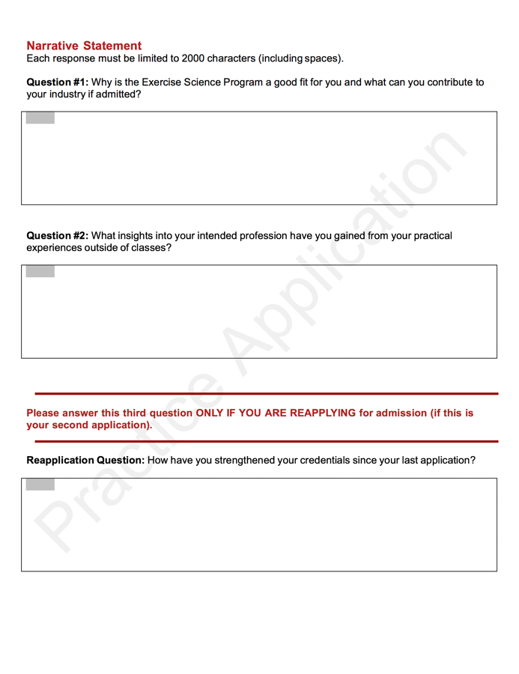
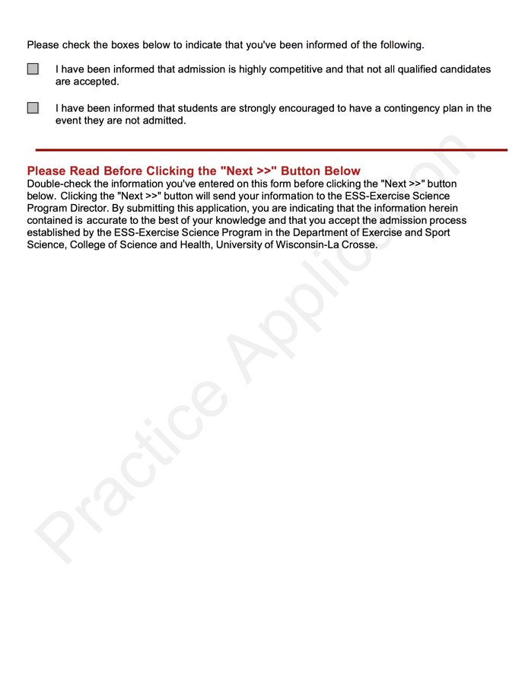

Slide 31
Application Tips
DON’T WAIT UNTIL THE LAST MINUTE!
Job shadows
Fitness test
Resume & narrative statements
Application building
Check sheet
Practice your application
Why do we recommend Sophomore year?

Slide 32
Consider This Scenario
Senior not yet in the program
Applies for admission
Isn’t admitted
Applies again next semester
Isn’t admitted
Can’t finish degree and only 2-3 classes left
Change track/major/campus
Probably two more years to finish

Slide 33
New Policy in CSH
Students must be admitted in a major by 60 credit hours (end of sophomore year)
Option A: Double-major (Exercise Science and plan B) until admitted
Option B: Receive special permission from a Dean’s Office advisor in order to register for next semester classes

Slide 34
What If I Don’t Get In?
Two tries allowed
See Dr. Mikat
Improve credentials
Apply again
Change track
Change major
Change campus

Slide 35
What If I DO Get In?
Pre-professional Track
97% go on to graduate school
100% of remaining employed in their field
Fitness Track
18% go on to graduate school
100% of remaining employed in their field
Internships: About 75% get job offers

Slide 36
Continue to Build
ESS 320 – Field Experience
ESS 450 – Internship (Fitness Track Only)
Clinicals and labs
Research
Volunteering
Employment

Slide 38
Forms You May Want
Course Substitution – Dean’s Office
Course Override (BLUE) – ESS Office
Time Conflict (BLUE) – ESS Office
Drop/Add Slip – ESS Office
Change of Program (GREEN) – Dean’s Office
Intent to Graduate – WINGS
Transcript Request – WINGS

Slide 39
Graduation Requirements
See WINGS to indicate your Intent to graduate - gets you on important lists
See web for commencement information
See Mr. Herling in 205 Graff Main Hall
Credit Check
(Optional) Petition for Early Commencement
Meet all other graduation requirements
Outside tri-state region (beyond Chicago)
(Optional) go to117 Graff Main Hall to get your name on the program

Slide 40
Thank You!

