Slide 1

Archaeological Excavation by Robert Geiger
NEH Summer Institute at UW-La Crosse
July 2011
Archaeology - The systematic study of past human life and culture by the recovery and examination of remaining material evidence, such as graves, buildings, tools, and pottery.

Slide 2
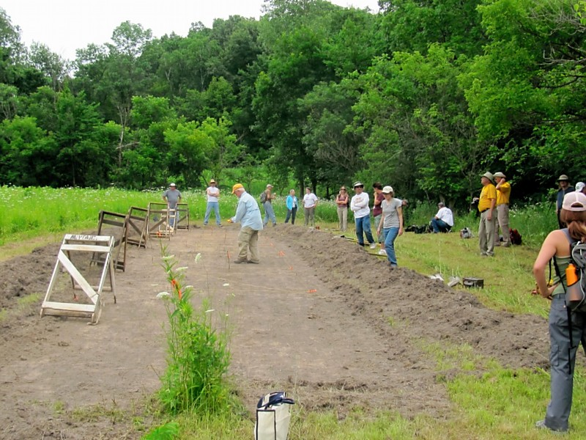
Site Excavation
Vegetation might be cleared
This will allow for easier screening of soil
Will save time
Here the vegetation is on the left and right of the excavation site

Slide 3
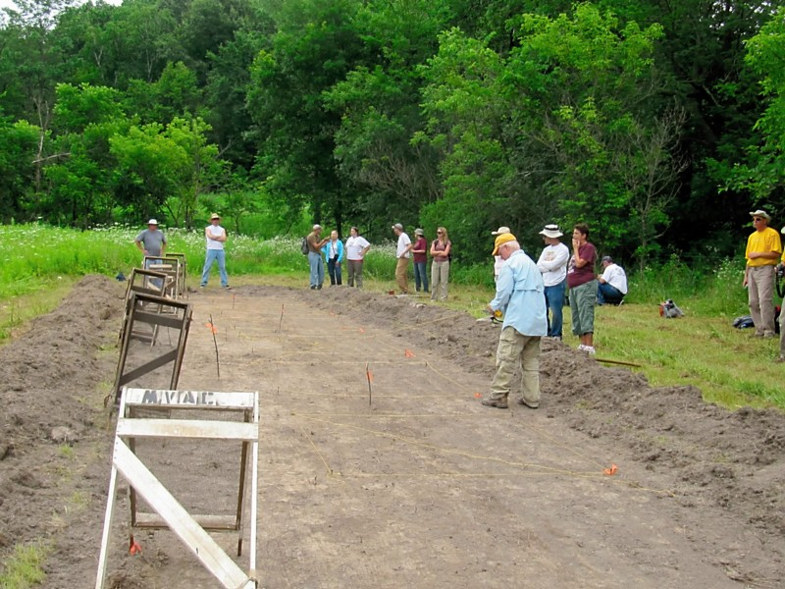
Site Excavation
A grid system is used to mark individual units within the dig site
Here six 2x2 meter squares are laid out (yellow string are placed in corners defined by spikes)

Slide 4
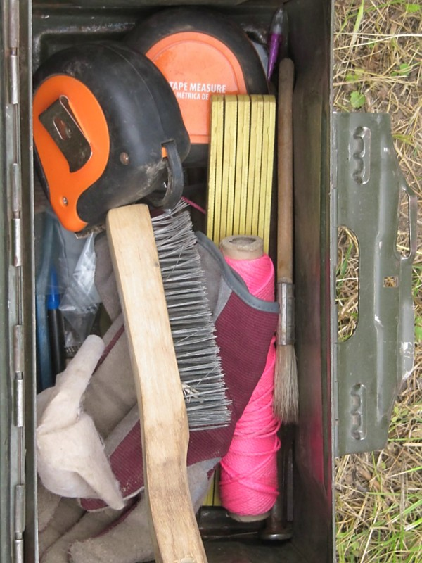
Tools
Tape measure
Line level
Trowels
Paint brushes
Wire brush
Metal file
Gloves
Paper/pencil

Slide 5
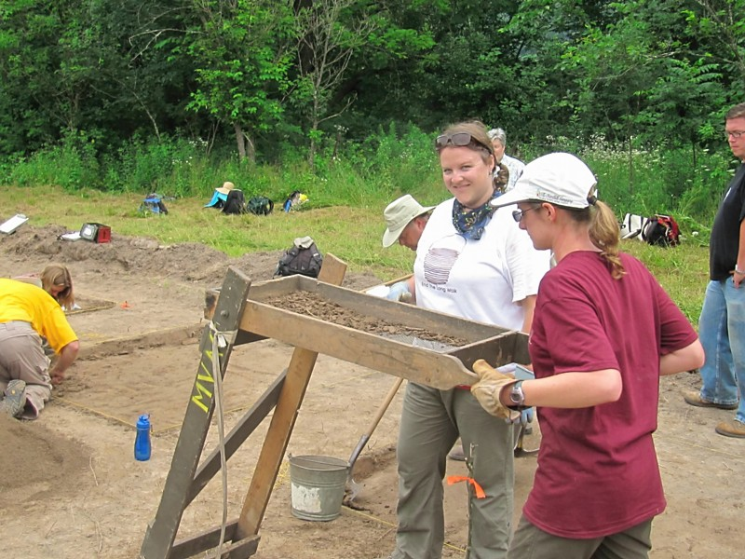
Tools
Screen for sifting soil
These screens are moved back and forth. Soil falls through the ¼” mesh and artifacts are removed and bagged to be removed and cataloged back at the lab.
Buckets are used for transferring soil

Slide 6
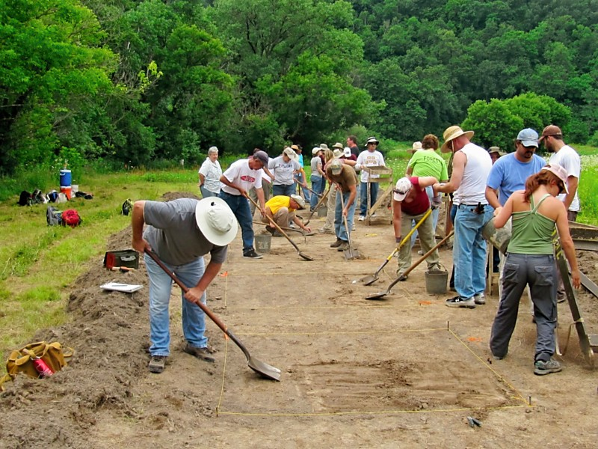
Tools
Flat shovels used to skim soil from within levels of each unit
Levels may vary in depths from 5cm+
These six units were being dug at 10cm depths

Slide 7
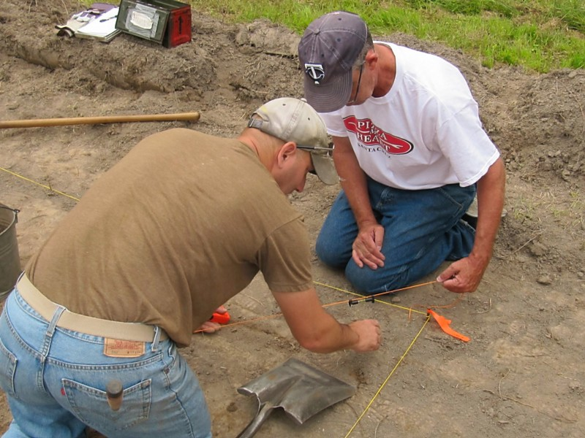
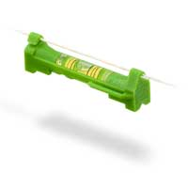
Checking Level Depths
String and a line level are used to check depths of levels
In this case there was a slope at the sight and measurements were taken from the high corner
Notice how the shovel is laying

Slide 8
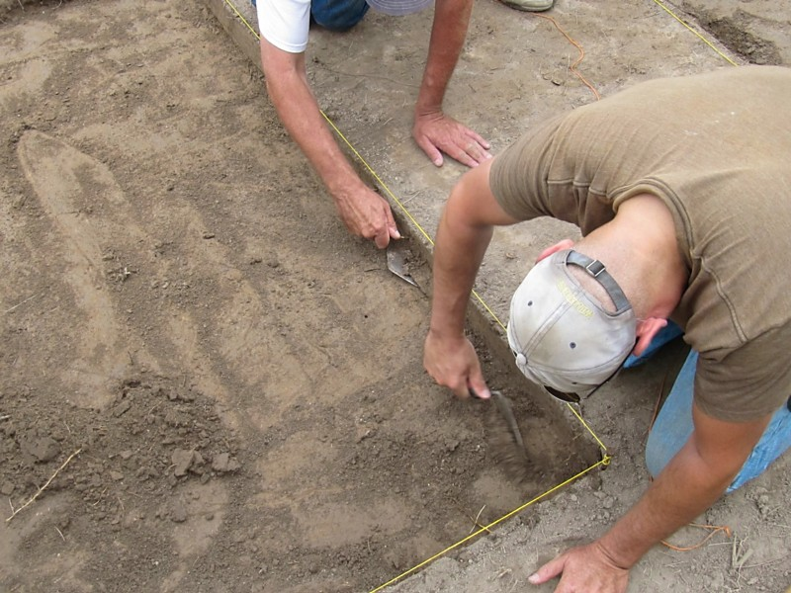
Cleaning Up the Sides and Corners
Sharpened trowels are used to clean up and smooth side walls and corners as levels are completed
This allows for viewing color variations

Slide 9
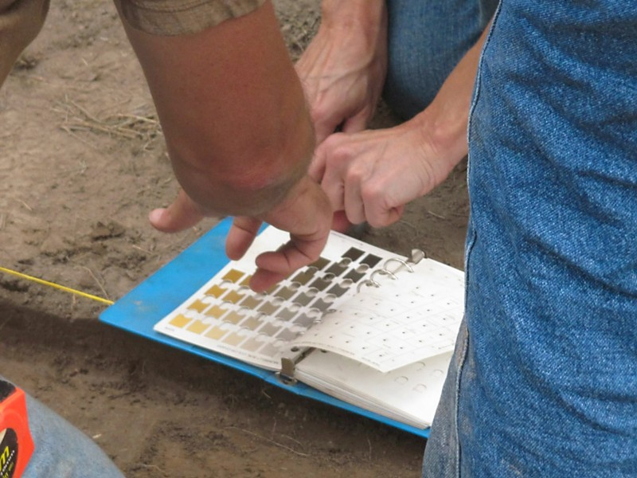
Soil Color
A Munsell soil chart is used to identify soil color
Moist soil is placed behind the pages and the color is chosen that best matches the sample

Slide 10
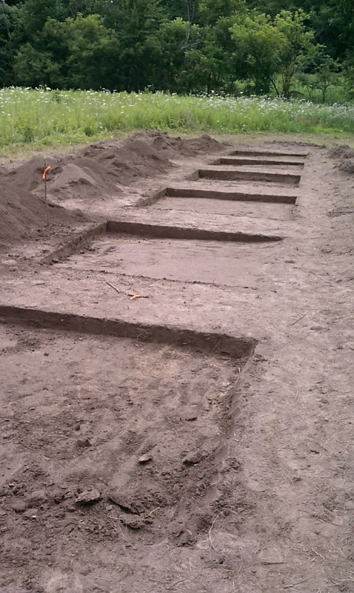
Post Excavation
Screened soil is placed back in the areas that have been excavated
Remember the excavation destroys the site. Never dig unless there are question that must be answered

Slide 11
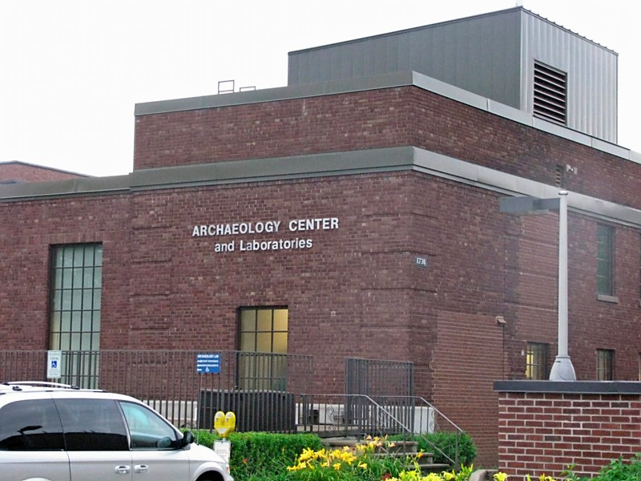
Processing Artifacts
Back at the lab artifacts are washed in water and dried
The artifacts are followed through the process with appropriate paperwork

Slide 12
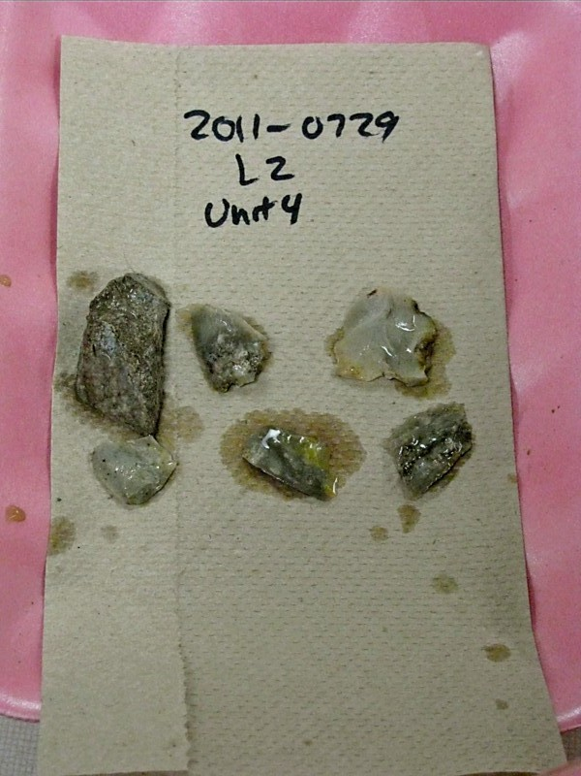
Tracking Artifacts Through the Cleaning Process
All artifacts are tracked carefully as they move through the lab

Slide 13
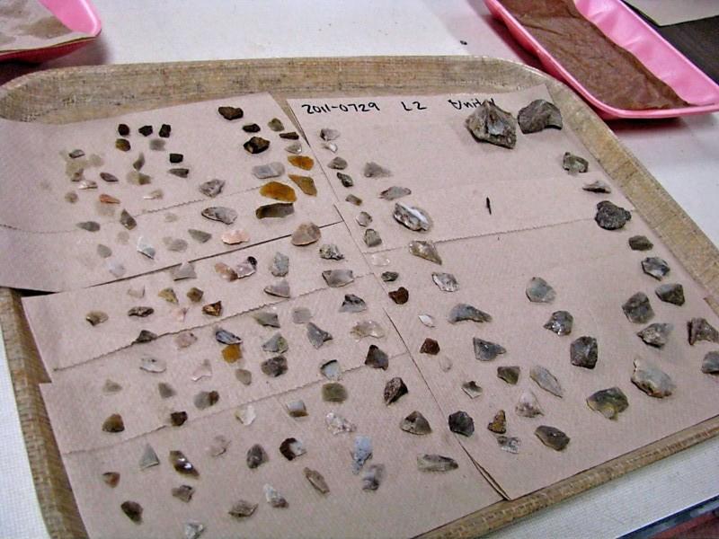
One 10cm level in a 2m x 2m unit
Most of these are flint flakes that were made ~1000 years before present by Native-Americans while they made arrow and spear heads

