Slide 1
Safe Harbor Petroglyphs
Susquehanna River, Pennsylvania

Slide 2
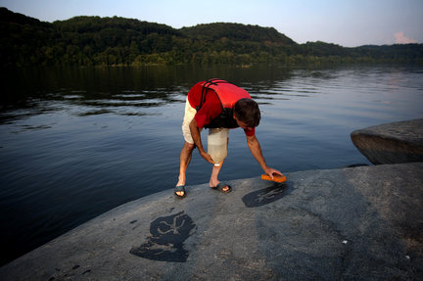

Slide 3
Rock Art
Picto = to paint
Graph = to write
Petro = rock
Glyph = carved work

Slide 4



Symbols
What do these symbols represent?

Slide 5
What was the purpose of petroglyphs?
Petroglyphs are a form of symbolic communication.
Archaeologists analyze rock art figures and patterns and have ideas, based on research, about the possible purposes of petroglyphs:
Tribal boundary markers
Teaching rocks – to pass along the beliefs and values of the tribe to the children
Markers of sacred places for meditation or to receive guidance from the spirits

Slide 6
Susquehanna River Petroglyphs
The lower Susquehanna river has the highest concentration of petroglyphs in the NE, with more than 1000 separate carvings at only 10 sites. Many of the petroglyphs have been submerged or removed due to dam construction along the river.

Slide 7

Safe Harbor Site – Big and Little Indian Rocks – First recorded in 1863

Slide 8
Animal Glyph from Safe Harbor Site, on display at the Blue Rock Heritage Museum in Washington Boro, Lancaster, PA.
The Safe Harbor petroglyphs are thought to have been carved 1,000 years ago. Archaeologists and historians are not sure which native people carved them, but the most commonly held belief is that the carvings were done by people of the Shenks Ferry culture.

Slide 9
Where can we see Safe Harbor petroglyphs?
The mosaic tiles in the PA State Capitol depict seven different designs from the petroglyphs. You can also see some of the petroglyphs that were removed when the dam was built and were put on display at the PA State Museum. Look for them on your field trip! The petroglyphs on the rocks in the Susquehanna River are only accessible by boat and are best viewed at sunrise or sunset.

