Slide 1
Creating a “Works Cited” Document for an Archaeology Project
By Carol Mills
NEH Summer Institute
UW-La Crosse
July 2011

Slide 2
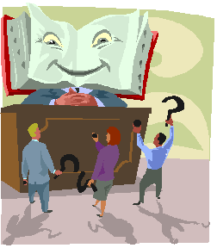
What is a “Works Cited” document?
A “works cited” document is a list of all the resources you used to find information for your final project.
We used to call them “bibliographies.” You may have heard that term.
Ask your teacher what he/she wants you to call your list. That will be your title.
Notes:
Prompt students to tell you what “resources” are. Ask why we no longer use the term bibliography. Point out spelling of “cited.”

Slide 3

Step one in creating a Works Cited Document
Ask your teacher what style guide he/she wants you to use.
The three major style guides are: Modern Language Association, American Psychological Association, and Chicago.
They are VERY different. Be sure you use the correct guide.

Slide 4
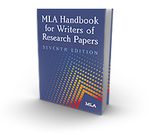
Modern Language Association
(MLA)
Use the MLA Handbook to cite your sources when you are doing a project for your liberal arts or humanities classes (such as English or French or art), or when your teacher tells you to.

Slide 5
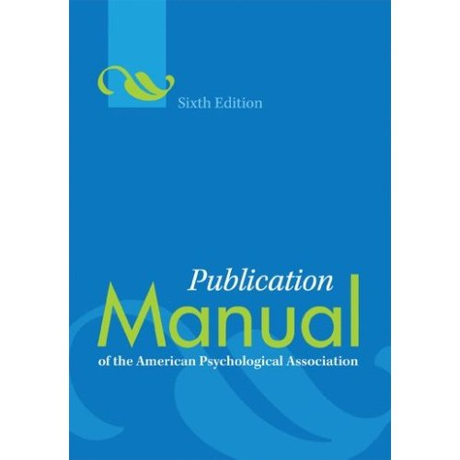
American Psychological Association
APA
Use the APA Publication Manual when you are doing a project for your social or behavioral science classes (such as psychology or sociology) or other science classes (such as biology or chemistry), or if your teacher tells you to.
Notes:
Advise students that what style is used is at the discretion of the teacher. These are guidelines and not rules.

Slide 6
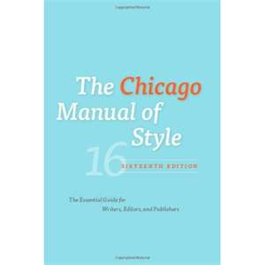
The Chicago Manual of Style
Use the Chicago Manual of Style to write papers in your journalism or history class, if you are going to publish your paper, or if your teacher tells you to. Some science teachers also use the Chicago Manual of Style. This is the style guide that most archaeology students use. (Practicing archaeologists use the Society for American Archaeology Publication Guide, but you may wait to use that one until you are actually working as an archaeologist.)
Notes:
Tell students that this is the style manual that you will demonstrate since their project is in archaeology.

Slide 7

First Things First!
The minute you begin to gather information from a source, before you ever write a note or copy and save anything, OPEN A WORD DOCUMENT .
Title this document using the title your teacher wants you to use (such as “Works Cited,” “Resources,” “Reference List,” or even “Bibliography”).
Write your entry for the source you are going to use and SAVE YOUR DOCUMENT.
Works Cited
David J. Meltzer, First Peoples in a
New World. Los Angeles: University
of California Press, 2009.
Notes:
Ask students to tell you why you need to write your bibliography entry first and save it.

Slide 8

As you work:
When you begin to gather information from other sources, open this saved document and add entries as you gather information
Alternatively, you may gather the information I’m going to tell you about on a “bib card” and compile your “Works Cited” document at the end of your project, but writing the entry as you gather information will save you time. Just remember:
DO THIS BEFORE YOU BEGIN GATHERING INFORMATION FROM EACH RESOURCE YOU USE. AND REMEMBER TO SAVE EVERY TIME YOU ADD AN ENTRY!

Slide 9
How to Write an Entry for a Book with One Author
Using the Chicago Style Manual
Author’s name , Book Title (in italics). City of publication: Publisher, year of publication.
Meltzer, David J., First Peoples in a New World. Los Angeles: University of California Press, 2009.
http://www.amazon.com/First-Peoples-New-World-Colonizing/dp/0520267990/ref=sr_1_1?ie=UTF8&qid=1311635572&sr=8-1#reader_0520267990
Ask your teacher or your librarian how to cite other kinds of books (for example, with more than one author, from and encyclopedia, with multiple authors, in an anthology, etc.).
Notes:
Admonish students to PAY ATTENTION TO PUNCTUATION AND INDENTATION. Show students where to gather information.

Slide 10


How to Write an Entry for an
Online Database Using the Chicago Style Manual
Online periodicals are cited exactly as their print counterparts with the addition of a URL at the end of the citation.
Author’s name, title of article. Title of Periodical. Volume, no. (year of publication), page numbers. url.
James L. Theler and Robert F. Boszhardt. Collapse of Crucial Resources and Cultural Change: A Model for the Woodland to Oneota Transformation in the Upper Midwest. American Antiquity. 71, no. 3 (2006), 433-472. http://web.ebscohost.com/ehost
Leave off the url (Internet address) if you actually have the journal in your hands.
Notes:
Tell students that most of the information they gather from online databases such as EBSCO will be from journals. They need to look at the handout for information for writing entries for online encyclopedias, e-books, etc.

Slide 11

Websites are different. Pay attention!
The most basic entry for a website consists of the author name(s), page title, website title, web address, and date accessed.
Leave out anything you can’t find, but ask your teacher or librarian to help you find the information first.
Hirst, K. Kris. “Folsom Culture.” About.com. http://archaeology.about.com/od/fterm
    /qt/folsom.htm (accessed July 20, 2011).

Slide 12

What if you get information from an artifact?
The Chicago Style Manual does not tell how to cite an artifact.
Some people think they do not need to be cited because they aren’t “published.”
Most archaeologists describe them in the body of their article or project. Here is how to do that:

Slide 13
Describing an
Artifact in the Body of Your Paper or Project
First give name of the artifact and where it is from (include site number and location within the site if you have that information).
State that the artifact is courtesy of the institution or person allowing you to use it and give the location of that institution or person.
Include the museum catalog number and or accession number if you have that information.
If you are using a photograph of the artifact, include the name of the photographer if you have that information.

Slide 14
Here are some examples:
Figure 10. Meadowood cache bifaces from the Hunter and Muskalonge Lake sites. Courtesy of the New York State Museum, Albany, NY (Photo Karine Taché).
Figure 1. Palettes from the Etowah site: EM-378. Courtesy of the Etowah Indian Mounds Museum, Georgia Department of Natural Resources.
Bomb fragments from Waialua, HI, 7 December 1941. Courtesy of Ross Moody, personal collection.

Slide 15
Any questions?

Slide 16
Remember . . . . .
If you don’t know what to do,
Ask your librarian!

Slide 17
Works Cited
“The Chicago Manual of Style.” NAIWE. http://news.naiwe.com/files/chicago-manual-16th.jpg (accessed 25 July 2011).
“Citation Guide.” bibme. http://www.bibme.org/citation-guide/Chicago., (accessed 25 July 2011).
“Citation Manuals.” Baker University. http://www.bakeru.edu/library2/library-resources/citation- manuals (accessed 25 July 2011).
“Editorial Policy, Information for Authors, & Style Guide.” Society for American Archaeology. http://saa.org/AbouttheSociety/ Publications/StyleGuide (accessed 25 July 2011).
“MLA Handbook for Writers of Research Papers.” MLA. http://www.mlahandbook.org (accessed 25 July 2011).
Nullet, Kathleen. “How to Cite Sources,” Kailua Intermediate School. http://kailuain.k12.hi.us/library/lmc/kislibrary.html (accessed 25 July 2011).
Steponaitis, Vincas P. , Samuel E.Swanson, George Wheeler, and Penelope B. Drooker. “The Provenance and Use of Etowah Palettes.” American Antiquity, (January 2011) 81- 106.
Taché, Karine. New Perspectives on Meadowood Trade Items.” American Antiquity. (January 201) 41-79.

