Slide 1
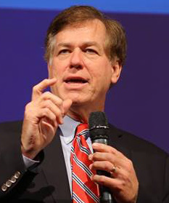
Russell Cleary Leadership Lecture Featuring
Harry M. Jansen Kraemer, Jr.
Executive partner with Madison Dearborn
Partners, Chicago
Clinical Professor of Strategy, Northwestern
University, Kellogg School of Management
Monday, Oct. 29, 2018
5:30 p.m.
Hesprich Auditorium in Graff Main Hall on the UWL Campus.
Register at www.uwlax.edu/cei/events

