Slide 1
PURCHASING CARD
ORIENTATION

Slide 2
PCARD OVERVIEW
Purpose:
Travel
Membership Renewals
Conference registrations
Credit Limits:
$5,000 per transaction
$5,000 per billing cycle
Billing cycle = 2 weeks
Billing cycle calendar (see Resources slide for link)

Slide 3
CARD SECURITY & FRAUD
Card Security:
Keep your PCard secure when carrying with you or keep in locked office/desk/cabinet
Do not let others use your PCard. This includes providing your PCard number for someone else to make a purchase.
Lost or stolen card? IMMEDIATELY contact US Bank at 800-344-5696. US Bank will close your account and issue a new card.

Slide 4
CARD SECURITY & FRAUD
Fraud:
If you suspect fraudulent activity:
Immediately contact US Bank: 1-800-344-5696
Notify UWL Purchasing Services
If US Bank contacts you regarding fraudulent activity:
Return the call as soon as possible – your PCard will be frozen until US Bank confirms with you whether or not the transaction they are questioning is fraudulent.
US Bank does not have your personal information (birthdate, social security number) and will ask you to identify through work related information (last four digits of your of employee ID, your office phone number or campus address).

Slide 5
MAKING A PURCHASE
Activation Code: The last four digits of your employee ID will activate your PCard.
Ineligible Vendor Listings: Check vendor eligibility before making a purchase: https://doa.wi.gov/Documents/DEO/CertList.pdf
Split/Serial Purchasing: Do not break up purchases to avoid credit limits.
Sales Tax: UWL is tax exempt; the sales tax exemption number is listed on the PCard in the upper right corner. Cardholder is responsible for reimbursing the university for any sales tax charged, if not credited by vendor. Check your receipts!
Service fees/credit card processing fees: While not prohibited, these should be avoided. Request invoice from vendor.
Shipping Address: Always use the campus address for shipping.

Slide 6
MAKING A PURCHASE (Con’t)
Declines: If your PCard is declined, first call US Bank at the number on the back of the PCard to determine why the charge is declining. If US Bank cannot resolve the issue, contact pcards@uwlax.edu or Laurie Becker: lbecker@uwlax.edu or 608.785.8555.
Credits: If you receive a credit on a statement, you must submit a credit memo, credit receipt or provide a short narrative on why you are receiving the credit. Reference should be made to the statement on which the charge being credited originally appeared.
Vendor follow-up: It is the responsibility of the cardholder to follow-up with the vendor asap if there are any discrepancies on the statement versus the receipt provided by the vendor.

Slide 7
MAKING A PURCHASE (Con’t)
PCard use is being highly scrutinized and all purchases outside of travel, memberships and conference registrations are being funneled through ShopUW+ as the preferred method.
If the ShopUW+ catalog suppliers do not offer the required item, and if the supplier is eCommerce one (does not accept POs), then the PCard can be used.
When you can get a quote from a supplier and purchase through a non-catalog item request in ShopUW+, that is recommended instead of using the PCard.

Slide 8
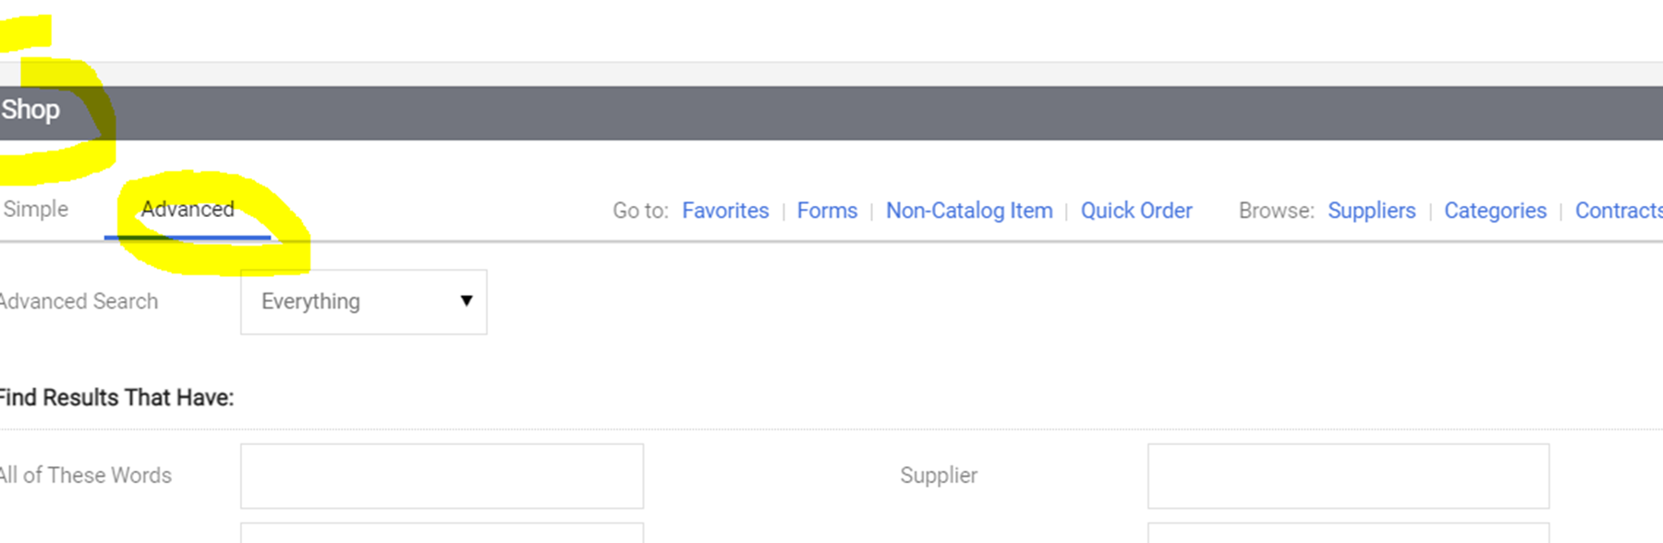
MAKING A PURCHASE (Con’t)
The advanced search in ShopUW+ should be used to search for an item on catalog before shopping outside of the catalog suppliers. Cardholders must attach to their PCard statement a screenshot of the results from their search (first page only if search returns multiple pages) with a note indicating why those options did not meet their needs.
Price alone is not an acceptable reason to use Amazon or other non-catalog supplier. If a significant price difference is found, the cardholder should email purchasing@uwlax.edu before proceeding with a PCard purchase based solely on a price difference.

Slide 9
PROHIBITED PURCHASES
Amazon Prime Memberships: Amazon Prime Memberships cannot be purchased with your PCard or any state funds. You may use your own Amazon Prime Membership if the order is tax-free and shipped to campus.
Greeting Cards: Greeting cards are not allowable on PCard.
Gifts: Gifts are not allowable on PCard unless they adhere to UW System Policy 330, Sec. C
Individual Meals: Meals while traveling should be paid for out of pocket and reimbursed through e-Reimbursement.
Personal Items/services: Non-business items and services are strictly prohibited.
Recurring Charges: charges billed automatically to your PCard without your review/approval
Other Non-reimbursable/payable expenses: https://www.uwlax.edu/business-services/our-services/expense-reimbursement/#tab-non-reimbursablepayable-expenses

Slide 10
SPECIAL PROCESS PURCHASES
Books: UWL has a contract with Follett for books; The campus bookstore should be used for all book purchases and only if Follet is unable to source the book can a PCard be used to purchase it elsewhere. Email Bookstore Manager Carlena Goddeau: cgoddeau@uwlax.edu
Cell Phones, Cellular Service, Phone Cards: Contact Information Technology Services via: https://www.uwlax.edu/its/technology-purchases/
Clothing: A Clothing Purchase Approval Form is required if the individual items are $75 or more:
https://www.uwlax.edu/globalassets/offices-services/business-services/forms/clothing-purchase-approval-form.pdf
Computers, Computer Equipment: Contact Information Technology Services via: https://www.uwlax.edu/its/technology-purchases/
Food: A Food Expense Approval Form is required: https://www.uwlax.edu/globalassets/offices-services/business-services/forms/2018.04.05-ap-food-approval-form.pdf

Slide 11
SPECIAL PROCESS PURCHASES (Con’t)
Furniture: Contact Campus Planning: planning-construction@uwlax.edu
New Memberships: New memberships must go through an approval process; renewal of membership may go on PCard. Membership policy https://www.uwlax.edu/globalassets/offices-services/business-services/forms/2021.08.25-membership-policy.pdf
Office Supplies: Mandatory contract with Staples. ShopUW+ should be used. Do not purchase directly from Staples.
Parking: Parking at lodging and transportation locations allowed. PCard can not be used for parking at other locations, such as event parking or public lots/garages.
Print: Contact Purchasing Services, Carly Martinco: cmartinco@uwlax.edu
Software: Software must be sourced from the State’s mandatory software reseller contract. Enter request into ShopUW+ and Purchasing will source.

Slide 12
STATEMENT PROCESSING
Statements are available in the US Bank Access Online portal.
Submission instructions can be found on the PCard website under PCard Statement Processing: https://www.uwlax.edu/business-services/pcard/
Due Date for approved statements is two (2) weeks from statement date.
Business purpose must be provided for every charge on the statement.
Business purpose should state why UWL needed the item, not restate what the item is.
Statements that do not contain business purposes for all charges will be returned to the cardholder.
Approvals are required from cardholder and their supervisor
Physical signature on statement, or email with words ‘Approve’ or ‘Approved’
Expense Transfers – funding changes can be made online through the US Bank Access Online portal via Transaction Management or after the charges are in WISER, the Cost Transfer Tool can be used.
Audit Process – UWL, UW System and the DOA all audit PCard statements.
Don’t use abbreviations or acronyms

Slide 13
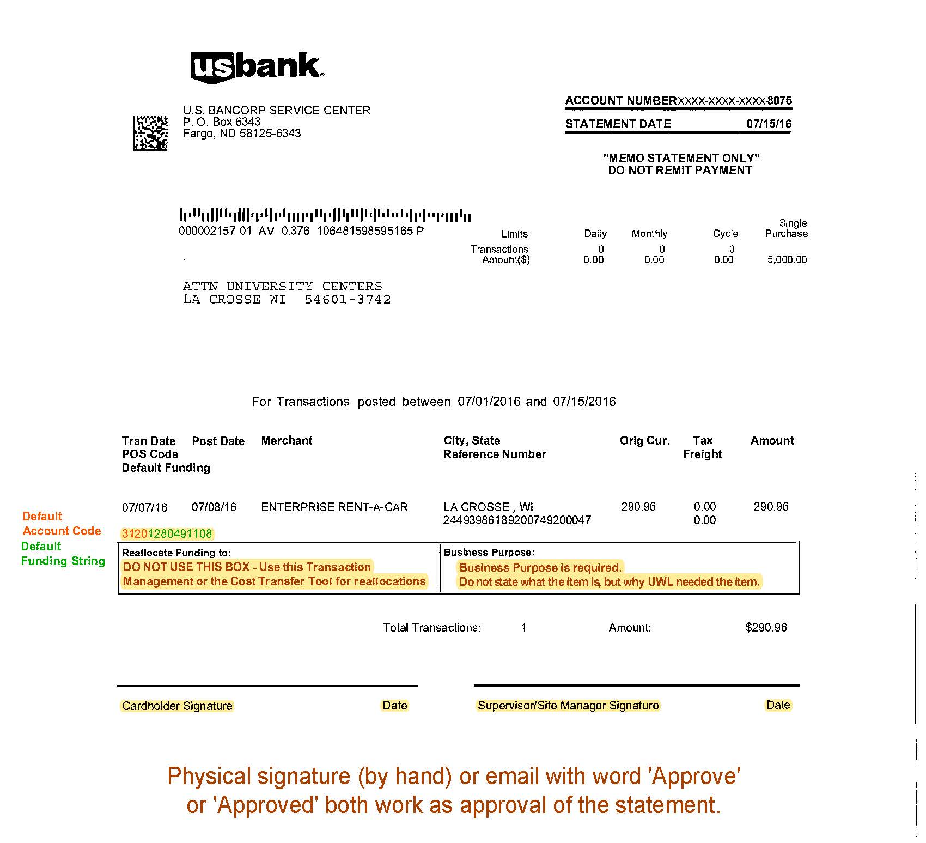
EXAMPLE STATEMENT

Slide 14
SUPPORTING DOCUMENTATION for STATEMENT SUBMISSION
All charges on your PCard statement must have an accompanying itemized receipt.
Airfare charges must be accompanied by the TravelWise confirmation/invoice AND a conference/meeting agenda or registration confirmation.
Hotel/Lodging receipts must be accompanied by a copy of the conference/meeting agenda or registration.
Rental Car receipts must be accompanied by a copy of the conference/meeting agenda or registration. The rental car receipt submitted must be the receipt received after returning the vehicle, not the rental agreement signed at the time of rental.
Gasoline receipts must be accompanied by a copy of the rental car agreement or receipt.

Slide 15
SUPPORTING DOCUMENTATION for STATEMENT SUBMISSION (Con’t)
Food/Meals must be accompanied by a pre-approved Food Expense Approval Form: https://www.uwlax.edu/globalassets/offices-services/business-services/forms/2018.04.05-ap-food-approval-form.pdf.
Clothing over $75 each item must be accompanied by a pre-approved Clothing Purchase Approval Form: https://www.uwlax.edu/globalassets/offices-services/business-services/forms/clothing-purchase-approval-form.pdf
Prizes/Awards/Gifts must be accompanied by a pre-approved Prizes, Gifts and Awards Form: https://www.uwlax.edu/globalassets/offices-services/business-services/forms/prizes-awards-or-gifts-approval-form-updated-12.21.2021.pdf

Slide 16
RESOURCES
UWL Purchasing Cards: https://www.uwlax.edu/business-services/our-services/purchasing/#tm-purchasing-card--pcard-
UW System Purchasing Card Policy & Procedure Manual: https://www.wisconsin.edu/financial-administration/download/special_topics/purchasing_cards/Pcardmanual-12.06.21.pdf
Purchasing Card Billing Cycle Calendar:
https://www.uwlax.edu/globalassets/offices-services/business-services/procedures/pcard-calendar-2022.pdf
Purchasing Services: Laurie Becker, lbecker@uwlax.edu or Shelle Gholson, sgholson@uwlax.edu or pcards@uwlax.edu

