Slide 1
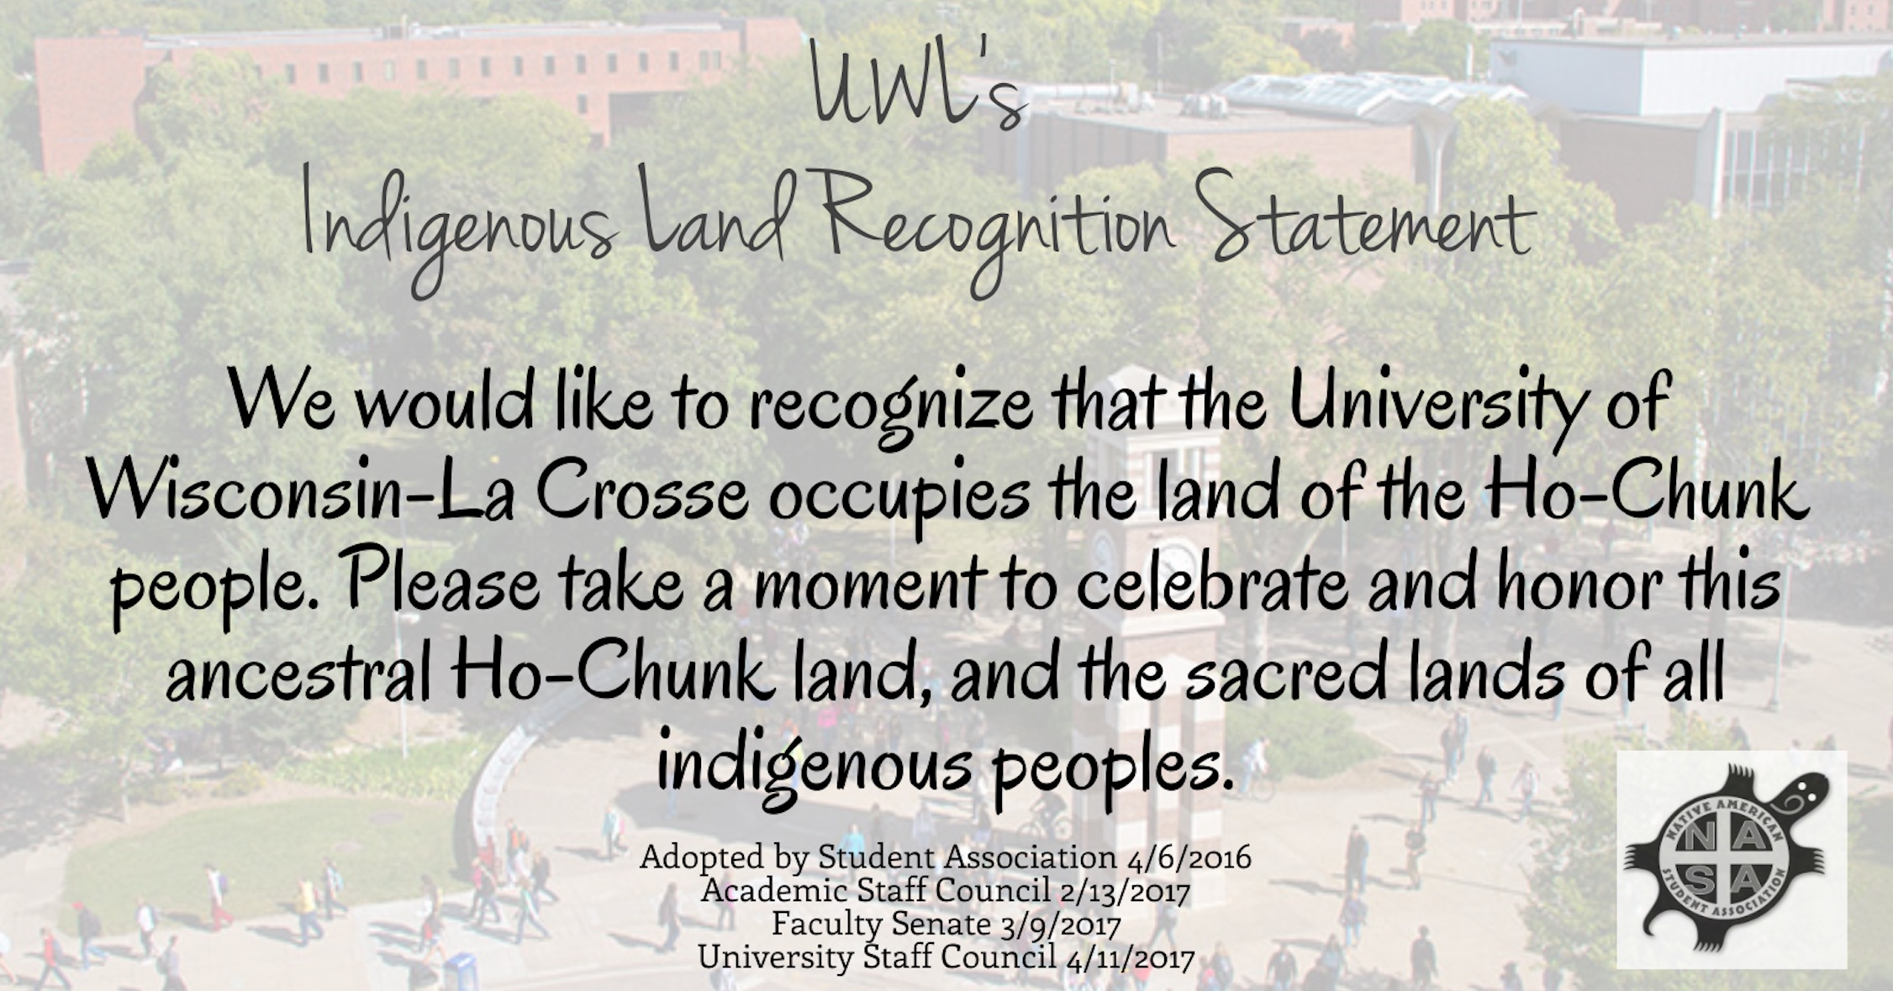
Notes:
Laura: We would like to begin by recognizing that the University of Wisconsin – La Crosse occupies the land of the Ho-Chunk people. Please take a moment to celebrate and honor this ancestral Ho-Chunk land, and the sacred lands of all indigenous people.

