Slide 1
JCES Sustainability Survey
2021-2022

Slide 2
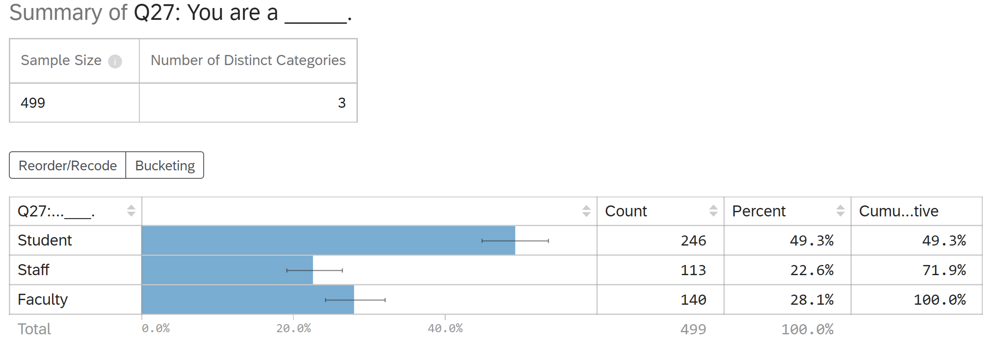
Q27: You are a ____

Slide 3
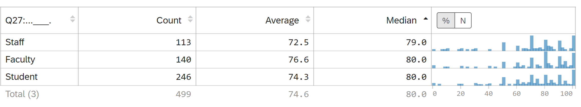
Q1 Rate your personal interest/investment in issues of environmental sustainability
Scale: 1-100, 1 equals no interest.

Slide 4
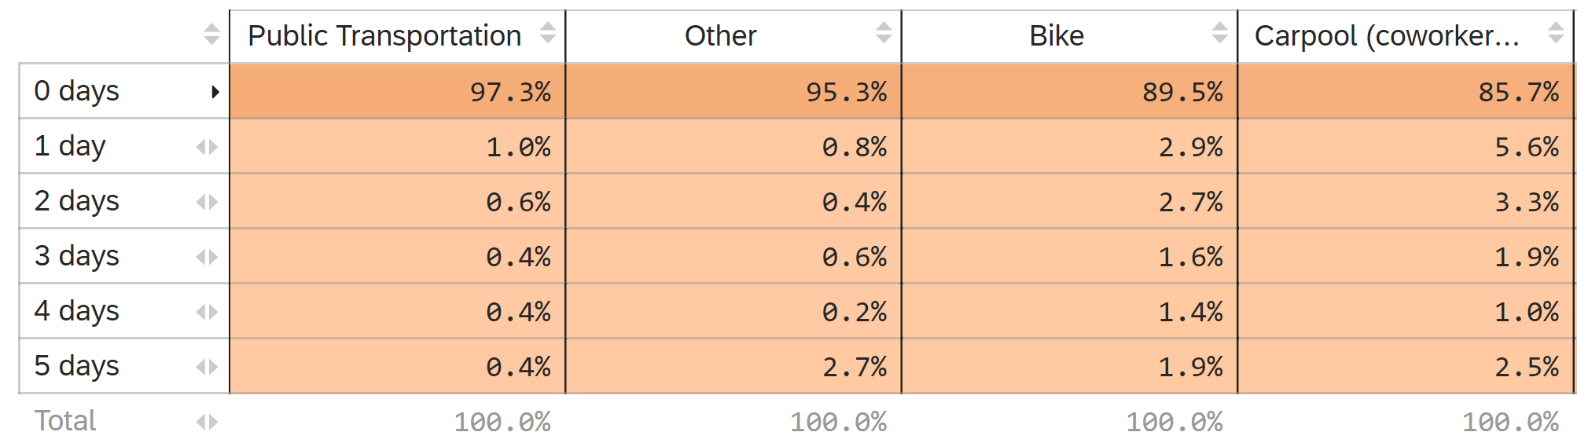
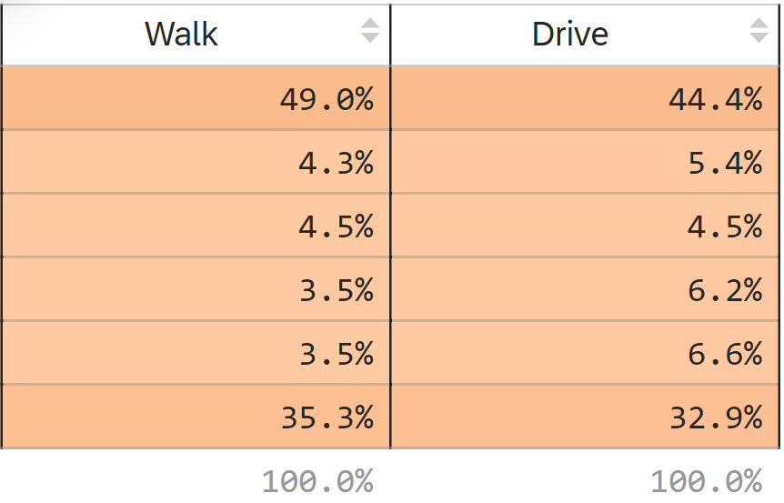
Q2 On average how do you currently transport yourself to campus?

Slide 5
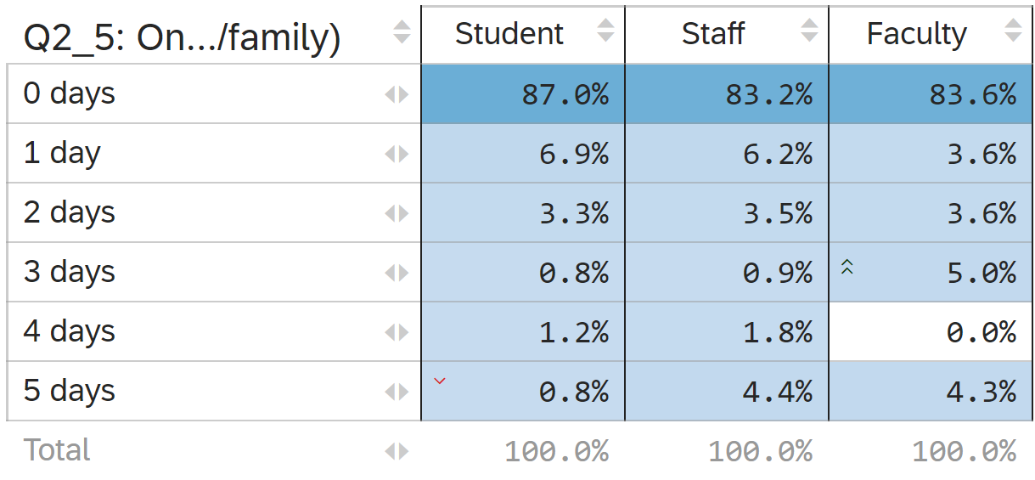
Q2 Carpool vs Q27

Slide 6
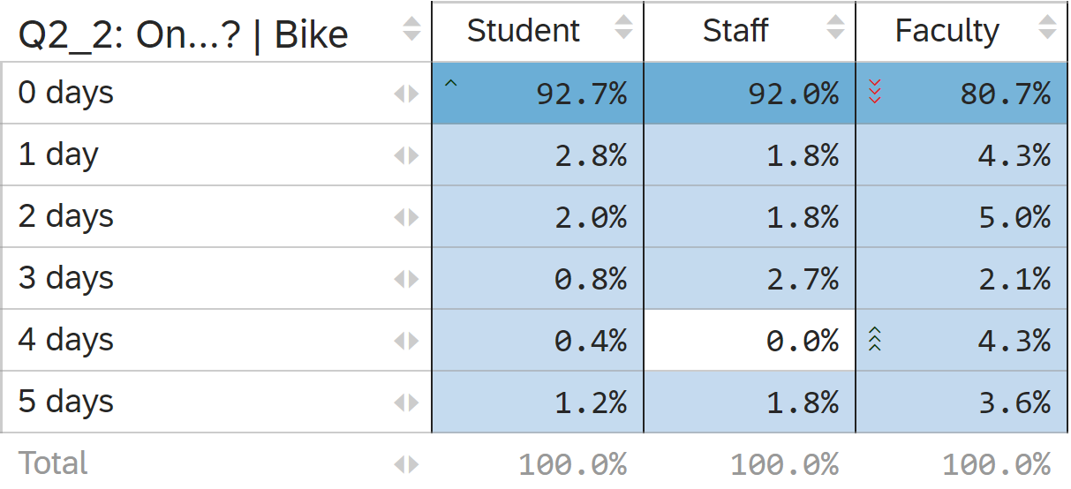
Q2 Bike vs Q27

Slide 7
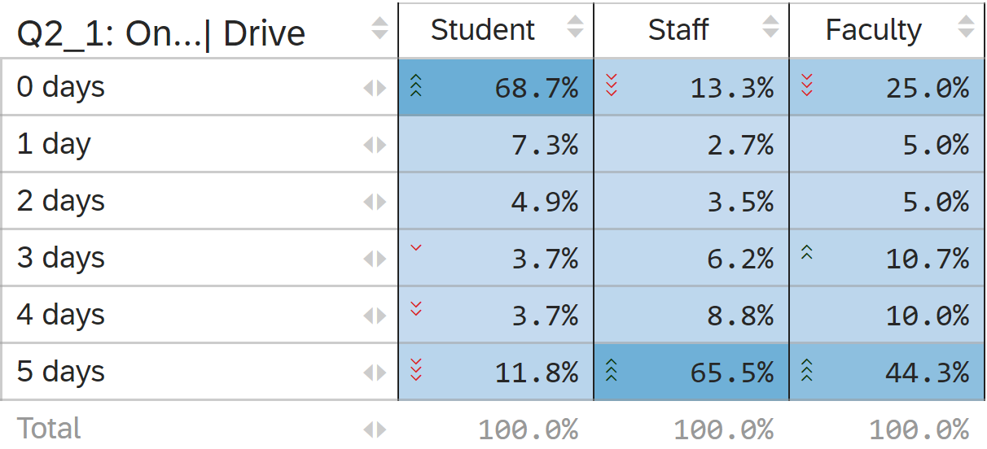
Q2 Drive vs Q27

Slide 8
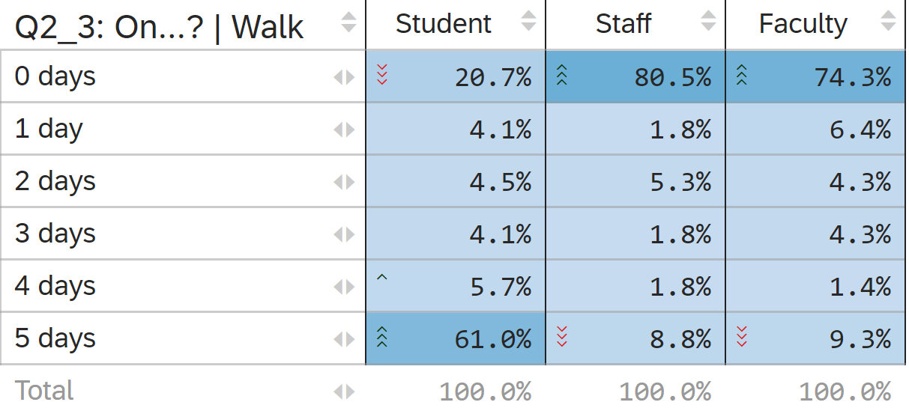
Q2 Walk vs Q27

Slide 9
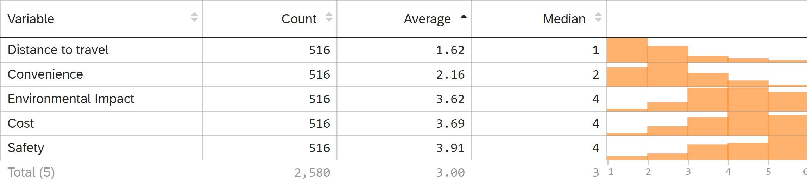
Q3: Rank the influence of each of these factors in your decision for mode of transportation to campus (from most important to least important)

Slide 10
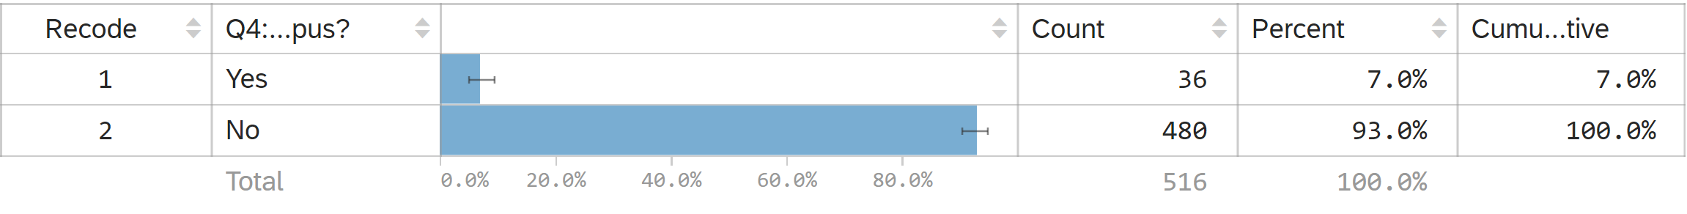
Q4: Has the COVID-19 Pandemic influenced the ways to get to campus?

Slide 11
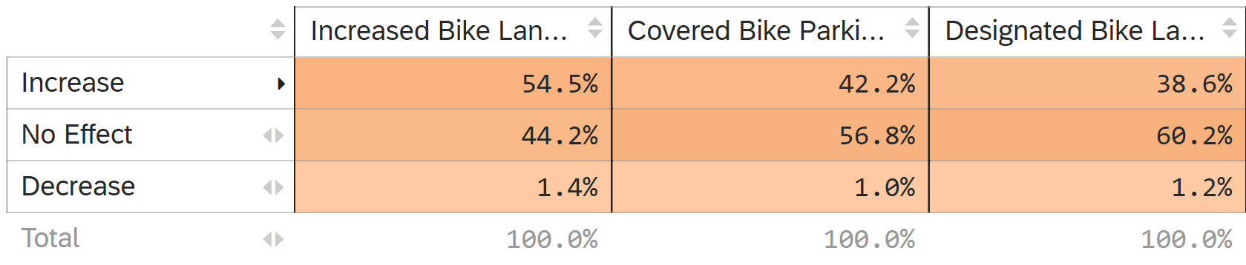
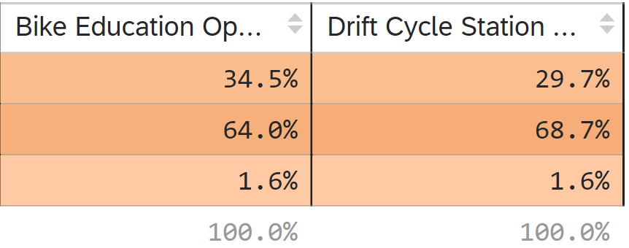
Q9: Please indicate how the following changes would impact your likelihood of biking to campus.

Slide 12
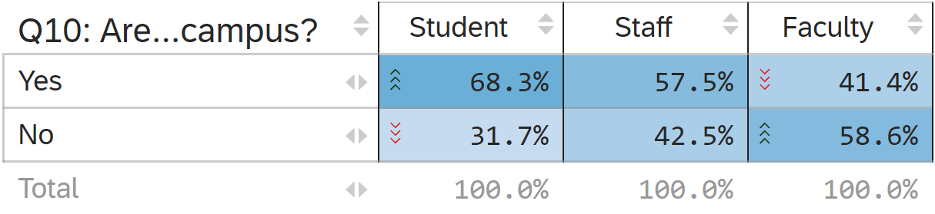
Q10 Are you concerned about bike theft on campus vs Q27

Slide 13
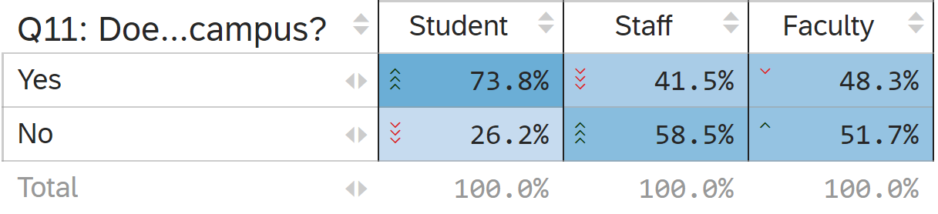
Q11: Does your concern about bike theft negatively impact your likelihood to bike to campus? Vs Q27
Only respondents who said yes to Q10 saw this question.

Slide 14
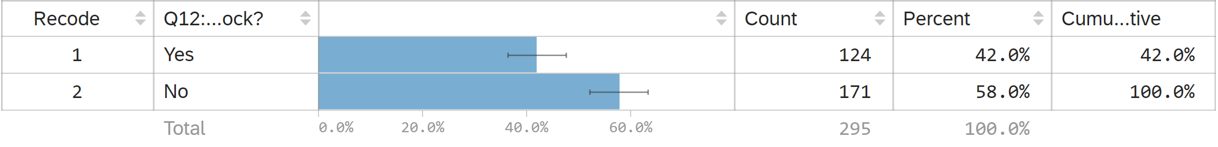
Q12: Do you currently own a U-Lock?
Note: Only respondents who said they were concerned about bike theft on campus saw this question (yes to Q10)

Slide 15
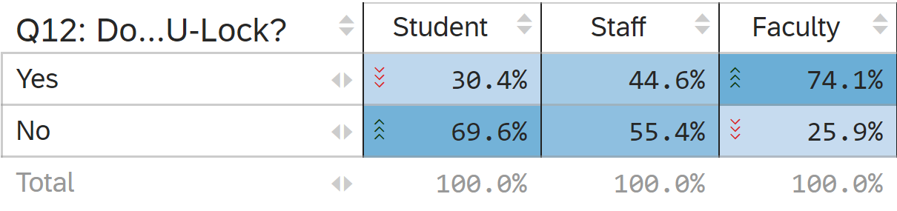
Q12 vs Q27

Slide 16
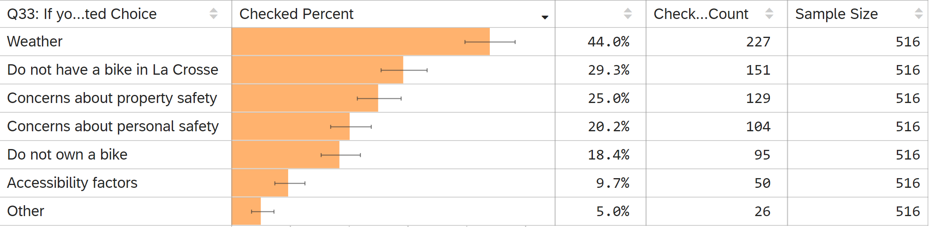
Q33: If you do not currently bike to campus, what prevents you from doing so? (Select all that apply) (optional)

Slide 17
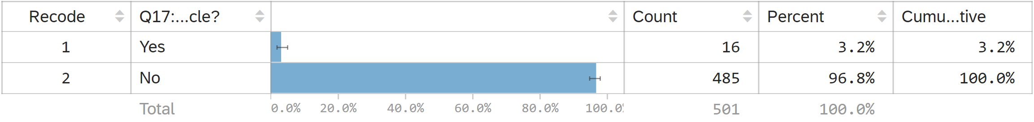
Q17: Do you currently own an electric/plug-in-hybrid vehicle?

Slide 18
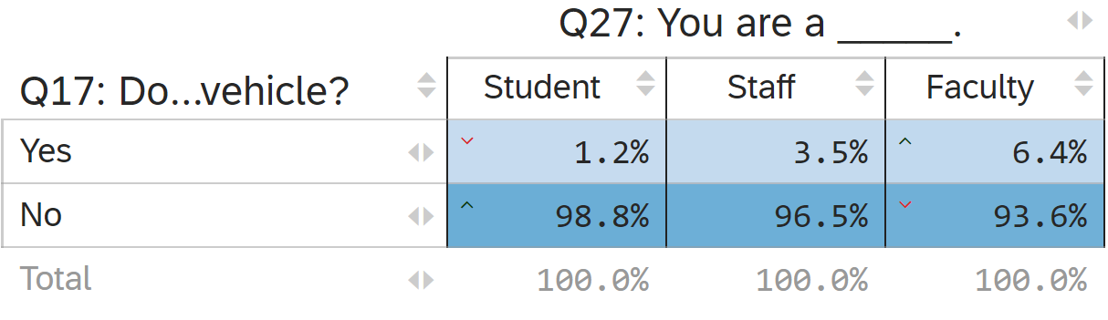
Q17 vs Q27

Slide 19
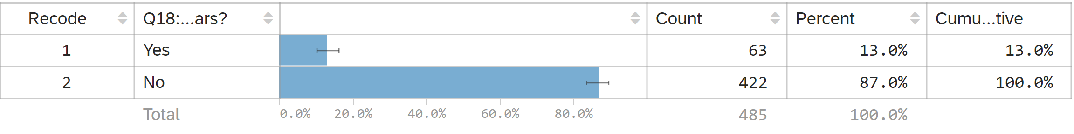
Q18: Do you expect to own an electric/plug-in-hybrid vehicle in the next 2 years?
Only respondents who said no to Q17 saw this question

Slide 20
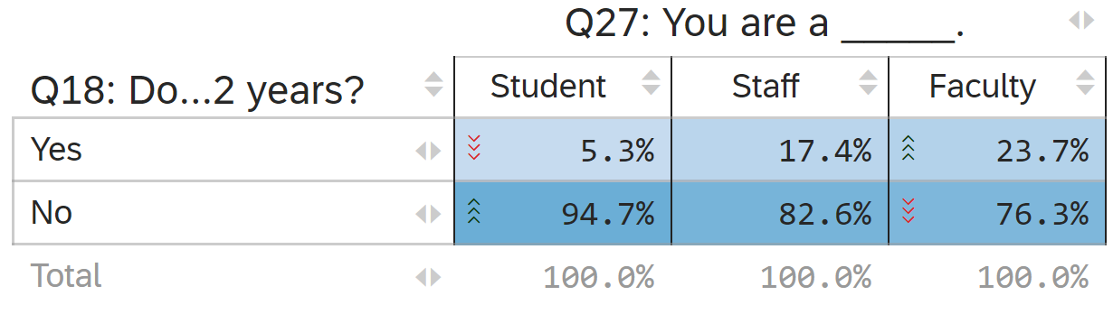
Q18 vs Q27

Slide 21
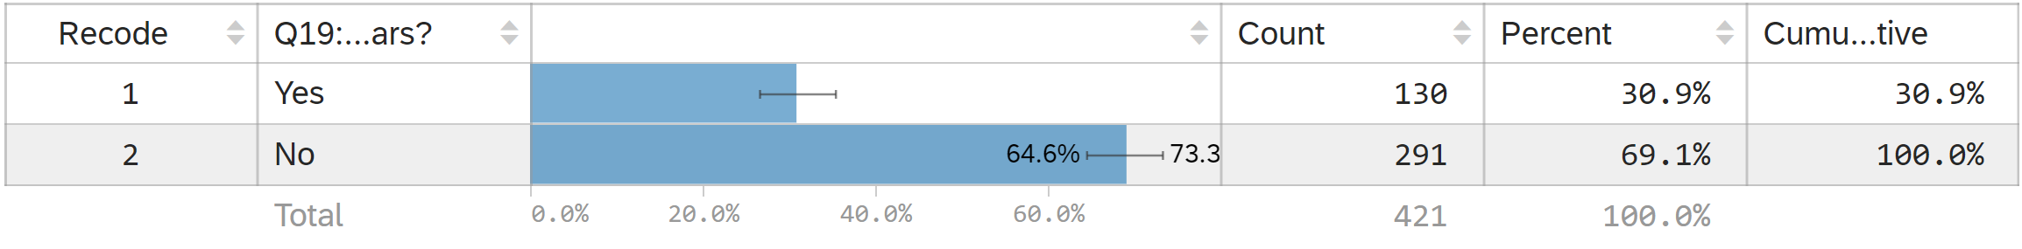
Q19: Do you expect to own an electric/plug-in-hybrid vehicle in the next 5 years?
Only respondents who said no to Q18 saw this.

Slide 22
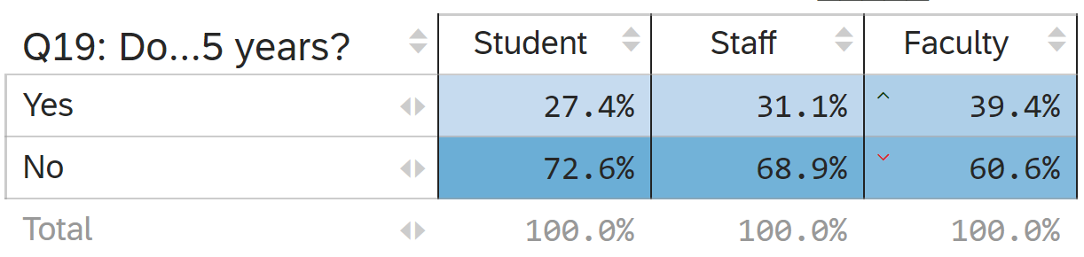
Q19 vs Q27

Slide 23
Net E-Car/Plug-In Hybrid Ownership (5year)
Summed number of respondents who currently own a E-Car/Plug-in hybrid and those who plan to own in 2 years and 5 years
  Students:
    Sum: 78 respondents, 78/246 – 31.7%
  Staff
    Sum: 51 respondents, 51/113 – 45.1%
  Faculty
    Sum: 79 respondents, 79/140 – 56.4%
Net Results
  Sum: 208 respondents, 208/499 – 41.7%

Slide 24
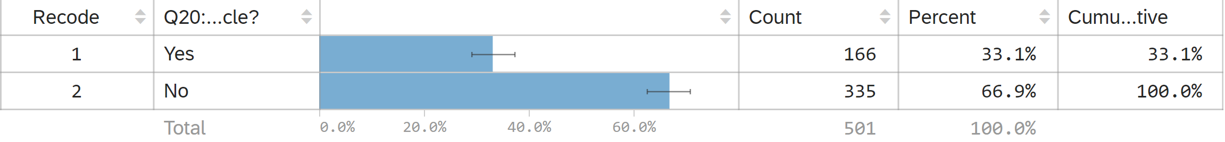
Q20: Do you have reservations about purchasing an electric vehicle?

Slide 25
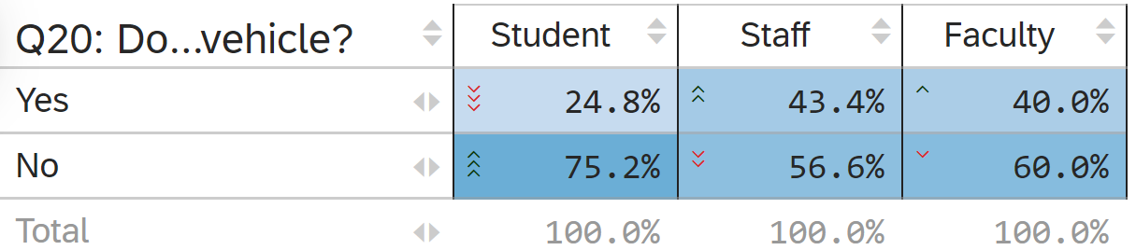
Q20 vs Q27

Slide 26
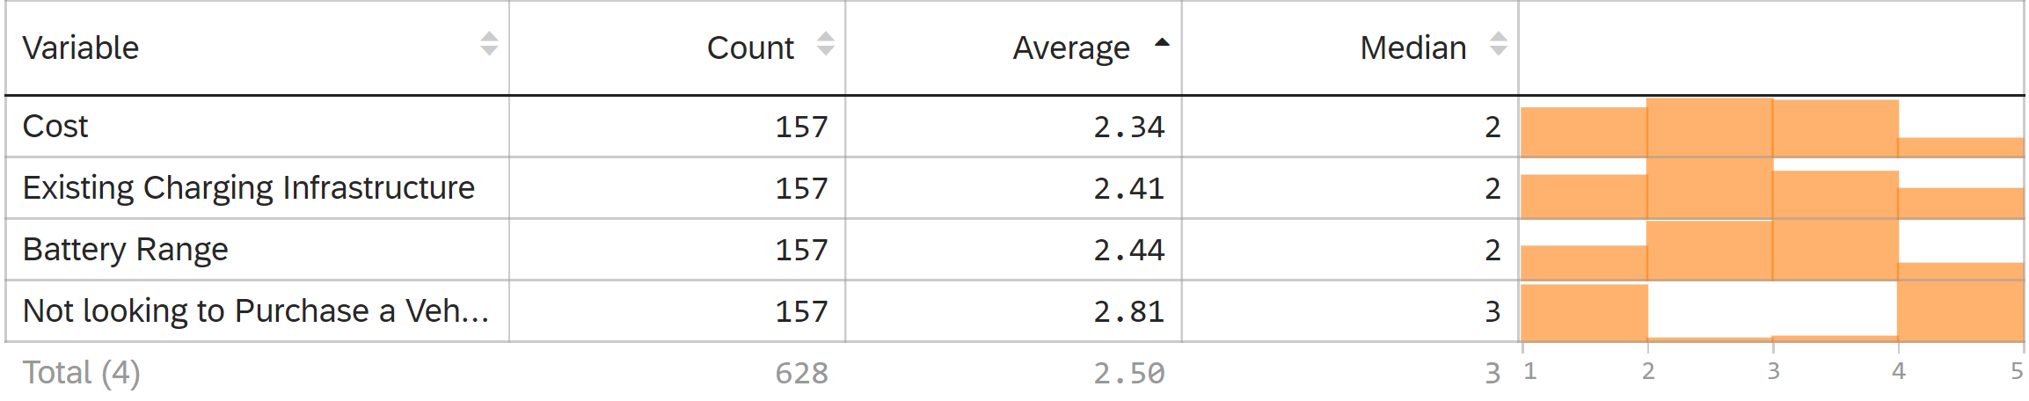
Q22: Please rank the following options, from most influential to least, in your reservations about owning an electric car.

Slide 27
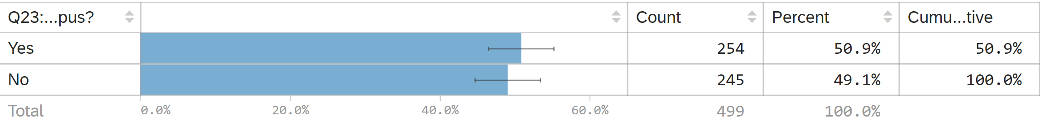
Q23: Would you be more likely to purchase an electric/plug-in-hybrid vehicle if there were charging stations on campus?

Slide 28
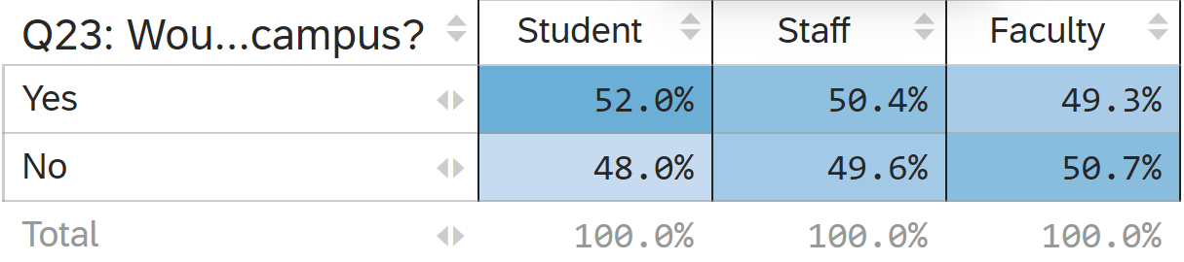
Q23 vs Q27

Slide 29
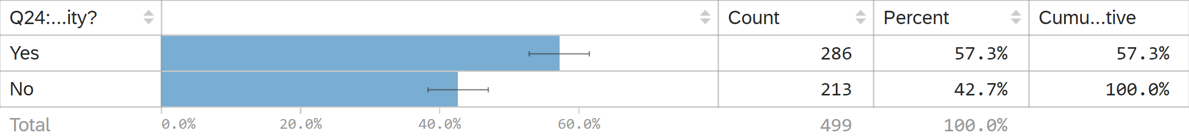
Q24: Would you be willing to pay for the electricity you used if charging stations were provided by the university?

Slide 30
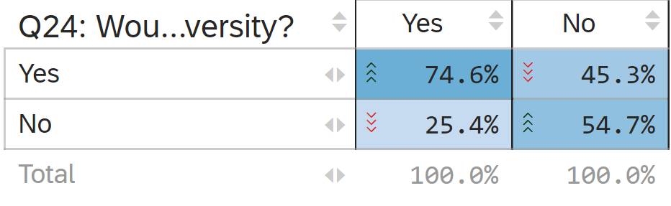
Q24 vs Q19 (E car ownership in 5 years)

Slide 31
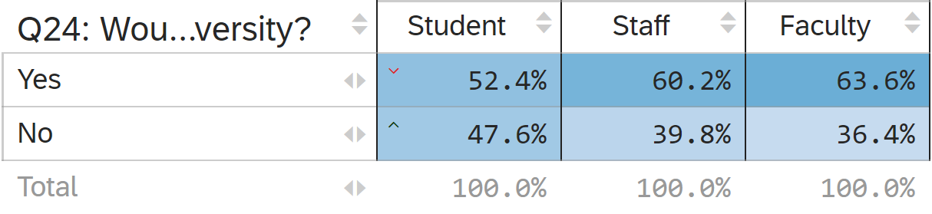
Q24 vs Q27

Slide 32
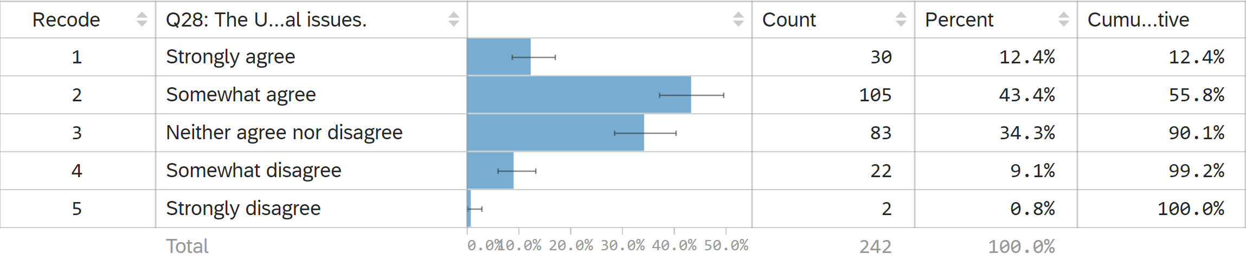
Q28: The University provides course offerings that meet your interest in Environmental issues. (Students only)

Slide 33
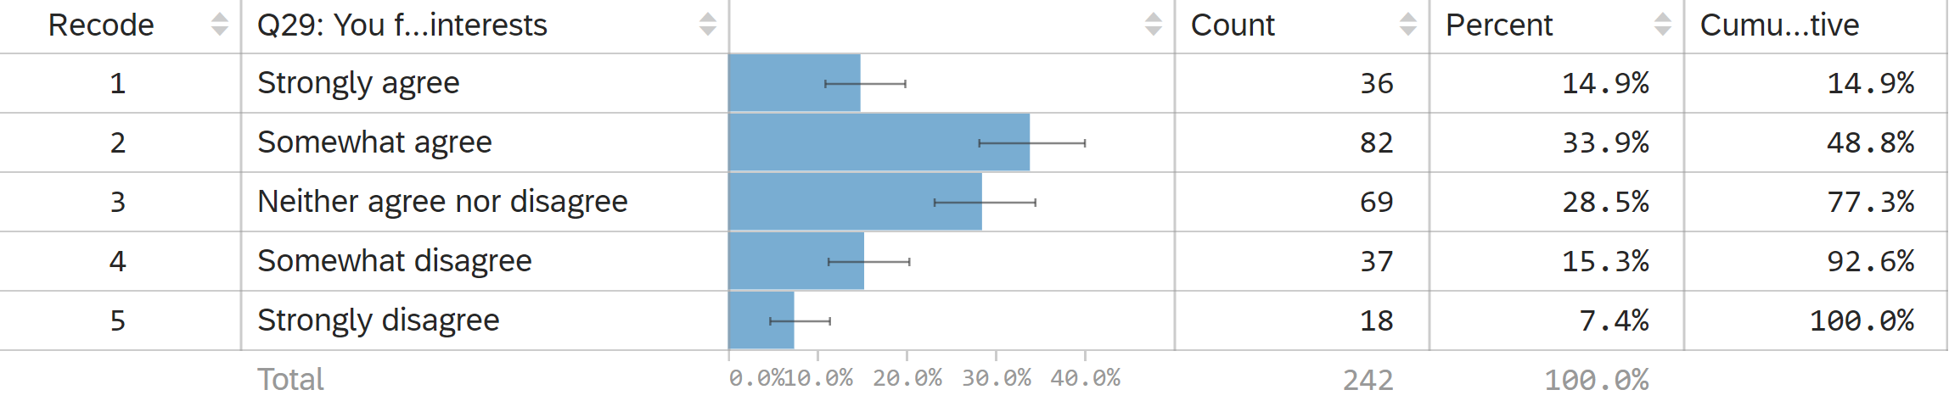
Q29: You find courses in your major that meet your Environmental interests

Slide 34
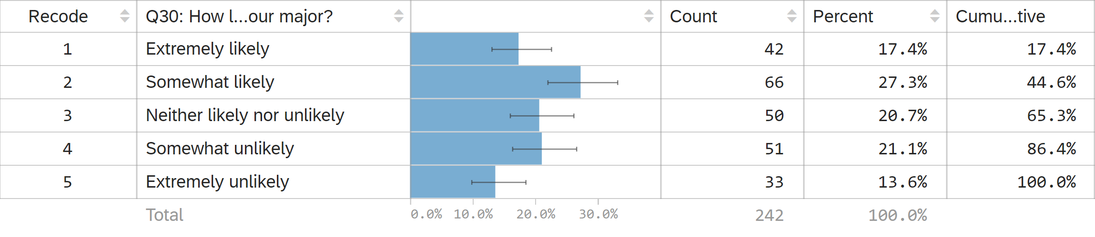
Q30: How likely are you to take an Environmental Studies course outside of your major?

Slide 35
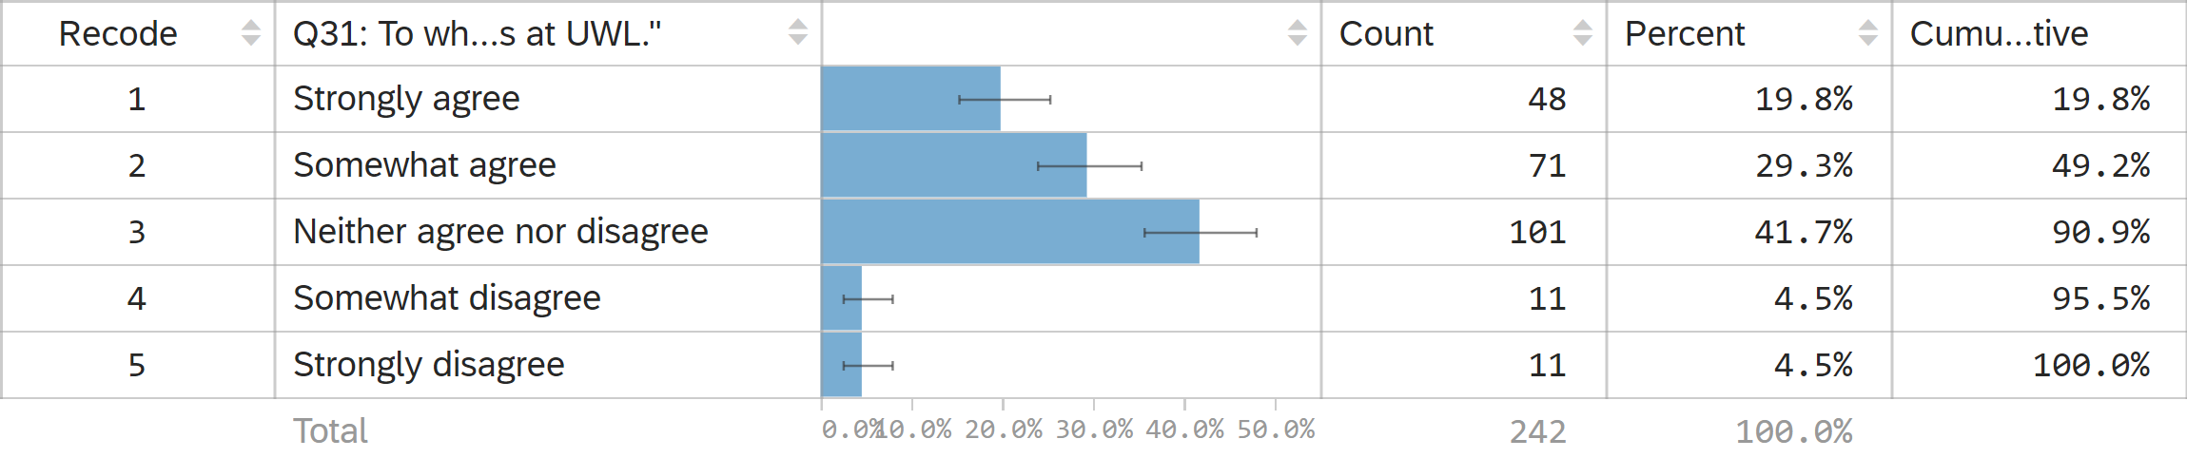
Q31: To what degree do you agree with the following statement: "I would you like more environmentally specific majors and minor options at UWL."

