Slide 1
Introduction to Youth Protection and Compliance
Prenicia Clifton- Director of Youth Protection and Compliance
University of Wisconsin System

Slide 2
Why Youth Protection

Slide 3
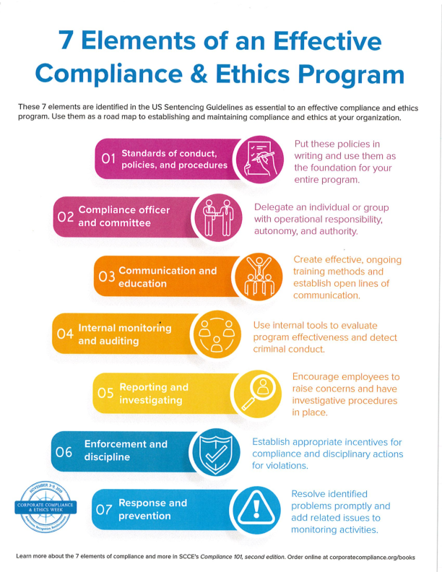
Building Effective Youth Protection Compliance
Centralized Youth Protection Policies
Precollege Liaison
Risk Mitigating Trainings for all Youth Serving Employees
Escalation Matrix and Program Audits
Escalation Matrix and Centralized Reporting
Failure to Comply
Responding

Slide 4
Who is here?
Who is responsible?
When?
Where?
Why?
Architecture of Compliance

Slide 5
Framework of Protection
Youth Protection-Protection from predators and peers
Youth Mental Health First Aid- Protection from self-harm
Standard Reporting Mechanisms for Consumers

Slide 6
Who Does This Policy apply to?
Custody
Are you in custody of the minor in absence of a parent or guardian?
Care
Would a reasonable person have an expectation of care in the space?
Control
Are you responsible for who and how others interact with the minor?
Oversight
Are you responsible for the vetting and training of staff supporting the minors?
Registration
Do you take a registration for the event or is it open to the general public

Slide 7
Is this a Covered Activity
Does the activity take Custodial Care of minors?
No
This activity is not a covered activity and may fall under other guidance and/or policies
Yes
This activity is a Covered Activity under Sys Policy 625
No
This covered activity may be a third party activity
*See additional charts
Does UW System take custodial care of the minor?
Yes
This is an university sponsored covered under Sys Policy 625
Custodial Care: The temporary responsibility for supervision, care, or control of Minors without accompanying parents, guardians, or chaperones.

Slide 8
Is this a 3rd Party Youth Activity
Is the covered activity ran and or owned by a UW System ?
This is considered a 3rd Party Covered Activity
No
This covered activity is a university sponsored event
Yes
Third Party: An organization or individual not affiliated with the Institution that is engaging in Covered Activities.

Slide 9
Institutional Policy Planning
Policy Education
Implementation Strategies
Standard Operating Procedures

Slide 10
Policy Education
Who needs to know about your policy?
How is the new policy being communicated?
Are there similar policy rollouts that can be duplicated?
How does one provide feedback

Slide 11
Implementation Strategies
What are you already doing that can be expanded?
Does each section need a staged approach?
Is the policy being used as best practice for Summer ‘22
What are anticipated barriers? (Cost, education, resources)

Slide 12
Standard Operating Procedures
How are you informed about a youth activity?
How do you train, vet, and verify compliance for all youth serving staff?
How does one make reports?
How do you verify compliance?

Slide 13
Questions
Contact:
Prenicia Clifton
pclifton@uwsa.edu

