Slide 1
ANNUAL REPORT
Office of Human Resources

Slide 2
About HR
The HR Team plans to use this information, and your feedback, to discuss with the Human Resources Advisory Committee what types of HR interventions may be developed to help continue to advance UW-La Crosse as a leader in higher education.

Slide 3
Human Resources
2020-2021 Projects/Goals
2021-2022 Projects/Goals
Enhanced data integrity and availability in HRS
Introduced first in UW System dashboards for employee KPIs that supervisors can see 24/7 (Tableau)
Enhance employee onboarding & training opportunities
Enhance customer/employee experience with HR through new case portal
In collaboration with stakeholders and UW System re-implement a more robust career progression program.

Slide 4
Definitions / Notes
Unless others stated, all information is for a Fiscal Year period (July through June)
Unless otherwise stated, all data represents Faculty, Academic Staff, Limited, and University Appointments
Unless otherwise stated, all data only includes “Redbooked” or “Budgeted Positions”
All separation data only accounts for voluntary separations

Slide 5
Recruitment Statistics
Human Resources assists with the coordination and management of the Recruitment function at UW-La Crosse.

Slide 6
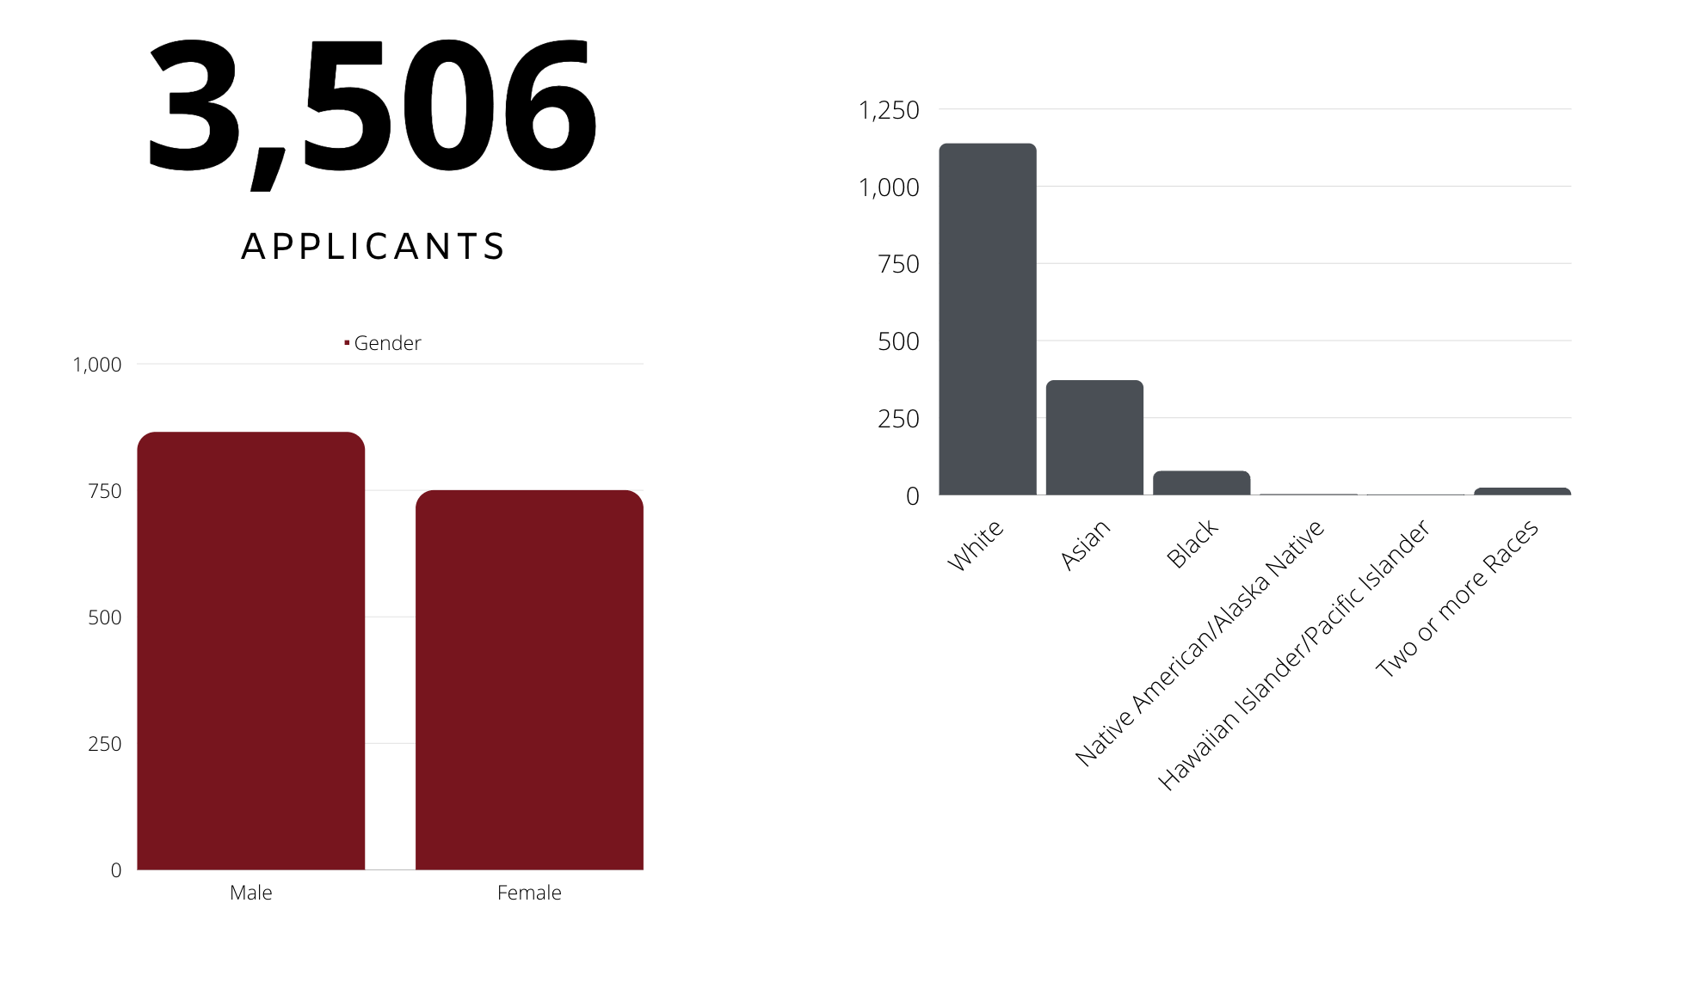
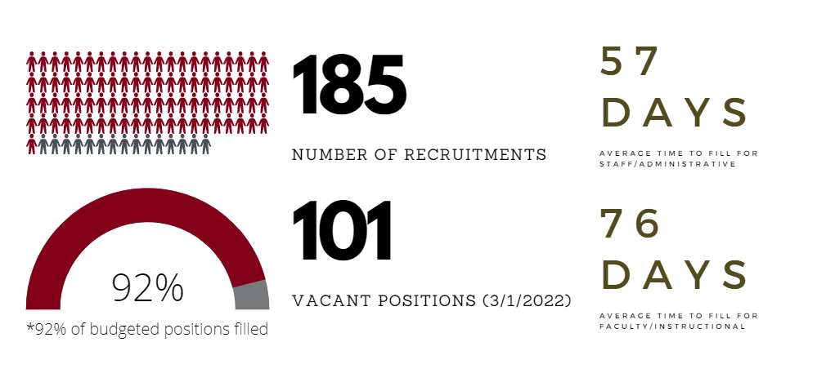
Recruitment Information

Slide 7
Sourcing Information (past 9 months)

Slide 8
Retention Statistics
Retention metrics are an integral component of measuring an organization's health. Retention metrics can be used to help analyze employment trends, plan for future needs and develop lasting learning & development programs so knowledge transfers and is not lost.

Slide 9
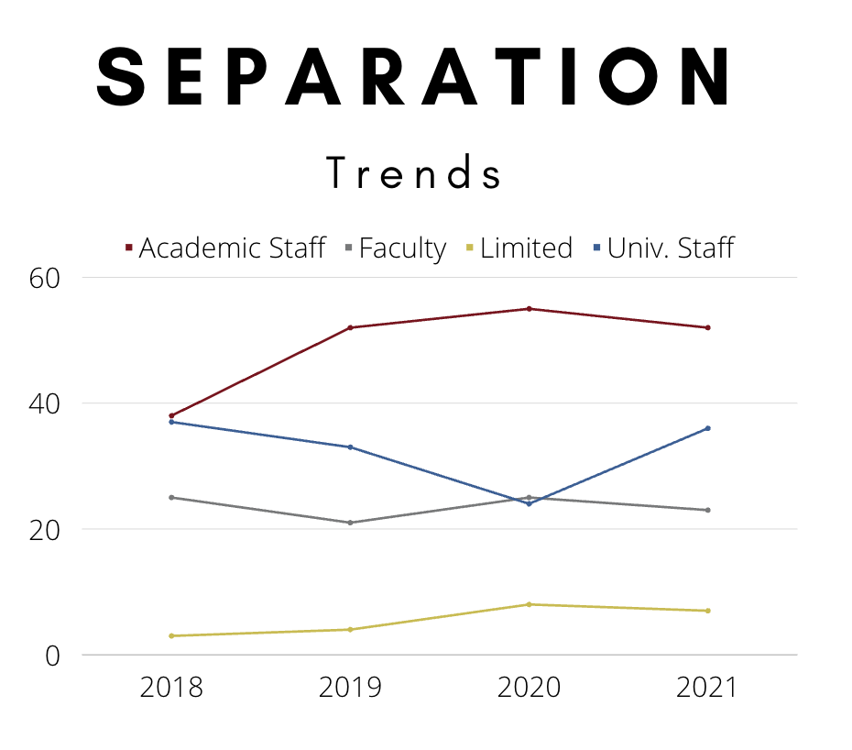
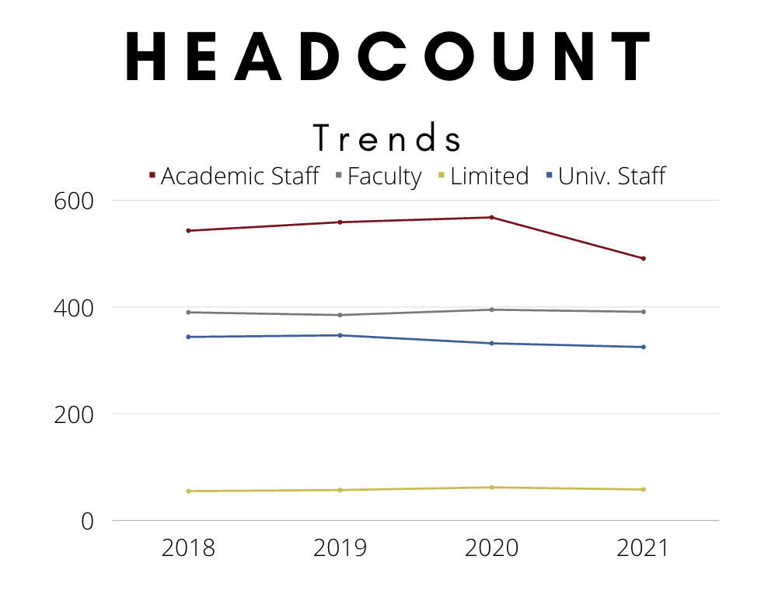
Separation vs. Headcount

Slide 10
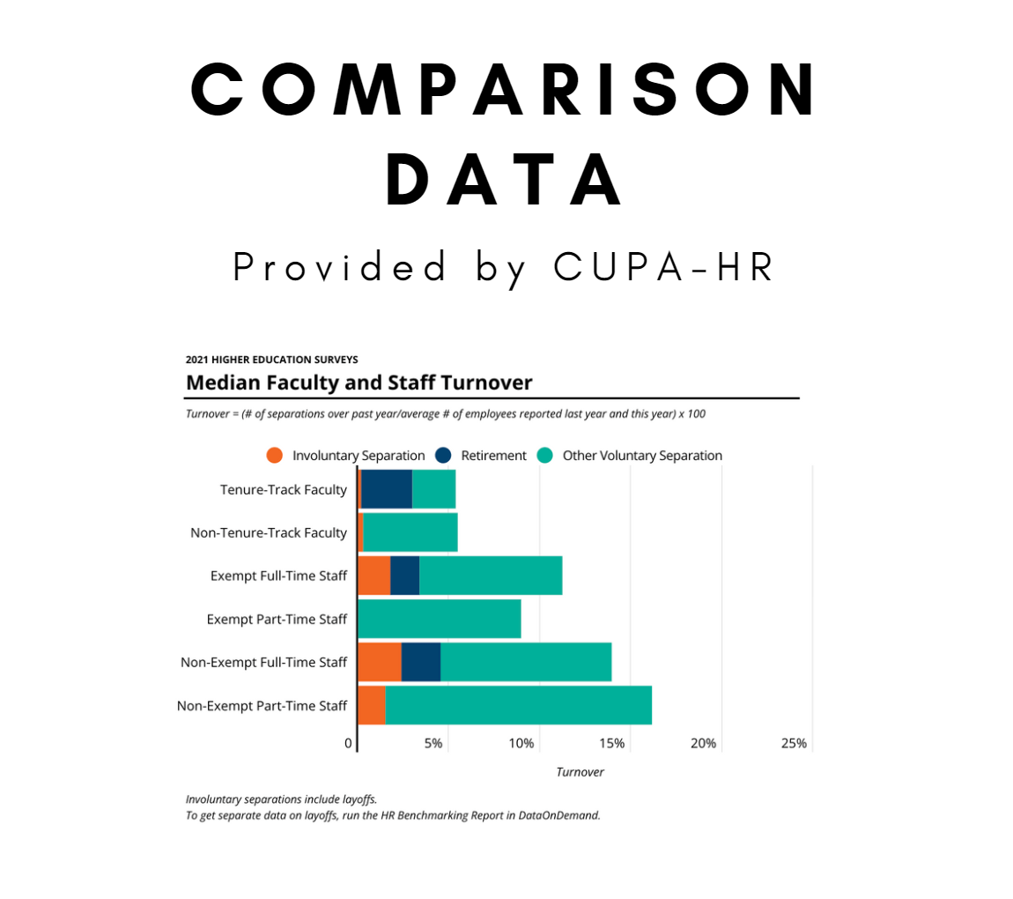
Comparison Data / KPIs for Retention
‘21 UWL Turnover Rate – 9.3%
‘21 UWL Retention Rate – 91.2%
‘21 UWL Avg. Empl Tenure - 9.9

Slide 11
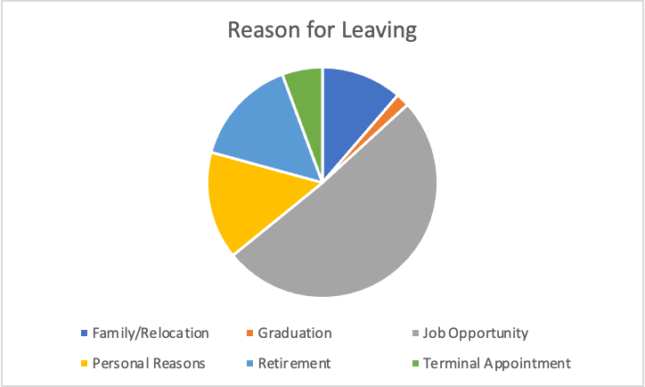
Exit Survey Information
Respondents represent 25% of all separating employees (this includes involuntary separations)
Influence for leaving
(1 is not influential, 5 is most influential)
Non-Qualitative Reason for Leaving

Slide 12
Exit Survey Information (cont.)
Respondents represent 25% of all separating employees (this includes involuntary separations)
Satisfaction Information
(1 is not all satisfied, 5 is totally satisfied)
Other Indicators
Average tenure of employment for those separating is 7.7 years

Slide 13
Diversity & Inclusion
UW-La Crosse is committed to creating an inclusive learning and working environment. Human Resources tracks and now reports on key demographic information related to our workforce.

Slide 14
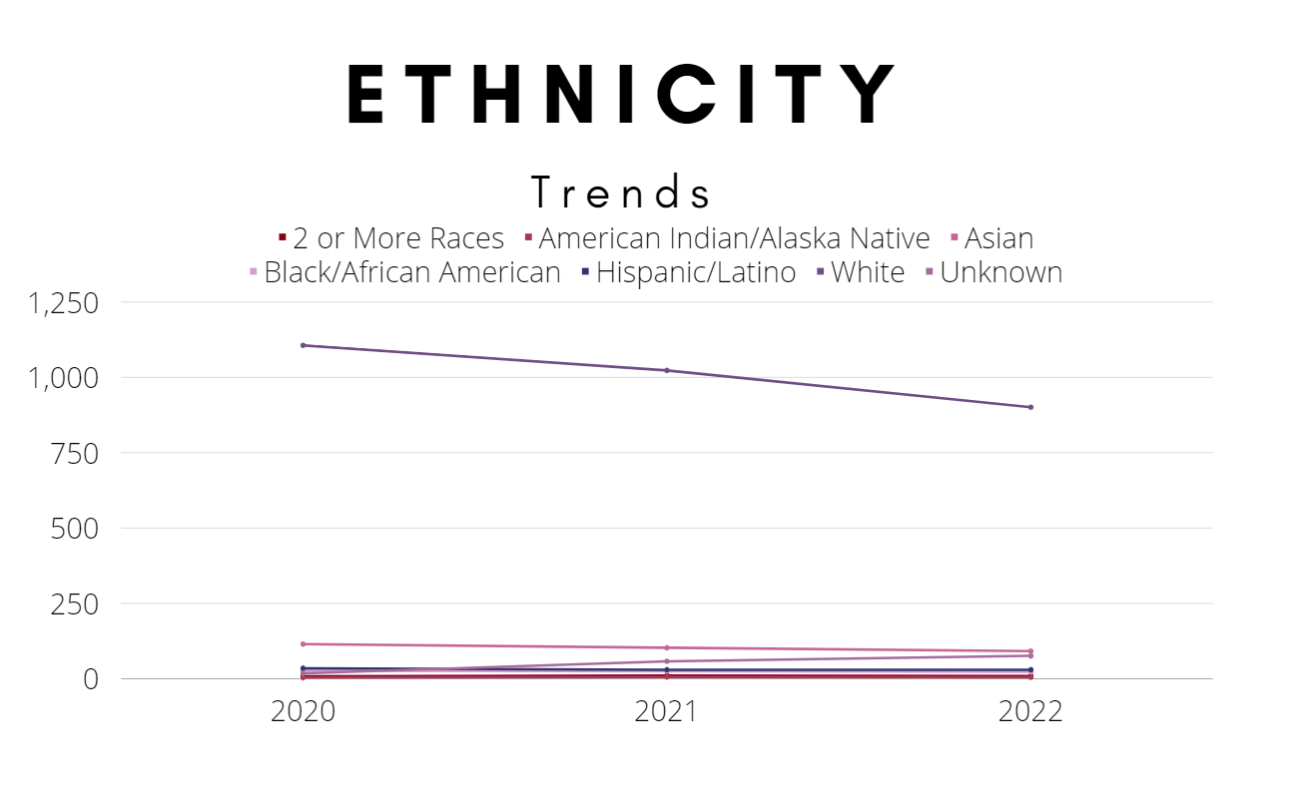
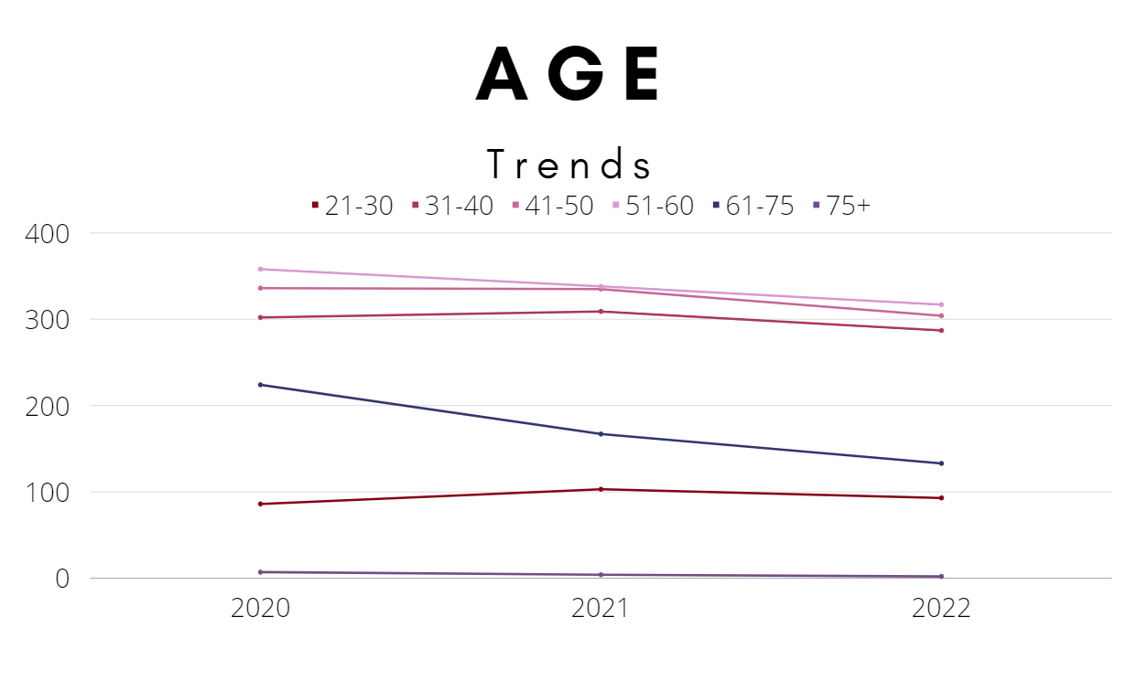
Ethnicity / Age

Slide 15
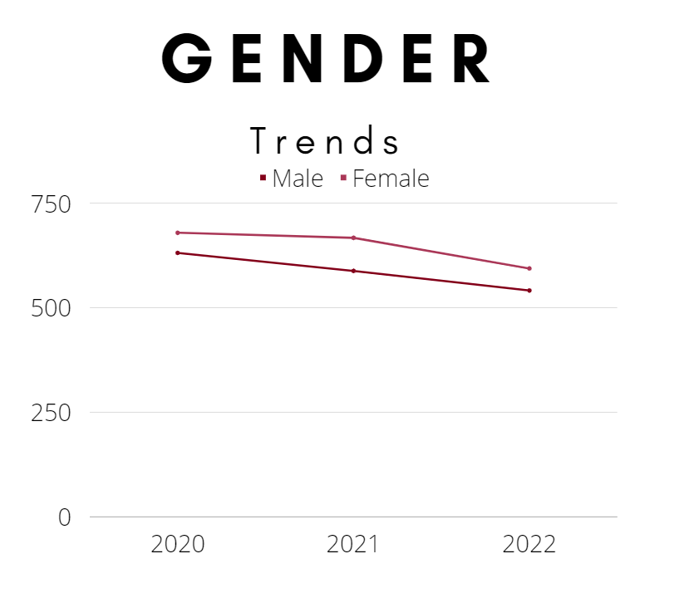
Gender / KPIs for D&I
‘21 Median Wage for all non-student groups - $57,715

Slide 16
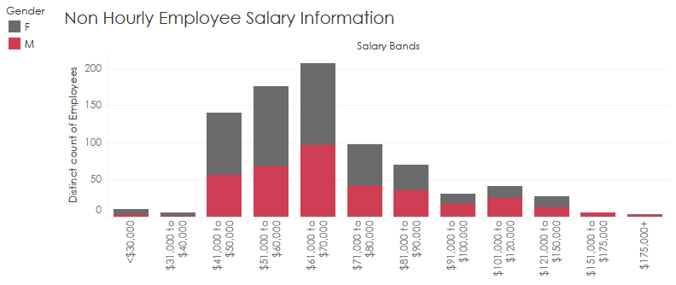
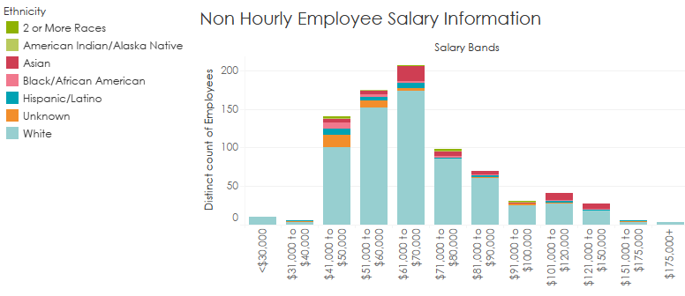
Non-Hourly Employee Salary Information (March 2022)

Slide 17
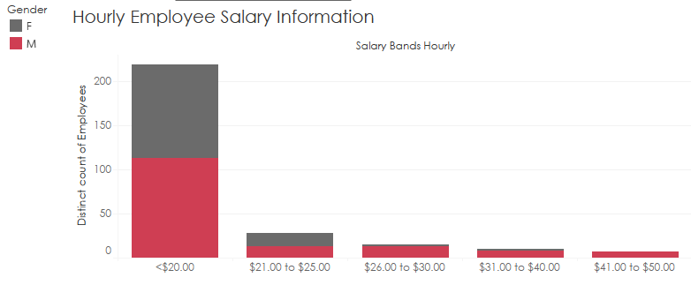
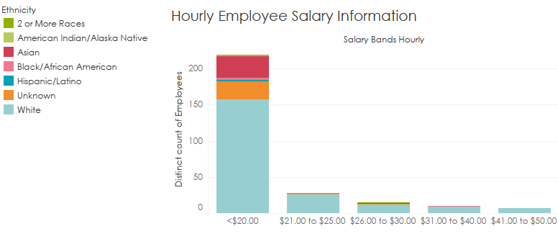
Hourly Employee Salary Information (March 2022)

Slide 18
Benefit Management
Benefits provide an insight into how the organization attracts, retains, and motivates talent. As benefits are managed on a calendar year, benefit analysis is done on a calendar year basis.

Slide 19
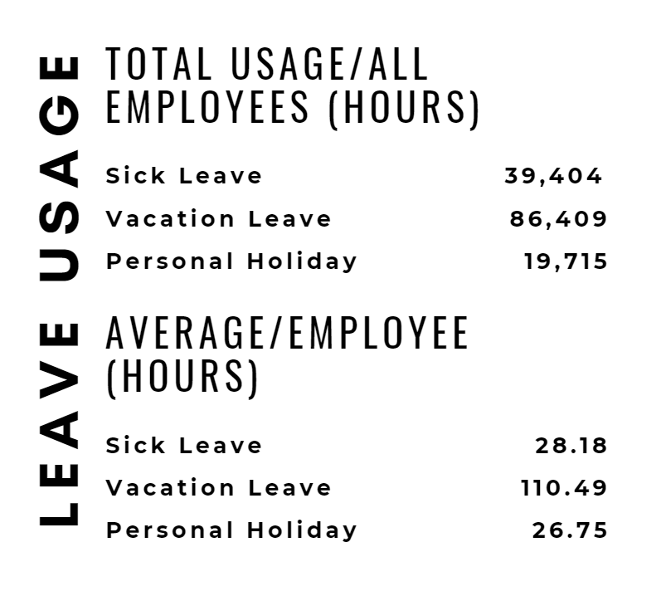
Leave Utilization
On average, each leave eligible employee used
  3.5 sick days
  13.8 vacation days
  3.34 personal holiday

Slide 20
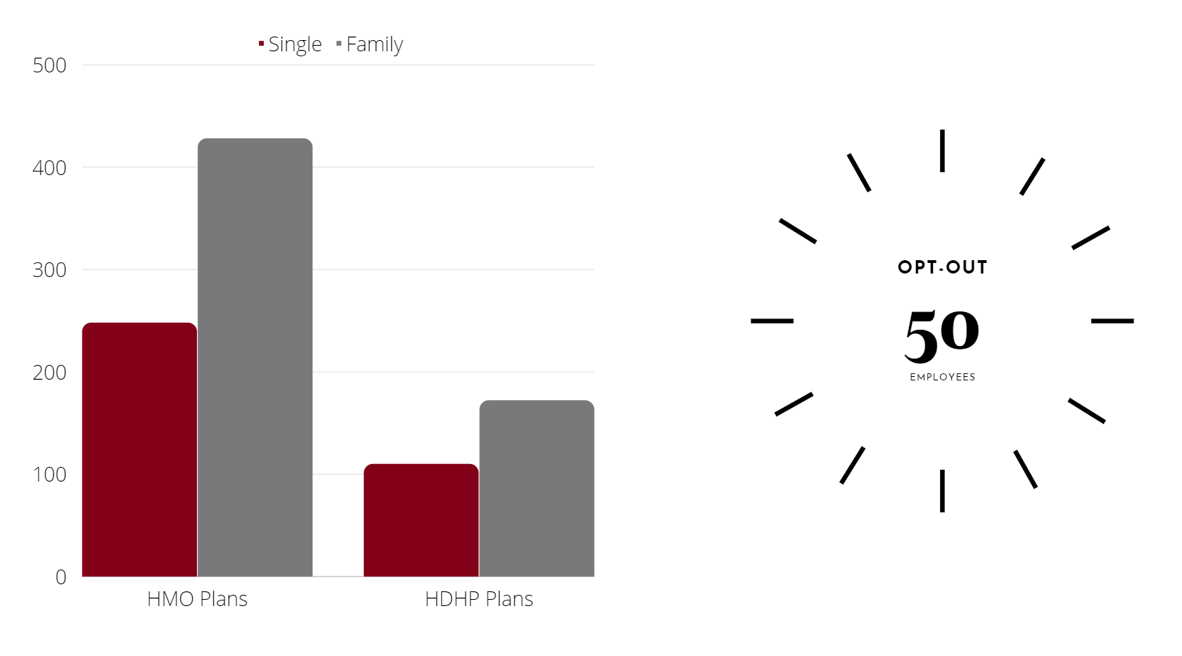
Health Insurance Utilization
(Calendar Year)
Health Insurance benefit utilization is HIGH. Almost all insurance eligible employees elect coverage
More family coverage on all plans than single coverage

Slide 21
Questions?

