Slide 1


Business Services Introduction
March 7, 2023

Slide 2


Overview
Business Services performs several accounting and business functions for the university, including:
Procurement –purchasing goods and services
Payables – paying for purchases
Contracts – negotiating and drafting legally binding agreements
Billing – billing students and others for goods and services
Accounting – recording expenses and revenues
Risk management – assessing and mitigating risk
Policy compliance – ensuring applicable policies are followed

Slide 3
Mission Statement
The mission of the University of Wisconsin-La Crosse Business Services is to effectively develop and manage university business operations to support the institution’s educational, research, and public service missions.
To fulfill its mission, Business Services implements procurement, payables, and receivables processes for efficient exchanges of economic resources and produces timely and accurate accounting information that reflects the financial position of the institution.
Business Services engages with students, faculty, staff, and external entities to support the institution’s fiscal management by providing exceptional customer service and guiding stakeholders through business processes with the highest standards of professionalism, integrity, and accountability.
https://www.uwlax.edu/business-services/mission-vision/

Slide 4
Vision Statement
The vision of the Business Services office at the University of Wisconsin-La Crosse is to serve the business needs of our diverse stakeholders by driving innovation, applying technology and business concepts to improve university operations, and setting a leading example of professionalism for the institution.
https://www.uwlax.edu/business-services/mission-vision/

Slide 5
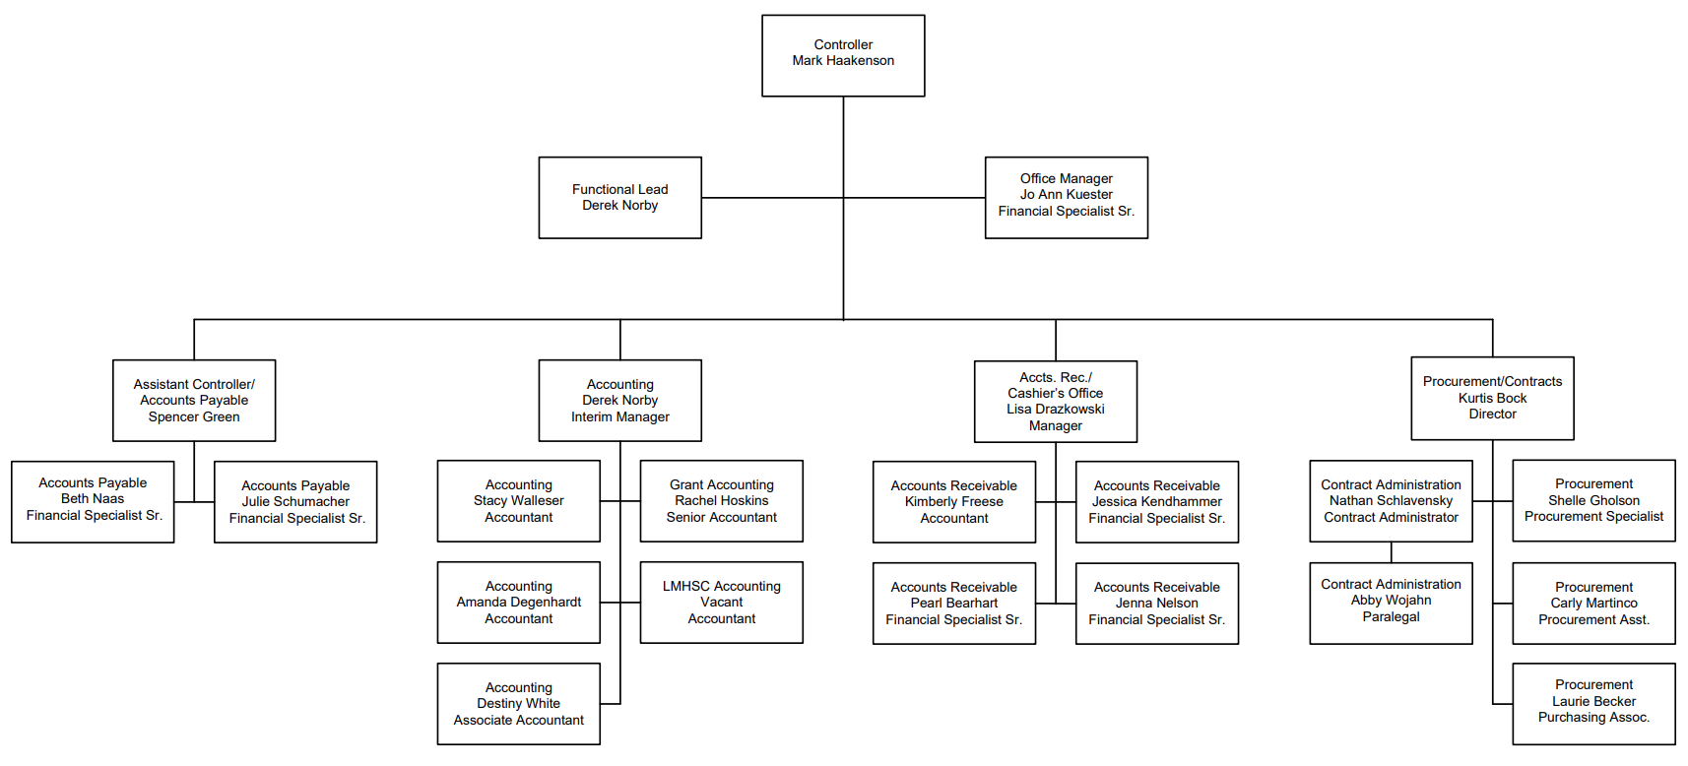
Organizational Chart
Notes:
https://wwwtest.ct.sfs.services.wisc.edu/

Slide 6
Leadership Team
Mark Haakenson – Controller
Kurtis Bock – Procurement Director
Derek Norby – Accounting Manager
Lisa Drazkowski – Accounts Receivable Manager
Spencer Green – Assistant Controller
Nathan Schlavensky – Contract Administrator
Full List of Business Services Staff
Notes:
https://wwwtest.ct.sfs.services.wisc.edu/

Slide 7
Physical Location
125 Graff Main Hall
Controller’s Office
Accounting
Accounts Payable
Cashiers Office/Accounts Receivable
118 Graff Main Hall
Procurement
Contract Administration
Notes:
https://wwwtest.ct.sfs.services.wisc.edu/

Slide 8
Contact Information
Primary
businessservices@uwlax.edu
Specific functions
purchasing@uwlax.edu
pcards@uwlax.edu
contracts@uwlax.edu
accountspayable@uwlax.edu
cashiers@uwlax.edu
Notes:
https://wwwtest.ct.sfs.services.wisc.edu/

Slide 9
Website
The Business Services website can be found here: https://www.uwlax.edu/business-services/
It includes:
  Staff Listing
  Policies
  Forms
  Fiscal year-end information
  Additional resources

Slide 10
Knowledgebase
Many Business Services resources can now be found on the UWL KnowledgeBase.
The Business Services KnowledgeBase Guide provides a summary of the various Business Resources available: https://kb.uwlax.edu/business-services-knowledgebase-guide

Slide 11
Controller’s Office
The Controller serves as the director of Business Services and chief accountant for the institution.
Oversees the staff and operations of the unit, as well as business processes across the university and serves as a primary contact for most institutional audits.
The Assistant Controller serves as the Risk Manager for campus and is responsible for financial policy compliance.
Notes:
UDDS 283690 for Journal.

Slide 12
Policy Compliance
Compliance with U.S. Federal, State of Wisconsin, UW System Administration, and UWL financial regulations and policies
Examples of UWL policies:
Food expense approval
Alcohol purchases
Prizes, Awards, and Gifts
Memberships
List of Business Services Policies

Slide 13
Risk Management
Provides guidance and training on managing risk for the
institution.
Incident reports should be completed and submitted
for any losses.
Ensures proper insurance coverage is in place.
Driver authorization process
Business Services Guide to Managing Risk

Slide 14
Forms
Commonly used forms that Business Services manages include:
  Academic Support Service Agreement (ASSA) Form
  Food Expense Approval Form
  Purchasing Card Statement Submission Form
  Transfer submission form (non-expense)
  WISER Access Request Form
    Full list of Business Services Forms

Slide 15
Systems
The systems that Business Services supports include:
  WISER - https://wiser.wisc.edu/
  ShopUW+ - https://shopuwplus.wisc.edu/
  Cost Transfer Tool - https://ct.sfs.services.wisc.edu/
  Share Financial System (SFS) - https://portal.sfs.wisconsin.edu/
    Includes eReimbursement and SFS security form for requesting ShopUW+ access
  DocuSign - https://www.docusign.com/

Slide 16
Procurement
Supports institutional procurement processes.
  https://www.uwlax.edu/business-services/our-services/purchasing/
ShopUW+ Procure-to-Pay (P2P) system
  https://shopuwplus.wisc.edu/
Procurement policy advising and training
Purchasing card training (Canvas) and management
https://www.uwlax.edu/business-services/pcard/
Vendor management (W-9s)

Slide 17
Accounts Payable
Direct payments
accountspayable@uwlax.edu
Student Faculty Organization (SFO) accounting
sfo@uwlax.edu
Travel advising and support now provided by UWSA uwstraveloffice@uwsa.edu
https://www.uwlax.edu/business-services/
our-services/travel/

Slide 18
Contract Administration
Development, review, and negotiation of institutional contracts and agreements.
External and internal contracts and agreements.

Slide 19
Accounting
General ledger processing and reporting
Banking services
Daily revenue posting
Chargebacks
Transfers
Capital equipment
LMHSC accounting
Grant accounting

Slide 20
Grant Accounting
Fund 133 and 144 gifts, grants, and contracts
Fund 233 gift accounting as well (Foundation funds)
Works with Research & Sponsored Programs
to ensure compliance and proper reporting
Invoicing, time and effort reporting, & reconciliation
Develops extramural fringe benefit rates
https://www.uwlax.edu/business-services/our-services/grant-accounting/overview/

Slide 21
Cashiers Office
Serves as the Accounts Receivable/Bursar function for the university.
Responsible for student billing and related customer service.
Collects and deposits non-student funds and scholarship checks.
Provides limited credit card billing services for
non-student operations
Cashless campus initiative
https://www.uwlax.edu/cashiers/

Slide 22
Questions?
Contact Business Services at: businessservices@uwlax.edu

Slide 23
Thank you!

Slide 24


