Slide 1
The Three C’s: Contracts, classification & Continuity Codes

Slide 2
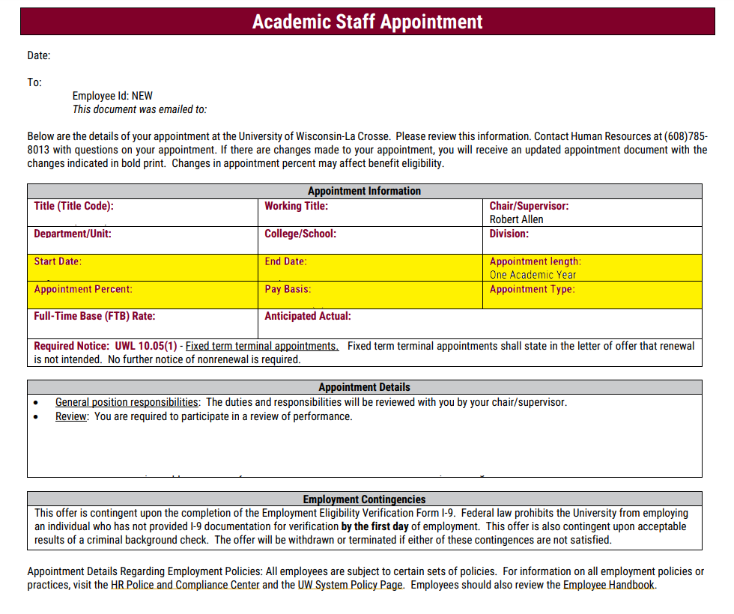
Contracts & pay basis
UW System Administrative Policy 1275
The terms and conditions of an appointment should be specified in a written letter of appointment. The appointment letter must be signed by an authorized official of the UW System institution and should contain details regarding the following:
type of appointment (e.g., fixed term, probationary, or expectation of continued employment);
duration of the appointment (starting date, ending date);
salary (hourly for nonexempt; salary for exempt);
general position responsibilities;
definition of operational area;
duration of the probationary period (if appropriate); and
recognition of prior service as part of the probationary period (if appropriate).

Slide 3
What are Appointment Types?
Fixed-Term Terminal (FTT)
Fixed Term Renewable (FTR)
The FTR appointments require a 12-month notice period and must be given for appointments ending in May or June.
If stopping the fixed-term renewable appointment, a written reason may be requested by the employee.
Appointments have an end date, generally in May (if a C-Basis appointment) or in June (if an A-Basis appointment).
The customary practice is to notify the employee of this decision at least 90 days prior to the contract end date.
Limited
An appointment to a designated administrative position, the holder of which serves at the pleasure of the authorized official who made the appointment. Certain positions must be designated as limited appointments under Wis. Stat. § 36.17(2), while others may be designated by the employer as limited appointments at the time of the appointment.
On-Going
Employed until employee decides to separate OR when the employer determines there has been an egregious action(s) necessitating termination for cause.
These appointments require no notice to not renew the appointment.
Notes:
UWS policy job security

Slide 4
Employee Classifications
Each of these categories is unique with regard to type of work performed, job security, benefits package, and/or ability to organize unions. Assignment to an employee category is based upon job title and the role of the position.
Group | Empl Class Code | Empl Class Name
Academic Staff | AS | Academic Staff
University Staff | CJ | Univ Staff Project - FT Finite (Classified Project)
 | CL | Univ Staff Temporary Employment (Classified LTE)
 | CP | Univ Staff Ongoing Employment (Classified Permanent)
Employees-in-Training | ET1 | Research Assoc
 | ET2 | Misc No Withholding
 | ET3 | Misc With Withholding
 | ET4 | Grad Intern/Trainee
Faculty | FA | Faculty
Limited | LI | Limited
Group | Empl Class Code | Empl Class Name
Other | OT1 | Ad Hoc Prg Spec/Corr Tutor
 | OT2 | Zero Dollar Conc/Teach Supv
 | OT3 | OT Pensions
 | OT4 | Honorary Assoc/Fellow
 | OT5 | Adv Opportunity Participant
 | OT6 | Pre-College Intern
Student Assistants | SA1 | Fellow,Scholar,Trainee,AOF
 | SA2 | Research Assistant
 | SA3 | Teaching Assistant
 | SA4 | Undergrad Asst
 | SA5 | PA/Grad Asst
 | SA6 | Undergraduate Intern
 | SA7 | Housefellow/Res Asst
Student Help | SH | Student Help

Slide 5
Pay Basis
Pay Basis Definitions
Academic (C-Basis) | FAASLI directly tied the AY calendar (39 weeks) & who are FLSA Exempt
Annual (A-Basis) | FAASLI directly tied to the Fiscal Year & who are FLSA Exempt
Hourly (H) | Generally, FLSA non-exempt staff who have a set hourly rate of pay. Also includes FLSA exempt US.
Lump Sum (L) | Short-term cases where establishing a rate of pay would not be appropriate.
Summer Session (SS) | Employment periods between the end of one AY and the beginning of the next.
Summer Service (SV) | Employment periods between the end of one AY and the beginning of the next for Research.

Slide 6
Continuity Codes
Value | Appointment Description and Duration | Expected Job End Date | WRS Eligible | Graduate/Short-Term Benefits Eligible
01 | Ongoing | Not Allowed | Yes - provided WRS Eligibility met | Only if WRS eligibility not met
02A | Fixed Terminal; If academic (C-basis) appointment: < 1 semester If annual (A or H-basis) appointment: < 6 months | Required | No | No
02B | Fixed Terminal; If academic (C-basis) appointment: ≥ 1 semester but ≤ academic year (w/ no expectation of renewal) If annual (A or H-basis) appointment: ≥ 6 months but < 12 months (w/ no expectation of renewal) | Required | No | Yes
02C* | Fixed Terminal; If academic (C-basis) appointment: ≥ academic year w/ expectation of renewal the following semester**; If annual (A or H-basis) appointment: ≥ 12 months** | Required | Yes – provided WRS eligibility met | Only if WRS eligibility not met
03 | Fixed renewable | Not allowed | Yes – provided WRS eligibility met | Only if WRS eligibility not met
04 | Limited | Not allowed | Yes – provided WRS eligibility met | Only if WRS eligibility not met
05A | Acting/Interim; If academic (C-basis) appointment: < 1 semester If annual (A or H-basis) appointment: < 6 months | Required | No | No
05B | Acting/Interim; If academic (C-basis) appointment: ≥ 1 semester but ≤ academic year (w/ no expectation of renewal) If annual (A or H-basis) appointment: ≥ 6 months but < 12 months (w/ no expectation of renewal) | Required | No | Yes
05C | Acting/Interim; If academic (C-basis) appointment: ≥ academic year w/ expectation of renewal the following semester**; If annual (A or H-basis) appointment: ≥ 12 months** | Optional | Yes – provided WRS eligibility met | Only if WRS eligibility not met
None | No Continuity (typically used for Student Help appointments) |  | No | No
An alphanumerical value that reflects the length or duration of an employee’s appointment/position (found in the contract).
One of the variables used to determine benefit eligibility.
Notes:
Highlight which ones wouldn’t be WRS elig (eg 05A/02A) – primary driver of leave/wrs benefits. Can’t pick and choose – has to reflect
Your appointment type, pay basis & contract dates determines which continuity
Provide example

Slide 7
Benefits, leave & the Three C’s
This Photo by Unknown Author is licensed under CC BY-SA

Slide 8
Benefit eligibility & administration Basics
Employee Class
Pay Basis
FTE
Continuity Code
Length of Appointment
Previous WRS Service
Benefits
&
Leave
Notes:
Benefits Administration (Ben Admin) is an automated process that performs a series of tasks that would normally be performed manually by Institution Benefits Administrators. The State of Wisconsin has complex rules regarding eligibility for the Wisconsin Retirement System (WRS) and related benefit plans.

Slide 9
HRS Benefits Process
Employee Class
FTE
Continuity Code
Previous WRS Service, if applicable
Assigns Benefit Program
The Benefit Program dictates:
Which Benefit Plans an employee is eligible for
If an employee will have their deductions taken on a pre-tax or after-tax basis
How frequently the deductions will take place and on which payroll periods
Their specific category for WRS (if applicable)
Any special circumstances that occur for that employee population (such as a unique payroll or deduction schedule)

Slide 10
Benefit eligibility & administration Basics
WRS Benefit Package
Richer benefit package as it allows for participation in the Wisconsin Retirement System.
Grad/Short Term Academic Staff Benefit Package
Does not allow for participation in the Wisconsin Retirement System.
Does not allow for participation in the High Deductible Plan Design for health insurance.

Slide 11
WRS Benefit Package
FAASLI (Faculty, Academic Staff & Limited)
2/3 of full-time is equal to 880 hours for at least one year*
UNIVERSITY STAFF
2/3 of full-time is equal to 1,200 hours for at least one year
42% FTE for 12-month employees
56% FTE for 9-month employees
58% FTE
*For 9-month employees, one year is considered the academic year and an expectation to return the following year.

Slide 12
Graduate/Short Term Academic Staff Benefit Package
STUDENT ASSISTANTS
Must be in one of the following titles: Research Assistant, Fellow, Advanced Opportunity Fellow, Scholar, Trainee, Teaching Assistant, Project Assistant or Program Assistant, and be expected to work at least 33% FTE:
For at least six months if you are a 12-month employee; or
For at least one semester if you are a 9-month employee
SHORT-TERM ACADEMIC STAFF
If not covered under the WRS, you are eligible for insurance benefits if you are expected to work:
At least 21% FTE for at least six months if you are a 12-month employee; or
At least 28% FTE for at least one semester if you are a 9-month employee
EMPLOYEES-IN-TRAINING
Must be in one of the following titles: Grad Intern/Trainee, Postdoc Fellow, Postdoc Trainee, Postgrad Trainee (1-7), Intern (non-physician), Research Intern or Research Associate, and be expected to work at least 33% FTE:
For at least six months if you are a 12-month employee; or
For at least one semester if you are a 9-month employee

Slide 13
Leave Eligibility: related, but separate
Do not assume that what is true for one employee will be true for another – there are far too many variables for that to be the case.
Eligible
NOT Eligible
University Staff
CP or CJ
Will earn leave regardless of FTE %
FAASLI, 12-Month
FA, AS, LI (A-basis)
Expected to work at least 21% FTE for at least 1 year
FAASLI, 9-Month
Expected to work at least 21% FTE for at least 2 semesters with the expectation to return the next semester.
Eligible for SICK LEAVE only.
University Staff – Temporary
CL
Student Assistants
SA 1 – SA 7
Other
OT 1 – OT 6

Slide 14
WRS Eligible?
YES
Yes, Leave Eligible
PASS #1
NO
Is the Continuity Code 01, 02C, 03, 04 or 05C?
Is FTE < 21% for A-Basis or 28% for C-Basis?
Yes, Leave Eligible
YES
YES
NO
NO
PASS #2
No, Not Leave Eligible
No, Not Leave Eligible

Slide 15
Employee assistance program

Slide 16
The employee assistance program: kepro
The Employee Assistance Program (EAP) provides you and members of your household with confidential resources to address personal/work-related concerns, assist with legal/financial situations or help with work-life balance.
Access to EAP services is employer-paid. You do not need to be enrolled in the State Group Health Insurance Program to use the EAP services.
24/7 access to licensed mental health professionals.
24/7 access to a robust website and mobile app offering dependent care, convenience resources information and more.
Expert personalized consultation with legal and financial professionals.
Services extend to employees, dependents and household family members.

Slide 17
The employee assistance program: Managers & Supervisors
The EAP also offers resources to assist with work-related concerns, some specifically geared toward managers/supervisors. To access these resources, follow the steps below.
Website: sowi.mylifeexpert.com/ (username: SOWI); account set-up required for access
In the upper right corner, click on the File/Toolbox icon
Select Documents
Click on the Management tab

Slide 18
Employee perks

