Slide 1

E-Performance
Supervisor Training
Notes:
Good morning – welcome to the most current e-Performance Supervisor Training. Today’s training will focus on where we are currently at in the process and provide you with instruction on how to bypass the optional steps this year. Just a reminder, and depending upon your employee’s employment status, Most of the yearly evaluations will be due on June 30, 2021 - so the required steps for managers will be due in the coming months.
For Instructional Staff, we realize that the evaluation calendar is different, and the due dates for review vary. Please be sure to follow the applicable calendar for your department and position.

Slide 2
e-Performance
The e-Performance Management system is set up to provide continuous feedback throughout the evaluation period. This program provides four opportunities to check-in throughout the year:
    Establishing goals,
    Checking-in on those goals six months into the year, and then finalizing the goals/and evaluation criteria,
    An employee self-evaluation,
    The final step, which is the Manager Evaluation.
Notes:
The new e-Performance management system is similar to that of the paper evaluations that were used in prior years, however and in addition to it now being in an electronic format, it was set up to help managers provide continuous feedback to their employee throughout the entire evaluation period. This new system provides four main opportunities to check-in with your employees throughout the year. These main check-ins will be:
1. While you and the employee are establishing goals for the year
2. A built-in check-in six months into the performance evaluation period to review and finalize goals and evaluation criteria
3. An opportunity for employee self-evaluation
4. And the final step, which would be the Manager evaluation.

Slide 3
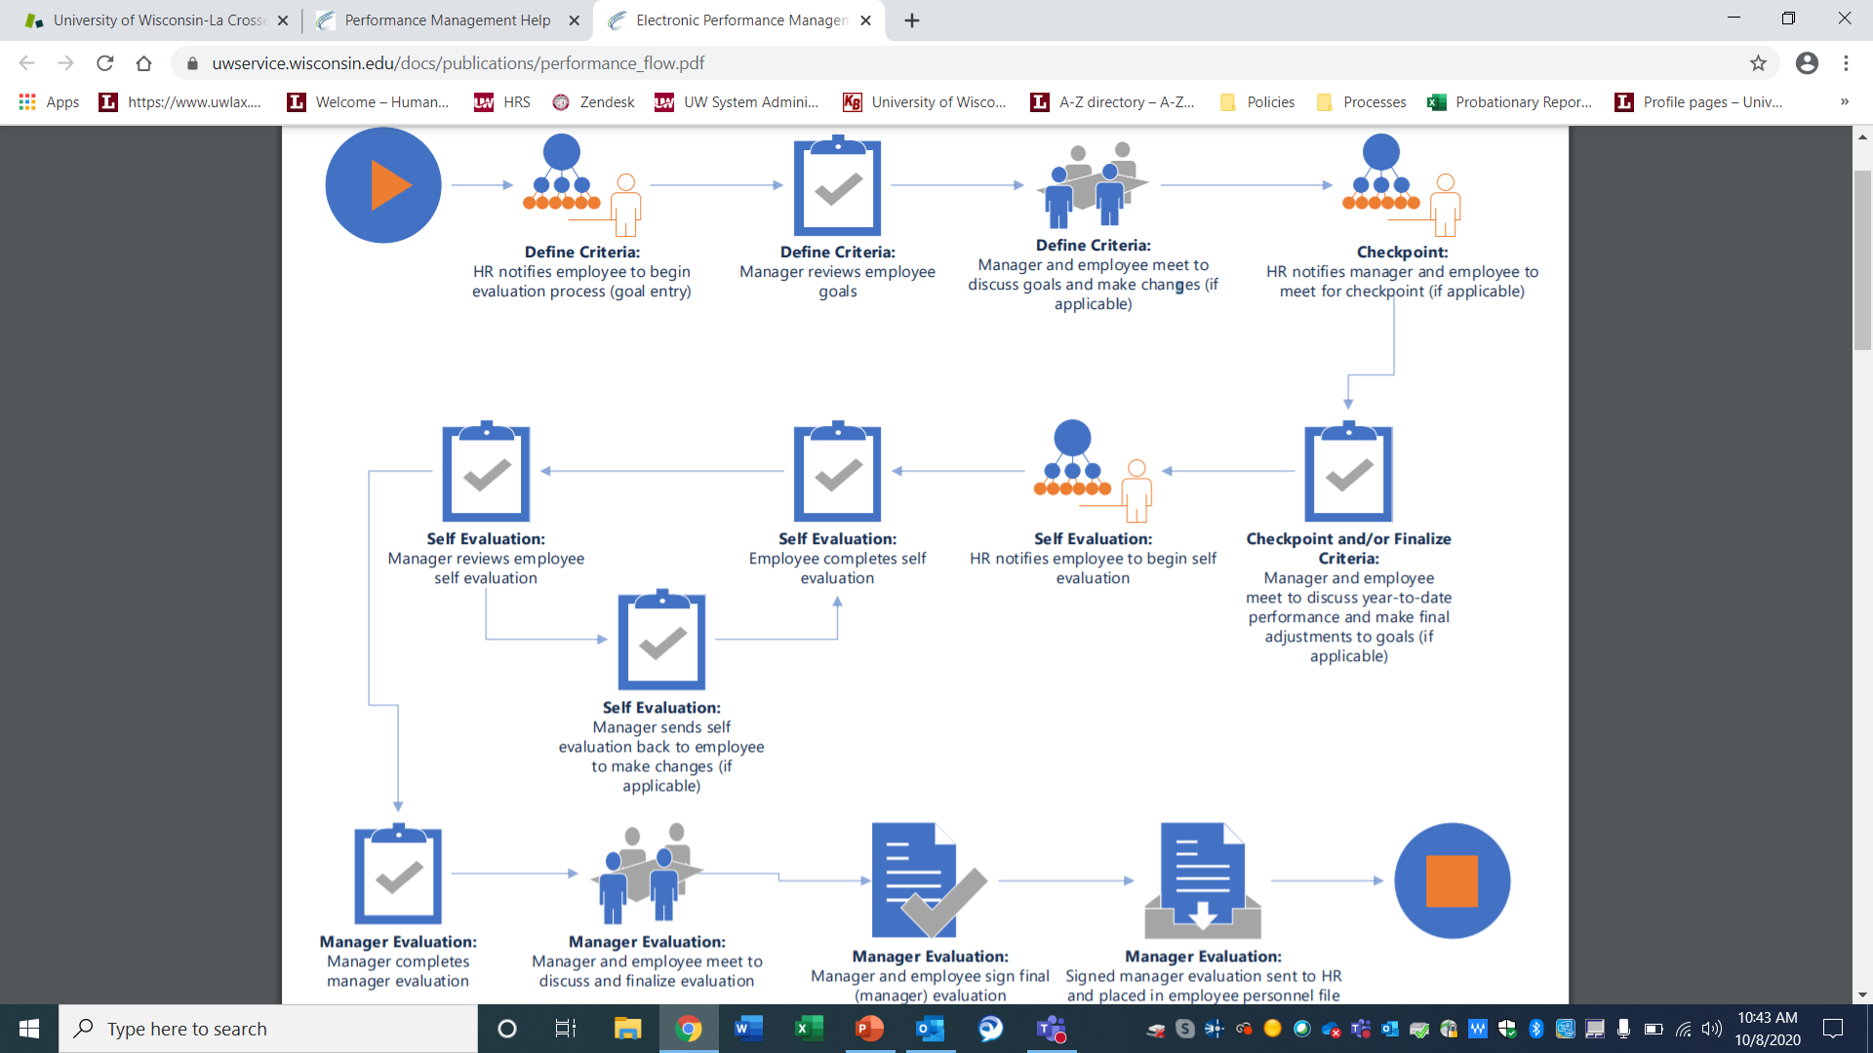
Notes:
In a normal year, the attached flow chart shows you the e-Performance process in full. However, this year most of these steps are optional, except for the manager evaluation.

Slide 4
Supervisor Instructions
Step 1 – Log into the MyUW Portal
Step 2 – Select the Manager option on the Performance Management Tile:
Notes:
First, to bypass the steps, you will want to login to your UW Portal, Select the Manager option on the e-Performance management tile.

Slide 5
Continued ~ Instructions
Step 3 – Select the employee for whom you will be evaluating first:
Notes:
Next, you will want to select the employee for whom you want to evaluate. Select their name to open the document.

Slide 6
Continued ~ Instructions
Step 4 – Notice on the left column there are the defined checkpoints for the entire evaluation process. The final step is highlighted with an arrow as this step is required.
Notes:
Once you are in the document, you can see on the left column all of the steps for the entire evaluation process. The final step with the arrow is the only step that is required. Therefore, we need to bypass the other open tasks before you can get to the Complete the Manager Evaluation.

Slide 7
Continued ~ Instructions
“Define Criteria” / “Check Point” / “Finalize Criteria” / “Review Self Evaluation” you will select the “Approve” button located in the upper right corner of your screen. You will confirm this step and continue to approve until you arrive at the “Manager Evaluation”.
Notes:
To bypass the optional steps of Define Criteria, Check-Point, Finalize Criteria, Review Self Evaluation – you will want to select the APPROVE button located in the upper right hand corner of your screen. You will then confirm this step and continue to approve until you arrive at the Manager Evaluation.
We will have continued trainings to assist in the Manager Evaluation closer to the due date.

Slide 8
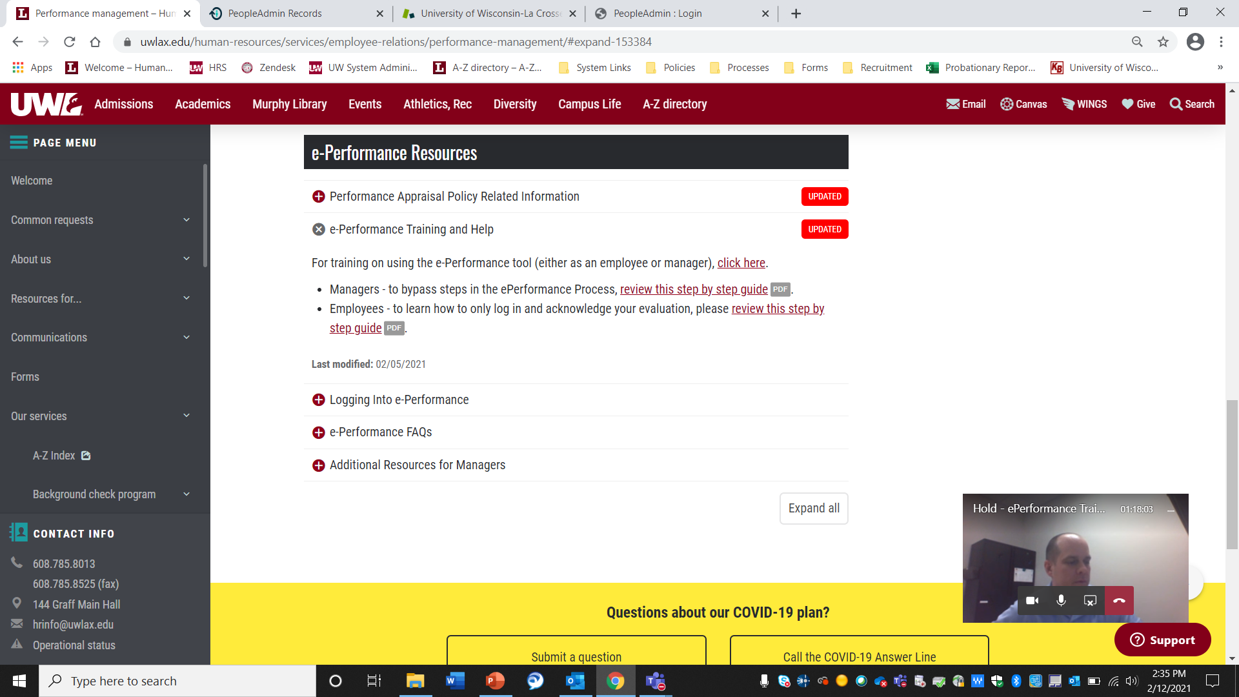
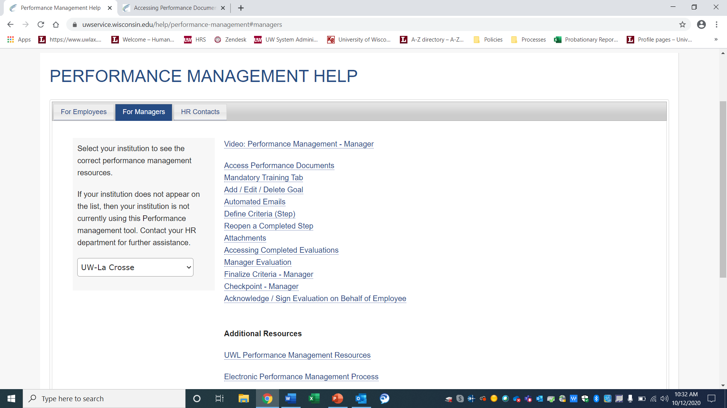
Notes:
You can find additional information and step by step instructions by accessing the link to the UW System e-Performance Training and Help site found through the UWL HR’s performance management page.

Slide 9
Define Criteria
  The Define Criteria phase is the first step in transitioning to the electronic version of the evaluation process.
  This step establishes the performance criteria that the employee will be evaluated against.
Notes:
The training today will focus specifically on the first step of the evaluation process – the Define Criteria step.
“Define Criteria” is the first step in transitioning to the electronic version of the evaluation process – this is achieved by establishing the performance criteria that the employee will be evaluated against – most commonly, goals are created in this initial phase.

Slide 10
Notes:
Included is a flow chart of the e-Performance process and the subsequent steps. Currently we are focusing on the Define Criteria step.
Before the supervisor can begin their portion of this step, the employee will need login to their e-performance evaluation and enter in their yearly goals. Once they have completed their step, it will initiate the supervisor portion of Define Criteria.
I do want to inform you that due to the current state of operations, we have opted for a soft launch of the e-performance system. Therefore, it was advised that employees can ignore the initial email prompting them to complete this step. Because the initial email has gone out, and we are allowing the departments to complete this step at their own pace, it will be required for you as the supervisor to initiate this step with your direct reports as your operations allow.

Slide 11
Supervisor Responsibility
To complete the Define Criteria step ~ managers will need to review the goals their employee have created and make any changes in the goal section for each of their direct reports:
Supervisor Step
      Goal Setting with Direct Report
System Generated
      Competencies & Mandatory Training
Notes:
There are technically 3 pieces of performance criteria that an employee will be evaluated against – Goals, Competencies and Mandatory Training.
The Competencies and Mandatory training are system generated criteria leaving only the Goal section to be completed by the employee and supervisor.
Managers will need to review the goals their employees have created and make any changes in the goal section for each of their direct reports to successfully complete this step.
Although, there will be no action needed for the competencies and mandatory training sections of the performance criteria, we will be taking a quick look at what this looks like in the system.

Slide 12
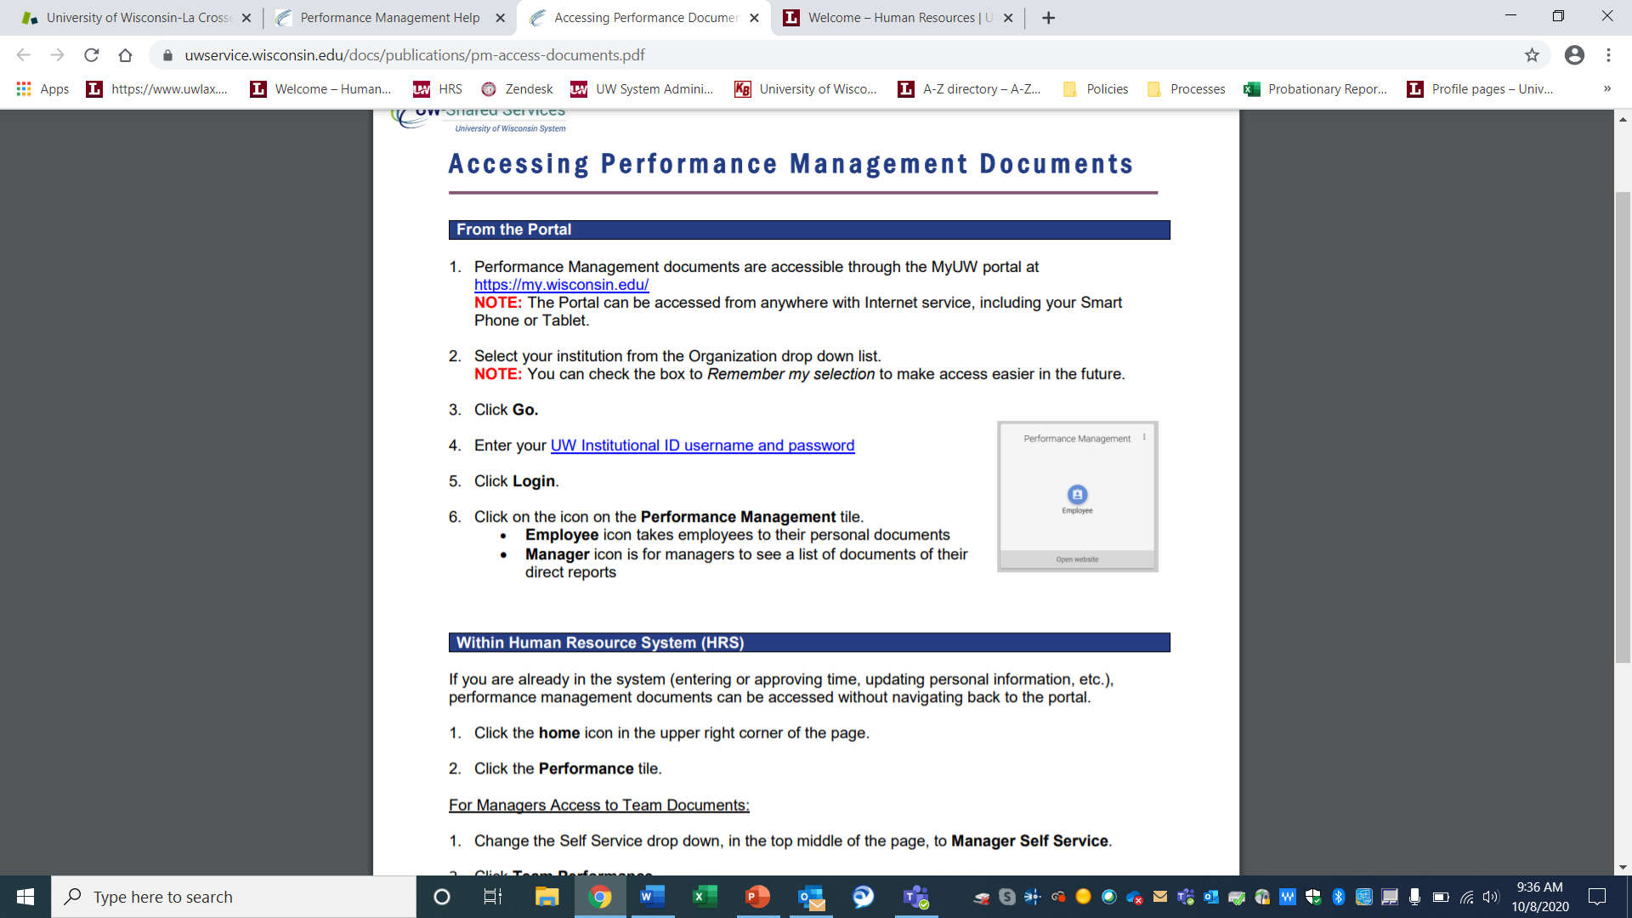
Notes:
The easiest route to access your Performance Management documents are through the My UW portal
Be sure to Select your institution from the Organization drop down list – UW La Crosse and Click Go. You will then be prompted to Enter your UW Institutional ID username and password. Once logged in you should see a Performance Management Tile. This Tile is where you will be able to access the performance management documents. The Employee icon takes you to your personal documents and the Manager icon is for managers to see a list of documents of their direct reports.

Slide 13
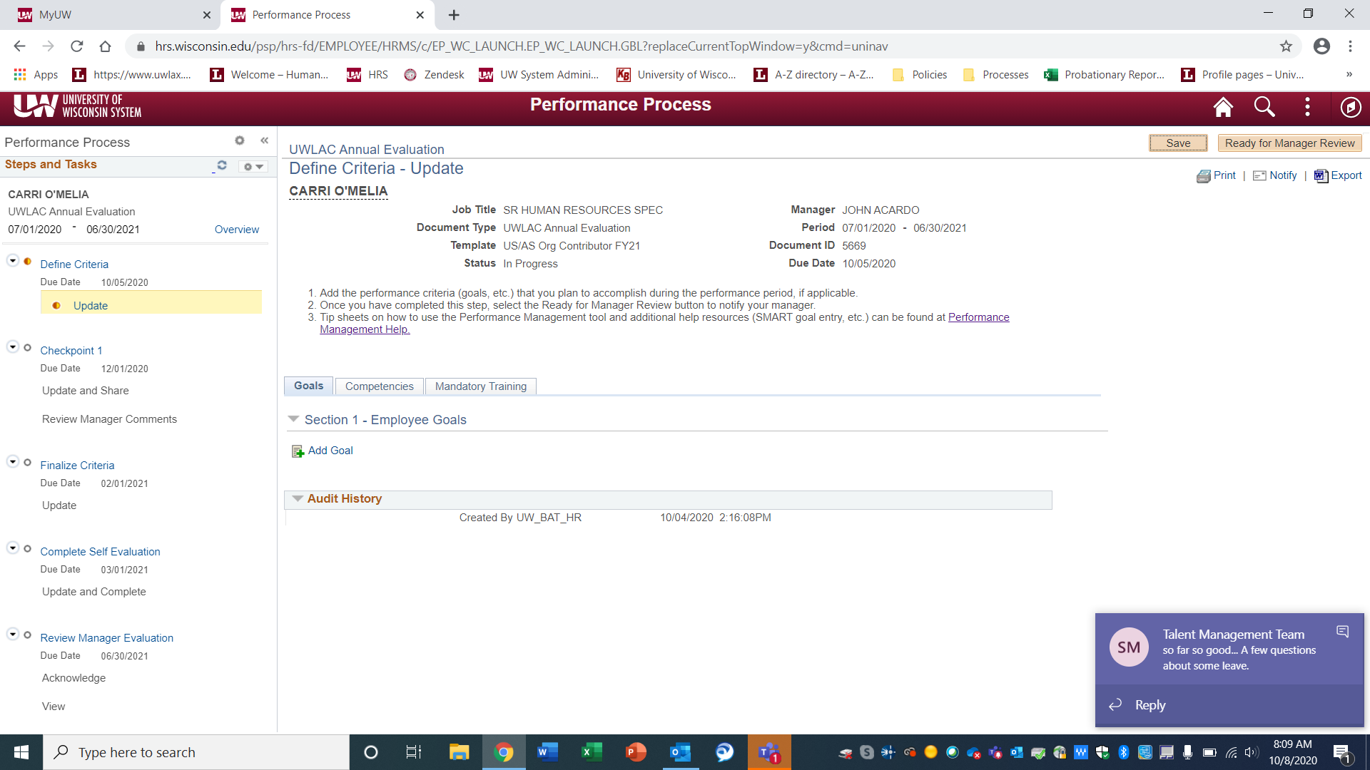
Notes:
Once you click on a direct report – you will see a similar screen. Though this is the employee view (I used mine as an example), you will see something very similar. Because I am in the Define Criteria Step, It has written instructions on what action is required for this step along with access to the performance criteria tabs of Goals, Competencies and Mandatory Training.
Although the Competencies and Mandatory Training tabs have no action required – I will go through those tabs briefly so you know what to expect later on.

Slide 14
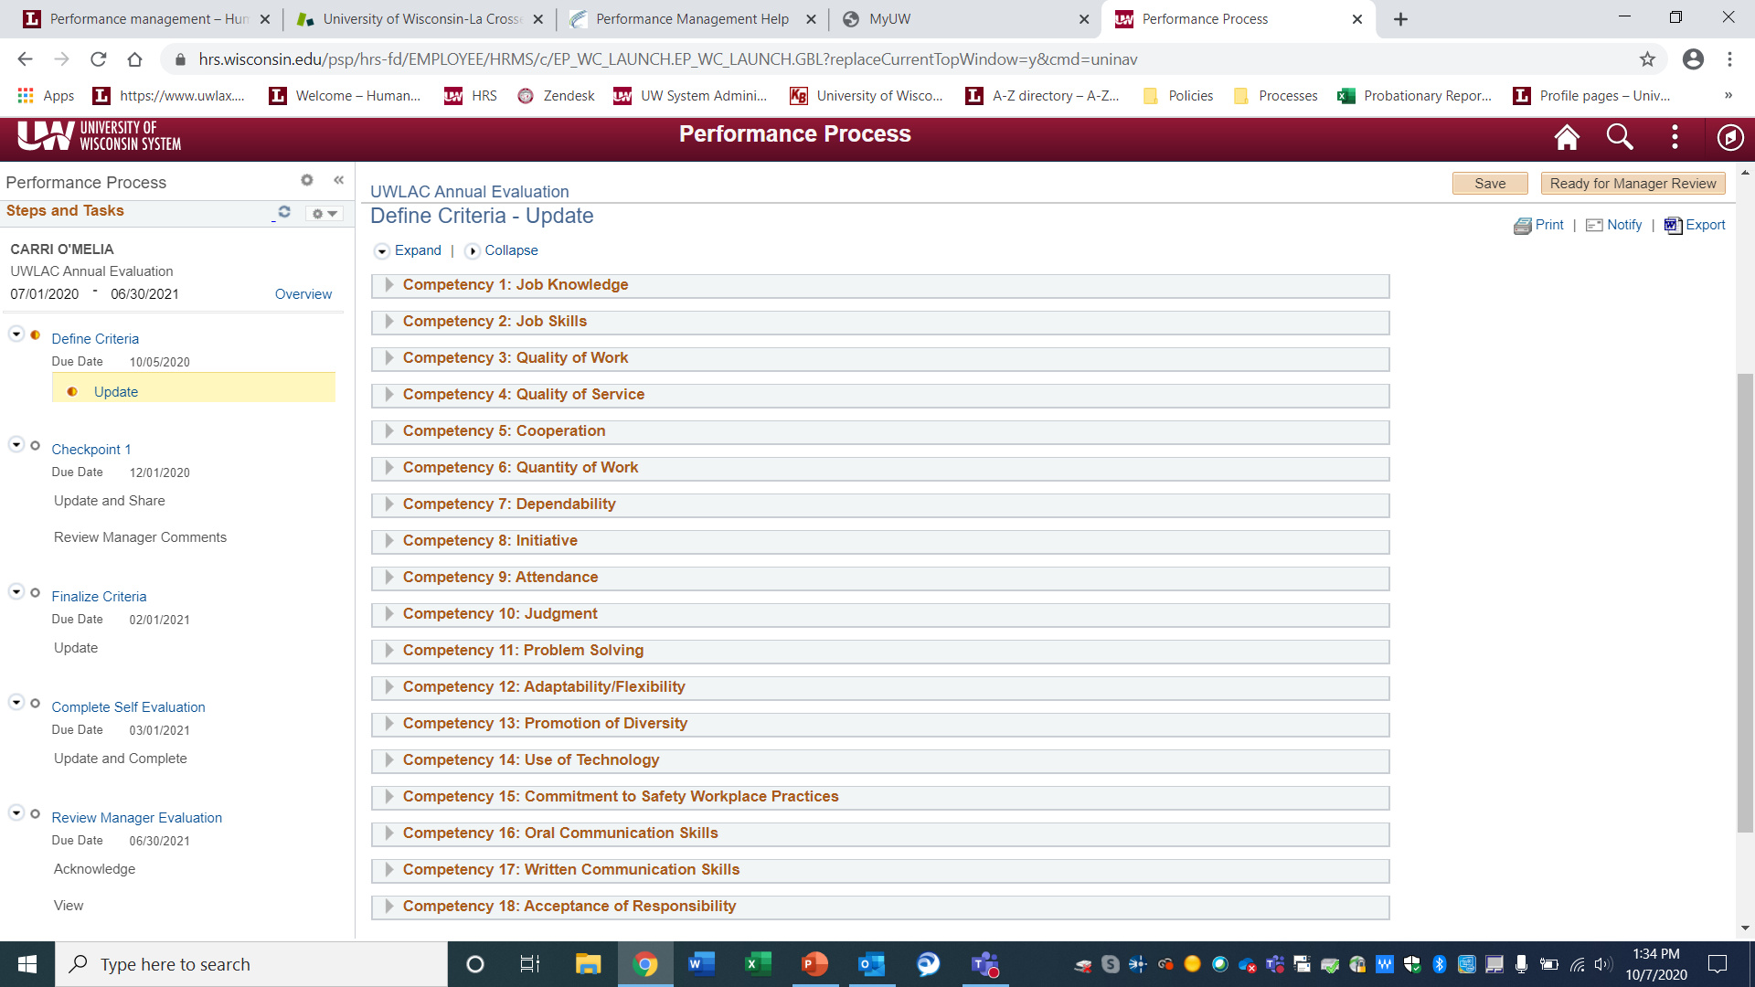
Competencies
    Core competencies describe the performance factors that each university employee is rated upon. This will be auto-populated and no action is needed at this time.
Notes:
First, let’s take a quick look at the Competencies Tab - Core competencies describe the performance factors that each university employee is rated upon. This will be auto-populated and no action is needed at this time.
As you can see, when I click the competency tab – it populates the competencies that I will be evaluated on for the evaluation period. For example, Job Knowledge, Quality of Work, Dependability, Initiative and the like.

Slide 15
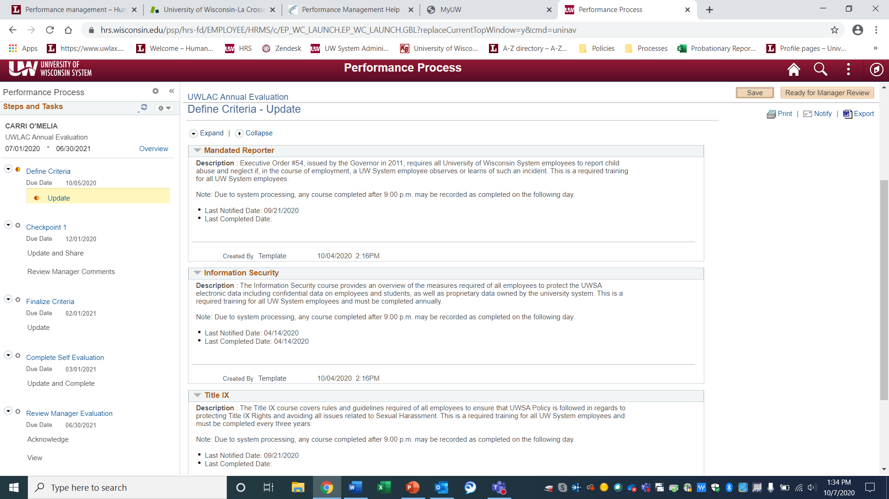
Mandatory Training
    Mandatory training for employee to complete for the upcoming year. This will be auto-populated and no action is needed at this time.
Notes:
Second, the Mandatory Training tab provides information for the courses designated by UW System Administration as system-wide required training to complete for the upcoming year. This will be auto-populated and no action is needed at this time.
In recent weeks, you may have received emails from UW System informing you of trainings that are required as designated by your position. These mandatory trainings are the trainings that you will see in this view. The dates are updated as part of an automatic process, and are not editable by managers, employees, or HR administration staff.

Slide 16
Notes:
Once your employee has filled out their yearly goals, they will submit the Ready for Manager Review button and it will be sent to you to complete the Define Criteria step. You will want to review the goals, edit them if needed, and add goals as appropriate.
To finish up today’s training, we will be watching a training video completed by UW System that will walk you through the Define Criteria step-by-step. However, before we watch this video (which will also be available to you on the UW System’s Performance Management Help Page), I wanted to quickly go through goal setting and provide you with some tips in creating goals that set your employee up for success.

Slide 17
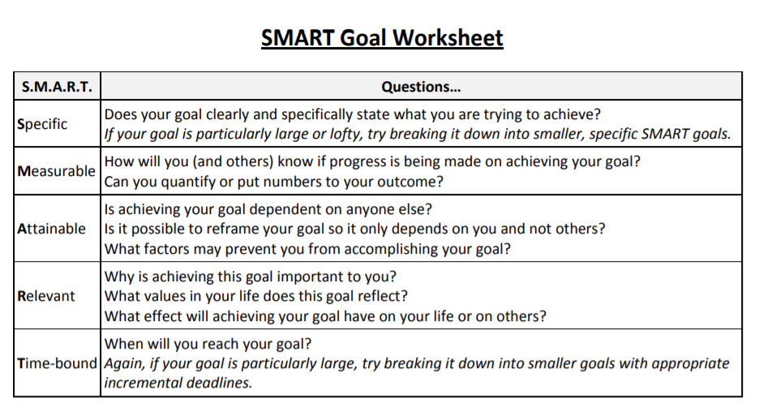
Notes:
Employees and Supervisors are encouraged to use SMART Goals when setting goals for the upcoming year. SMART goals are meant to address major job responsibilities and are intended to focus attention and resources on what is most important so that employees can be successful in achieving their priorities.
Common types of goals are to: Increase something; Make something; Improve something; Reduce something; Save something; Develop someone.
SMART Criteria:
S – Specific – When setting a goal, be specific about what is to be accomplished.
M – Measurable – What metrics will be used to determine if the goal is met?
A – Achievable – Goals must be attainable. The goal is meant to inspire and motivate, not discourage.
R – Relevant – Does the goal fit within the broader goals of the University
T – Timebound – What is the target date for completion? Is the timing realistic?

Slide 18
VIDEO Training
    https://uwservice.wisconsin.edu/video_learning/ep-manager/index.php
Notes:
And without further ado, let’s watch the video training that walks us through the Define Criteria step.

Slide 19
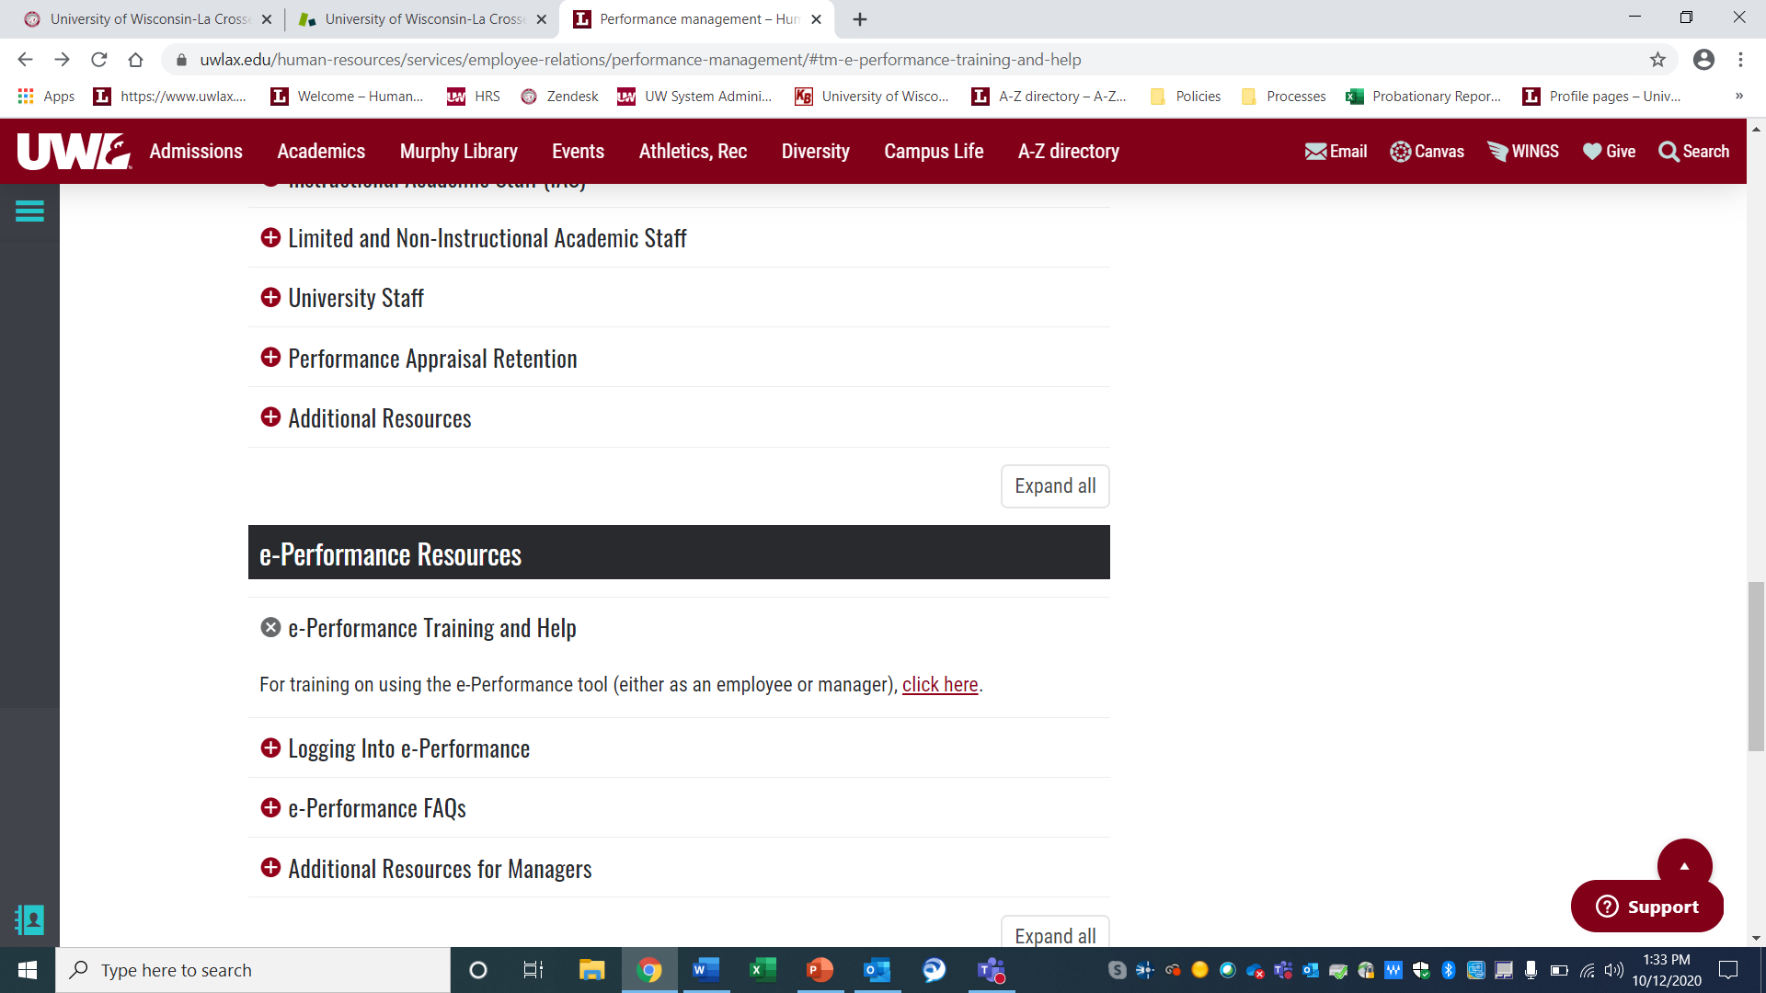
Notes:
You can find the link to the UW System e-Performance Training and Help site through the UWL HR’s performance management page.
At the bottom of the page there will be e-Performance resources section that will take you directly to a multitude of resources for each step.

Slide 20
Checkpoint
  The Checkpoint phase is the second step of the electronic version of the evaluation process.
  This step establishes the opportunity for the supervisor and employee to finalize any goals for that year and to discuss the employee’s performance and progress thus far.

Slide 21
Notes:
The first step of the transition to the e-Performance process, and the topic of our last training which you can find on our CSSN channel in Microsoft Teams, was the Define Criteria step. The Define Criteria step establishes the performance criteria that the employee will be evaluated against – more commonly known as goal setting.
As you can see on the flow chart of the e-Performance process, we have moved beyond the define criteria step and will be moving on to the next steps which are the optional checkpoint and Finalize Criteria of which our training will focus specifically on today.

Slide 22
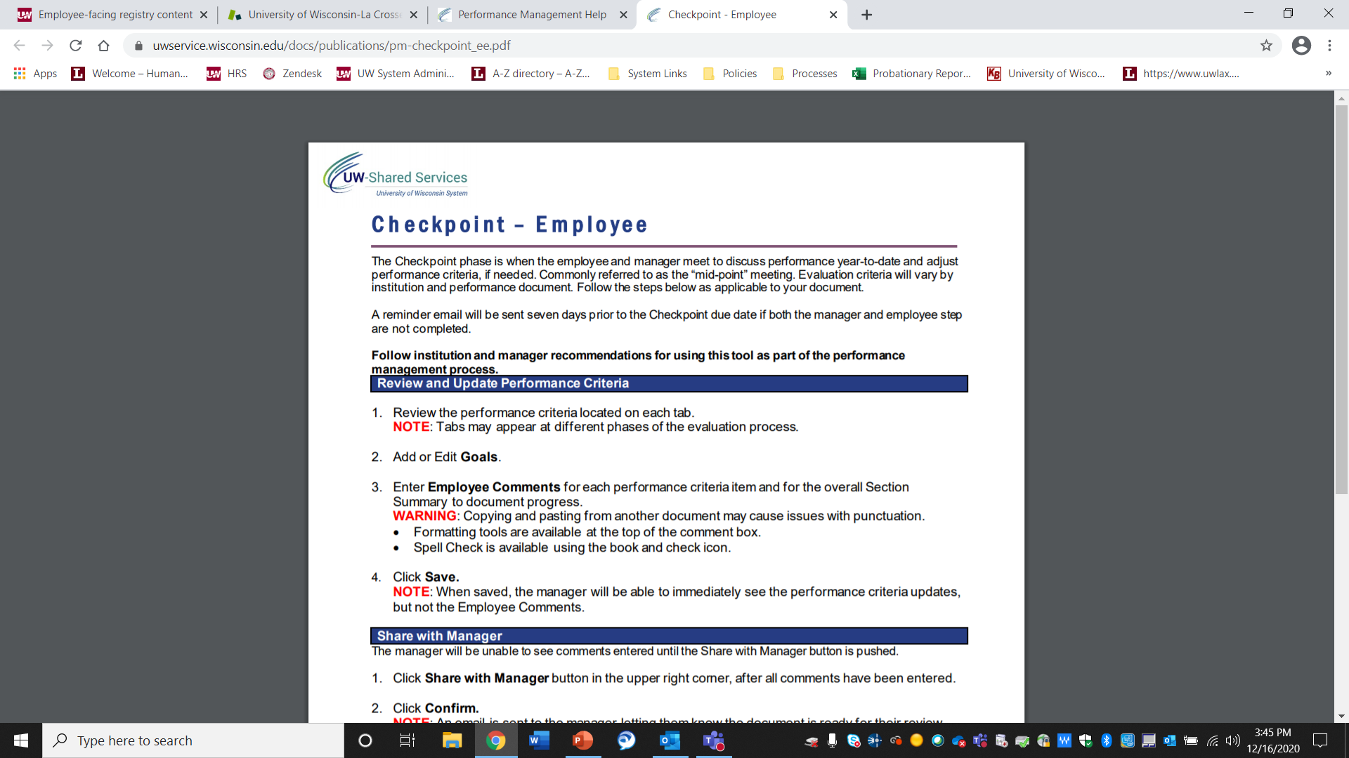
Notes:
Before we go into the steps of how to finalize criteria, I wanted to briefly touch on the optional checkpoint phase – this phase is when the employee and the manager meet to discuss the performance criteria, or goals, as needed.
In a normal year, this would be viewed as a mid-point meeting to give the employee and the manager an opportunity to discuss the progress of goals, to make any notes, or adjustments.

Slide 23
Finalize Criteria/Checkpoint
  The Finalize Criteria step is the last opportunity to adjust performance criteria (goals) and add comments.
  A reminder email will be sent from UW System seven days prior to the Finalize Criteria due date if both the manager and employee step are not completed.
Notes:
The Finalize Criteria step is the last opportunity to adjust the performance criteria and add comments before moving into the evaluation phase.
As an FYI, a reminder email will be sent from UW System 7 days prior to the finalize criteria due date to both the manager and the employee if these steps are not complete. Because our launch of e-performance is a soft launch, we do not require them to be due on their due date at this time. However, we highly recommend completing these as soon as possible as the evaluations are due on June 30th.

Slide 24
Notes:
To complete this step you will need to login and access the performance documents of each of your employees. The easiest route to access the Performance Management documents are through the My UW portal.
Be sure to Select your institution from the Organization drop down list – UW La Crosse and Click Go. You will then be prompted to Enter your UW Institutional ID username and password. Once logged in you should see a Performance Management Tile. This Tile is where you will be able to access the performance management documents. The Employee icon takes you to your personal documents and the Manager icon is for managers to see a list of documents of their direct reports.

Slide 25
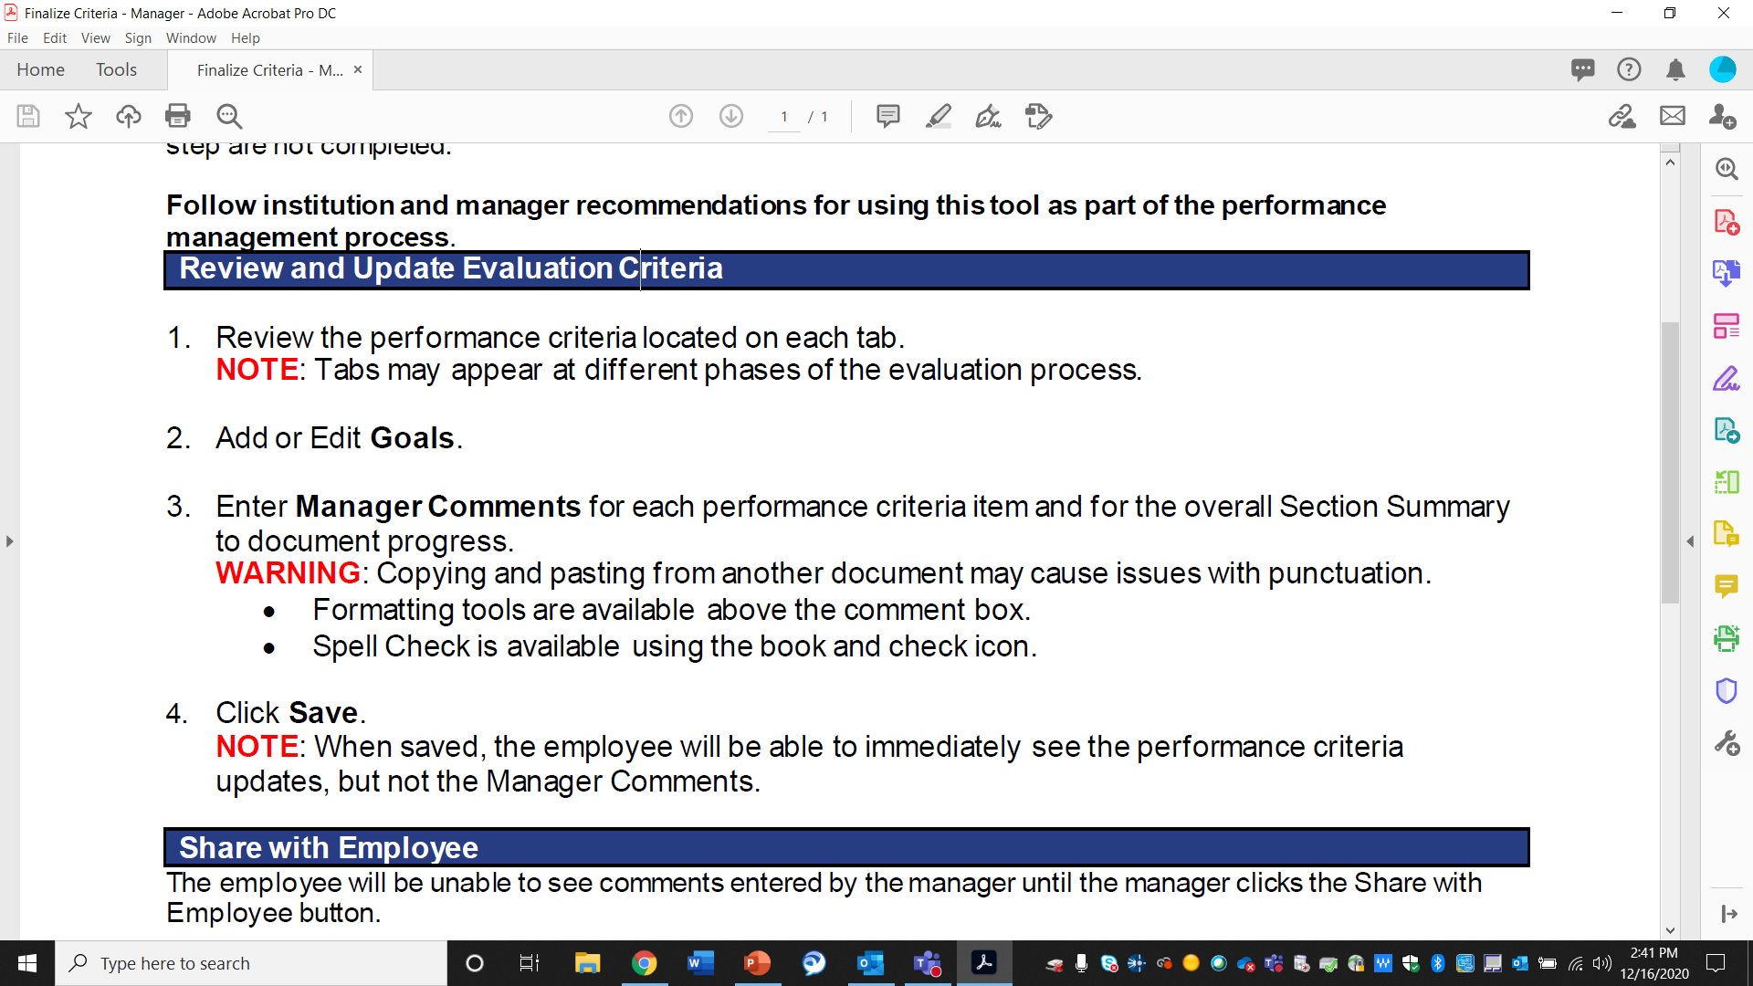
Notes:
Once you are in the evaluation and to begin completing the Finalize Criteria you will want to:
1. Review the performance criteria located on each tab to ensure that the goals are still relevant.
2. If changes need to be made – you will have the ability to Add or Edit the Goals (for example if due dates have changed or a project has been cancelled) by selecting the edit or add goal button
3. Next you will want to enter your Comments for each goal, as well as, in the overall Section Summary to document progress to date.
4. Finally, you will click Save. Please NOTE: When selecting the save button, the employee will be able to see the performance criteria updates, but not the Manager Comments.

Slide 26
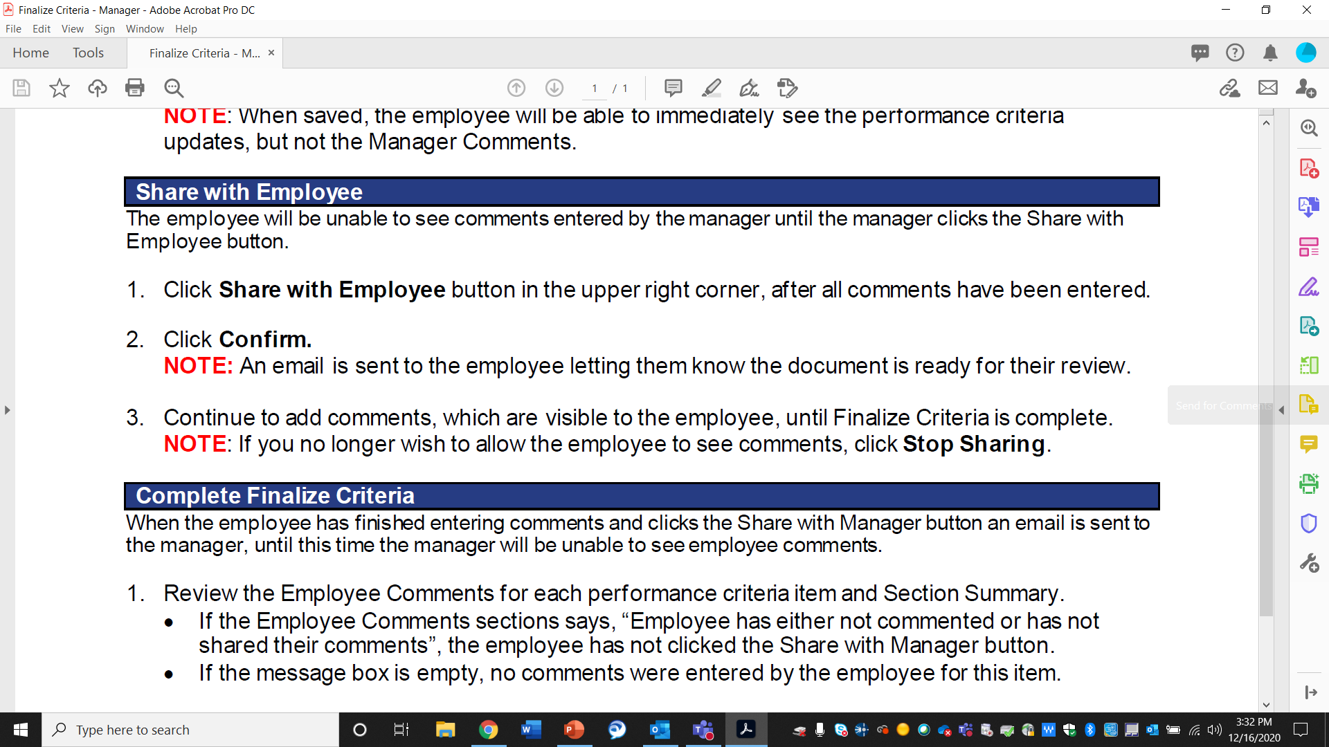
Notes:
Since the employee will be unable to see comments entered, and after you have entered all your comments, you will want to share with the employee. You can do this by:
1. Clicking the Share with Employee button in the upper right corner
2. And then Click Confirm. As a side NOTE: An email is sent to the employee letting them know the document is ready for their review.
3. You can continue to add comments, which will be visible to the employee, until the Finalize Criteria step is complete. **If you no longer wish to allow the employee to see comments, click Stop Sharing.**

Slide 27
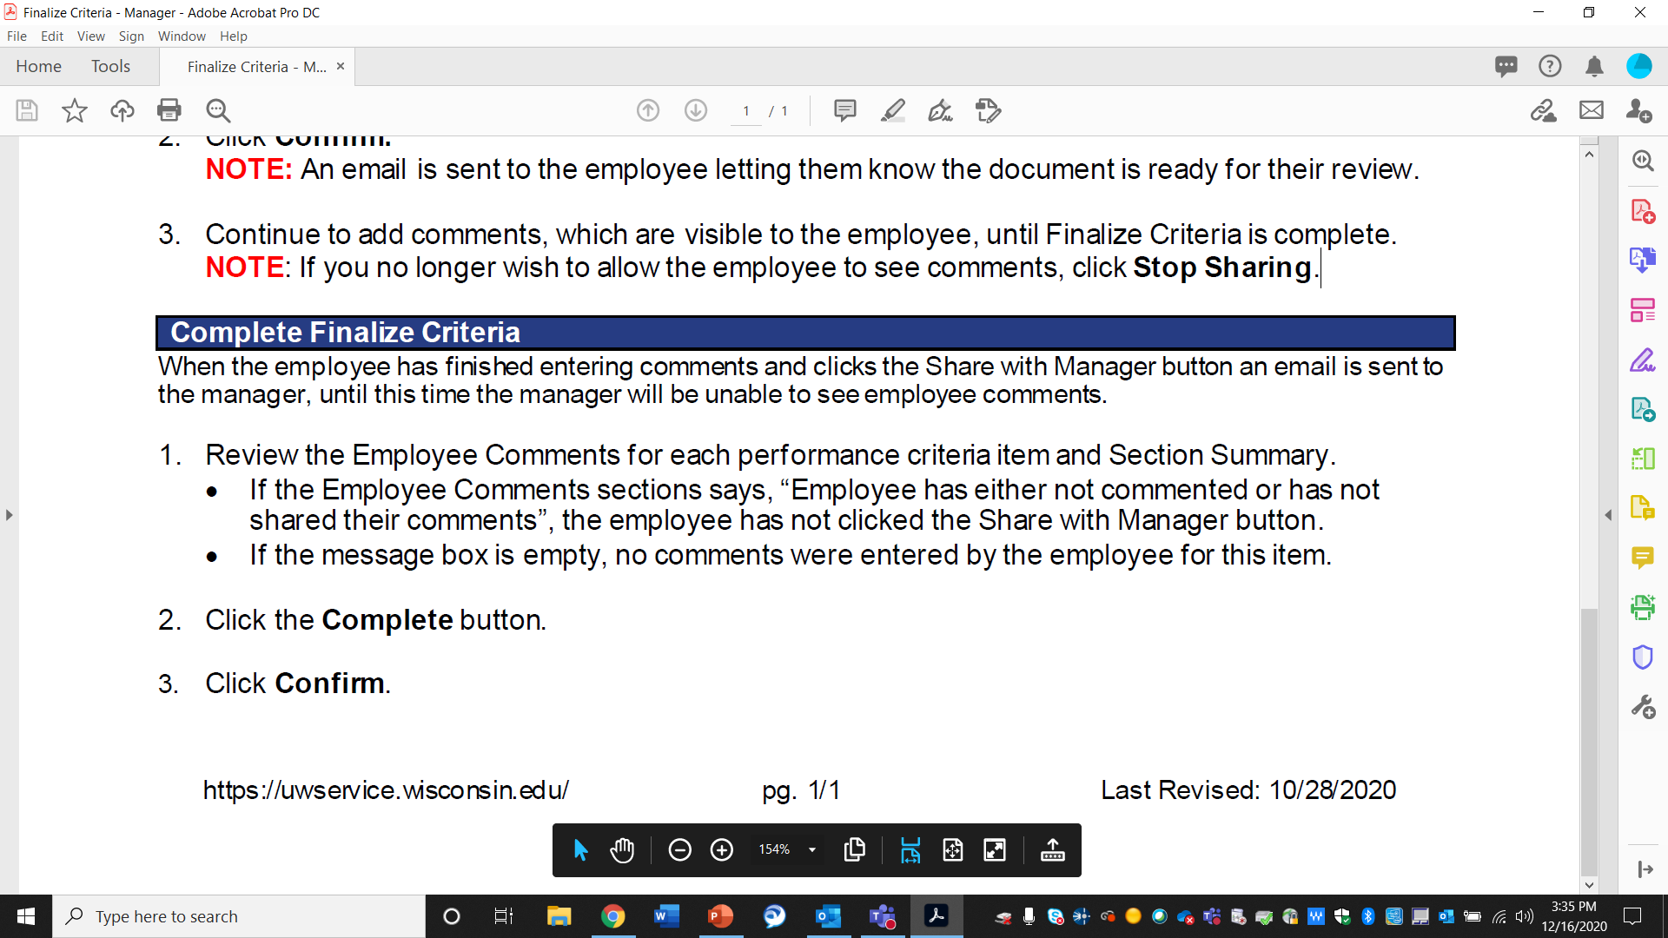
Notes:
Next, the employee will enter in their comments with any changes, additional goals, and current progress. Once they have finished entering comments and select the Share with Manager button, you will receive an email indicating that you will need to complete the final action step to the Finalize Criteria phase. To do this, you will want to go in and
1. Review the Employee Comments for each performance criteria item and Section Summary.
• If the Employee Comments sections says, “Employee has either not commented or has not shared their comments”, the employee has not clicked the Share with Manager button.
• If the message box is empty, no comments were entered by the employee for this item.
2. Click the Complete button.
3. Then Click Confirm.
Once these steps have been completed – you will have finalized the performance criteria for your direct reports.

Slide 28
Notes:
You can find additional information and step by step instructions by accessing the link to the UW System e-Performance Training and Help site found through the UWL HR’s performance management page.

Slide 29
Manager Evaluation
The manager evaluation is the final step of the ePerformance process for the annual review of the employee’s performance.
During this portion of the review process, the supervisor has the opportunity to evaluate the employee’s performance based on the assigned competencies, talk with the employee about their performance, and begin planning for the next year.

Slide 30
///////
Notes:
In a normal year, the attached flow chart shows you the e-Performance process in full. However, this year most of these steps are optional, except for the manager evaluation and employee acknowledgement.

Slide 31
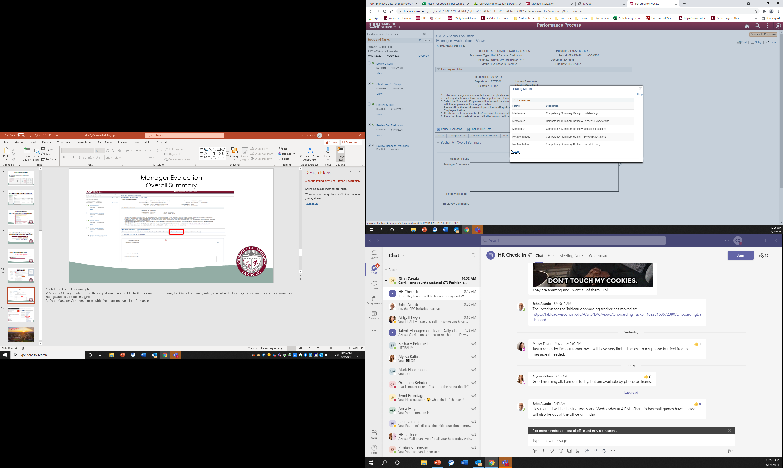
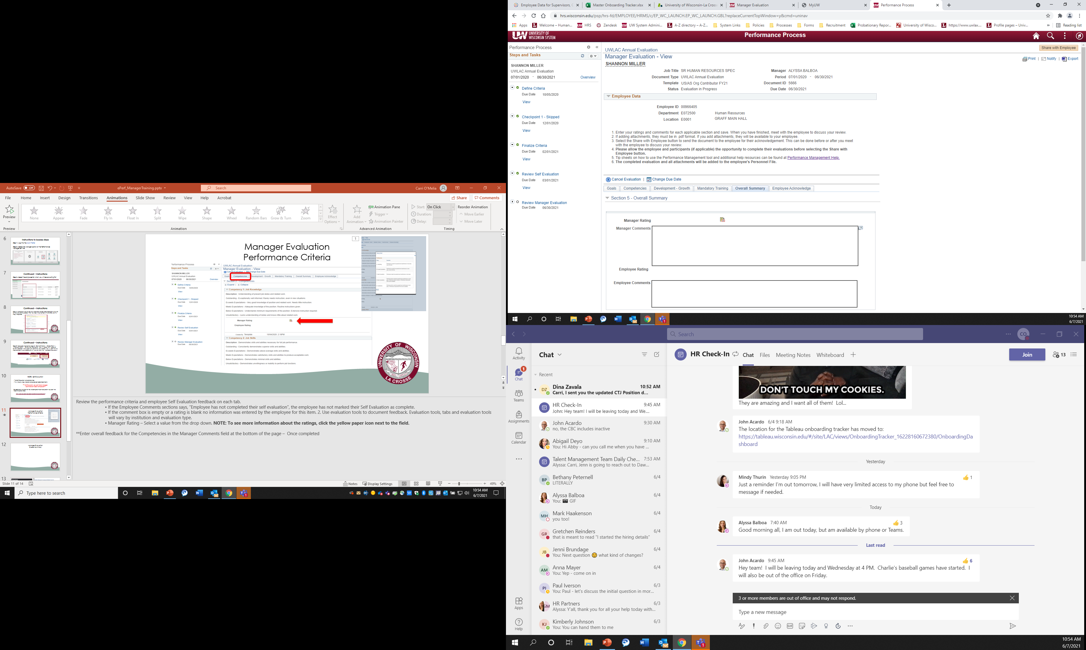
Manager Evaluation
Overall Summary
Notes:
Once the competencies have been completed, you will want to complete the manager evaluation overall summary.
First, Select the Overall Summary tab.
Second Select an overall Manager Rating for this Performance Evaluation cycle from the drop down (you can access the drop down by clicking on the yellow paper icon.) NOTE: For many institutions, the Overall Summary rating is a calculated average based on other section summary ratings and cannot be changed.
Lastly, Enter Manager Comments to provide feedback on overall performance.

Slide 32
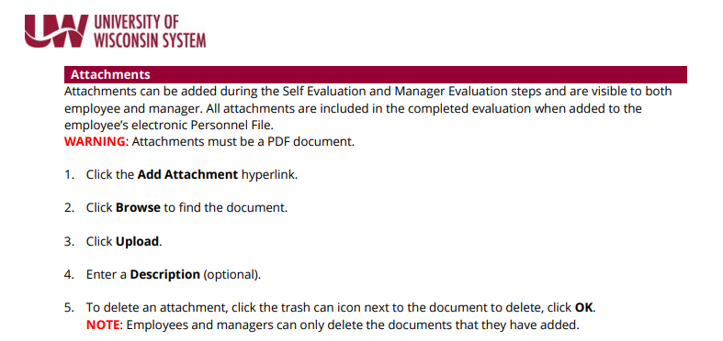
Attachments
Notes:
Attachments can be added during the Self Evaluation and Manager Evaluation steps and are visible to both
employee and manager. All attachments are included in the completed evaluation when added to the
employee’s electronic Personnel File. ALL: Attachments must be a PDF document.
1. Click the Add Attachment hyperlink.
2. Click Browse to find the document.
3. Click Upload.
4. Enter a Description (optional).
5. To delete an attachment, click the trash can icon next to the document to delete, click OK.
As a NOTE: Employees and managers can only delete the documents that they have added and will need to be added PRIOR to submitting as complete.

Slide 33
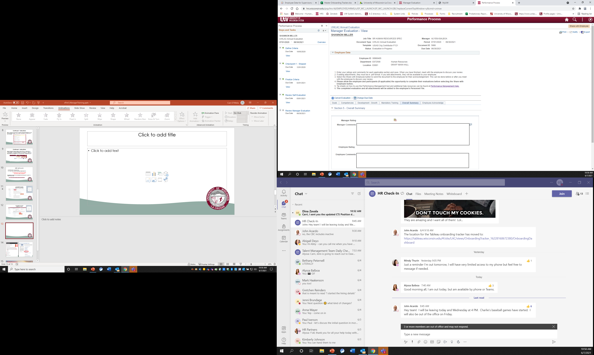
Manager Evaluation
Finalization
**Recommended to have the performance conversation prior to sharing the electronic evaluation**
Notes:
Once you have completed the competencies and overall summary section of the Performance Evaluation, to finalize the evaluation and send to the employee acknowledgement step, you will want to Click Share with Employee, in the upper right corner and then Click Confirm.
DO NOT SHARE the document with the employee UNTIL:
• the employee has marked their Self Evaluation complete, if applicable.
• and all ratings are entered. If ratings are not entered a red error message will appear below the Employee Data section on the document.
NOTE:
• Once the document has been shared with the employee, it can no longer be edited.
• An email notification is sent to the employee requesting acknowledgement.
IT IS RECOMMENDED TO HAVE THE PERFORMANCE EVALUATION CONVERSATION WITH THE EMPLOYEE PRIOR TO SHARING THE COMPLETED ELECTRONIC PERFORMANCE EVALUATION WITH THEM.

Slide 34

Employee Acknowledgement
Notes:
The last and final step is the employee acknowledgement of the evaluation. This acknowledgement serves as their signature.
To do this they will need to:
1. Access the evaluation.
2. Click the Employee Acknowledge tab.
3. Enter Employee Comments (optional)
4. Click the Acknowledge button in the upper right corner.
5. Click Confirm to verify they have reviewed the document with their manager.
NOTE:
• Clicking Confirm will act as your electronic signature on the document.
• An email notification will be sent to the manager.

Slide 35
Notes:
You can find additional information and step by step instructions by accessing the link to the UW System e-Performance Training and Help site found through the UWL HR’s performance management page.

Slide 36

E-Performance
Questions?
Notes:
Questions????

