Slide 1
SMART Goals

Slide 2
E-performance - Setting Goals
Employees and Supervisors are encouraged to use SMART Goals when setting goals for the upcoming year.
SMART goals are meant to address major job responsibilities. The goals are intended to focus attention and resources on what is most important so that employees can be successful in achieving their priorities.
Common types of goals are to: Increase something; Make something; Improve something; Reduce something; Save something; Develop someone.

Slide 3
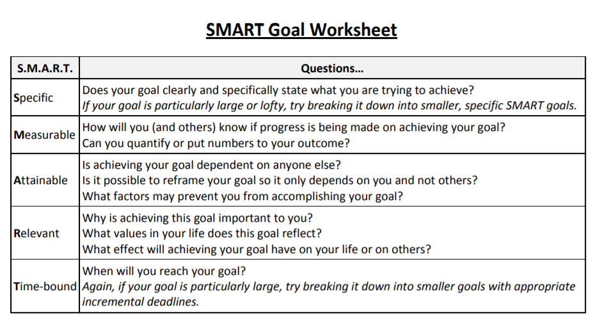

Slide 4
SMART Goal Topics
“Improve project management skills.”
“Send out welcome letters to our new students.”
“Keep our department’s website up-to-date.”
Talk amongst yourselves…

Slide 5
SMART Goal Examples
Goal Topic: “Improve project management skills.”
SMART: “Take the Project Management Essentials workshop on 10-18-2023, report what was learned to our team by 11-01-2023, and apply the relevant concepts while implementing our 2024 marketing plan.”
Goal Topic: “Send out welcome letters to our new students.”
SMART: “Produce and distribute personalized welcome letters, error free, to all new students in our department by 9-26-23.”
Goal Topic: “Keep our department’s website up-to-date.”
SMART: “Solicit updates and new material for the website from our department managers on the first Friday of each month; publish this new material by the following Friday. Each time material is published, review the website for material that is out-of-date and delete or archive that material.”

Slide 6
E-performance SMART Goals
Performance Management:
  UWL Performance Management Page
The most important steps of the whole process…. It sets the stage for the year.

