Slide 1
Budget Office
Fiscal Year 2022-23
0

Slide 2
UWL Operating Budget FY23
UWL Budget: $235,022,053

Slide 3
All Funds Budget by Division & College

Slide 4
Mission Statement
The mission of the University of Wisconsin-La Crosse Budget Office is to effectively manage the budgetary resources of the university in support of its mission of instruction, research, and public service.
To fulfill its mission, the Budget Office provides campus executive management with objective, accurate and timely information and analyses to inform central decision making and strategic planning processes.
The Budget Office is responsible for ensuring that campus budgetary policy and practice conform to Federal, State, System and University regulations.
The Budget Office works with campus academic and administrative units in guiding the annual and biennial budgetary processes, assessing ongoing budget and planning issues, and establishing and monitoring controls over fund allocations. It provides decision support through cost benefit analysis, institutional research, and data reporting, analyzing, and forecasting.

Slide 5
Budget Team
Emily Roraff – Interim Budget Director
College of Business Administration
College of Arts, Social Sciences, and Humanities
College of Science & Health
Kelly Reuter– Senior Budget Analyst
Division of Student Affairs
Division of Diversity and Inclusion
Kristen Piske – Budget Analyst
Division of Administration & Finance
Division of University Advancement
Mandi McKinney – Budget Analyst
Division of Academic Affairs
School of Education
Division of Graduate & Extended Learning

Slide 6
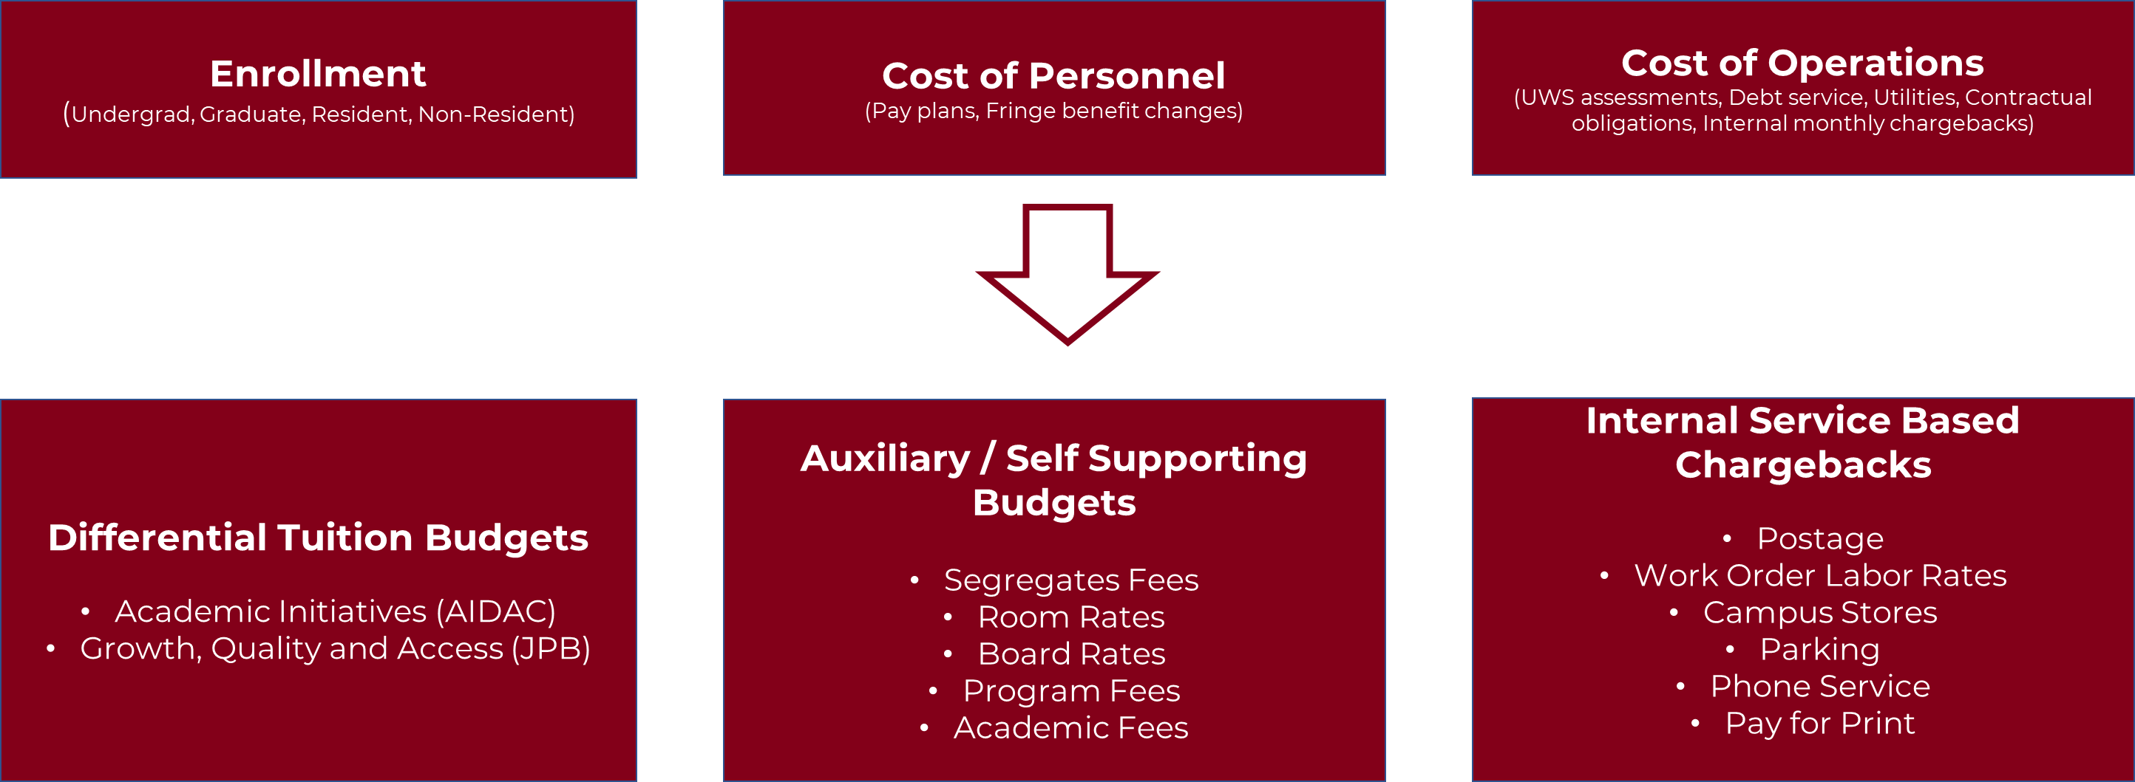
Annual Budget Cycle

Slide 7
Annual Budget Cycle
Enrollment/Tuition Forecasting
Rate Analysis
Budget Hearings
Budget Entry
UW System Reporting
Tuition and Fees
Current & Multi Year Forecasting
PR Balances/Spend Plans
Fiscal Year End Transfers and Internal Reporting

Slide 8
Ongoing Functions
Project Funding
- Coordinate funding to DOA for major projects
- Manage funding for “small” campus projects
Grants
- Oversee state appropriation grants
- Internal grants
Budget Transfers
- Review from units
- Initiate transfers from central funds
Recruitment / HR
- Analysis for target salaries
- HR forms
Financial analysis for new programs or degree offerings
UW System and other Financial Reporting
Deficit account management*
Guidance on use of fund types*
Request new accounts*
WISER*

Slide 9
Budget Management

Slide 10
Resources
https://www.uwlax.edu/budget/
Budget Policies and Procedures
Budget FAQ

Slide 11
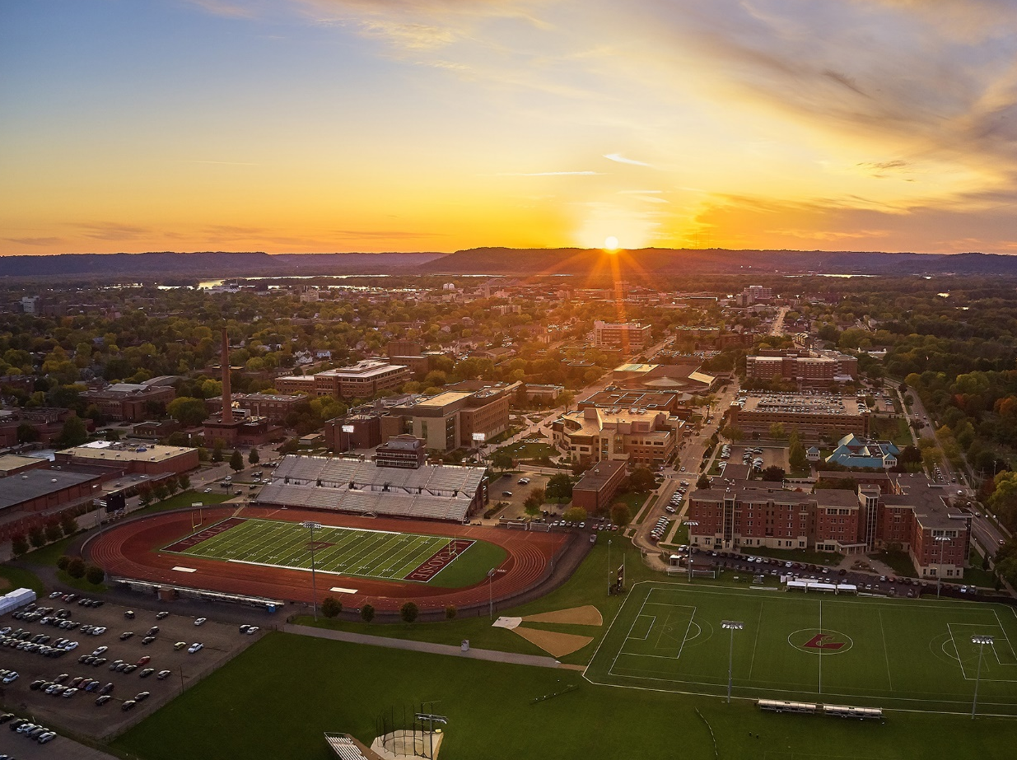
Questions & Answers

