Slide 1
Time and Labor Reporting/Approving for Supervisors

Slide 2
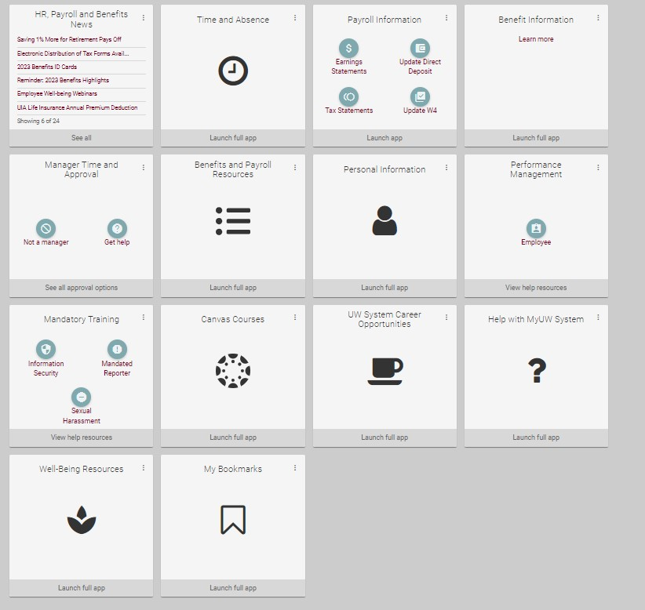
My UW Portal
Your My UW Portal is your one-stop shop for all things related to you as an employee and a supervisor.
Time and Absence for yourself and your employees, Payroll, Benefits, ePerformance, Mandatory Training, and many more can be accessed in your Portal.
Notes:
Your My UW Portal is your one-stop shop for all things related to you as an employee and a supervisor.
Time and Absence for yourself – click
Your employees – click
Payroll – click
Benefits – click
ePerformance – click
Mandatory Training – click
and many more can be accessed in your Portal. – click to next slide

Slide 3
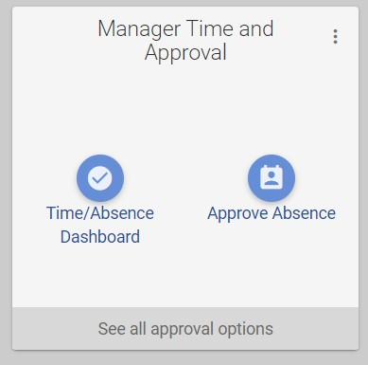
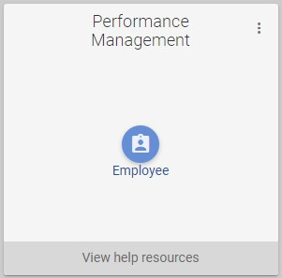
Manager Tiles
Notes:
Some tiles in your My UW Portal would only be used for you as an employee and some will be for you as a supervisor/manager. You can approve time and absences in the “Manager Time and Approval” tile and complete your manager evaluations for your employees in the “Performance Management” tile
Today I am going to talk about the Manager Time and Approval time. – click to next slide

Slide 4
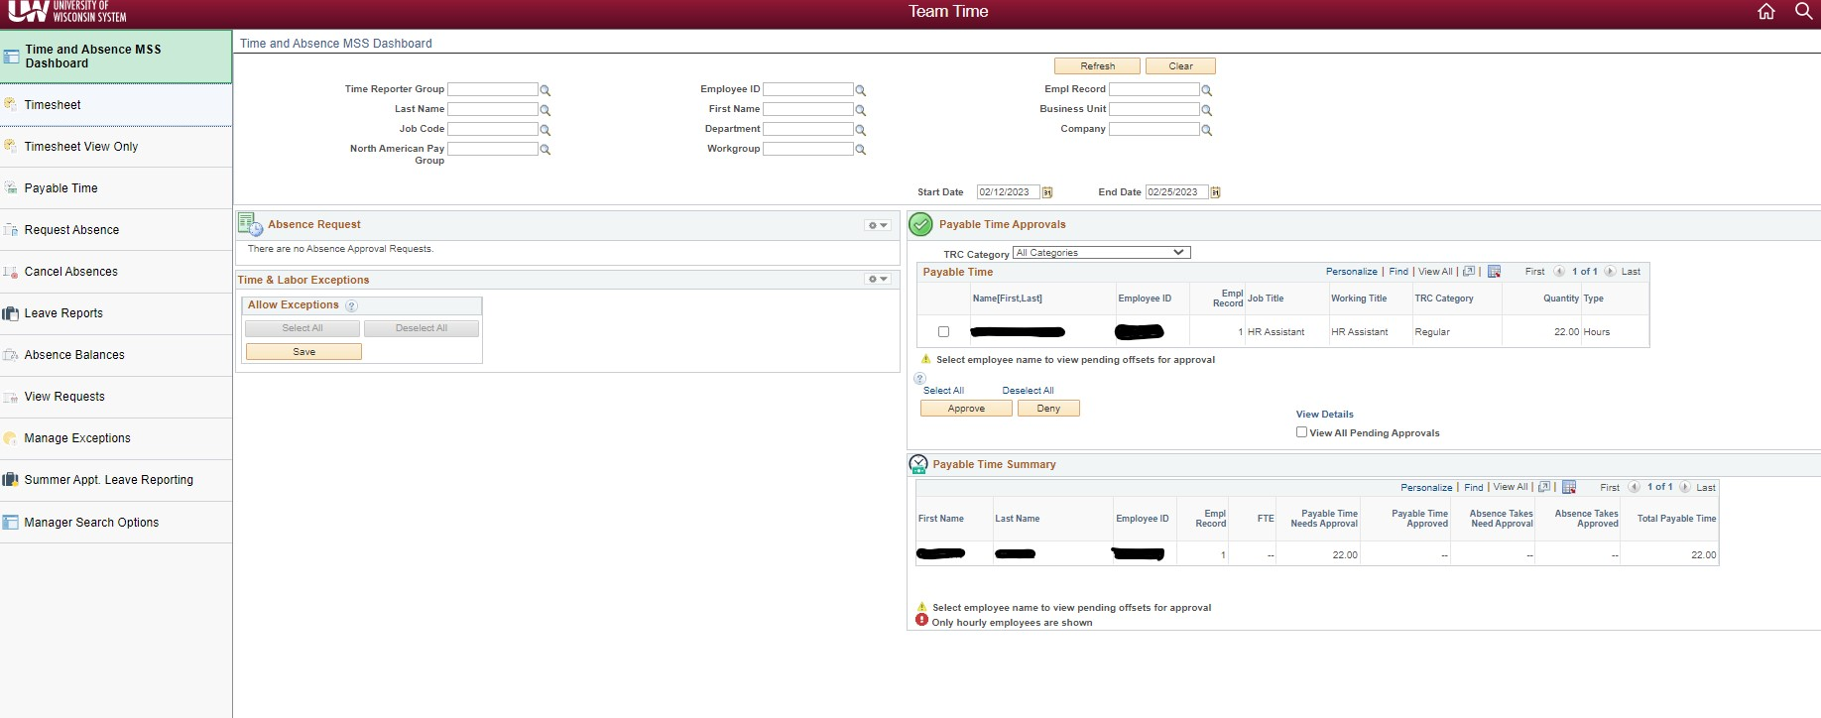
Manager Dashboard Informational Video from UW System
Notes:
We will start with a cheesy, but information video from UW System about navigating through your Manager Time and Absence Dashboard
Click Video link

Slide 5
Time and Absence MSS Dashboard View
After accessing your dashboard, you will be able to see an overview of all the time, absences, and exceptions that need to be reviewed
Notes:
After watching that video, you are now a little more familiar with your Manager Time and Approval Dashboard. This gives you the at a glance view of everyone in your area. The Selection criteria at the top of your dashboard allows you to narrow your view of employees on your dashboard. (click) The time reporter group will default based on your manager search options page; this can be found in the bottom tab on the left-hand side of your screen if you wish to make changes to the default values.(click) If you are wanting to search for different employees, time report groups, etc. you can enter the information in the search criteria fields and click “refresh” to return the results.
The Dashboard will show your
Absence Requests - click
Time & Labor Exceptions – click
Payable Time approvals – this shows time that needs to be approved, and it can be approved in this section - click
Payable Time Summary – at a glance view of all payable time for that time period – click to next slide
Accessing the Dashboard: https://uwservice.wisconsin.edu/docs/publications/mss-accessing.pdf
Selection Criteria: https://uwservice.wisconsin.edu/docs/publications/mss-selection-criteria-113.pdf
Time Reporting Groups: • "B" Groups - UW Supervisor • "C" Groups - UW Supervisor Backup

Slide 6
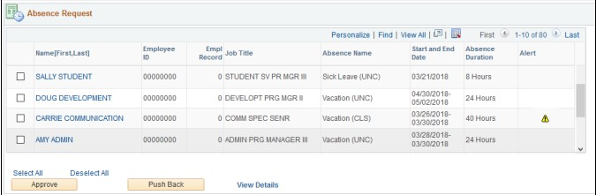
Time and Absence MSS Dashboard View – Absence Requests
The absence request section will allow you to view all absence requests that are waiting for approval. This is not limited to the pay period and includes any requests that have not been approved
An Alert will show if the absence requests will result in negative hours to the employee
Notes:
The absence request section will allow you to view all absence requests that are waiting for approval. This is not limited to the pay period and includes any requests that have not been approved. An Alert will show if the absence requests results in negative hours to the employee – click to next slide
https://uwservice.wisconsin.edu/docs/publications/mss-absence-request.pdf

Slide 7
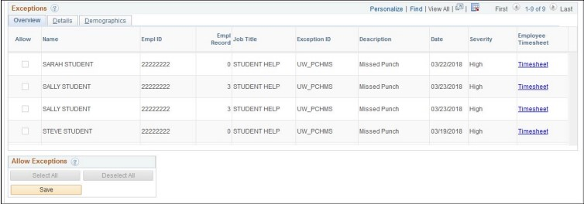
Time Exceptions MSS Dashboard View
This section allows you to review and fix time exceptions that may be showing on an hourly employee’s timesheet.
There are many reasons why a time exception may occur but most commonly you will see an exception for a “missed punch” or a punch that is longer than 12 or 24 hours
Exceptions can be reviewed either through the dashboard view or by clicking the hyperlink to go to the employee's timesheet
Notes:
This section allows you to review and fix time exceptions that may be showing on an hourly employee’s timesheet.
There are many reasons why a time exception may occur but most commonly you will see an exception for a “missed punch” or a punch that is longer than 12 or 24 hours. NOTE: You will see an exception for hourly employees for a “missed punch” when their clock may be running. You can act on a “missed punch” action if it is after a day or so.
Exceptions can be reviewed either through the dashboard view or by clicking the hyperlink to go to the employees timesheet – click to next slide
https://uwservice.wisconsin.edu/docs/publications/mss-exceptions.pdf

Slide 8
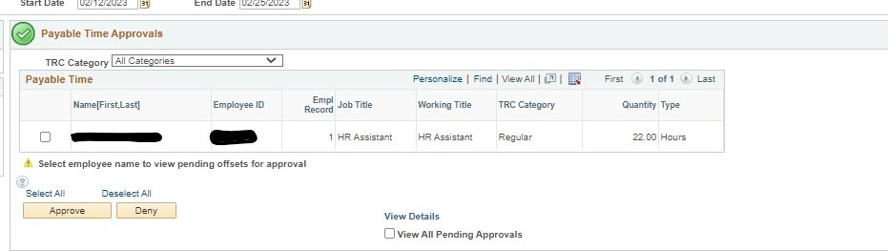
Payable Time MSS Dashboard View
Will only show you payable time that needs approval during the current pay period that is being processed
If you would like to view an employee's timesheet, you can click their name in this section
You can filter your results to show different categories like overtime etc.
You can approve individual or multiple requests with this section
An alert will show if you have other payable time to approve that does not fall within the current pay period
Notes:
Will only show you payable time that needs approval during the current pay period that is being processed
Clicking the hyperlink on their name will let you view an employee’s timesheet to adjust if needed
The category is set to view all pending approvals. You can filter your results to show different categories like overtime, comp time, regular hours, etc. if you wish to see a select group of time.
You can approve individual or multiple requests with this section at once by checking the box next to their name and click “approve/deny”
An alert will show if you have other payable time to approve that does not fall within the current pay period, to view this time you can click the “View all pending approvals” box – click to next slide

Slide 9
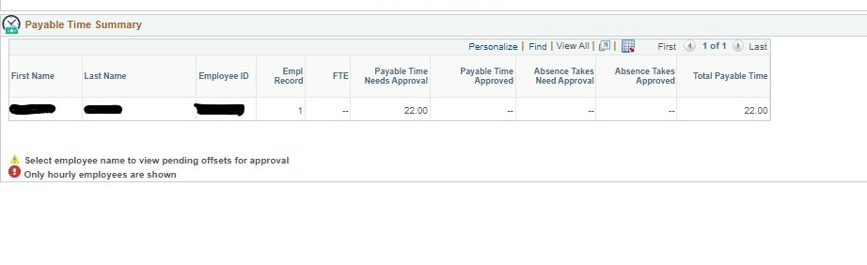
Payable Time Summary MSS Dashboard View
This section gives you an overview of all payable time for your employees
It will show time that has been approved, needs approval, absences taken, and total payable time
This is your at a glance section to see a quick overview of your employees time
Notes:
This section gives you an overview of all payable time for your employees
It will show time that has been approved, needs approval, absences taken, and total payable time
This is your at a glance section to see a quick overview of your employees time
Time and absences can not be approved/denied in this section, as this is just an overview

Slide 10
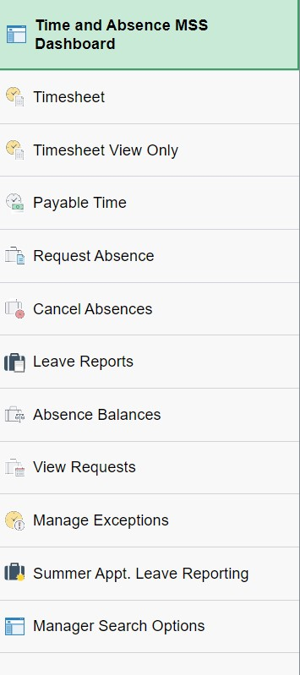
Additional Tabs
There are other specific tabs you can choose on the left-hand side that you can click on see a more focused view of the items you wish
Notes:
There are other specific tabs you can choose on the left-hand side that you can click on see a more focused view of the items you wish
The most notable tab would be the “Timesheet” tab – click to next slide

Slide 11
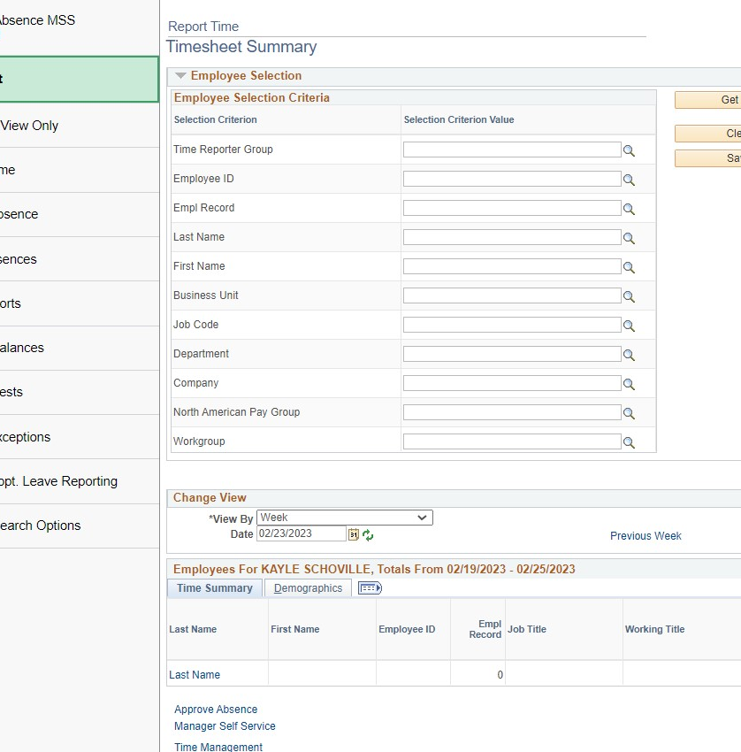
Timesheet Tab
Supervisors have the capability to change their employees time if needed before final calc
Supervisors can access their employee's timesheet by searching for them in the Employee Selection boxes
Notes:
Supervisors have the capability to change their employees time if needed before final calc
Supervisors can access their employee's timesheet by searching for them. You can enter information in any of the fields, click “Get Employees” then their name will appear at the bottom. From here you can click their name that is hyper linked, and it will take you into their timesheet.

Slide 12
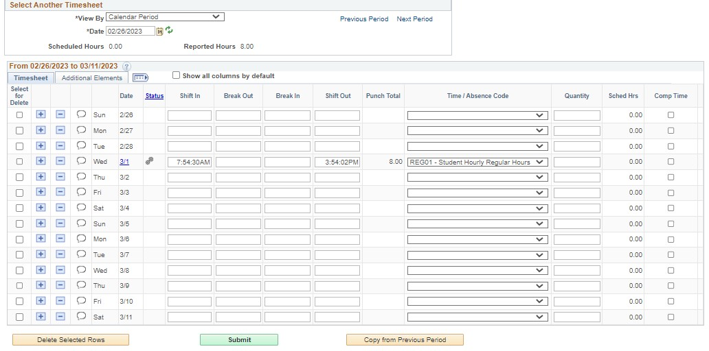
What if my employee entered the incorrect time on their timesheet, how would I change that?
Notes:
To update time for your employees you will need to click “timesheet” on the left-hand side
Once you access the employee's timesheet you can change/modify any of the time that is needed and can resubmit for approval later.
If time needs to be changed for previous pay periods you will need to submit your requests through hrinfo@uwlax.edu and we will work with our payroll team at UW System to make the corrections

Slide 13
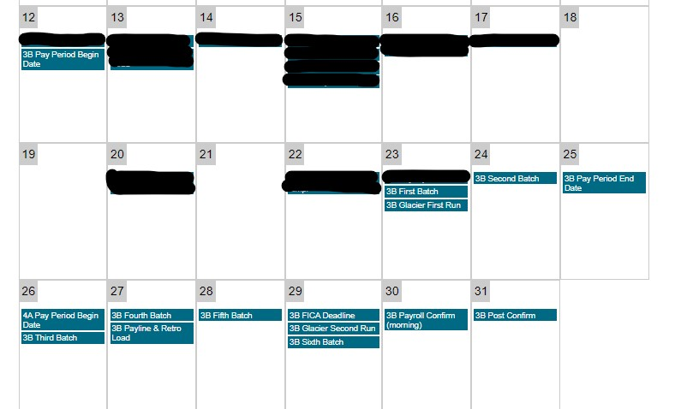
When do I need to approve time by?
Time approvals need to be processed the Tuesday after the pay periods end date by noon.
Notes:
Time approvals need to be processed the Tuesday after the pay periods end date by noon.
Using our next pay period as an example, we can see how we can determine what approvals are needed to be paid on time.
The 3B pay period starts on 03/12/2023 - click
and ends on 03/23/2023 - click
This means that the time worked during these dates needs to be approved by - click 03/28/2023
In addition, payments are made on the second Thursday following the pay period end date. That means the 3B paycheck will pay out on 04/06/2023. – click to next slide
Add links to payroll calendars

Slide 14
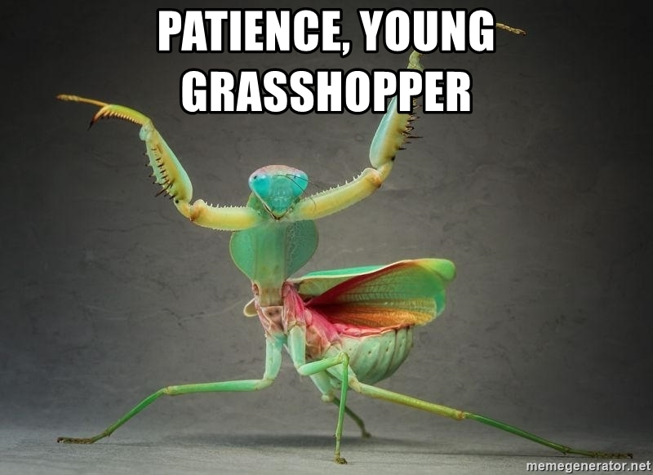
I already approved this time, why is it still showing as “unapproved”?
The time and absence dashboards will update 6 different times during the day. If time was approved outside of these times you will have to wait for the next run to see the updated approvals
Time Admin process will run at 4am, 9am, 11am, 1pm, 3pm, and lastly between 6-8 pm
Notes:
The time and absence dashboards will update 6 different times during the day. If time was approved outside of these times you will have to wait for the next run to see the updated approvals
Time Admin process will run at 4am, 9am, 11am, 1pm, 3pm, and lastly between 6-8 pm

Slide 15
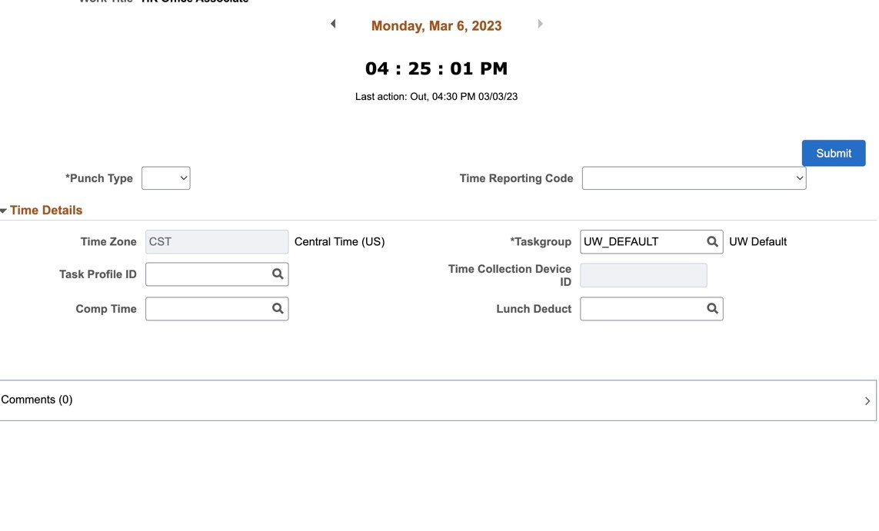
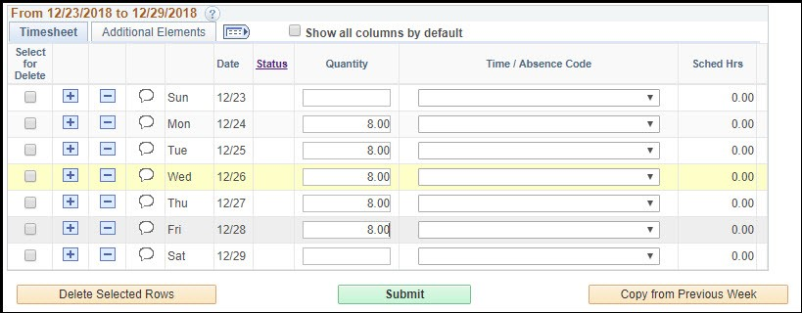
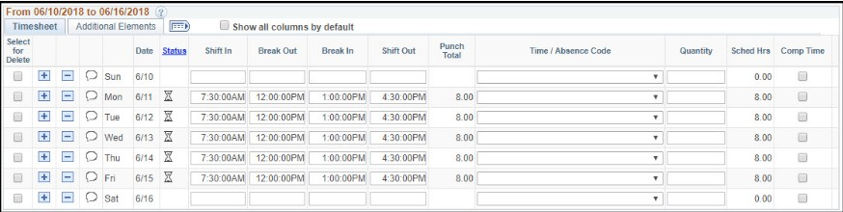
How does time reporting differ between employees I manage?
Depends on their classification/pay basis and FLSA status.
  Student Help – Webclock
  Hourly/FLSA Non-Exempt – Integrated Timesheet
  Hourly/FLSA Exempt – Elapsed Hourly Integrated Timesheet
  Academic/Annual/FLSA Exempt – only records absences
Notes:
Depends on your classification/pay basis and FLSA status.
Student Help – Webclock
Only able to punch time, no adjustments can be made by the student. If adjustments are needed the supervisor can make the changes or they can be sent to HR
Hourly/FLSA Non-Exempt – Integrated Timesheet
Standard timesheet that includes punch in, break out, break in, and punch out times. These employees can also earn comp/overtime
Hourly/FLSA Exempt – Elapsed Hourly Integrated Timesheet
Employees only record the quantity of hours worked on their timesheet. No need to enter punch in, break out, break in, and punch out times. These employees do not earn comp/overtime
Academic/Annual/FLSA Exempt – only records absences

Slide 16
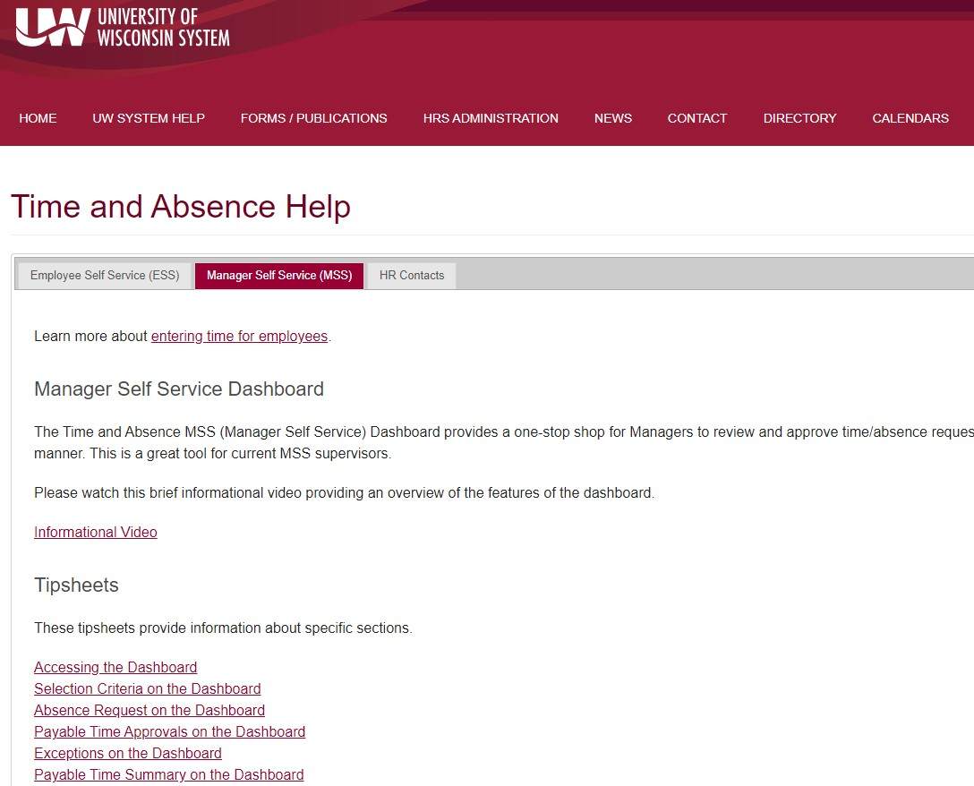
Additional Resources from UW System
https://uwservice.wisconsin.edu/help/time-absence/
Notes:
This website is full of different knowledge base articles to help employees and managers when it comes to approving time and absences.

