Slide 1

Reappointment:
Extend Fixed Term Employees
3.19.26

Slide 2
Extending Existing Contract – Fixed Term
Extend a fixed-term contract end date
  Part 1: Change Job > Extend Expected Job End Date (EJED)
    Use the Change Job Business Process to Extend Expected Job End Date (EJED)
    Enter the updated contract end date in the Maintain Employee Contract task
      Date must match the EJED
      If the EJED and Contract dates do not align, it may cause benefit and leave issues
  Part 2: Change Job > Reappointment - Terminal
    Shared Services recommends processing and completing EJED changes separately before using the Reappointment – Terminal for changes to compensation, business title, or FTE.
    Use the Reappointment - Terminal Contract Business Process if needing to make multiple changes to a position
      Can be used for any terminal contract
      Should be used when current position is continuing and can generate a new contract letter (but current contract details should not be inactivated)
        To prevent Workday from creating a new contract, the Expected Job End Date change BP needs to be submitted separately and use an effective date on or prior to the current contract end date

Slide 3
Part 1: Change Job > Extend Expected Job End Date (EJED)
Extend a fixed-term contract end date
  Part 1: Change Job > Extend Expected Job End Date (EJED)
    Use the Change Job Business Process to Extend Expected Job End Date (EJED)
    Enter the updated contract end date in the Maintain Employee Contract task
      Date must match the EJED
      If the EJED and Contract dates do not align, it causes benefit and leave issue

Slide 4
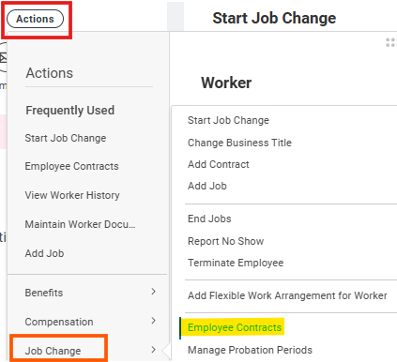
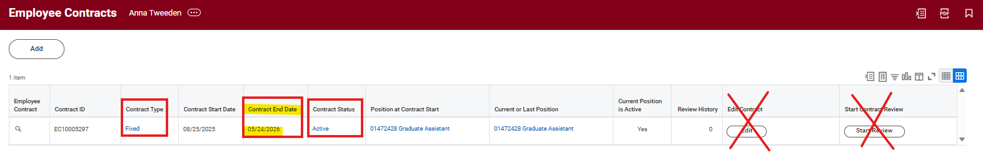
Step 1: EJED – Review Current Contract Details
Step 1: Review Current Contract Details
Navigate to the Worker Profile.
Click Actions → Job Change → Employee Contracts.
Confirm: Correct position is selected, Contract Type = Fixed, Contract Status = Active.
Make note of the Contract End Date
  Example: 05/24/2026
  Do not select Edit Contract or Start Contract Review

Slide 5
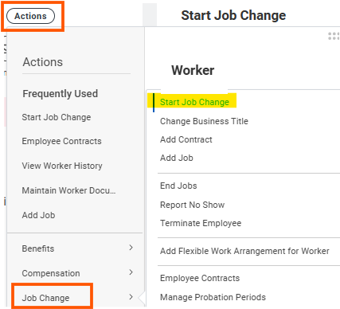
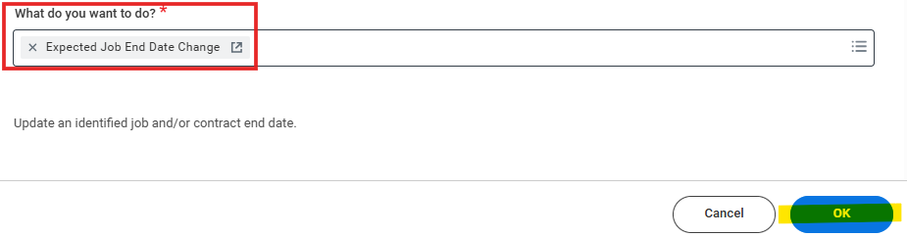
Step 2: EJED – Initiate Job Change
Step 2: Initiate Job Change
Return to the Worker Profile
Click Actions → Job Change → Start Job Change.
Within the 'What do you want to do?' field, select “Expected Job End Date Change” and click OK.

Slide 6


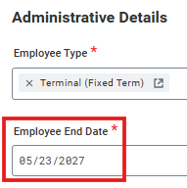
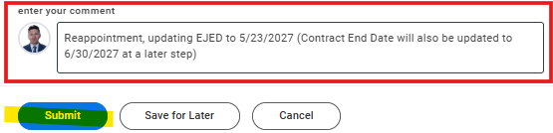
Step 3: EJED – Update Effective Date and EJED
Step 3: Update the Effective Date and EJED (Expected Job End Date)
Within the 'When do you want this change to take effect?’ field, type in the current Contract End Date that you noted in step 1.
  Example: 05/24/2026
Do NOT modify business title or pay rate type.
Update Employee End Date to the new job end date.
Make note of the new EJED date, as it will be required later when performing the 'Maintain Employee Contract' process to ensure the Contract End Date aligns with the EJED.
  Example: 05/23/2027
Add a comment: 'Reappointment, updating EJED and Contract End Date to MM/DD/YYYY.'
Attach supporting documents if needed.
Click Submit.
The change will then route to UWSS, the Position Budget Manager, and the HR Partner.
Notes:
Beverly Graves > Kristen Piske > Vinny Heal

Slide 7
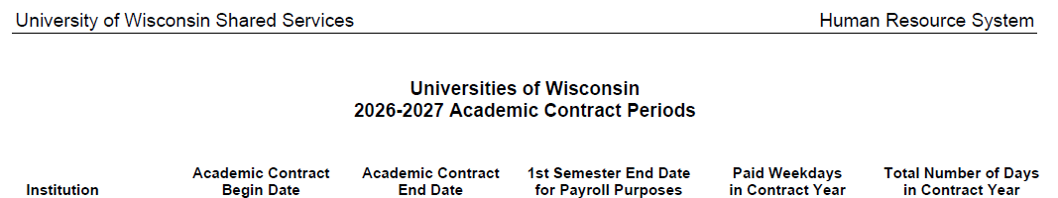
Contract End Dates
Contract End Dates for This Reappointment Cycle
Most contract end dates for this reappointment cycle will be 05/30/2027, as the majority of employees are 9‑month
Ifan employee is being extended for the Fall semester only, use 01/06/2027 as both the contract end date and the job end date (EJED).
For 12‑month employees, most contract and job end dates (EJED) should be set to 06/30/2027.
Notes:
Beverly Graves > Kristen Piske > Vinny Heal

Slide 8
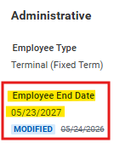
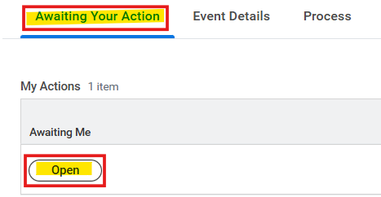
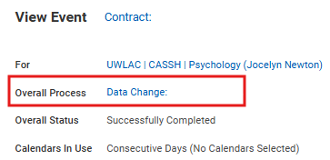
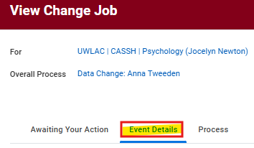
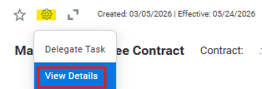
Step 4a: EJED – Maintain Employee Contract
Step 4a: Maintain Employee Contract
  Once the full sequence of approval tasks has completed, the Maintain Employee Contract task will be generated.
  The contract end date must align with the EJED to avoid unintended impact to Benefits and Leave eligibility.
  To check the previously updated Employee End Date:
    From the contract task, click on the Wheel > View Details > Click Data Change > Click Event Details
    The updated Employee End Date will appear underneath the administrative section
  Navigate to the Awaiting Your Action tab to go back to where you left off, and then click Open

Slide 9
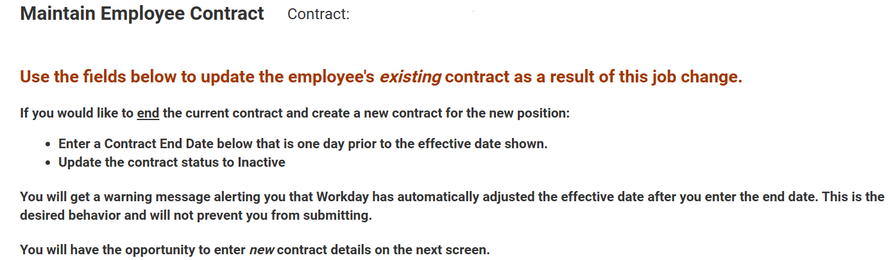
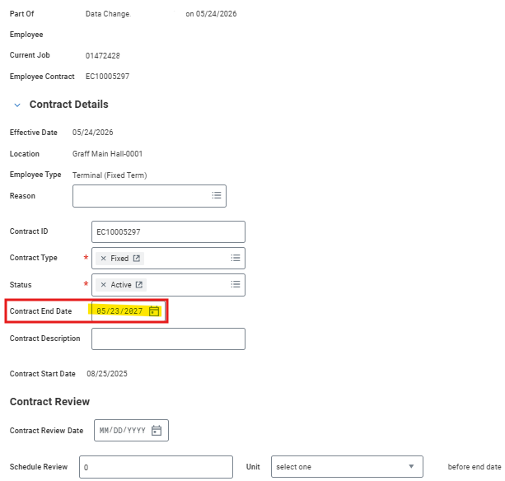

Step 4b: EJED – Maintain Employee Contract
Step 4b: Maintain Employee Contract
Within the Maintain Employee Contract task: Update the Contract End Date to match the new EJED.
  Scroll to the ‘Contract End Date’ field and modify the MM/DD/YYY to match the new EJED (Expected Job End Date).
    Example: 05/23/2027
  The contract end date must align with the EJED to avoid unintended impact to Benefits and Leave eligibility.
Click Submit.

Slide 10
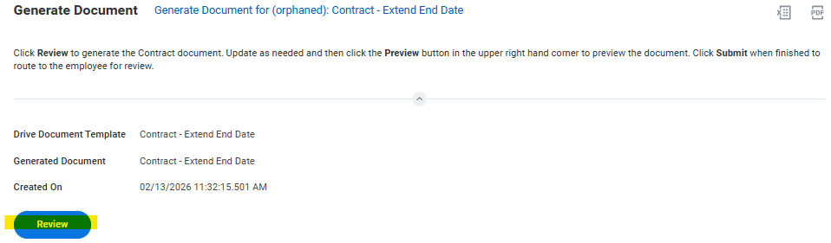
Step 5: EJED – Generate Document
Step 5: Generate Document
Open the ‘Review & Update Employee Contract Document:’ task and click ‘Review’
Update and edit all necessary fields (including those highlighted in red).
  Click the Preview button in the upper right-hand corner to preview the document
  Please ensure the contract is fully edited before sending, as the employee currently does not have the option to return it for further revisions.
Please refer to the Appointment details standard language located on the Business manager specific information page and include accordingly
If this is for an IAS position, include the following language in the offer letter:
  'You are paid based on credit hours assigned to this course and based on enrollment. This offer is contingent upon satisfactory enrollment in the assigned courses, or related courses, as determined by the Dean in consultation with the Provost at the conclusion of the registration period. If enrollments are not sufficient to warrant continuing one or more of the courses, the appointment may be modified to suit the enrollment demands, including withdrawal of this offer.’
Click Submit when finished to route to the employee for review.
An Assign Costing Allocation for Change Job task will route to the Cost Center Accounting Specialist
  They will complete the task by following the Assign Costing Allocation for Change Job process
    If not making changes to Costing Allocation, then they can Skip This Task
  At the same time, the contract will route to the employee’s Workday inbox for acknowledgement. Timely completion is essential to prevent potential issues with payroll, benefits, or leave.
Notes:
  If only updating the EJED, then do not skip the ‘Generate Document’ step.
    If the ‘Generate Document’ step is skipped, Shared Services will not be able to correct any contract details.
  If you are submitting both an EJED change and any other change through the Reappointment Terminal BP, then you should skip the Generate Document task as part of the EJED BP and use the Generate Document task from the Reappointment Terminal BP

Slide 11
EJED – Additional Notes
Additional Notes
Use the Expected Job End Date Change for updating job and/or contract end dates.
  Typically, stand-alone action (“Add Contract’, ‘Edit Contract’) should not be taken on Employee Contracts unless there is a data entry error, or you are starting the contract review (only for Regular Employees with Ongoing Contracts)
Effective Date should match the current Contract End Date.
EJED and Contract End Date must align to prevent Benefit and Leave issues.
Shared Services recommends processing EJED changes separately before using the Reappointment – Terminal BP for changes to compensation, business title, or FTE.

Slide 12

EJED – Questions

Slide 13
Part 2: Change Job > Reappointment Terminal
Extend a fixed-term contract end date
  Part 2: Change Job > Reappointment - Terminal
    Shared Services recommends processing and completing EJED changes separately before using the Reappointment – Terminal for changes to compensation, business title, or FTE.
    Use the Reappointment - Terminal Contract Business Process if needing to make multiple changes to a position
      Can be used for any terminal contract
      Should be used when current position is continuing and can generate a new contract letter (but current contract details should not be inactivated)
        To prevent Workday from creating a new contract, the Expected Job End Date change BP needs to be submitted separately and use an effective date on or prior to the current contract end date
  For Academic Staff, Fixed/Limited:
    9 Month employee staying in same position that has 5/24/26 contract end date and has FTE/Compensation change:
      After completion of Change Job EJED to update EJED and contract end date to 5/23/27
        Initiate a Change Job - Reappointment Terminal Contract BP with effective date of 8/24/26 (1st day of Academic Year)
    12 Month employee that has 6/30/26 contract end date and has FTE/Compensation change:
      After completion of Change Job EJED to update EJED and contract end date to 6/30/27
        Initiate a Change Job - Reappointment Terminal Contract BP with effective date of 7/1/26 (1st day of new contract)

Slide 14
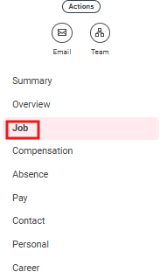
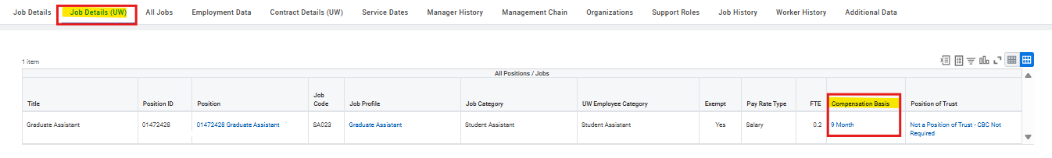
Determine if 9-Month or 12-Month Employee
Determine if 9-Month of 12-Month Employee
Navigate to the Worker Profile.
Click Job Tab from left navigation panel
Click Job Details from upper tabs
Review the Compensation Basis section
    9 Month employee staying in same position that has 5/24/26 contract end date and has FTE/Compensation change:
      After completion of Change Job EJED to update EJED and contract end date to 5/23/27
        Initiate a Change Job - Reappointment Terminal Contract BP with effective date of 8/24/26 (1st day of Academic Year)
    12 Month employee that has 6/30/26 contract end date and has FTE/Compensation change:
      After completion of Change Job EJED to update EJED and contract end date to 6/30/27
        Initiate a Change Job - Reappointment Terminal Contract BP with effective date of 7/1/26 (1st day of new contract)

Slide 15
Step 1: Reappointment Terminal –
Review Current Contract Details
Step 1: Review Current Contract Details
Navigate to the Worker Profile.
Click Actions → Job Change → Employee Contracts.
Confirm: Correct position is selected, Contract Type = Fixed, Contract Status = Active.
Make note of the Contract End Date.
  Example: 05/24/2026

Slide 16
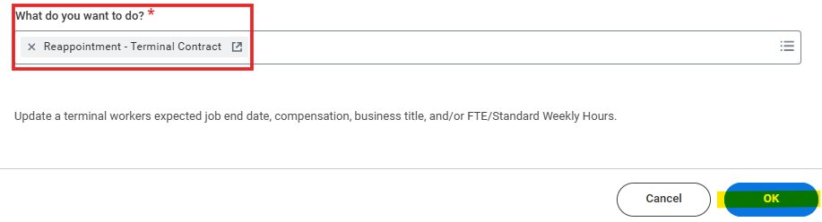
Step 2: Reappointment Terminal –
Initiate Job Change
Step 2: Initiate Job Change
Return to the Worker Profile.
Click Actions → Job Change → Start Job Change.
Please note that although the Reappointment – Terminal Contract BP refers to updating the EJED, we had to initiate this as a separate business process to avoid Workday initiating a new contract.
Within the 'What do you want to do?' field, select “Reappointment – Terminal Contract” and click OK.

Slide 17

Step 3: Reappointment Terminal –
Update the Effective Date
Step 3: Update the Effective Date
In the “When do you want this change to take effect?” field, the effective date depends on the employee’s compensation basis:
  9 Month Employees:
    The effective date should be the first day of the upcoming Academic Year.
    Example: 08/24/2026.
  12 Month Employees:
    The effective date should be the day after the current contract end date.
    Example: If the contract ends on 06/30/2026, the effective date would be 07/01/2026.
Note: If this was for a 9-month employee, you would update the effective date to reflect the first day of the academic year (ex: 8/24/26)
If this was for a 12-month employee, you would update the effective date to reflect the day after the current contract end date (ex: 7/1/26)

Slide 18
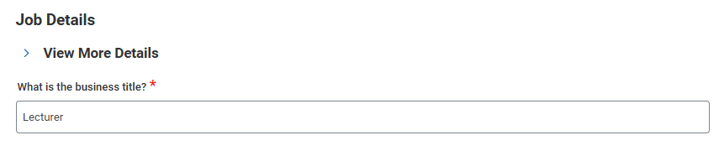
Step 4: Reappointment Terminal –
Update Business Title (If Needed)
Step 4: Update Business Title (If Needed)
Update Business Title if applicable and within policy (Title Change | UW System Administrative Policy 1257)

Slide 19
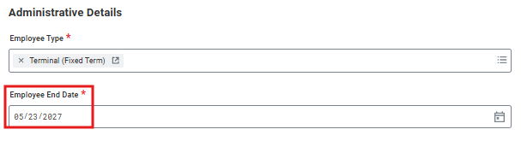
Step 5: Reappointment Terminal –
Confirm EJED
Step 5: Confirm EJED
The Employee End Date (Expected Job End Date) should already be updated through the previously completed EJED business process.
  Do not modify this field during the Reappointment – Terminal process.
To prevent Workday from generating a new contract, the Expected Job End Date (EJED) must be submitted as a separate business process (Step 1). Additionally, ensure that the EJED matches the Contract End Date to avoid issues with benefits and leave eligibility.
Do not modify during Reappointment – Terminal process

Slide 20
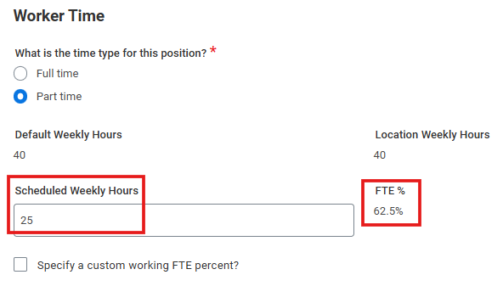
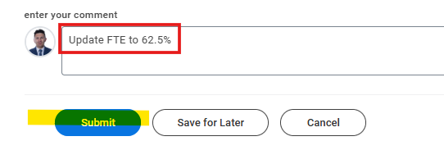
Step 6: Reappointment Terminal –
Modify FTE (If Needed)
Step 6: Modify FTE (If Needed)
Update Scheduled Weekly Hours under Worker Time.
  From the ‘Scheduled Weekly Hours’ field, you can type in the new amount.
  After clicking off this field, the FTE will calculate automatically.
Add comments.
Include attachments if needed.
Click Submit.

Slide 21
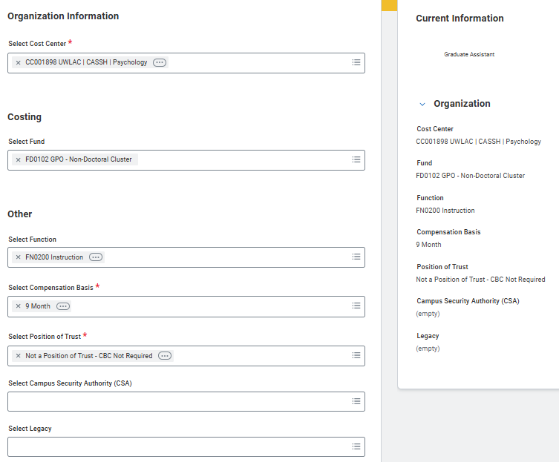

Step 7: Reappointment Terminal –
Modify Organization Assignments (If Needed)
Step 7: Modify Organization Assignments (If Needed)
Can update Cost Center, Fund, Function, Compensation Basis, Position of Trust and other fields if needed
Click Next when ready to advance

Slide 22
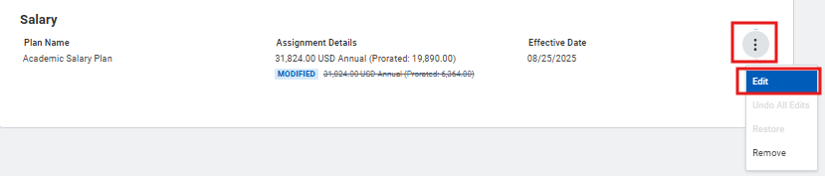
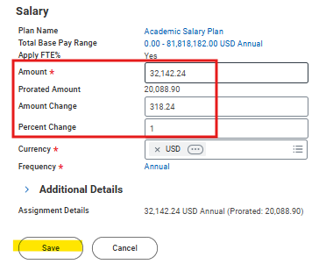
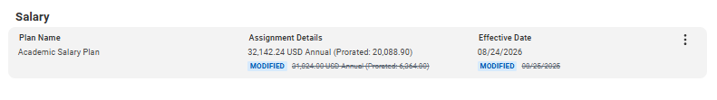

Step 8: Reappointment Terminal –
Update Compensation (If Needed)
Step 8: Update Compensation (If Needed)
Edit Salary under Compensation Stage.
  Click on the 3 Vertical dots within the Salary Section
  Click Edit.
  Adjust salary amount and click Save.
Click Next to advance from the ‘Compensation’ stage to the ‘Review and Submit’ stage.

Slide 23
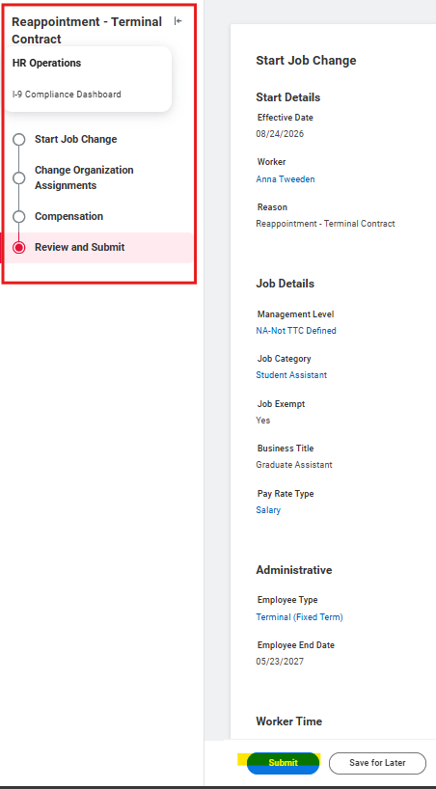
Step 9: Reappointment Terminal –
Review and Submit
Step 9: Review and Submit
Verify changes, add comments/attachments, click Submit.
  If changes are needed, use the stage menu on the left to navigate back to the appropriate step and make any necessary adjustments.

Slide 24
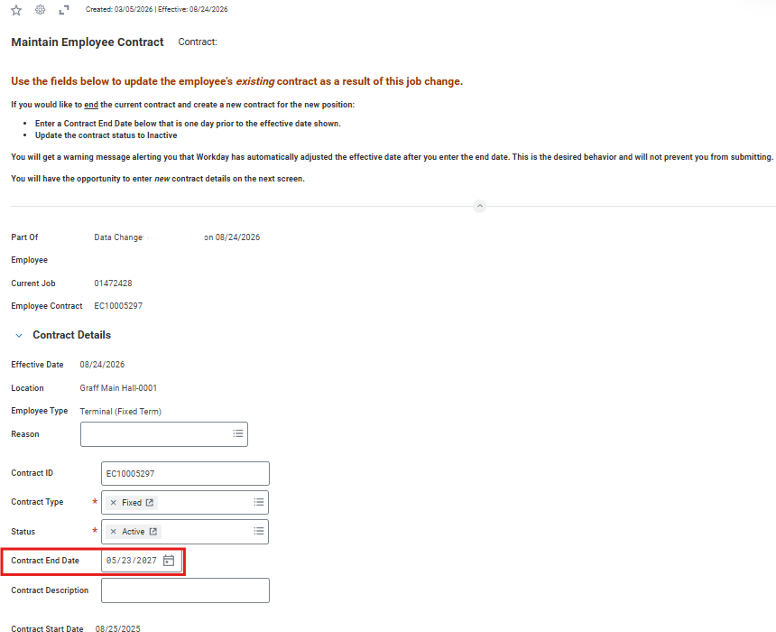

Step 10: Reappointment Terminal –
Maintain Employee Contract Task
Step 10: Maintain Employee Contract Task
The remaining business process will include a series of approval tasks but will eventually result in a Maintain Employee Contract task for the HRPC.
Within the Maintain Employee Contract task: Confirm the Contract End Date matches the new EJED
  Example: 05/23/2027
The contract end date must align with the EJED to avoid any unintended impact to Benefits and Leave eligibility.
Click Submit.
Notes:
UWSS (Beverly Graves) > Position Budget Manager (Kristen Piske) > HR Partner

Slide 25
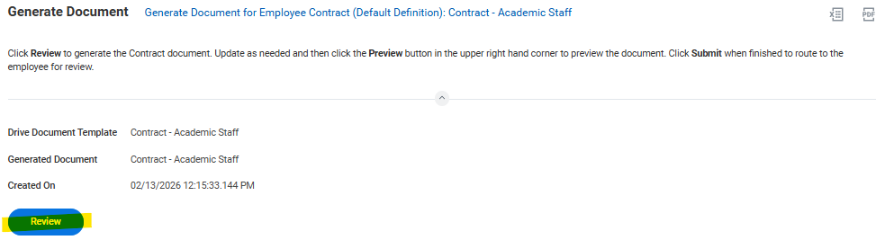
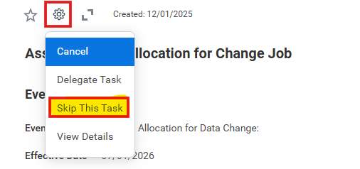
Step 11: Reappointment Terminal –
Generate Document
Step 11: Generate Document
Open the ‘Review & Update Employee Contract Document:’ task and click ‘Review’
Update and edit all necessary fields (including those highlighted in red).
  Click the Preview button in the upper right-hand corner to preview the document
  Please ensure the contract is fully edited before sending, as the employee currently does not have the option to return it for further revisions.
If this is for an IAS position, include the following language in the offer letter:
  'This offer is contingent upon satisfactory enrollment in the assigned courses, or related courses, as determined by the Dean in consultation with the Provost at the conclusion of the registration period. If enrollments are not sufficient to warrant continuing one or more of the courses, the appointment may be modified to suit the enrollment demands, including withdrawal of this offer.’
Click Submit when finished to route to the employee for review.
An Assign Costing Allocation for Change Job task will route to the Cost Center Accounting Specialist
  They will complete the task by following the Assign Costing Allocation for Change Job process
    If not making changes to Costing Allocation, then they can Skip This Task
    Open Task> Click the Wheel/Gauge > Click Skip This Task
At the same time, the contract will route to the employee’s Workday inbox for acknowledgement. Timely completion is essential to prevent potential issues with payroll, benefits, or leave.
Notes:
  If only updating the EJED, then do not skip the ‘Generate Document’ step.
    If the ‘Generate Document’ step is skipped, Shared Services will not be able to correct any contract details.
  If you are submitting both an EJED change and any other change through the Reappointment Terminal BP, then you would want to skip the Generate Document task as part of the EJED BP and use the Generate Document task from the Reappointment Terminal BP

Slide 26
Resources
    Managing and Reviewing Employee Contracts – Job Aid
    Extending Job End Dates - Transition Guide – Job Aid
    Contracts Part II Workshop 10/30/25 - Universities of Wisconsin – Audio Only
    Contracts Part II Workshop 10/30/25 - Universities of Wisconsin- Slide Deck

Slide 27
Reappointment – Terminal
Questions

Slide 28
Recap
No Extension
• Action: No steps required.
• Result: Fixed Term Worker Process Review will automatically terminate the employee.
Reappointment – Extension Only
• Use: Job Change: Expected Job End Date (EJED) BP
Steps:
1. Effective date = current contract end date.
2. Enter new employee end date (must match contract end date in Maintain Contract step).
3. Reminder: Enter contract end date during Maintain Contract (even if not marked required).
4. In Generate Document, edit fields before sending to employee.
Reappointment – Changes to FTE, Compensation, or Title
• Step 1: Submit Job Change: EJED (skip Generate Contract task).
• Step 2: Submit Job Change: Reappointment – Terminal Contract
Effective date :
  12 Month Employee: Day after current contract end date.
  9 Month Employee: 1st day of Academic Year
- Update FTE, Compensation, Business Title.
- In Generate Document, edit before sending to employee.

