Slide 1

Reappointment:
Ongoing/Renewable Employees
Spring 2026

Slide 2
Extend Existing Contract – Ongoing
Ongoing Contracts
  Use ‘Start Review’ from the Employee Contracts screen:
    The Contract End Date can be used to:
      Document the current end date of an ongoing contract
      Track renewal cycles
      (Typically applies to Academic Staff who are considered ongoing but require renewal tracking)
  Potential Issue:
    Ongoing contracts are not included in the fixed-term worker process managed by Shared Services.
      HRPC must monitor end dates and adjust as needed.
      If the contract expires, it will automatically trigger termination of benefits.
    Do not use the ‘Add’ or ‘Edit’ buttons.
      Rather, we should initiate the extension with the ‘Start Review’ button.
    Do not take action to modify the Contract type. Please reach out to Catelyn if questions on the contract type.
  Changes to FTE or Compensation
    Any adjustments to FTE or Compensation must be processed as separate business transactions:
      FTE Change:
      Navigate to: Actions → Job Change → Start Job Change → FTE Change Voluntary – Perm
        Use this for permanent, voluntary FTE adjustments.
      Compensation Change:
      Navigate to: Actions → Compensation → Request Compensation Change
        Use this to update or adjust compensation details.

Slide 3
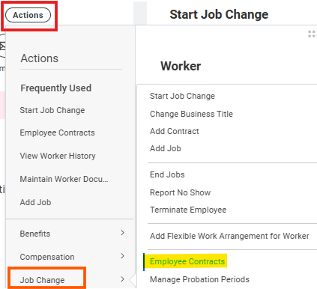
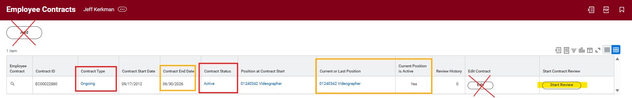
Step 1: Reappointment –
Review Current Contract Details
Step 1: Review Current Contract Details
Navigate to the Worker Profile.
Click Actions → Job Change → Employee Contracts.
Confirm: Correct position is selected, Contract Type = Ongoing, Contract Status = Active.
Do not select Add or Edit Contract
Note the Contract End Date. If you are making changes to FTE or Compensation, the effective date should be set to one day after the current contract end date.

Slide 4
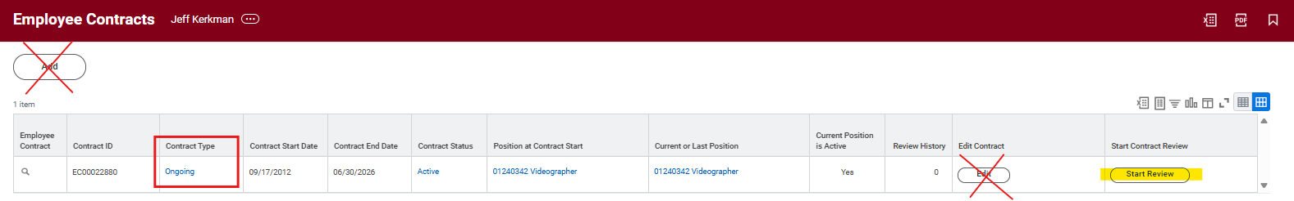
Step 2: Reappointment –
Click Start Review
Step 2: Click Start Review
After confirming you have identified the correct position and contract, click Start Review

Slide 5
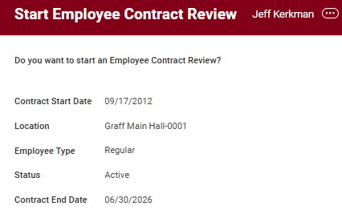

Step 3: Reappointment –
Start Employee Contract Review
Step 3: Start Employee Contract Review
You will be taken to another screen that prompts: “Do you want to start an Employee Contract Review?”
Click OK.

Slide 6
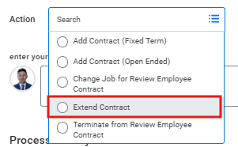
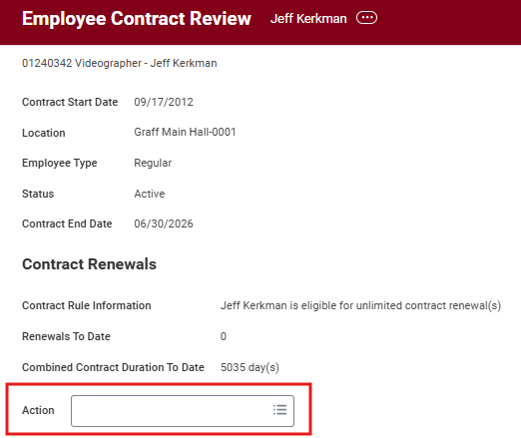

Step 4: Reappointment -
Choose Extend Contract
Step 4: Choose Action Type
From the Action dropdown menu, select Extend Contract.
  The Review Contracts task has caused quite a bit of uncertainly, but as a reminder, it should not be used to initiate actions such as Change Job, Terminate, or Add a contract. The only thing this can be used for is to extend an end date for a Regular, Ongoing employee.
Click Submit.

Slide 7
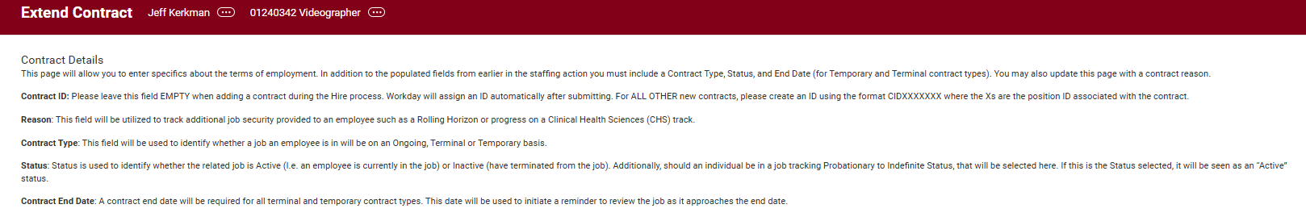
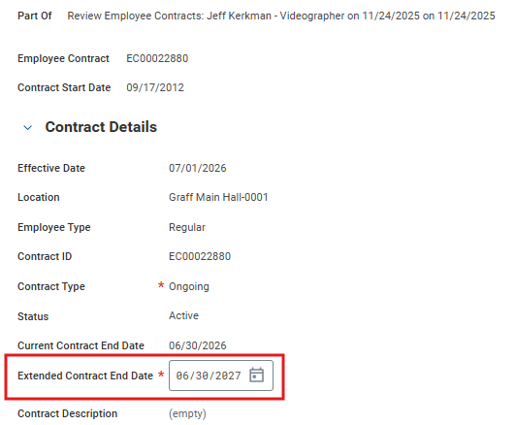
Step 5: Reappointment –
Extend Contract
Step 5: Extend Contract
Enter the new Extended Contract End Date
  Example: 6/30/2027
Click Submit.

Slide 8
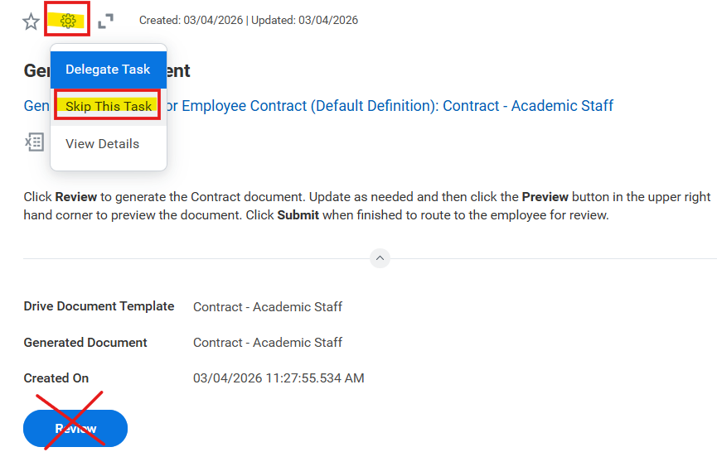
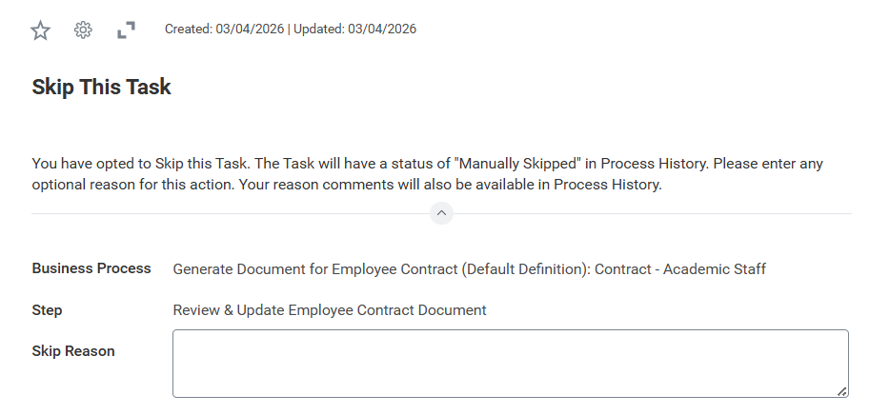

Step 6: Reappointment –
Skip Generate Document
Step 6: Skip Generate Document
You will skip the Generate Document task.
  Click on the wheel and click Skip This Task
  This will then prompt a Skip Reason, which is optional. Then click OK
The reasons:
  Reappointment renewal notices are not required for Academic Staff Regular, Ongoing employees as renewal is assumed under - UWS Chapter 10 - Academic Staff Appointments
  The Workday contract template contained unnecessary or irrelevant language.
  There have been ongoing issues ensuring these contracts consistently reflected accurate information.
  During the week of May 4, HR will email to all Academic Staff employees to confirm their renewal and provide instructions on how to see their contract details in Workday.

Slide 9
Reappointment – Non-Renewals
Non-Renewals
  If there are any non‑renewals during this reappointment process, please notify HR by March 30. You may do so by replying directly to the original message from hrinfo@uwlax.edu
Non-Renewal Appointment Notices
  If employed for less than 2 years:
    Must receive 3 months’ notice prior to the contract end date.
  If employed for 2+ years:
    Must receive 6 months’ notice prior to the contract end date.
      If notice is not issued in time, please work with HR Ops to update the employee’s appointment to Fixed Term – Terminal and extend the current contract end date by 3 months before the HR Partner/Employee Relations can process the termination.
Termination Process
  After Employee Relations meets with the employee, the assigned HR Partner (Vinny, Catelyn, or V) or Employee Relations will proceed with termination.

Slide 10

Questions – Reappointment
Extend Contract

Slide 11
Recap
Reappointment – Extend Contract End Date
Use: Start Review from Employee Contracts
Steps:
1. Select Extend Contract from the Actions Dropdown Menu
2. Enter new contract end date
3. Skip the Generate Document step
Reappointment – Changes to FTE or Compensation
  Any adjustments to FTE or Compensation must be processed as separate business transactions:
    FTE Changes
    Navigate to: Job Change → FTE Change Voluntary – Perm
      Use this for permanent, voluntary FTE adjustments.
    Compensation Changes
    Navigate to: Actions → Compensation → Request Compensation Change
      Use this to update or adjust compensation details.
Non-Renewal
• Action: Communicate back to HR by March 30th so Employee Relations can have timely discussions.
Non-Renewable Appointment Notices
If employed for 2+ years:
Must receive 6 months’ notice prior to contract end date.
If employed for less than 2 years:
Must receive 3 months’ notice prior to contract end date.

Slide 12
Resources
    Managing and Reviewing Employee Contracts – Job Aid
    Contracts Part II Workshop 10/30/25 - Universities of Wisconsin – Audio Only
    Contracts Part II Workshop 10/30/25 - Universities of Wisconsin- Slide Deck

