Slide 1

Lab Training
Notes:
· Transferology was launched 5 years ago.
· More than 1 million students from all 50 states and 177 countries have searched to see how their courses transfer.
· In 2018, over 19 million course equivalencies were added.
· Created in Ohio so usage in the Midwest is very high. Ohio, MN, Illinois and most recently Wisconsin all have state subscriptions.

Slide 2
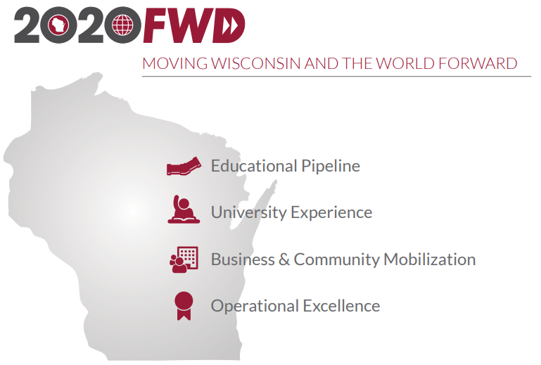
Notes:
How did we get here?
· In August 2016, UW System Board of Regents approved UW System 2020FWD: Moving Wisconsin and the World Forward.
· This framework was intended to provide strategic direction to the UW System in four key areas. The important one for this presentation is the Educational Pipeline.

Slide 3


COLLEGE OPTIONS
360 ADVISING
SEAMLESS TRANSFER
The UW System will expand the Transfer Information System (TIS) to increase both the number of articulation agreements and the number of participating higher education entities. The transfer process should be seamless, smooth, and easily navigable for all students at any step of their educational journey.
NEW TRADITIONAL
WISCONSIN WORKFORCE NEEDS
Notes:
Four priorities fall under the key area of Educational Pipeline - College Options, 360 Advising, Seamless Transfer, New Traditional, and Wisconsin Workforce Needs. Transferology stems from the Seamless Transfer priority. This priority intends to:
1. Expand the Transfer Information System (TIS).
2. Increase articulation agreements.
3. Increase number of participating higher education entities.
4. Ensure transfer process is seamless, smooth and easy to navigate.
Transferology was intended to help by replacing the TIS, increasing the number of participating institutions in their system - including all the UW System 4-year schools and branch campuses, technical schools and tribal college - and helping improve the transfer process by making equivalencies easier to find and navigate.

Slide 4





Notes:
· In June 2019, UW System secures a statewide CollegeSource subscription.
· The subscription includes all UW System and Wisconsin Technical College System campuses, plus two tribal college partners.
· In addition to supporting “UW System 2020 FWD” and UW System Level Priority of “Seamless Transfer,” the subscription also fulfills statutory requirement to establish and maintain a computer-based transfer system between UWS and WTCS.

Slide 5
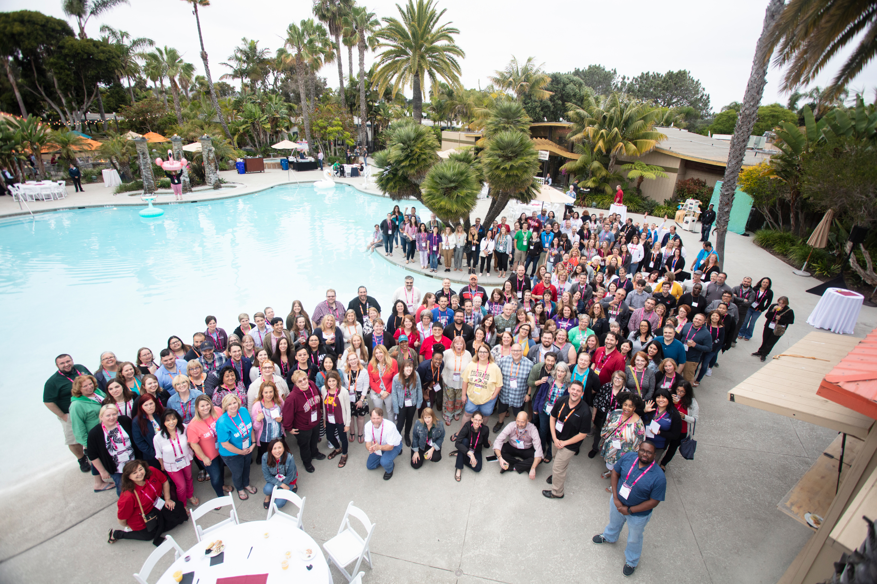
TIS
TRANSFER
INFORMATION
SYSTEM
CollegeSource Annual Conference
June 17-20, 2019
Notes:
· In June 2019, it was announced that the existing Transfer Information System (TIS) would be decommissioned and replaced by Transferology. In July 2020, this replacement officially occurred.
· UW System provided funding to send staff from UW System campuses to attend Annual CollegeSource Users Conference. (See picture of the happy attendees ☺ )
· Additional UW System provided funding to campuses to create, add, and update existing course equivalencies. UWL used that money to add over 6,000 courses to the UWL database during the fall of 2019. UWL went live with its equivalencies in Transferology in April of 2020.

Slide 6
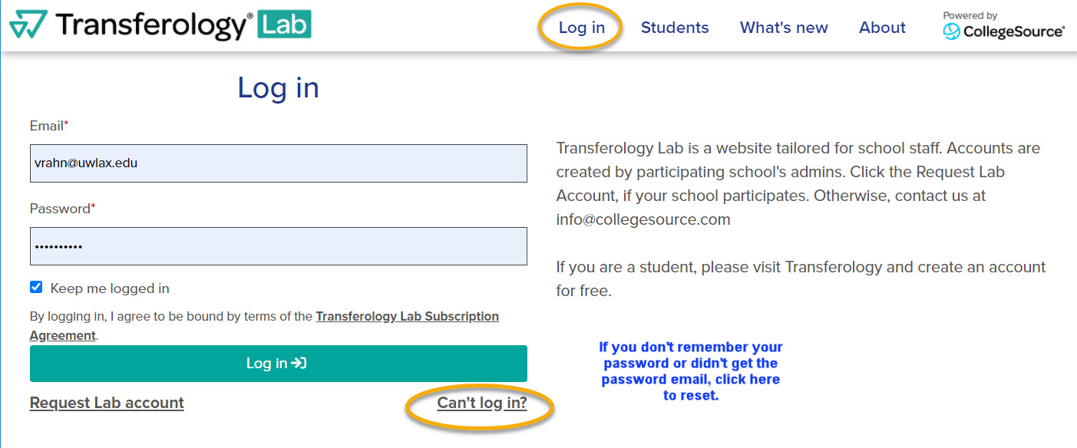
Log into your Transferology Lab account at https://www.transferologylab.com
Notes:
A Lab account is what advisors should use to help their students. A Lab account has more access to advising resources than a student Transferology account which is created elsewhere. To request a Lab account, you can email Victoria Rahn in the Records office. If you have an account, but are not able to get in, you can go to the login screen and click the “Can’t Log in” link to reset your password. You can find this link on the UWL website, under the Faculty & Staff menu at the top.

Slide 7
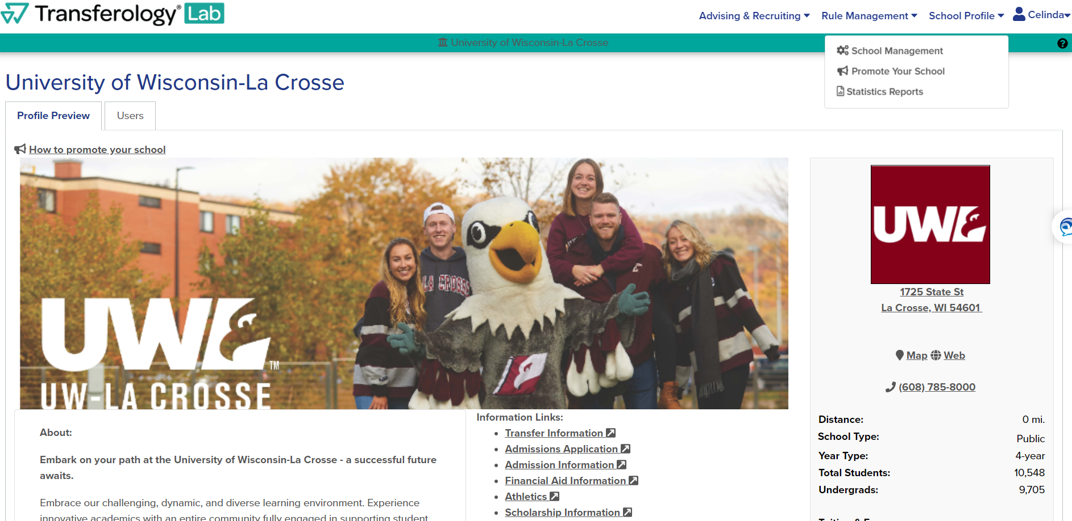
School Profile
Notes:
This is the landing page when you first login, also known as the School Management screen. The Profile Preview tab is the same information that the students see in their account. You can always get back to this screen by going to the School Profile list at the top and selecting School Management.

Slide 8
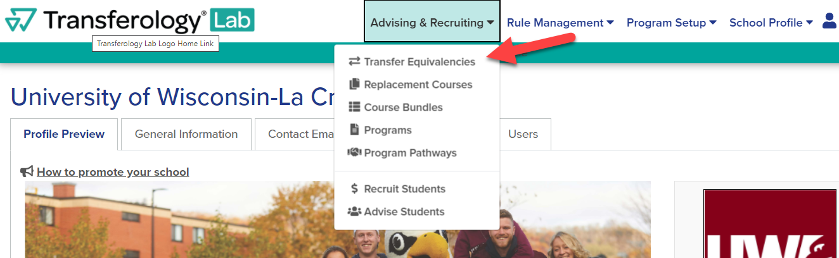
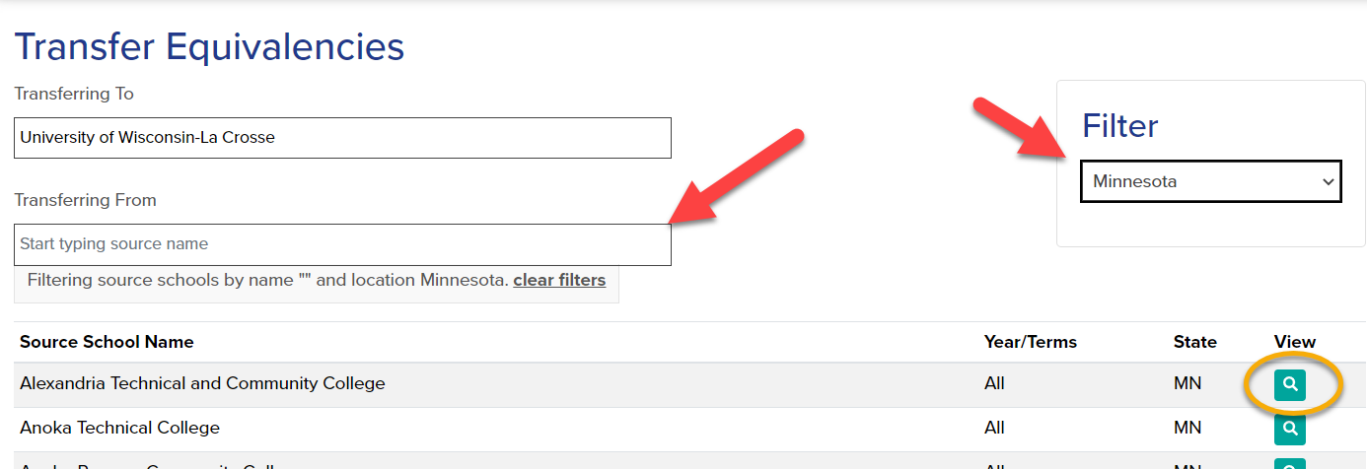
Transfer
Equivalencies
Notes:
On the Transfer equivalency page, you can see all the current equivalencies we have for each school. Filter by state on the right. There is a default setting on this page to the state that you are in, so be sure to change it if looking for a school from out of state. The filter also includes the standardized exam equivalencies at UWL (AP, IB, and CLEP exams). Find the school you are interested in by typing in the “Transferring From” field. Then click the magnifying glass next to its name to select.

Slide 9
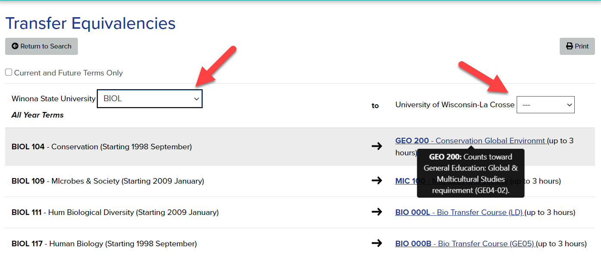
Transfer Equivalencies
Notes:
On this page, you can filter the equivalencies by subject, either under the sending school side or the receiving school side (which is us). If a course is underlined, it has a note attached. Hover over the link with your cursor to see the note. Notes are about how the course will count as an elective, toward general education, or as part of the Universal Credit Transfer Agreement in the UW System.

Slide 10
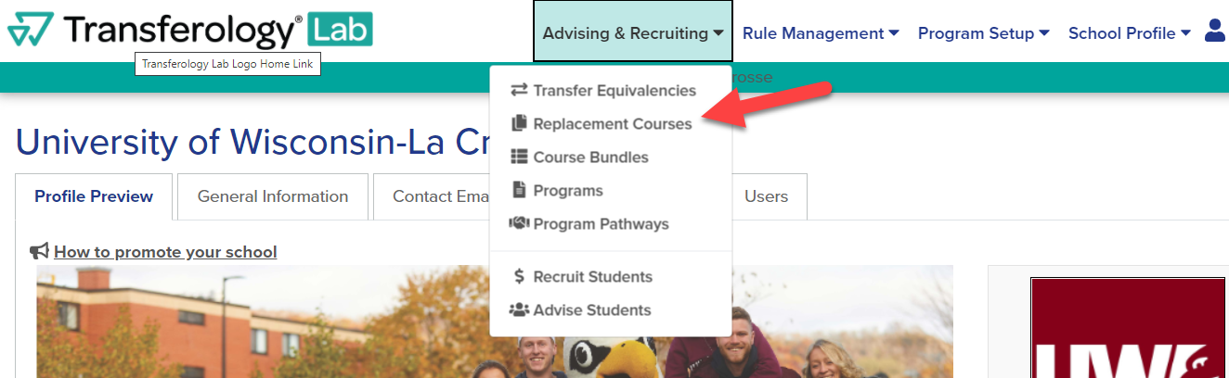
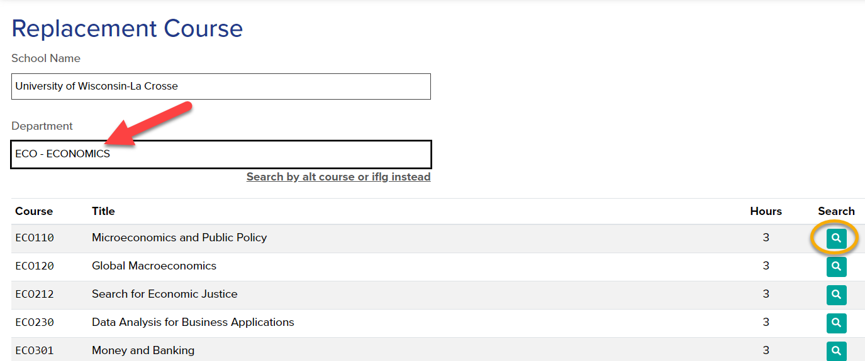
Replacement
Courses
Notes:
Use the Replacement Courses page when your student wants to take a course at another school and transfer it back to UWL to fulfill a requirement here. Many times students do this over the summer when they are back home. Enter the UWL department or abbreviation for the subject in the Department field. Once you locate the course, click search (magnifying glass).

Slide 11
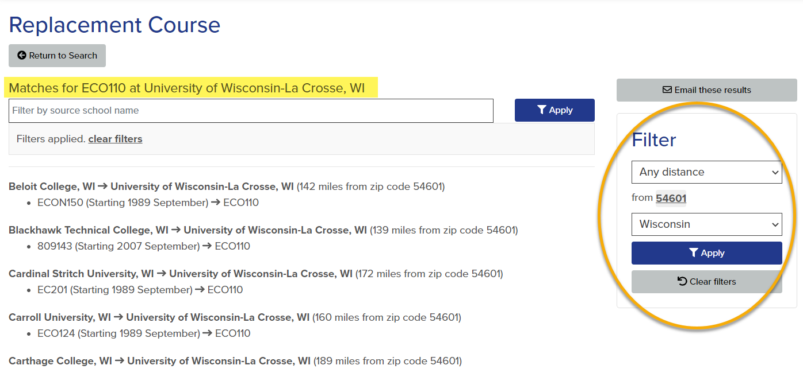
Replacement Courses
Notes:
The results page shows all the schools that have a similar course that we (UWL) will accept in transfer as the same course. If the list is long, you can filter by distance, state, and zip code. Remember, the filter will already be set to a specific state, so that may need to be changed.

Slide 12
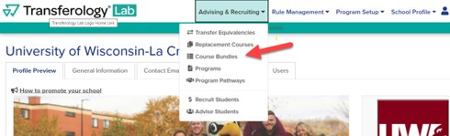
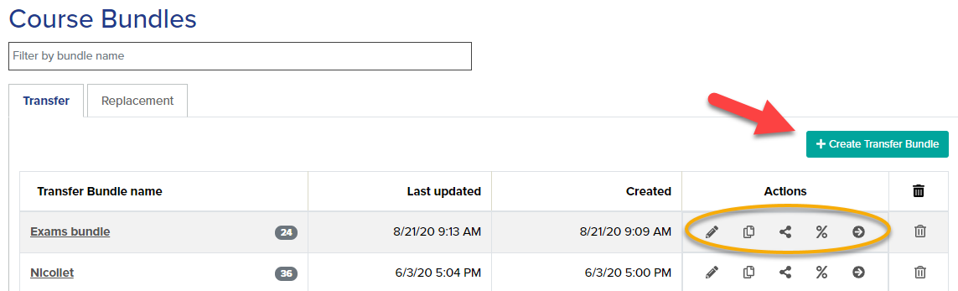
Course Bundles
Notes:
The Course Bundles allow you to enter in all the courses a student took at their previous institution to see which of them will transfer to UWL, if any. Students also have the ability to create course bundles in their own accounts. Click on Create a Transfer Bundle or edit an existing bundle using one of the actions.

Slide 13
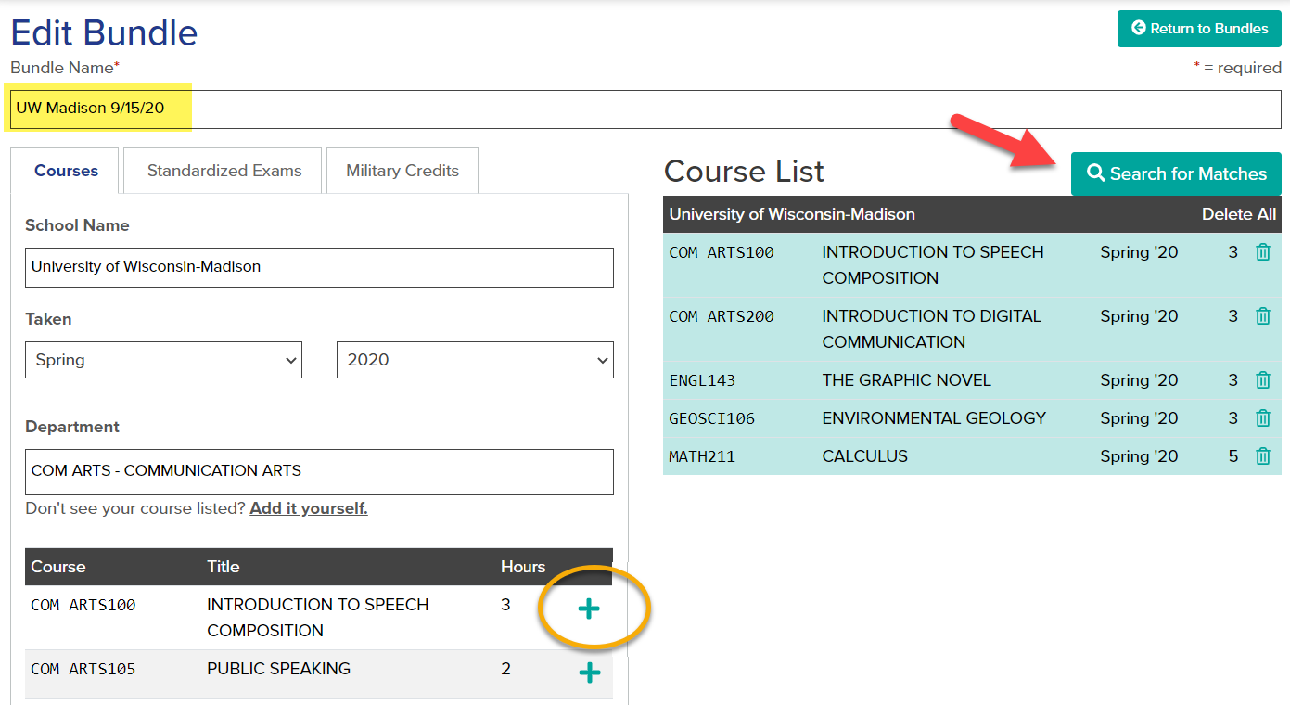
Course Bundles
Notes:
Rename bundle to something helpful, but do not use any identifying information on the student (i.e. do not use Date of Birth, ID number, or full name). It will also be good practice to periodically delete out your course bundles when they are no longer needed. Filter on the school and the term in which the class was taken. There are tabs for Courses, Exams, and Military Credits, but UWL does not currently have its military credits listed in Transferology. If you have a student with a joint services transcript, please have that student contact Admissions for an evaluation. Add the course to the list. Click Search for Matches when done.

Slide 14
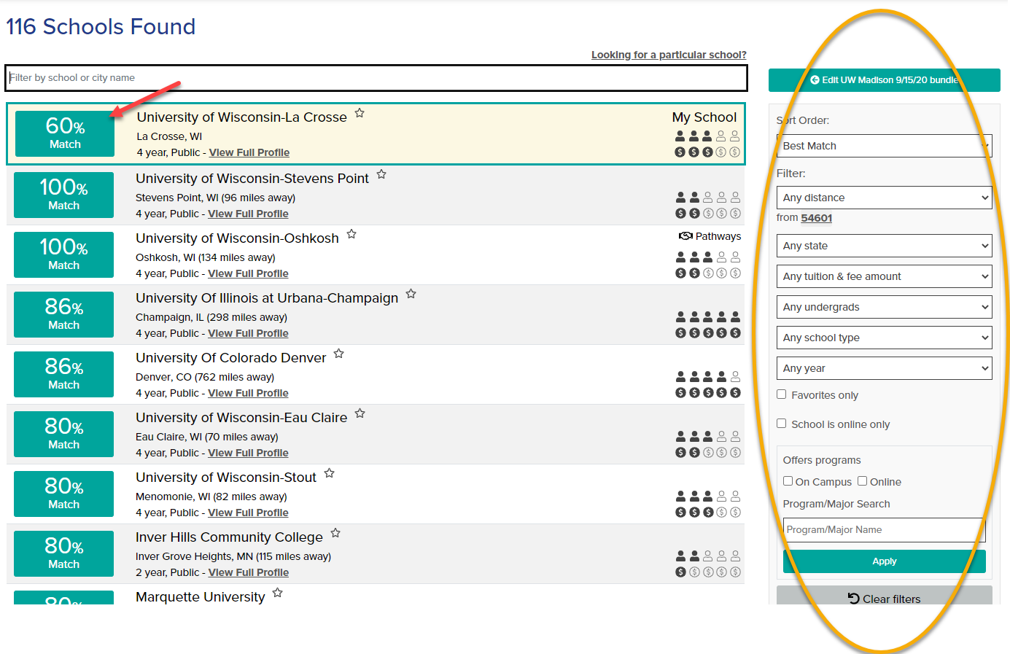
Notes:
A list of schools that have matches will be found. If using our Transferology Lab, or if the student went to their Transferology account using our school’s link, UWL will always come up at the top of the matches, even if the percentage is not the highest. After UWL, the list defaults to be ordered by percentage, then distance. You can continue to filter using one of the filters on the right, including looking for online programs. (Note that whether or not a course will be offered online is not listed in Transferology, only whether the program itself is entirely online or not. To find schedule info on individual courses, contact the other school.) Click on the percentage to see the details on the matches.

Slide 15
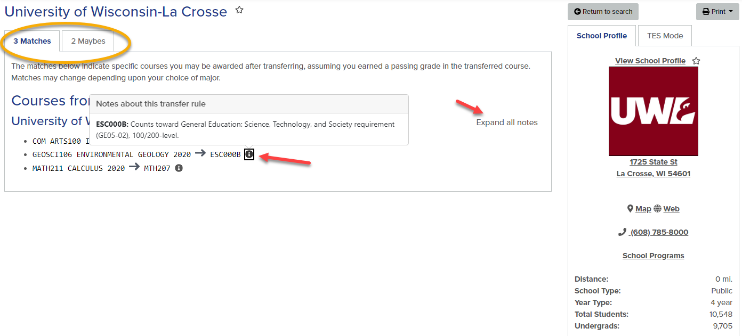
Course Bundles
Notes:
The results for that school can have Matches, Misses, and Maybes. Matches mean the course will transfer and lists the equivalency. The notes on how the course credit affects electives and the general education program are under the info icon, if there is one. Misses mean that the course does not transfer. It was evaluated at one point and our school will not award credit for that course. This is often the low numbered, skill-building math or English classes. Maybes mean the course has not been evaluated yet by our school. The student should contact the Admissions Office to see if the course can be evaluated.

Slide 16
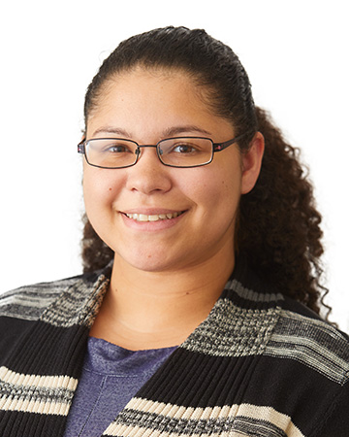


Questions?
Celinda Davis
Academic Advisor, Academic Advising Center
Email: cdavis2@uwlax.edu ~ Phone: 608.785.6950
Scott Johns
Assistant Director, Admissions Office
Email: sjohns@uwlax.edu ~ Phone: 608.785.8939
Victoria Rahn
Assistant Registrar, Records & Registration
Email: vrahn@uwlax.edu ~ Phone: 608.785.8579
Notes:
In the live presentation, Celinda demonstrated how to use Transferology Lab using her own account as an example. If there are questions current equivalencies, please contact Scott Johns in Admissions. If you need help getting into the Lab or with the training site, contact Victoria Rahn in Records. If you have advising questions, Celinda Davis in the AAC can also help. UWL’s training page for Transferology Lab is https://www.uwlax.edu/records/faculty-staff-resources/transferology-lab/.

