Slide 1
Emergency Preparation: Don’t Get Caught Off Guard
Kim Clark, Director, Campus Recreation
University of Houston
Mo McAlpine, Associate Director, Recreational Sports
University of Wisconsin-LaCrosse
This seminar was created for the live learning environment of the Athletic Business Conference & Expo.
Kim Clark & Mo McAlpine have listed no financial interests/arrangements that would be
considered a conflict of interest.

Slide 2
Learning Objectives
Upon completion of this seminar, you will be able to:
  Identify components to incorporate into an Emergency Action plan to prepare students to respond to emergency situations with confidence.
  Develop and implement an emergency response team and red shirt reviews to train and prepare your staff to respond to emergencies.
  Understand the importance of the debrief process following an incident.

Slide 3
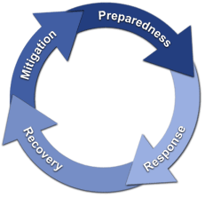
Risk Management Phases
Identify Risks
Measure/Assess
Plan (strategies)
Implement
Debrief/Evaluate/ Revise
FEMA 1979

Slide 4
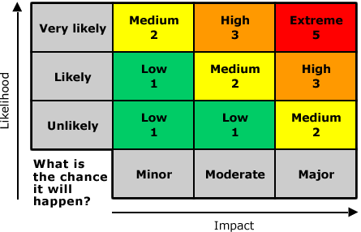
Mitigation
Identify Risks
  Campus
  Programs
  Facilities
  Culture & Climate
Assess/Measure

Slide 5
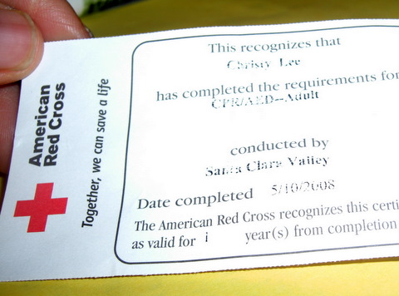
Preparedness
Culture & Climate
Job Descriptions
Certifications & Trainings
Meetings/In-services
Policies & Protocols
EAP
Documentation
Collaboration

Slide 6
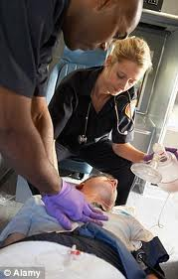
Preparedness – Components of EAP
Medical
  Life-Threatening
    Drowning
    Severe Bleeding
    Heart Attack
    Shock
    Head, Neck, & Back
    Heat Stroke
    Stroke
    Epileptic, Diabetic & other attacks
  Non Life-Threatening
    Cuts & Bruises
    Sprains & Strains
    Dislocations

Slide 7

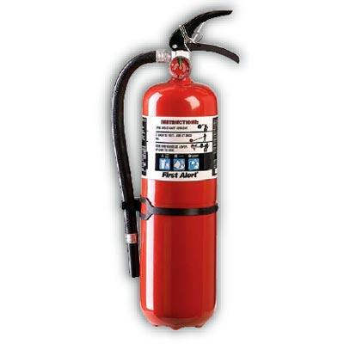

Preparedness – Components of EAP
Fire Prevention
  Extinguishers
  Egress Routes
  Signage
  Laundry Lint Traps
  Chemical Storage
  Area Occupancies
  Chemicals & Cleaning Solutions

Slide 8

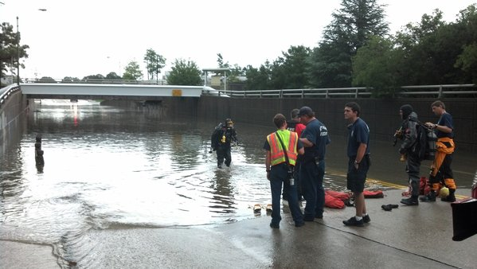
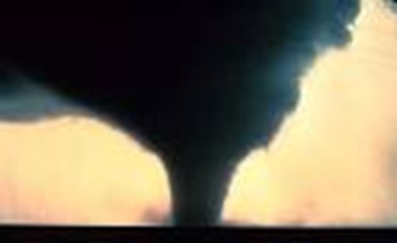
Preparedness – Components of EAP
Weather
  Heavy Rain, Winds, Flash Flooding
  Lightning
  Hurricanes
  Tornadoes
  Earthquake
  Heat Procedures

Slide 9
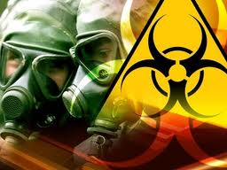

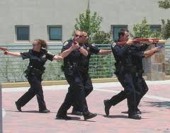
Preparedness – Components of EAP
Shelter in place
Weapons
Bomb
Theft
Suspicious Packages/Items
Radiation Chemical or Biological Threats

Slide 10
Preparedness – Documentation
Forms & Checklists
  Release & Indemnity/Health History Forms
  Photo/Video Releases
  Safety Checklists
    Opening/Closing
    Facility Inspection
    Equipment Inventory & Inspections
    Maintenance Logs
    Pool Chemistry Logs
    AED Inspection & Maintenance

Slide 11
Documentation - Accident

Slide 12
Documentation - Incident

Slide 13
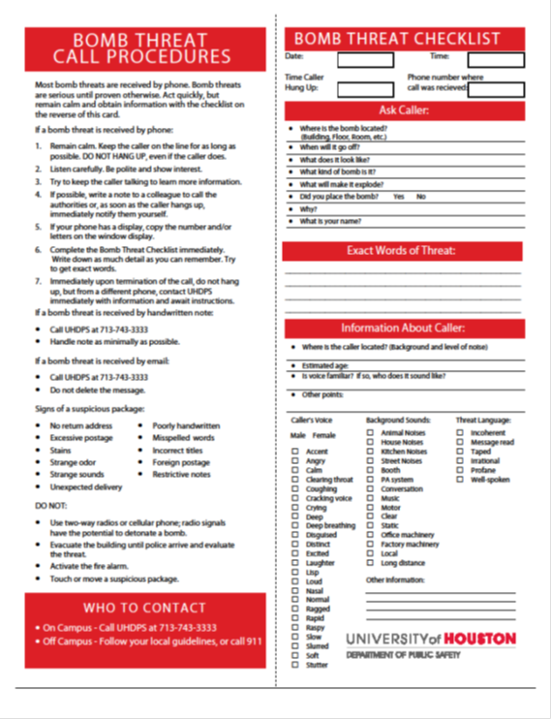
Documentation - Bomb

Slide 14

Response
Activating EAP
  Implementing appropriate response strategy
Communication
  Walkie Talkies
  Calling 911
Completing Documentation

Slide 15
Recovery
Debrief
  Evaluate Response
  Review Documentation
  Critical Stress Debrief
Follow Up
  Staff
  Participants
  Restock Supplies
  Inspect/Clean Facility/Equipment
Re-open Facility
Planning for Recovery begins in the Preparedness Phase!!

Slide 16
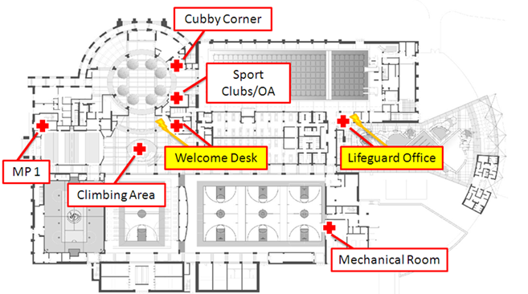
Tips
Iterative Process
Dynamic Document
  Bullet Points
  Flow Charts
  Diagrams
Consistency Across Program Areas
Collaborate/Utilize Resources
  Campus Police
  Risk Mgmt./Safety Office/Emergency Mgmt.
  Counseling & Psychological Services
  American Red Cross

Slide 17
Samples

Slide 18
Sudden Cardiac Arrest
January 27, 2010
9:24PM
20 year old female
Group X Class
21:24:13 - call received by 911
21:25:11 - call dispatched to station
21:26:12 - University Police informed
21:26:20 - call to Mo
21:26:21 - paramedics in route
21:26:46 - face is blue
21:28:40 - AED in use
21:29:00 - University Police arrive
21:30:50 - paramedics on scene
21:31:09 - code in progress
21:49:30 - ambulance departs to hospital
21:57:42 - ambulance arrives at hospital
Notes:
There is no better lesson than a real life situation. But before I set the scene, we’d like to know how many of you have experienced a life-threatening emergency in your facility?
While I am fortunate to stand before you and share our story of saving a life, both Kim and I realize, understand and appreciate that there are all levels of emergencies out there from minor injuries to even deaths in your facilities. For those who have dealt with a death, we are truly sorry.
To set the scene with our scenario: it was January 27, 2010 at approximately 9:24pm. Clare (who has given us permission to use her name) was a healthy 20 year old female participating in a groupx class:
Drink to abs
Became unresponsive so CPR was started by her friend who is a lifeguard
Friend became overwhelmed so another student took over – happened to be a student athletic trainer
In the meantime, the instructor went to the Info Counter and alerted staff
Call was made to 911, UP, Mo
Staff took the AED to the room and immediately applied it; shock was administered
When she left, her heart was not beating
What saved her life? the efficient actions and teamwork of our staff, university police and the paramedics in addition to Clare’s incredible fight to live!

Slide 19
Improvements after Cardiac Arrest
Realistic verbiage on 911 phone calls
Building Manager cell phones
CPR masks for entire facility and employees
Red Cross reference cards
Semester CPR & AED reviews with staff
Bystander awareness
Intentional initiation of emergency response
team (ERT)
Notes:
After dealing with this emergency, we felt good about our emergency action plan and our staff’s ability to implement it. As we assessed and learned from it, we were grateful that we were in a position to make a good thing even better, as we made several improvements:
I listened to the phone call that was made by our staff member. While the end result was that EMS was dispatched, he wasn’t real confident with the details such as phone number and address, even though they were written on the EAP near the phone (understandable in such an anxious situation). On TV they make it seem like calls are answered with “911 what is your emergency?”. Reality is that the call was answered “911, what number are you calling from?”. Let’s face it. None of us have to remember phone numbers any more so having the phone number and address clearly written and part of your emergency response training is imperative.
Another thing we learned from the call is that when you have a life threatening situation, you are transferred to a nurse advisor to provide updates and to get advice if needed. The 911 call that night was made from our information counter so there was no clear sight line of the scene. Therefore, staff had to use two-way radios to relay Clare’s status, which obviously isn’t ideal for many reasons.
Prior to this emergency, we just had a CPR mask on the AED that was stored in the Information Counter. After this, we placed CPR masks in all rooms throughout the building and purchased pockets masks for the staff to wear during their shifts.
We purchased first aid, cpr & aed reference cards and placed them in the information counter so that staff could refer to them frequently. We also have information posted on D2L and our ERT website. This year, committee members put together a binder with all of our resources.
Immediately after Clare’s sudden cardiac arrest, we had every staff member “check off” CPR & AED with our graduate assistant. Now we build it into what we call “spring training” that happens the second week of classes in the 2nd semester and all staff members are required to attend.
I had just gotten home from work when I received the phone call that this was happening. By the time I returned, the EMT’s were close to leaving with Clare. One of the things that LITERALLY hit me in the face when I came flying in was the impact that this was having on SO MANY PEOPLE as students who were in the groupx class were huddled outside the room; some embracing each other; some in tears. For whatever reason, my instinct was to have a staff member start gathering names of those who were there at the time. We then invited them to the debriefing sessions that took place the next day. Now that is written into our EAP so that we can provide support if necessary.
The long term and biggest impact of our evaluation was the reality that we need to become intentional in our year long emergency response training. We had previous conversations about it and even tried a couple of pilots. But then the concept sat on a bookshelf and was something that just didn’t happen…until now. We were fortunate that the graduate assistant I referred to earlier was part of a similar program at the University of MN. They graciously shared their resources which became the foundation of what we call our emergency response team or ERT, which is the premise of the rest of my presentation.

Slide 20
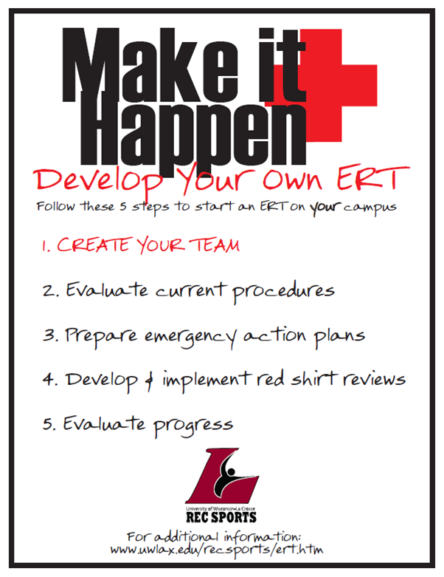
Emergency Response Team
Notes:
How many of you have similar programs on your campuses? So…many of you have an idea of how to make this happen while others may be here to learn how to do so. At the end of this presentation, we hope that there is time for us all to learn from each other as the UW-L way is only one of many ways to train your staff.
We have come up with five steps that we think it takes to create your own ERT. First: create your team! Obviously we had a lot of buy-in due to our sudden cardiac arrest. That laid the foundation to successful, ongoing involvement from staff members who volunteer their time each year. We simply put out an e-mail at the time to recruit members. Now we present a brief overview of this and our four volunteer committees at our fall staff training and typically have plenty of interest. I have heard of other schools who just send out an e-mail, inviting staff members to participate. Other institutions may require participation at certain staffing levels; some pay certain members.

Slide 21
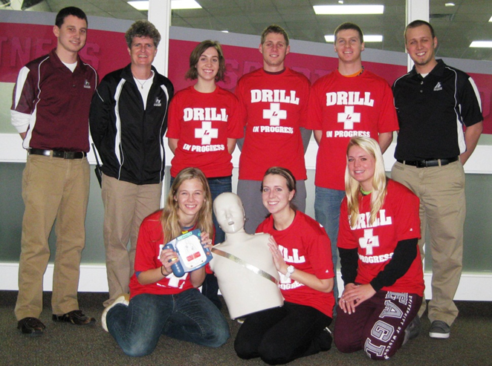
ERT
Advisor
  Associate Director
Chair
  Student staff member(s)
Representatives
  1 from each position area
Other potentials
  Police; medical staff; risk management/safety; counseling
Notes:
As you can see, our team is definitely student based. I serve as the advisor and am Red Cross instructor certified in first aid, CPR & AED. For the past 2 years, we have had co-chairs as leaders who have shared the responsibilities of leading meetings and the staff reviews. Ideally, we’d like to have one representative from each of our 10 staff position areas. Though we don’t necessarily get that each year, we do have good participation. We work closely with our university police officers and our athletic training program but they don’t hold a “seat” on the team. Other schools may have university representation as part of their programs with routine feedback, such as risk management and/or the counseling department, which I believe would be extremely valuable as well.

Slide 22
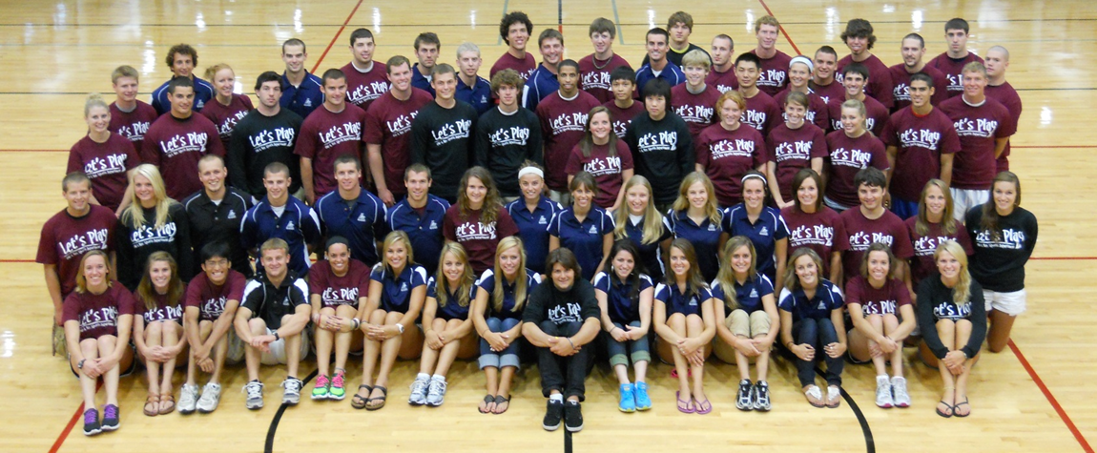
ERT Mission
As a preparatory unit of the Recreational Sports student staff, the Emergency Response Team (ERT) will ensure the readiness of the Recreational Sports Department for any potential emergency, review emergency action plans, and strive for efficiency in upholding accident, incident, and injury protocol.

Slide 23
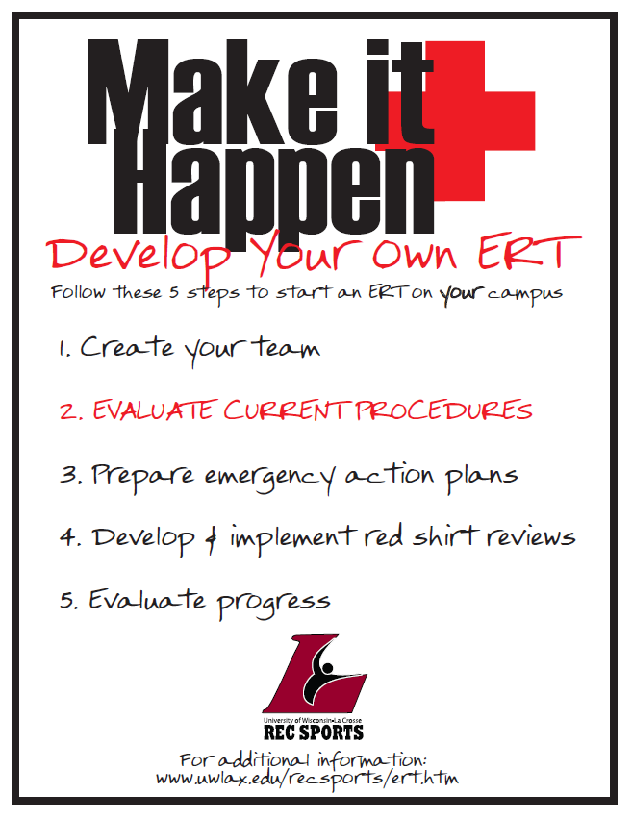
Mitigation

Slide 24
Mitigation
What are your current procedures?
  Emergency action plans
  Forms & checklists
  Documentation - reports
  Equipment and supplies
  Common practices
  Certifications and training of staff
  Institutional coordination
Notes:
This is an inventory of everything you have and do related to your emergency procedures. It’s important for the committee to know and review:
*emergency action plans – Kim hit that extremely well; make sure the committee knows them inside out
*make sure committee reviews and is familiar with all forms, checklists, and reports for documentation – ensure the documents stay up to date
*what equipment do you have for care and communication, such as an AED, first aid kits, two way radios, & cell phones that have all been mentioned before; committee can assist with equipment and supply inventory, especially with restocking as Kim discussed
*what are your common practices? Who initiates the EAP? How does he/she initiate the plan? Who responds within the facility? How long does it take for EMS to respond? Who contacts university police? At UW-L we are fortunate to have a certified athletic trainer working with our sport clubs and student athletic trainers working as first aiders, though not all day; several radios allow many to hear the calls so we tend to flock to an emergency
*Kim mentioned this as well regarding your required certifications; our staff has a minimum of first aid, CPR & AED certifications; trip leaders have WFR; what type of training do you do and when? we will come back to how we train our staff
*important to have university collaboration, especially for life threatening emergencies; we have discussed the importance of university police; risk management/safety office; medical personnel; and potentially counseling; our procedures require us to call university police anytime we call 911, even though it is patched thru; when an officer arrived during Clare’s sudden cardiac arrest, he immediately initiated 2-person cpr

Slide 25
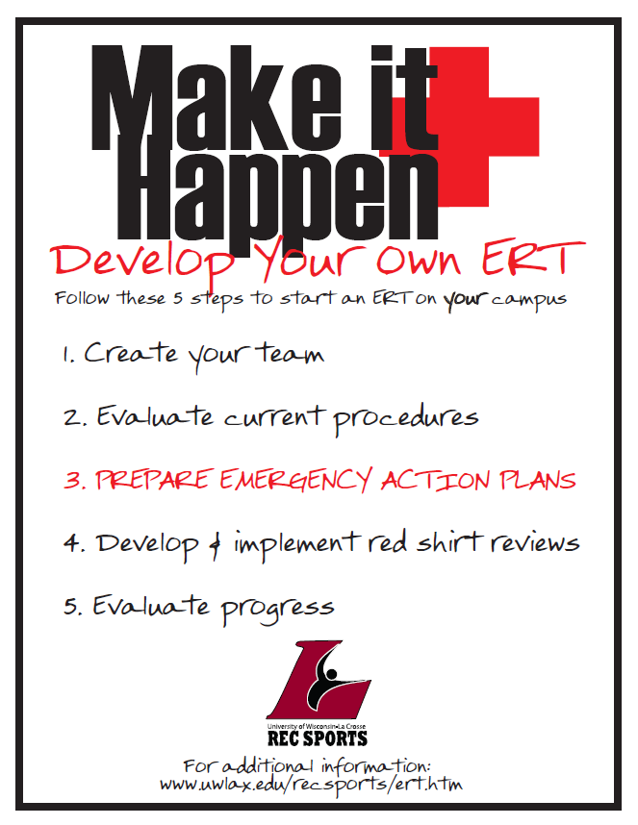
Preparedness
Notes:
Kim did a phenomenal job covering this!

Slide 26

Preparedness/Response
Notes:
The nuts and bolts of ERT! What are “red shirt reviews”?

Slide 27
Red Shirt Reviews
Purpose: to create a non-intimidating environment with real life situations for staff members to practice and become comfortable implementing EAP’s
Resources
  Your institution
  Other institutions
  Conferences
  NIRSA Habitat
  Certifying agencies & professionals
Notes:
We spend a lot of time talking about ways to help staff members become “comfortable” dealing with situations. In fact, we used to call them red shirt drills but felt that was too intimidating so we changed the wording. There are many resources you can use to create your review scenarios, such as… We have a certified athletic trainer review ours for us but you could have many different levels/agencies involved.

Slide 28
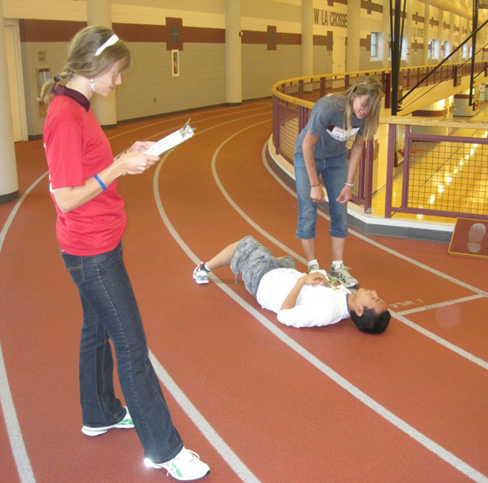
Red Shirt Reviews
Logistics
  Develop scenarios
    Currently medical based
  Create checklists
    Based on EAP & appropriate progression of care
    Scene
    Front Desk
  Train ERT members
  Schedule RSR
  Plan coverage
Notes:
We have identified 5 different types of scenarios that are based primarily on situations that we have dealt with in the past. We also want to be as inclusive as possible with the types of injuries so we currently review cardiac arrest, lacerations, dislocations, head trauma, and a rolled ankle for basic first aid care. We have a template that we follow, which you will see, that is basically a checklist for ERT members to follow during the review. We make sure that the entire committee is comfortable with the scenarios prior to starting the reviews. We then use a google doc to schedule the reviews with the ultimate goal being to review every service staff member once per semester. Coverage is important so that regular business can continue throughout the review process so it’s built into the google doc as well.

Slide 29
Red Shirt Reviews
Red Level
  Life-threatening
  911 and University Police
  Factors beyond training level
  May include first aid treatment
  May include progression to shock
Green Level
  Non-life-threatening
  Within training level
  May include some first aid treatment
  Does not include 911, University Police, or shock

Slide 30
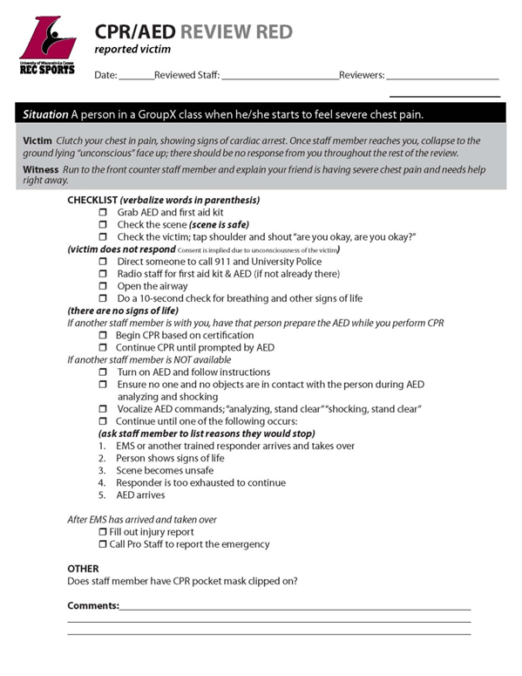
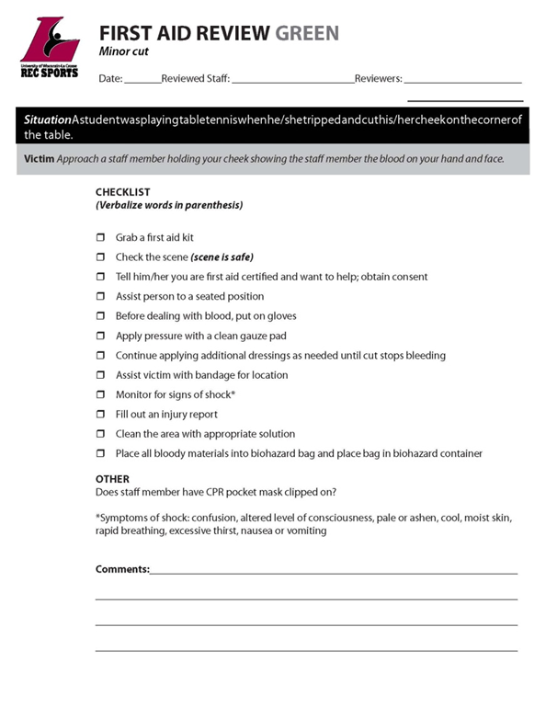
Red Shirt Reviews
Notes:
You hopefully can see the “checklist” format that allows ERT members to walk through the process and the steps. We have several documents on our website so please feel free to use them at your discretion. We will see that site shortly.

Slide 31
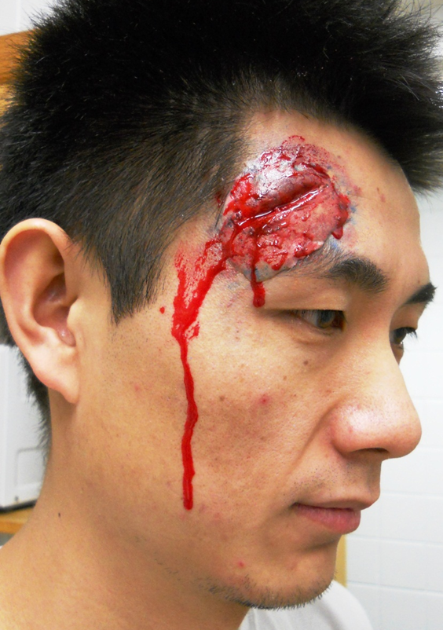
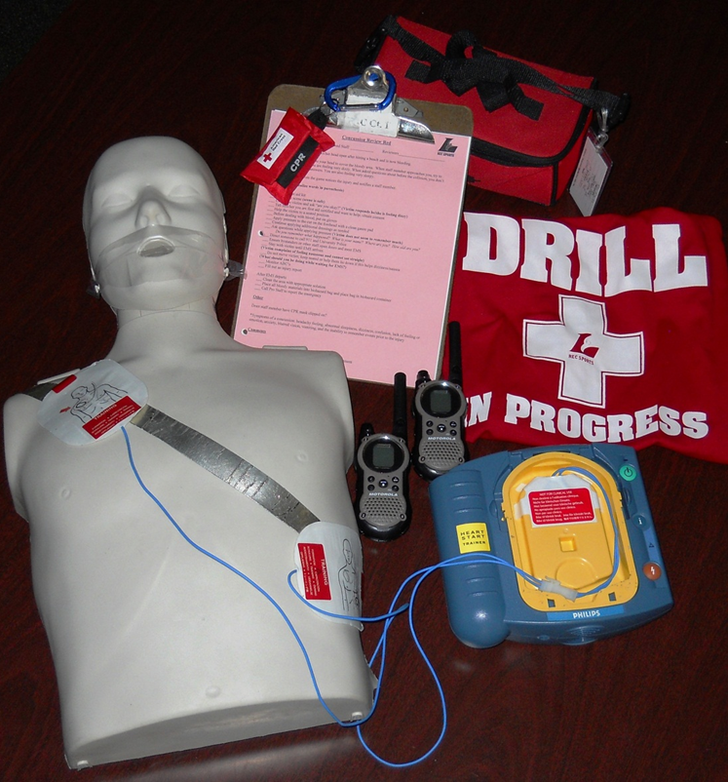
Red Shirt Review Props
Notes:
Every ERT member wears a drill shirt

Slide 32
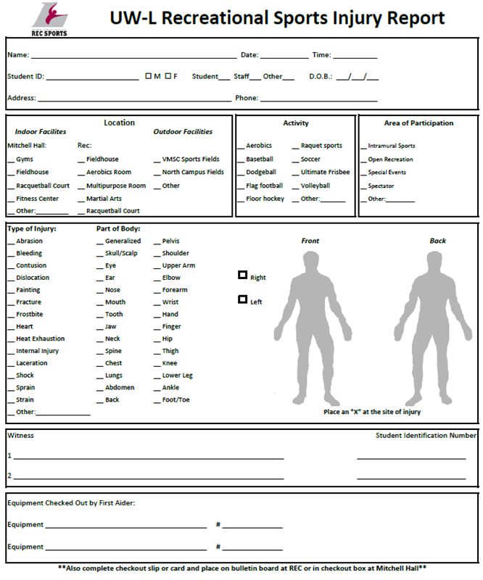
Red Shirt Reviews
Implementation
  As realistic as possible
Debriefing
  Review entire scenario with staff on duty
Paperwork
  Injury report
  Incident report
ERT website
  www.uwlax.edu/recsports/ert.htm
Video
Notes:
Debriefing: important to review with all of them, regardless of their role; review entire process so all of them are walked through each “phase”; with Clare’s SCA, we held 4 debriefing sessions with our Counseling & Testing Center, including 1 at 6am the morning after it happened. It’s critical for the learning process as well as recovery.

Slide 33

Video of mock red shirt review:
www.uwlax.edu/recsports/ert.htm

Slide 34
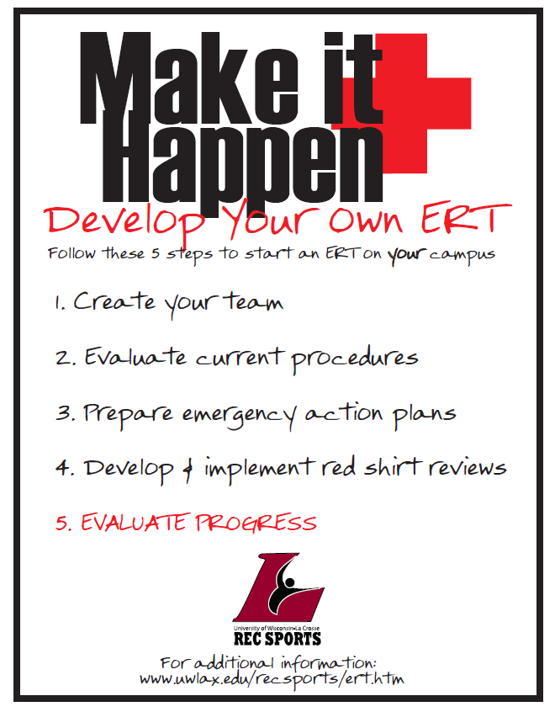
Recovery

Slide 35
Evaluations
Improved responses in daily implementation of emergency situations
Increased comfort and level of care
Positive comments from University Police
Survey results
Notes:
There is no doubt that our red shirt reviews have improved staff responses. We see it on a regular basis as the EAP is implemented correctly and the appropriate care is provided…let’s hope I didn’t just jinx us! Undoubtedly the reviews help with their comfort level and their confidence, which ultimately provides a better level of care. This year we started something new as ERT held an open review session for staff to just come practice. One of those who attended had to deal with a student passing out the very next day (during the election nonetheless…side note…do not allow campus to hold a blood drive on the same day as a presidential election). He communicated that the review session definitely helped him deal with the situation.
*University Police have shared with us that when a call comes from the REC, they know that they are walking into a situation that is being well managed and that our staff knows what to do.
*we have conducted a couple of formal surveys through qualtrics, that clearly demonstrate improved confidence as a result of red shirt reviews and training procedures.

Slide 36
Training of Service Staff
Fall (prior to academic year)
  Emergency procedures and action plans
  Mini red shirt reviews
  Large group debriefings
  Facility tours
  Introduction to emergency equipment and locations
Spring (first week of semester)
  Updates on emergency procedures and action plans
  Hands on CPR and AED review
  First aid presentations by student athletic trainers
Notes:
What do we do for training? In the fall, we hold a 4 day training session. We bring everyone together (approx. 85 service staff members) for about 3 hours and do an overview of care as well as the emergency procedures and action plans. After time in the classroom, we split the group up into small groups with approximately 5 rotations that are basically mini red shirt reviews; we bring them back together for a debriefing on all of the stations…

Slide 37
Ongoing Training
Certifications
  CPR, AED, and first aid (minimum)
Weekly Staff Meetings
  ERT updates from committee members
  Debriefings regarding recent incidents
Situational Debriefings
  Review with staff involved immediately following situation

Slide 38
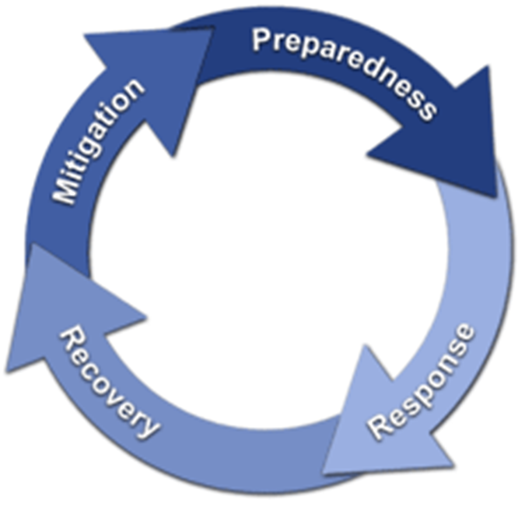
Risk Management Phases
Identify Risks
Measure/Assess
Plan (strategies)
Implement
Debrief/Evaluate/ Revise
FEMA 1979

Slide 39
Learning Objectives
Upon completion of this seminar, you will be able to:
  Identify components to incorporate into an Emergency Action plan to prepare students to respond to emergency situations with confidence.
  Develop and implement an emergency response team and red shirt reviews to train and prepare your staff to respond to emergencies.
  Understand the importance of the debrief process following an incident.

Slide 40
References
U.S. Department of Education. Action Guide for Emergency Management for Institutions of Higher Education. (Revised June 2010). Available at http://rems.ed.gov/docs/REMS_ActionGuide.pdf
U.S. Department of Education. Practical Information on Crisis Planning: A Guide for Schools and Communities. (Revised January 2007). Available at
http://www2.ed.gov/admins/lead/safety/emergencyplan/crisisplanning.pdf
U.S. Department of Homeland Security, Federal Emergency Management Agency. Building a Disaster-Resistant University. (2003). Available at http://www.fema.gov/hazard-mitigation-assistance/building-disaster-resistant-university

Slide 41
Make it Happen!
Thank You Video

Slide 42
Contact Information
Kim Clark, Director
University of Houston
kdclark@central.uh.edu
www.uh.edu/recreation
Mo McAlpine, Associate Director
UW-La Crosse
mmcalpine@uwlax.edu
www.uwlax.edu/recsports
www.uwlax.edu/recsports/ert.htm

