Slide 1
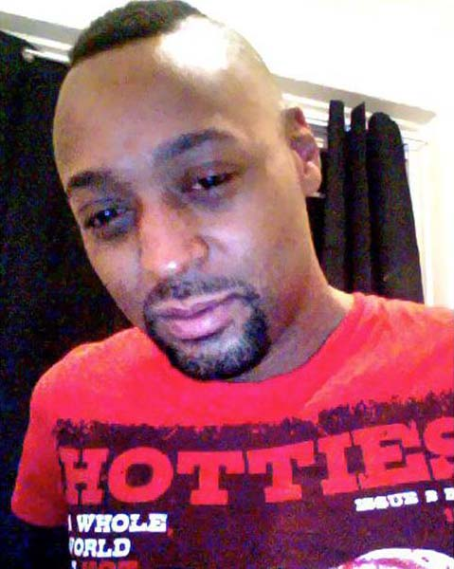
Son
Brother
HUMAN
Friend
Neighbor

Slide 2


Slide 3


Slide 4


Slide 5


Slide 6


