Slide 1


Eating Healthy in College

Slide 3
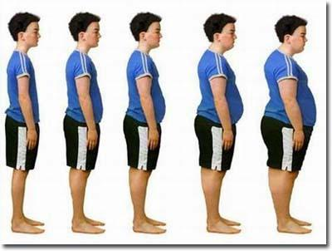


Slide 5

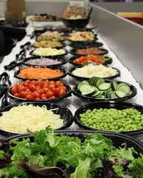

Slide 7





1
3
2
4
5

