Slide 1
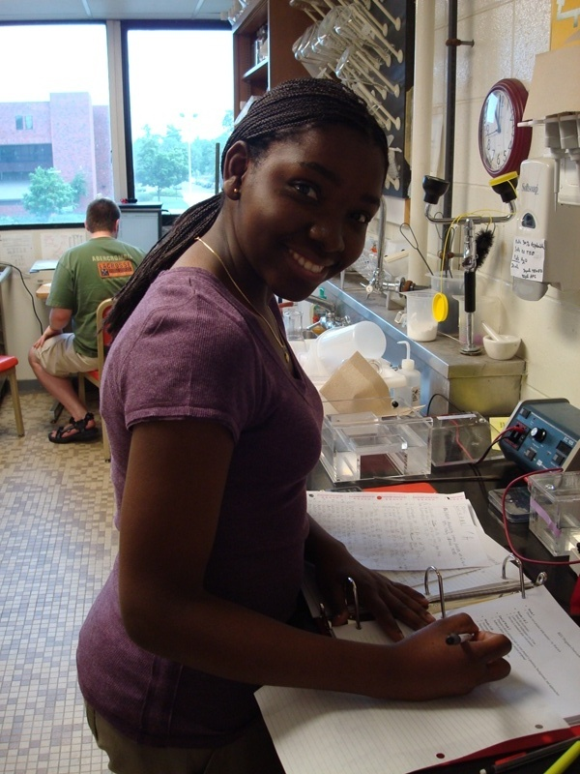
Undergraduate Research & Creativity

Slide 2
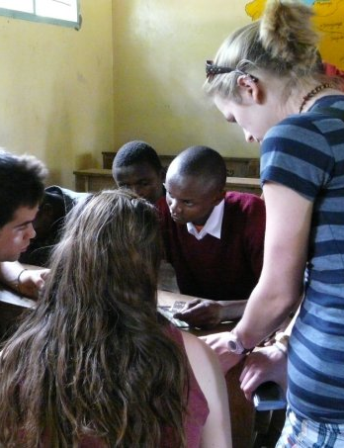
What is Undergraduate Research & Creativity?
  Working on a project outside of class.
Notes:
Undergraduate research is the equivalent of working on an independent research or creative project under the supervision of a faculty mentor. In many cases, an undergraduate research project will start in a class – either through a project or an idea (maybe based on a lecture or topic). Think about it as engaging in a scholarly or creative project that you take a leadership role in.

Slide 3
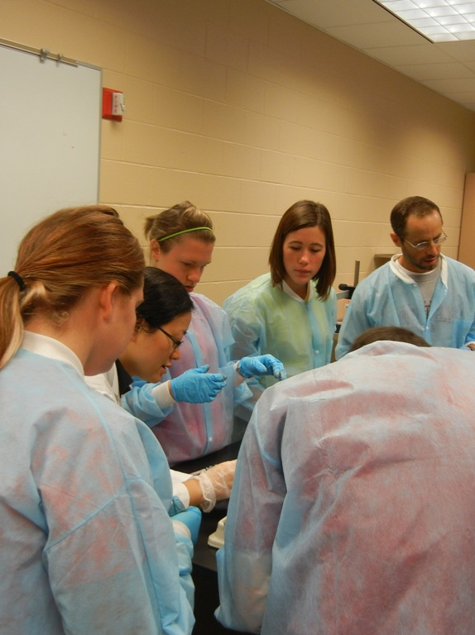
What is Undergraduate Research & Creativity?
  Can be in collaboration with a faculty mentor and other students.
Notes:
There is the possibility of working individually with a faculty mentor, or with 1 or more students. Working with other students can affect the scholarship money received and the amount of money available for supplies and/or travel. The main thing is finding a faculty member to work with who can and will be a MENTOR to you.
Domestic** individual (one student) projects; $2,000 total of which up to $1,000 can be a student scholarship.
Domestic** collaborative (2 or more students) projects; $2,500 of which up to $1,500 can be student scholarships.
International* individual (one student) projects; $3,500 of which up to $1,000 can be a student scholarship. *see note below
International* collaborative (2 or more students) projects; $4,000 of which up to $1,500 can be student scholarships. *see note below

Slide 4

What is Undergraduate Research & Creativity?
  During academic year, summer
Notes:
Grants in the fall semester are expected to be completed in the spring. Grants funded in the spring semester can carry over the summer to the next academic year. It is up to you and your mentor to decide when the actual deadline to complete the project will be, but the project would need to be completed by the following spring (unless you are graduating in December). Always keep in mind the length of the project relative to how much time you have left at UWL!

Slide 5

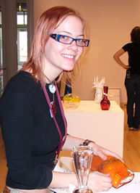
What is Undergraduate Research & Creativity?
  Experience, credit, pay
  89 grants totaling $167,000 awarded last year
Notes:
Domestic** individual (one student) projects; $2,000 total of which up to $1,000 can be a student scholarship.
Domestic** collaborative (2 or more students) projects; $2,500 of which up to $1,500 can be student scholarships.
International* individual (one student) projects; $3,500 of which up to $1,000 can be a student scholarship. *see note below
International* collaborative (2 or more students) projects; $4,000 of which up to $1,500 can be student scholarships. *see note below
In my department, we have a Readings and Research Class and a Research Apprenticeship Class that students can register for as they are working on their grants and/or in some cases when they are working on their projects.

Slide 6
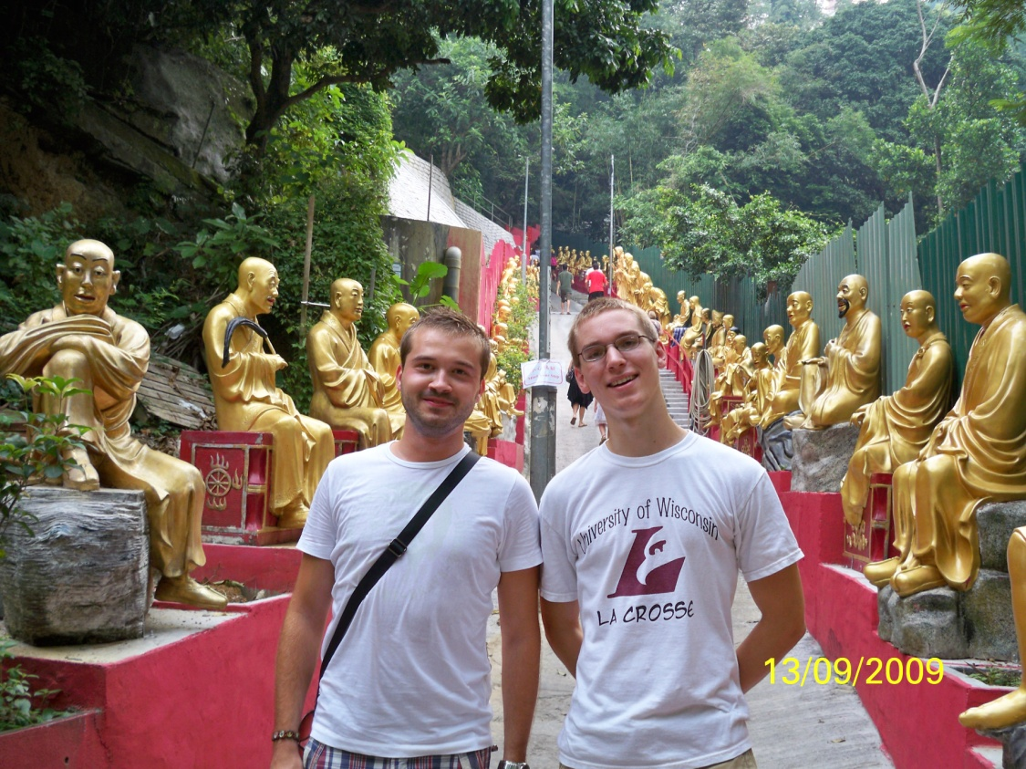

What is Undergraduate Research & Creativity?
  At UWL or abroad

Slide 7
Testimonial
“In my opinion the undergraduate research grant program is one of the most valuable resources available to UW-L students. This opportunity provided me the motivation, not to mention the funds, to travel to Bolivia to complete my research and get a jump start on writing my senior thesis. I was also able to present my research to peers, professors, state senators, congressmen/women, and even to Wisconsin's Governor due to the Office of Undergraduate Research’s sponsorship of events like Posters in the Rotunda and Celebration of Student Research and Creativity.”
Matt Sitek, UWL undergraduate research participant

Slide 8
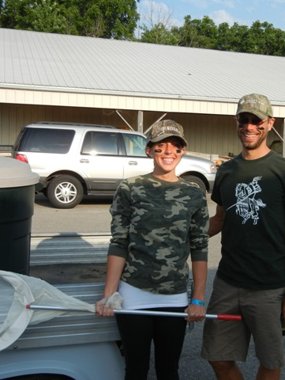
Benefits beyond college
Experience for jobs and graduate school
Do you enjoy working in your field?
Resume enhanced by presentations and publications.
Get to work with cool faculty mentors

Slide 9
Get started by…
Picking a topic
Topic from a course
Faculty member invitation
Fellow students doing research
Lists of faculty member's research
Finding a mentor
Similar interests
Engaging in research under guidance
Outline project in detail

Slide 10
Next you can…
Volunteer
See if you like it
Course credit
May count as electives for major
Writing a grant proposal
Full-time & part-time students of UWL are eligible to apply
Fall and Spring Grant Competitions
Domestic or International
Individual or Collaborative

Slide 11
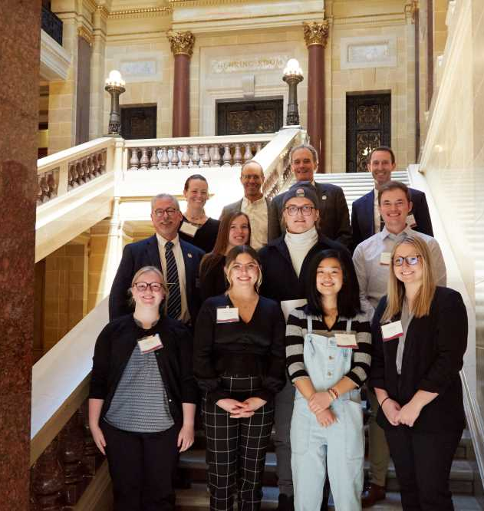
Finally, Present your work
UW-L Research & Creativity Symposium
UW-System Symposium
Research in the Rotunda
NCUR

Slide 12
Find out more
www.uwlax.edu/urc
srcel@uwlax.edu

