Slide 2
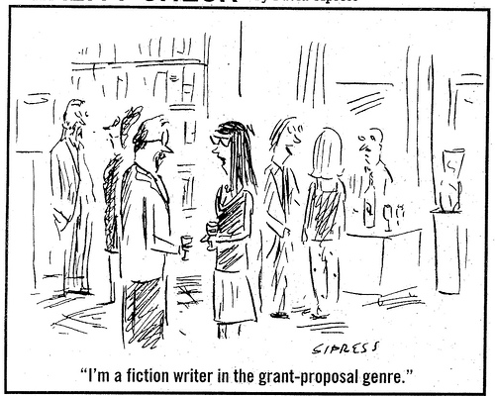
Choosing a project
Work with your mentor
Identify a current and important question to ask.
Be sure that what you propose is:
Specific
Measurable
Achievable
Realistic
Time-bound

Slide 3
Recipe for a competitive proposal
Explain the need for the project.
State your objectives.
Prepare a work plan.
Determine the final products and a dissemination plan.
Review with your mentor.
Think about your audience….

Slide 4
Parts of a grant
Cover Page
Narrative
Title and abstract
Budget
Mentor contact information
Background and Significance.
Objectives.
Methods.
Dissemination.
Budget justification
Previous funding
Letter of support
UW-L Transcript (unofficial)

Slide 5
Background and Significance
Get the reader’s interest early.
Quote, statistic, or question
“This community is like an alcoholic. It would rather think a killer is loose than admit that it’s got a drinking problem.” – Dan Marcou, La Crosse police lieutenant
Wisconsin leads the nation in underage drinking.
Why do so many college students binge drink?

Slide 6
Background and Significance
Background
Briefly summarize previous work.
Big picture down to your specific topic.
Why should the public fund this work? How will society benefit?
Your project is logical next step in the field.
Significance
Last sentences address your project in detail.

Slide 7
Objectives
2-3 bullets with specific objectives.
Objectives can include:
Testing a hypothesis: designing an experiment and collecting data.
Creative works: producing abstract works that convey a message.
Description and annotation: naturalist and archeological forays.
Measuring trends: analyzing data for correlations.

Slide 8
Objectives
Objectives answer the questions:
Who?
How much?
What?
By when?
What will the results be?
Goals vs. objectives
Goals: broad, general, intangible, abstract, cannot be validated
Objectives: narrow, specific, tangible, concrete, can be validated

Slide 9
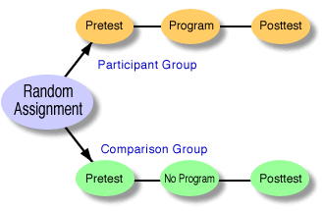
Methods – if human participants
What will you do to achieve your objectives?
Quantitative or Qualitative?
Quantitative Design
Experimental
Quasi-Experimental
Survey/Correlational
Qualitative Design
Interviews/Essays
Sample
Size
Selection
Analysis plan for qualitative or quantitative data
Reason for any travel
Supplies or equipment used
Institutional Review Board approval for human participants (unless data is archival)
These should all tie back to your objectives

Slide 10
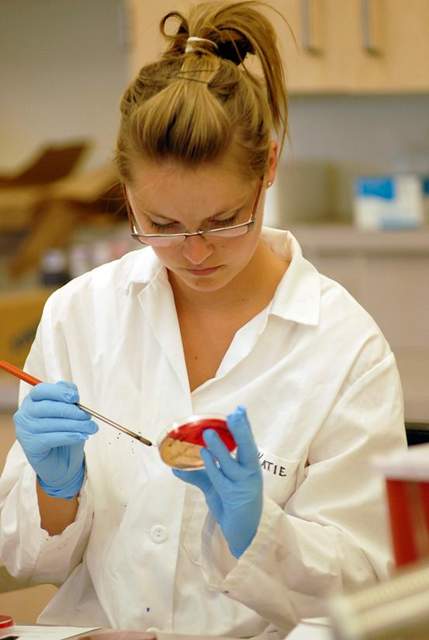
Methods – Lab or Field Research
What will you do to achieve your objectives?
If laboratory or field research
Explain
Method for conducting the research
Reason for any travel
Supplies or equipment used
These should all tie back to your objectives

Slide 11
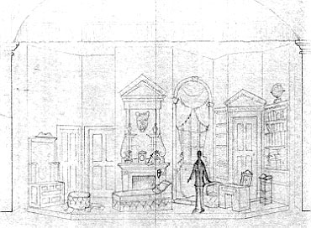
Methods – Performance/Project
What will you do to achieve your objectives?
If performance/project based
Explain
Method for developing the performance or project
Reason for any travel
Supplies or equipment needed
These should all tie back to your objectives

Slide 12
Methods – Original Source
What will you do to achieve your objectives?
If textual or original source
Explain
Method for analyzing
Reason for any travel
Supplies or equipment needed
These should all tie back to your objectives

Slide 13
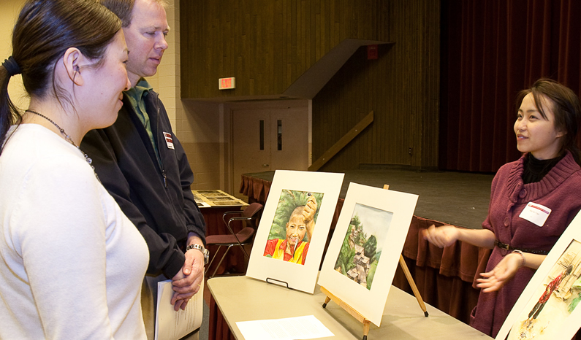
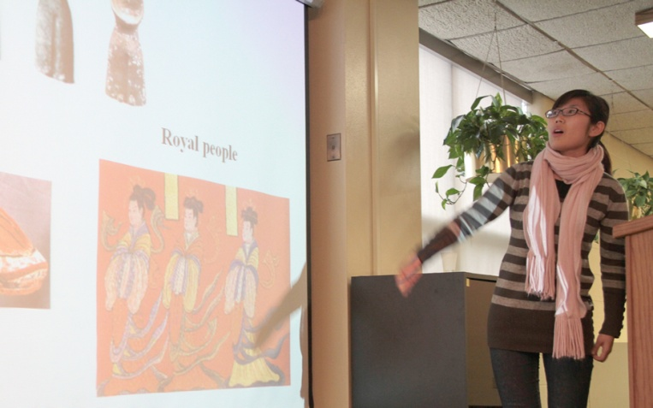
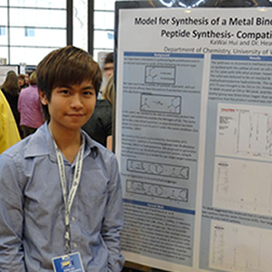
Final products and dissemination
What results do you expect?
How will you tell others about your work?
Publication
Oral or poster presentation
Gallery display

Slide 14
Budget
Do:
Justify equipment
Justify travel
Round to the nearest dollar
Check the accuracy of your math
Don’t:
Include unrelated expenses
Guess on costs
Pad the budget with inflated costs
Request money for work you’ve already done

Slide 15
We DO look at the budget…..
Check the rules for mileage and accommodation on the university’s travel website.
Anything purchased with supply money is the property of your Department
unused materials + non-consumables must be returned
All books are the purchased through the library and belong to the library

Slide 16
Most Common Mistakes
International:
Grant is just used to get airfare.
Little or no development of a research question.
Arts:
Grant is just used to get supplies.
Only focuses on benefits to artist.
No larger motive or purpose.

Slide 17
Most Common Mistakes
Sciences:
Too technical. Uses jargon and undefined scientific terms.
Not explained at a general level.
Cannot see big picture.
Humanities:
Example questions in surveys not included.
IRB required.
Sample size and other experimental details lacking

Slide 18
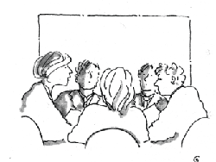
Undergraduate Research and Creativity Committee
Nine Faculty
From all three Colleges
Two Students
Agreed, we only fund those proposals we can understand

Slide 19
Submission process
Through Google Documents
Let the URC office know you will be submitting a grant by March 10, 2015.
A folder will be placed into your Google Documents account containing a cover page and narrative.
Fill out the forms with your mentor
Share your files with your mentor and fill them out in Google Docs. This will automatically save your changes.
E-mail the URC office when you are done, the grant deadline is March 24, 2015.

Slide 20
Receiving funds
The Office of Undergraduate Research & Creativity will notify award recipients, typically within 6 weeks of grant submission.
Funds should be available to students for accepted grants by the end of December for fall submissions, and mid-June for spring submissions.
http://www.uwlax.edu/urc/

